Slide 1
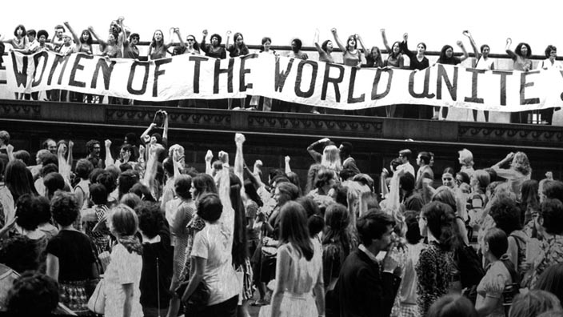
FEMINISM

Slide 2
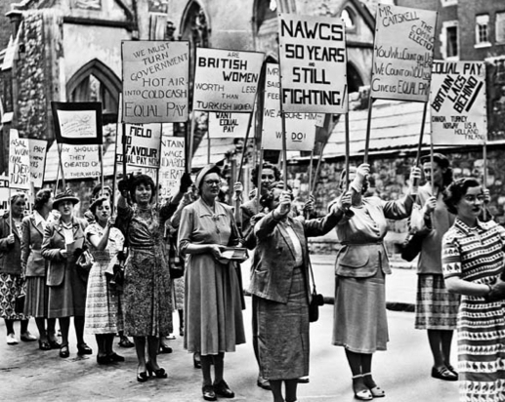
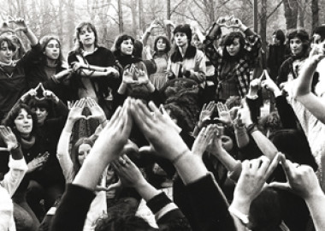
Feminism is a movement characterized by various ideologies aimed at defining, establishing and defending equal political, economic, cultural, and social rights for women.

Slide 3
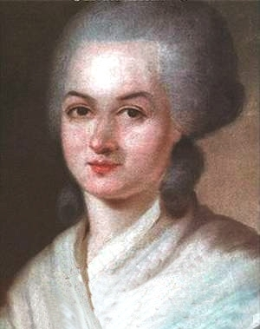
Some of the first advocates of women's emancipation
Olympe de Gouges (1748-1793) wrote the Declaration of the Rights of Woman and Female Citizen of 1791, dedicated to Marie Antoinette. De Gouges served his pro-monarchist political moderation and Girondin (was denounced by the Republican Women of Paris) ending up on the guillotine in 1793.

Slide 4
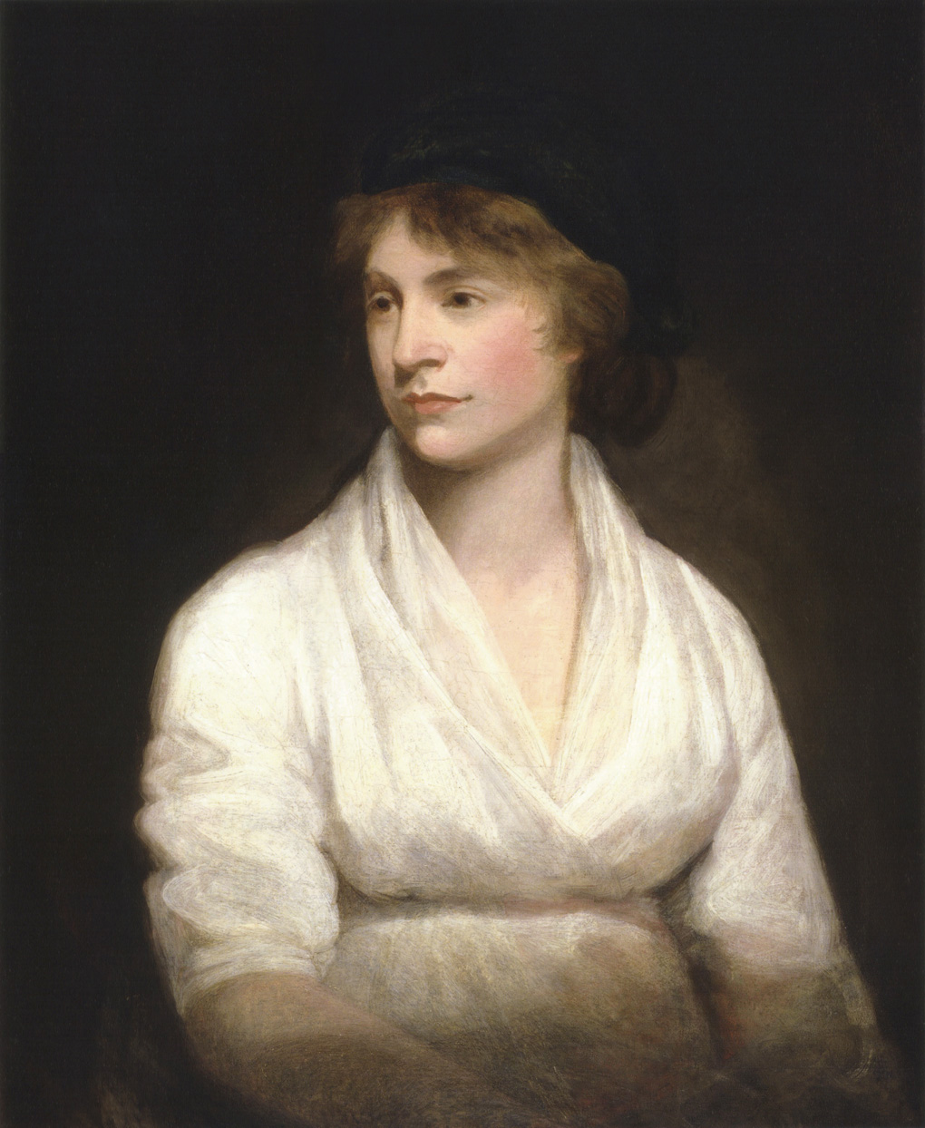
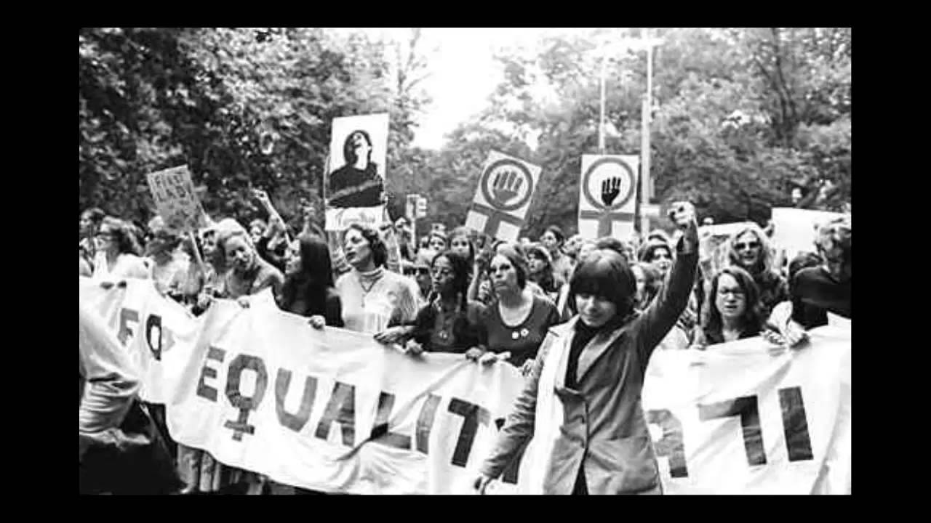
The English Mary Wollstonecraft (1759-1797) wrote in his A Vindication of the Rights of Woman that: "it is time to make a revolution in the ways of life of women - it is time to restore the lost dignity - and make them, as part of the human species, operate by reforming themselves to reform the world. "

Slide 5
POLITICAL MOVEMENTS
Born some branches of feminism
Liberal feminism
Radical feminism
Conservative feminism
Libertarian feminism
Separatist feminism
Ecofeminists

Slide 6
Liberal feminism seeks individualistic equality of men and women through political and legal reform without altering the structure of society.
Radical feminism considers the male-controlled capitalist hierarchy as the defining feature of women's oppression and the total uprooting and reconstruction of society as necessary.
Conservative feminism is conservative relative to the society in which it resides.
Libertarian feminism conceives of people as self-owners and therefore as entitled to freedom from coercive interference.

Slide 7
Separatist feminism does not support heterosexual relationships. Lesbian feminism is thus closely related. Other feminists criticize separatist feminism as sexist.
Ecofeminists see men's control of land as responsible for the oppression of women and destruction of the
natural environment; ecofeminism has been criticised for focusing too much on a mystical connection between women and nature.

Slide 9
Literature
The feminist movement produced both feminist fiction and non-fiction, and created new interest in women's writing. It also prompted a general reevaluation of women's historical and academic contributions in response to the belief that women's lives and contributions have been underrepresented as areas of scholarly interest.[Much of the early period of feminist literary scholarship was given over to the rediscovery and reclamation of texts written by women. Studies like Dale Spender's Mothers of the Novel (1986) and Jane Spencer's The Rise of the Woman Novelist (1986) were ground-breaking in their insistence that women have always been writing.A Vindication of the Rights of Woman (1792) by Mary Wollstonecraft, is one of the earliest works of feminist philosophy. A Room of One's Own (1929) by Virginia Woolf, is noted in its argument for both a literal and figural space for women writers within a literary tradition dominated by patriarchy.The widespread interest in women's writing is related to a general reassessment and expansion of the literary canon. Interest in post-colonial literatures, gay and lesbian literature, writing by people of colour, working people's writing, and the cultural productions of other historically marginalized groups has resulted in a whole scale expansion of what is considered "literature," and genres hitherto not regarded as "literary," such as children's writing, journals, letters, travel writing, and many others are now the subjects of scholarly interest.Most genres and sub-genres have undergone a similar analysis, so that one now sees work on the "female gothic"or women's science fiction. Feminist science fiction is sometimes taught at the university level to explore the role of social constructs in understanding gender.[Notable texts of this kind are Ursula K. Le Guin's The Left Hand of Darkness (1969), Joanna Russ' The Female Man (1970), Octavia Butler's Kindred (1979) and Margaret Atwood's Handmaid's Tale (1985).

Slide 10
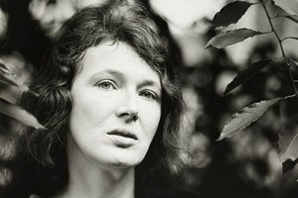
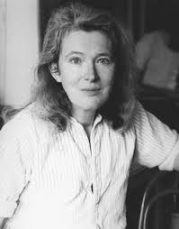
Angela Carter
She was an English novelist and journalist, known for her feminist, magical realism and picaresque works.

Slide 11
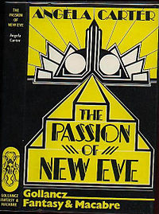
Some of her works
The Passion of New Eve
This is a novel by Angela Carter, first published in 1977.It’s a work post-feminist due to the genre of magical realism, in which the female characters dominate over the men.

Slide 12
The Sadeian Woman and Ideology of Pornography.
It's about desire and its destruction, the self-immolation of women, how women collude and connive with their condition of enslavement.

