Slide 4
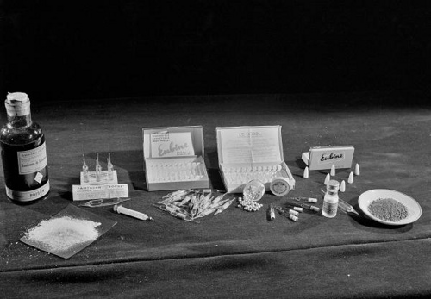
Half life = 0.693 x Vd/ total body clearance
Alpha half life = plasma / distribution half life
Beta half life = tissue / elimination half life
Plasma half life of some drugs:
Drug Half Life
Acetylcholine, GABA, Catecholamine's Milliseconds
Adenosine 10 seconds
Aspirin 15 minutes
Digoxin 39 hours
Amiodarone more than 100 days
http://howmed.net/pharmacology/plasma-half-life-of-drugs/

Slide 5
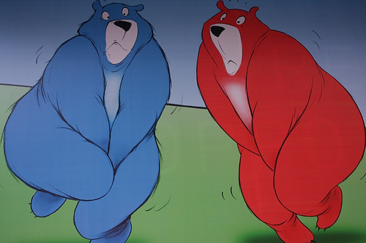
What is excretion?
The elimination of waste products by an organism.

Slide 6
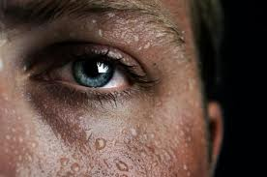
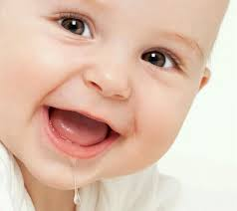
Humans
Humans excrete waste products through:
Urine
Feces
Expired air (CO2)
Sweat
Saliva
Breast milk

Slide 7
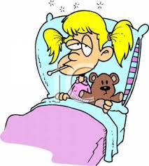
What about medicine?
Think of the last time you were sick.
You most likely took some sort of medication that eventually helped you feel well again.
But what happened to the medicine once it completed its task?
It must be excreted!!!

Slide 8
Excretion of Drugs
Drugs are eliminated from the body either unchanged by the process of excretion or converted to metabolites .
Excretory organs, the lung excluded, eliminate polar compounds more efficiently than substances with high lipid solubility.
Lipid-soluble drugs thus are not readily eliminated until they are metabolized to more polar compounds.

Slide 9
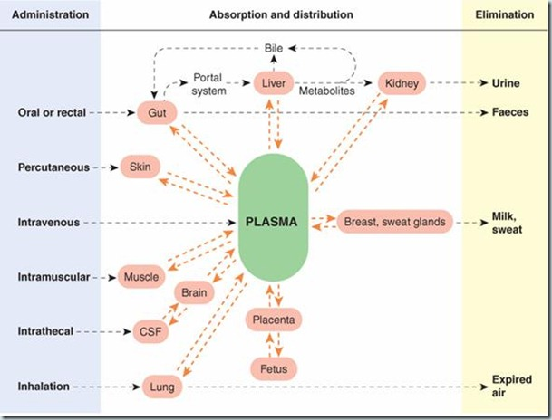
Notes:
Assignmet….examples of drugs?

Slide 10
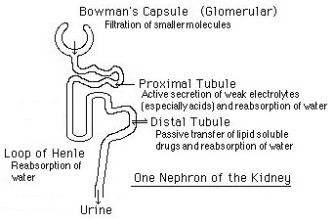
kidney
The kidney is the most important organ for excreting drugs and their metabolites.
Substances excreted in the feces are principally unabsorbed orally ingested drugs or drug metabolites excreted either in the bile or secreted directly into the intestinal tract and not reabsorbed.

Slide 11
Major Excretory Processes in the Nephron
Glomerular filtration
Increase drug conc. in lumen
Tubular secretion
Increases drug conc. in lumen
Tubular re-absorption
Decreases drug conc. in lumen

Slide 12
Glomerular Filtration
Begins at the glomerulus
Consists of a capillary network surrounded by Bowman's capsule
Small pores perforate the capillary walls
Drugs are forced through these pores
This process moves drugs from the blood into the tubular urine.
Fig. -Renal corpuscle

Slide 13
Passive Tubular Reabsorption
Blood vessels to the glomerulus meet up with the renal distal tubule.
Here, concentration of drugs in the blood are lower than drugs in the tubule.
This concentration gradient acts as a driving force to move drugs from the tubule back into the blood (reabsorption).
Fig. 6-Glomerular capsule.
http://kvhs.nbed.nb.ca/gallant/biology/nephron_structure.html

Slide 14
Active Tubular Secretion
Drugs are pumped from the blood to tubular urine via active transport systems.
An area of lower concentration toward an area of higher concentration.
Requires energy
Tubular cells contain P-glycoprotein in their membranes, which pump drugs into urine.
Fig. 7-Renal drug xcretion.

Slide 15
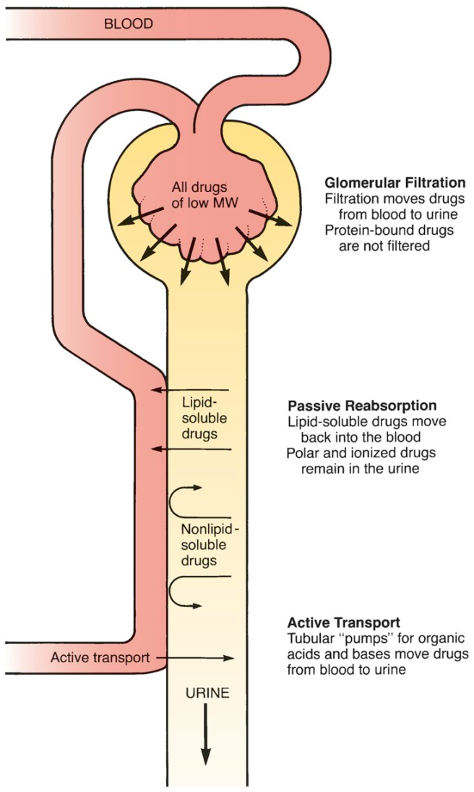

Slide 16
Milk
Excretion of drugs in breast milk is important not because of the amounts eliminated, but because the excreted drugs will have unwanted pharmacological effects in the nursing infant.
Lung
Excretion from the lung is important
mainly for the elimination of anesthetic gases
Notes:
Volatile drugs, such as gaseous anesthetics, alcohol, or drugs with high volatility, are excreted via the lungs into expired air

Slide 17
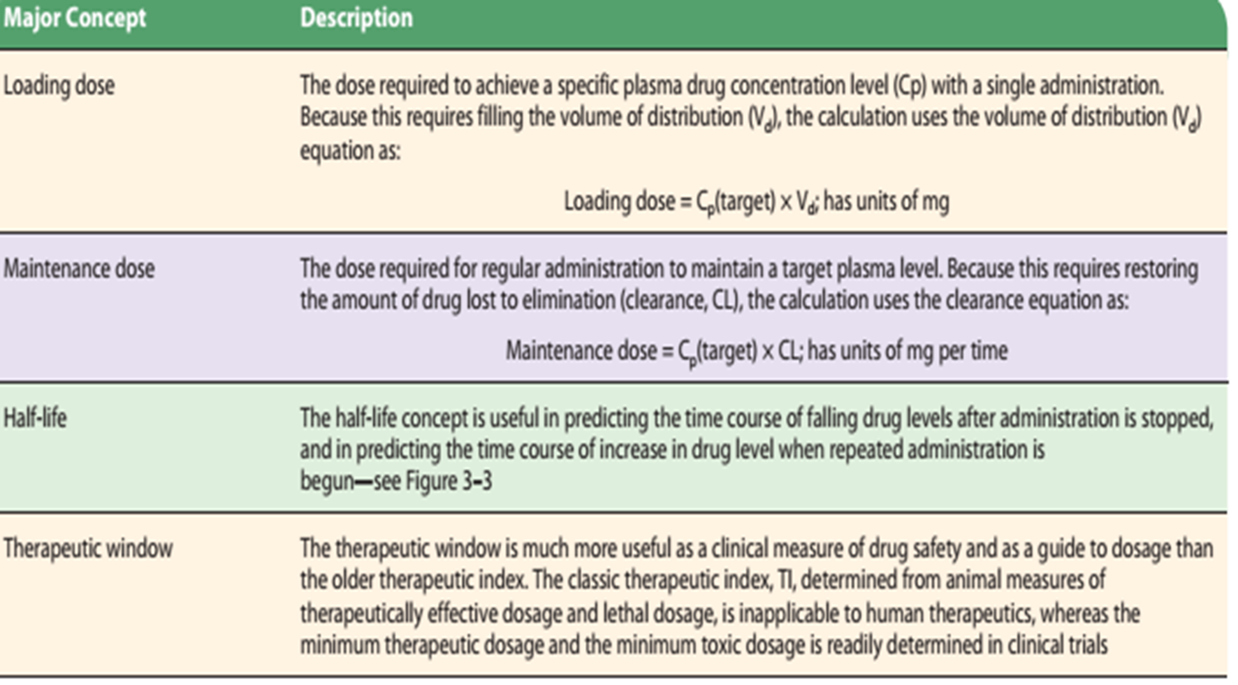

Slide 18
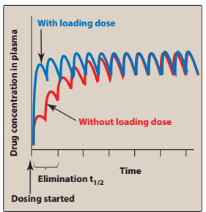

Slide 19
The dosing rate can be determined by knowing the target concentration in plasma (Cp), clearance (CL) of the
drug from the systemic circulation, and the fraction (F) absorbed
(bioavailability):
Notes:
Zero order…warfarin,theophylline ,,,,

Slide 20
Advantage:
For drugs that have a relatively long half-life. Without an initial loading dose, these drugs would take a long time to reach a therapeutic value that corresponds to the steady-state level.
Disadvantage:
Increased risk of drug toxicity and a longer time for the plasma concentration to fall if excess levels occur.

