Slide 1
Heavy metal stress

Slide 2
What are heavy metals?
Heavy metals are naturally occurring elements that have high atomic weight and density at least 5 times greater than that of water.
They have a relatively high density and are toxic or poisonous at low concentration.
Heavy metal pollution can originate from natural and anthropogenic sources.

Slide 3
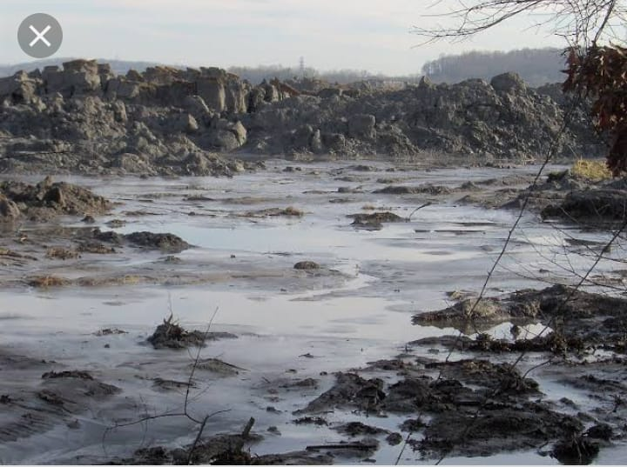

Slide 4
Environmental pressure of heavy metals released from industries:

Slide 5
Why heavy metals are poisonous?
Heavy metals are dangerous because thy tends to bio-accumulate.
Bio accumulation means an increase in the concentration of a chemical in a biological organism over time, compared to the chemical concentration in the environment.
Compounds accumulate in living thing any time they are taken up and stored faster then they are broken down or excreted.

Slide 6
Heavy metals in fish due to ocean acidification:

Slide 7
How are people exposed to heavy metals?
Heavy metals contamination may occur due to factors including irrigation with contaminated water, the addition of fertilizers and metal based pesticides , industrial emission, transportation, harvesting process, storage or sale.
People may be exposed to small amount of heavy metals through food, water , air and commercial process.

Slide 8
Heavy metals from Ash:

Slide 9
Toxic water: huge harvests irrigated

Slide 10
Examples of heavy metals
Examples of heavy metals include mercury , cadmium, arsenic, chromium, thallium and lead.

Slide 11
List of heavy metals
U
As
Ba
Th
List of
Heavy
metals
Sn
Cd
Pt
Cs
Ni
Cu
Hg

Slide 13
Threats
Heavy metals occur naturally in environment .
Heavy metals such as zinc, iron, or copper plays an important role in our bodies.
Lead arsenic and mercury can build up in fish and potentially threatening human health after consumption.
Also contaminate the environment.

Slide 14
Effect of acid rain:

Slide 15
Industrial waste water testing services:

Slide 16
Heavy metal stress
Most common source of heavy metals is volcanic activity.
Materials from such activity find way to various water bodies.
Ore minerals hidden and compact in the crust, releasing few metals in the environment

Slide 17
Heavy metals from mining:

Slide 19
Levels of toxicity
Metals including iron ores, argite, and apatite produce mild level of toxicity.
Copper other and naturally occurring found in the earth’s crust at low concentration, hence no toxic effects.
Copper released to water bodies through decaying vegetation or copper mining activities, agricultural activities, such as use of fertilizers.

Slide 20
The impact of factory forms:

Slide 21
Heavy metals from agricultural activities
Agricultural activities a source of heavy metals in water resources.
Heavy food damage influence use of fertilizers. Pesticides for better production.
Metals find way to water resources through runoff. Drainage, seepage into soil.

Slide 22
Plants cultivated in contaminated soil:

Slide 24
Heavy metals from sewage system
Bio solids-sewage sludge, animal wastes and industrial wastes often released into water.
Sewage sludge contains traces of zinc and copper.
Huge concentrations of iron, nickel, lead, cadmium, cobalt and zinc found as one moved lower due to the presence of any industries.
Ore industrial nations ore porn to the effects of heavy metals

Slide 25
Heavy metals from sewage system:

Slide 26
CONTROL
Use of alkaline materials to naturalize acidic mine waters.
Process raising the Ph of acidic mine drainage.
Accelerates the oxidation rate
Cause heavy metals to precipitate fro solution as hydroxides and carbonates.
Absorbents use to remove metals from contaminated water

