Slide 1
Intervention 6
Management of Severe Acute Malnutrition (SAM)

Slide 2
What is Severe Acute Malnutrition?
Severe acute malnutrition in children is characterized by one of the following:
Weight-for-height measurement below minus 3 Z-scores below the median weight-for-height compared to the reference population
Weight for height below 70% of the median compared to the reference population
Mid-Upper Arm Circumference (MUAC) measurement below 110mm
The presence of bilateral oedema

Slide 3
Why is the management of severe acute malnutrition a key intervention in emergencies?
Children with SAM have a 10 to 20-fold risk of dying compared to well nourished children1 .
SAM can be a direct cause of child death, or it can act as an indirect cause of death by dramatically increasing case fatality in children suffering from common childhood illnesses such as diarrhoea and pneumonia.
This is particularly heightened in conditions of poor sanitation, hygiene and poor provision of health services that often characterise emergency situations.
Timely and effective interventions for the management of SAM, which achieve high coverage, could prevent hundreds of thousands of child deaths.

Slide 4
When is an emergency therapeutic feeding programme required?
Therapeutic feeding is the specialised treatment to manage severe acute malnutrition.
The treatment of SAM through existing services such as hospitals or PHC clinics becomes difficult with the increased numbers of severely malnourished children that occur during an emergency.
Programmes are therefore needed to support existing services, and in some cases, additional services must be implemented to meet the needs of the population.

Slide 5
The decision to start a therapeutic feeding programme (TFP) incorporating community-based and inpatient components is based solely on the presence of large numbers of severely acutely malnourished children requiring immediate life saving treatment.
The decision is based on the prevalence of global acute malnutrition; >10% of the under-five population, with no aggravating factors, or >5% of the underfive population, with aggravating factors (see SFP Box 8).

Slide 6
Therapeutic feeding programmes should not undermine the capacity of health systems, nor should external programs allow governments to abdicate their responsibilities for providing services.
Wherever possible, programmes should aim to build on and strengthen existing capacity to treat severe malnutrition.
The decision to scale-up services with emergency programmes should be taken only when necessary.
When assessing capacity, available supplies, staff, and resources should be measured against the numbers of severely malnourished children expected from prevalence estimatesxvi.
If no programme has already been established to support children with SAM in the emergency area, then the programme must be created with the support of the community and the existing health services.

Slide 7
How is a Therapeutic Feeding Programme implemented in an emergency?
Factors that should be taken into account when planning a TFP include the numbers and geographical spread of affected individuals, the security situation, and the capacity of existing services.
The purpose of the programme should be clearly communicated and discussed with the target population and the planning of the programme should involve key decision makers from the existing health systems and the community.

Slide 8
There are two distinct components of management for severe acute malnutrition (Boxes 9,10).
Combined they offer an effective integrated approach to the management of SAM which can greatly increase coverage potential.

Slide 9
Box 9: Community-Based Management of SAM
Community-Based Management of SAM
This approach aims to maximize coverage and access of the population to treatment for SAM by providing easier access to treatment through outpatient services, closer to homes (within a days return walk). An essential component of the approach is community mobilization techniques to engage the affected population in designing an appropriately structured programme and foster participation for timely identification and referral of cases of SAM in the community.
These factors enable the programme to achieve high coverage, without which impact cannot be achieved. The approach enables cases of SAM to be caught before medical complications take hold but also provides mechanisms of referral for any complicated cases to inpatient care.
The outpatient service should be set up wherever possible in existing health facilities or using existing community-level trained health staff.

Slide 10
The programme should include orientation for caretakers and families to ensure appropriate home treatment with Ready-to-use Therapeutic Food and routine medicines. It should include nutrition/health education and counselling for caretakers and families including appropriate use of locally available foods, to reduce re-admissions.

Slide 11
Box 10: Facility Based Inpatient Management of SAM
Facility-Based Inpatient Management of SAM
This approach caters to the proportion of children with acute malnutrition referred from the community-based programme with anorexia, severe medical complications, severe oedema or for infants less than 6 months of age with SAM.
These children are at the highest risk of death and receive 24-hour care until their condition is stabilized and their appetite returns. Stabilisation may take up to 7 days or longer, including a transition phase for 1-3 days before being referred for rehabilitation in the community.
In emergencies, facility based care can often be provided through additional support to existing hospital paediatric wards or health centres. If numbers are great, specialized centres for inpatient treatment may need to be set up, ideally near to a hospital, in temporary buildings or tents. These should remain small (a maximum of 50 children), should not undermine the capacity of the existing health system and maintain strong links to the community-based programme so that children are smoothly integrated into outpatient care for a full recovery.

Slide 12
The programme should include nutrition/health education and counselling for caretakers and families to reduce re-admissions.

Slide 13
The integrated approach is the combination of these two components in order to maximize the impact of TFP in reducing child mortality.
By combining these components some of the limitations noted in TFP approaches that rely solely on either an inpatient or outpatient strategy can be reduced.
These limitations have included poor coverage, late referrals, high default rates, cross infection, lack of appropriate treatment of infants <6 months and reduced critical medical care in complicated cases.

Slide 14
The classification of SAM using the integrated approach defines each case through indicators and determines whether a child should be treated in a facility or through outpatient services.
This is shown by flow chart in Annex 5.

Slide 15
Annex 5: Classification of Severe Acute Malnutrition using an Integrated Approach

Slide 16
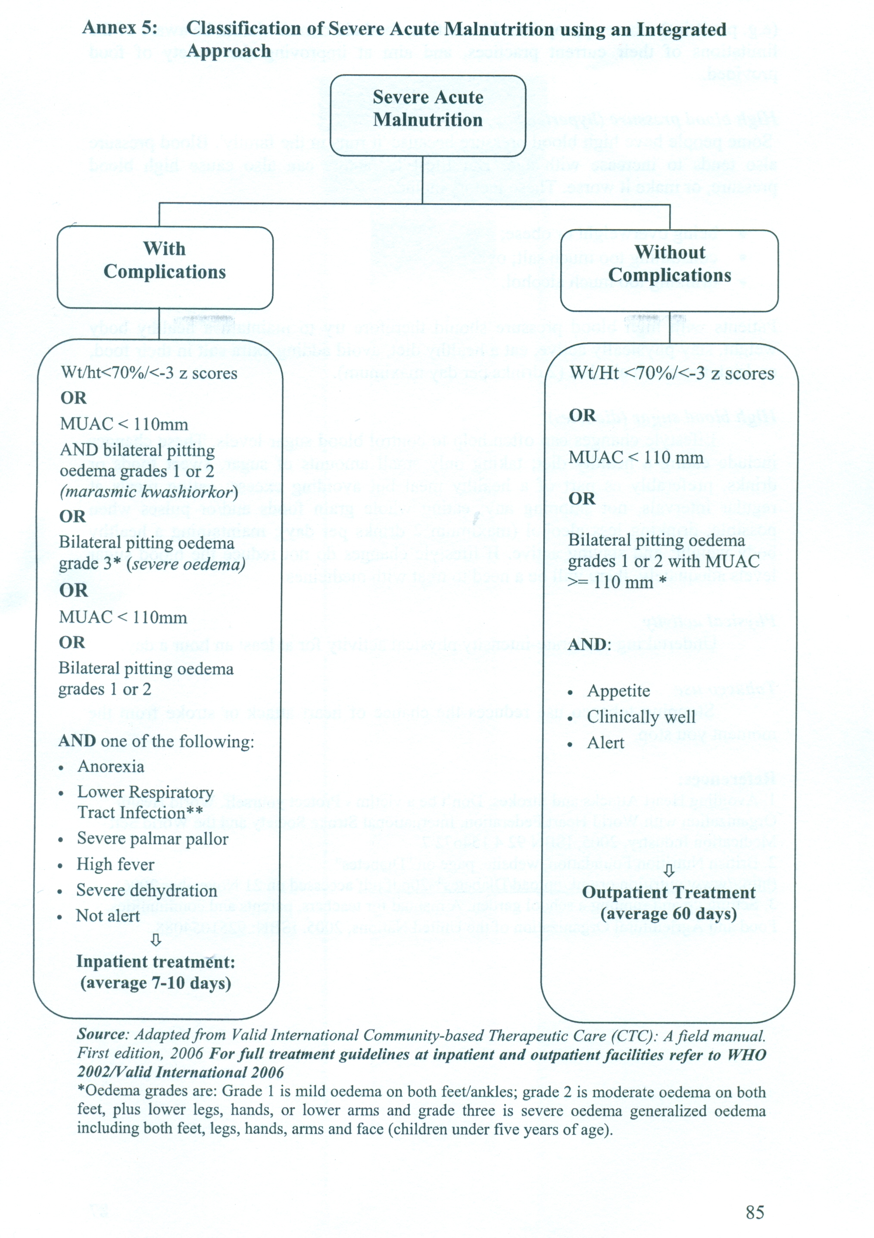

Slide 17
Measuring Success/Benchmarks
The quality of programmes is monitored with a range of quantitative and qualitative indicators using reporting formats given in international guidelines.
It is preferable to combine the outcomes of inpatient and outpatient components in a given area to assess the quality of the total integrated response.

Slide 18
Some of the main indicators can be compared against international Sphere standards for emergency response (Box 11):
The percentage and causes of readmission, defaulting and failure to respond should be investigated and documented on an ongoing basis.
Monitoring and on-site training should be conducted every month after the initial training on the management of SAM.

Slide 19
Box 11: Benchmarks for Emergency SAM Programmes
BENCHMARKS FOR EMERGENCY SAM PROGRAMMES
Deaths | <10% of exits
Defaults | <15% of exits
Recovered | >75% of exits from outpatient care
Mean weight gain | >4g per Kg per person per day**
Average length of stay
In inpatient care | 4-7 days (where OTP is in place)
Average length of stay
Outpatient care | <60 days
Coverage | >50% in rural areas
 | >70% in urban areas
 | 90% in camp situations

Slide 20
** >8g per person per day is recommended by Sphere for inpatient treatment.
Lower rates of weight gain are more acceptable in outpatient programmes because the risk of exposure to infection and the opportunity costs for beneficiaries are much lower.
This must be explained to carers at the outset to avoid false expectations leading to defaulting.

Slide 21
Other Issues/Debates
Children with SAM and severe dehydration must be treated with ReSoMal (rehydration solution for malnourished) and NOT standard formula ORS.
See treatment guidelines for management of dehydration in SAM5
The massive problem of shortage of staff and frequent staff transfers in most developing countries shows the important need for regular on-site training and skills transfer on the management of SAM.
It is recommended for integration into national nursing, nutrition and medical school training curricula
The standards for recovery and the minimum length of stay in the inpatient and outpatient programmes may be difficult to achieve in areas where HIV is prevalent.

Slide 22
Activities related to the management of severe malnutrition should be strongly linked to activities related to the prevention and treatment of HIV and AIDS (e.g. promotion of infant and young child feeding practices, mothers' voluntary testing and counselling, and antiretroviral therapy).
In both facility and community-based care, there is a need to specifically address and improve the guidelines and capacity for the management of severely malnourished infants <6 months, the management of rehydration in SAM, and the management of SAM in HIV positive children.

Slide 23
Other important points to consider include the continuous availability of supplies such as Complex Minerals Vitamins (CMV), therapeutic milk/RUTF or their components, and essential drugs for the treatment of complicated severe malnutrition
Socio-cultural aspects including staff behaviour with mothers or caretakers, psychosocial support and the rejection of therapeutic foods by mothers or caretakers need to be factored into programming.
The potential to integrate community-based care with IMCI services in the post-emergency phase should be explored.
The emotional and physical stimulation of the child (environment, play activities and physical activities) have very important roles to play in the child’s rehabilitation.

Slide 24
Supplies
Human Resources
Facility-based inpatient management of SAM in a hospital or health centre requires on average, one part-time doctor, three nurses and a nutritionist.
The number of health care providers will vary depending on the number of admissions.
There should be a minimum of one feeding assistant for 10 inpatients.
Some health workers should provide care during the night, as an important proportion of deaths happen at night.
The mothers or caretakers of children should continue be involved in feeding, bathing, and giving psychosocial stimulation.
They should also be shown how to recognize signs of danger in order to alert a health care provider on time in an emergency.

Slide 25
Community-based management of SAM requires that key resource people within the community are contacted and involved in the programme design, implementation and monitoring.
The outpatient service can be implemented by existing clinic/health centre staff, although additional staff will be needed if there are more than 15 children per clinic worker to be treated each day.

Slide 26
This may take the form of mobile teams comprising a qualified health worker and 2-3 assistants that travel to multiple existing sites in a week to take measurements, and assist the nurse or set up new satellite sites to meet high demand in specific areas.
An overall supervisor working for the district health management team is also required to ensure quality of the programme.

Slide 27
Physical Resources
The inpatient facility should be equipped with minimum supplies needed for a severe malnutrition ward including medical formula diets (or locally available ingredients and Complex Mineral Vitamins to prepare them), ReSoMal for the treatment of dehydration in severe malnutrition, hygiene supplies for mothers and staff including mosquito nets, supplies for reference and record keeping, kitchen equipment, and laboratory resources should be accessible either on site or through referral

Slide 28
Both the facility and community-based programs require basic equipment and food supplies including: RUTF (Ready-to-use Therapeutic Food), MUAC bands, medical supplies, soap, weighing scales, height boards, and basic kitchen equipment.
All equipment and supplies, including the RUTF, can be either kept and managed at clinics stores if there is capacity, or transported by mobile teams in a strong equipment box.

Slide 29
Transport may also be required for those children identified at the outpatient service who require referral to inpatient care if the inpatient facility is far away.

