Slide 2
Emergency procedures in Physical Therapy Primary care & Dr.Waqas PPDPT(RIU),BSPT(KEMU)

Slide 3
For any kind of MSK injury What are the areas of focus before and after the injury ???
Injury prevention, assessment, treatment, and rehabilitation, particularly in the orthopedic and musculoskeletal disciplines is necessary

Slide 4
To attain Skills, knowledge, practice, and preparation needed to handle athletic emergency situations is important whenever we talk about sports related injuries

Slide 5
Emergency medical situations can occur in athletics at any time.
When they do occur, it is important to have the proper emergency action plan (EAP) in place to provide the best possible care to the athletes with potentially life threatening injuries or illness.

Slide 6
The development and implementation of the EAP will help ensure that the quality of care provided to the athletes is the best possible.
The goal of the sports medicine staff of any athletic organization is to have an EAP that will minimize the time needed to provide an immediate response to a potentially life-threatening situation or medical emergency

Slide 7
Because medical emergencies can occur during any activity, the sports medicine staff must be prepared for any type of situation.
Emergency care preparation includes the formation of an EAP, proper coverage of athletic events and practices ,maintenance of emergency equipment and supplies, utilization of appropriate personnel involved with the sports medicine team, continuing education of the sports medicine team

Slide 8
Although every precaution may be taken by the athletic organization and its sports medicine staff, it is important to understand that medical emergencies may still occur.
With proper organization and administration, emergency situations can be handled in a timely, effective, and professional manner.

Slide 11
Emergency Situation
Proper Emergency Plan
Immediate repose to counter Life threatening situation with Best Possible Quality Care

Slide 12
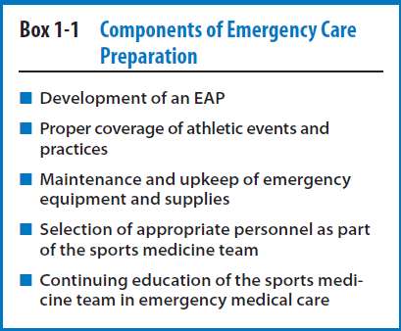
Proper preparation of sports medicine staff for any kind of sudden sports emergency

Slide 13
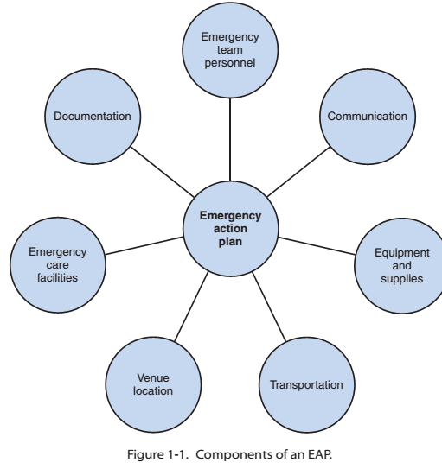

Slide 14
Factors to consider in the proper organization and administration of emergency care in athletic activity include the following:
1. Development and implementation of an EAP
2. The sports medicine staff and emergency team
3. Initial patient assessment and care
4. Emergency communication
5. Emergency equipment and supplies
6. Venue locations
7. Emergency transportation
8. Emergency care facilities
9. Legal need and documentation

Slide 15
Develop and Implement an EAP
Research show that almost one third (1/3rd of athletes are injured in some way during their careers
In a National Athletic Trainers’ Association Statement it was recommended that each organization or institution that sponsors athletic activities or events develop and implement a written EAP

Slide 16
Emergency action plans should be developed by organizational or institutional personnel in consultation with local emergency medical services.
EAP should be implemented for the safety of all athletic personnel, including athletes.
After development of plan its implementation is necessary

Slide 17
How to make sure proper implementation of EAP ???
Documentation
Education
Frequent Rehearsal

Slide 18
EAP should be clear enough regarding its mechanism of action
There should be separate plan for Different venues and Game Vs Practice
There is possibility of unavailability of team physician during game so it should be kept in mind while designing EAP
Location and type of Equipment may be different among sports teams and avenues.

Slide 19
Outdoor sports with a high risk of heat illness may require a large tub or wading pool to be used for emergency cooling of athletes at risk of heat stroke.

Slide 20
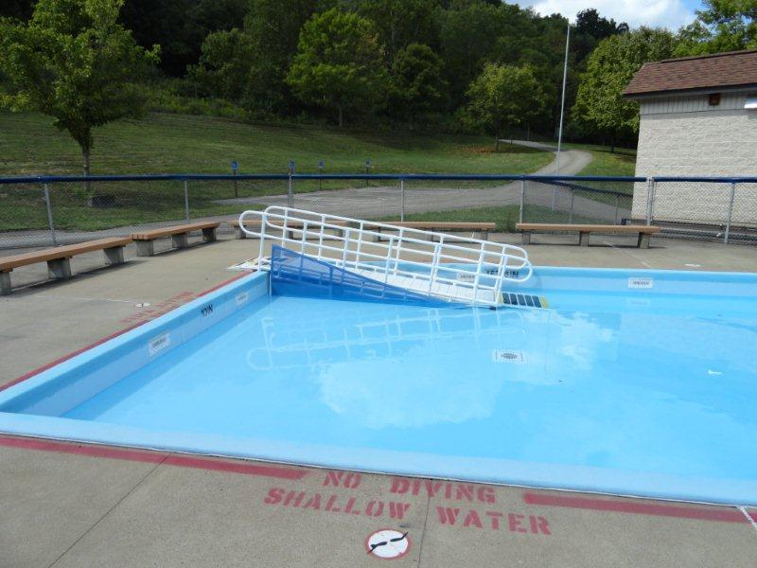
Wading pool

Slide 21
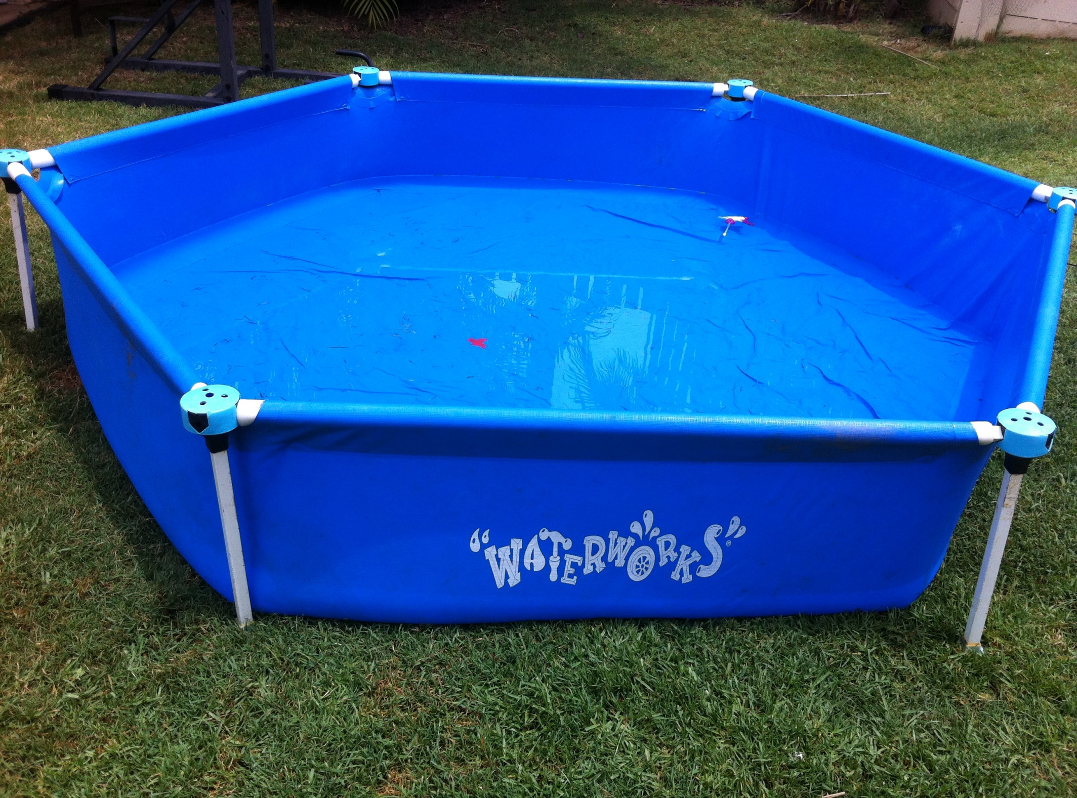

Slide 22
Proper education of all members of emergency team regarding EAP
All team members should have familiarity with EMS that will be providing services in that area.
written copy of the EAP that provides complete documentation roles and responsibilities of all members in every emergency situation.
Pasted copy near main areas.

Slide 23
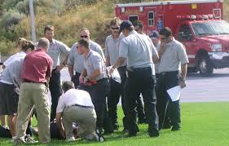
Rehearsal of EAP

Slide 24
Rehearsal of EAP by emergency team
providing a way to show emergency skill at high level of competency
It also provides the opportunity for athletic trainers and other emergency medical personnel to communicate regarding specific procedures in their respective areas.
Several meeting in a year
Before the start of specific game season
Upgradation of Plan per need

Slide 25
Primary Care
Health care provided by a medical professional (such as a general practitioner, paediatrician, or nurse) with whom a patient has initial contact and by whom the patient may be referred to a specialist.

Slide 26
Secondary Care
Medical care provided by a specialist or facility upon referral by a primary care physician.
Tertiary Care
Highly specialized medical care usually over an extended period of time that involves advanced and complex procedures and treatments performed by medical specialists in state-of-the-art facilities.

Slide 27
APTA Vision Sentence for Physical Therapy 2020
By 2020 physical therapy will be provided by physical therapists who are doctors of physical therapy, recognized by consumers and other health care professionals as the practitioners of choice to whom consumers have direct access for the diagnosis of, intervention for, and for the prevention of impairments, functional limitations, and disabilities related to movement, function and health.

