Slide 1
Factory Method Pattern

Slide 2
Contents / Agenda
Definition
Implementation – Class diagram
Implementation – Step 1 to 3
Implementation – Test and Result
Advantages and Usage
Difference between Factory and Abstract Factory Patterns

Slide 3
Definition
A Factory Pattern or Factory Method Pattern says that just define an interface class for creating an object but let the subclasses decide which class to instantiate.
In other words, subclasses are responsible to create the instance of the class.
The Factory Method Pattern is also known as Virtual Constructor.
Factory Method pattern comes under “Creational Design Patterns”.
In Factory pattern, we create object without exposing the creation logic to the client and refer to newly created object using a common interface.

Slide 4
Example
Imagine you are constructing a house and you approach a carpenter for a door. You give the measurement for the door and your requirements, and he will construct a door for you. In this case, the carpenter is a factory of doors. Your specifications are inputs for the factory, and the door is the output or product from the Factory.
Now, consider the same example of the door. You can go to a carpenter, or you can go to a plastic door shop or a PVC shop. All of them are door factories. Based on the situation, you decide what kind of factory you need to approach. This is like an Abstract Factory.

Slide 5
Implementation - Overview
We're going to create a Shape interface and concrete classes implementing the Shape interface. A factory class ShapeFactory is defined as a next step.
Factory Pattern Demo, our demo class will use ShapeFactory to get a Shape object. It will pass information (CIRCLE / RECTANGLE / SQUARE) to Shape Factory to get the type of object it needs.

Slide 6
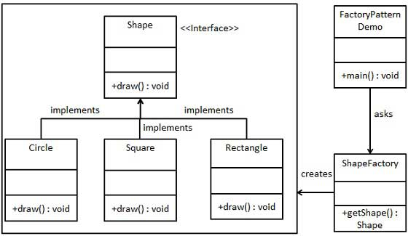
Implementation – Class diagram
We are going to implement following class diagram with step by step explanation.

Slide 7
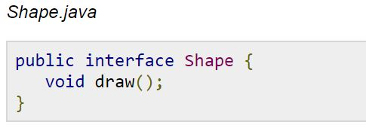
Step 1 : Create Interface
Our interface is simple, just contains a method to draw a shape.

Slide 8
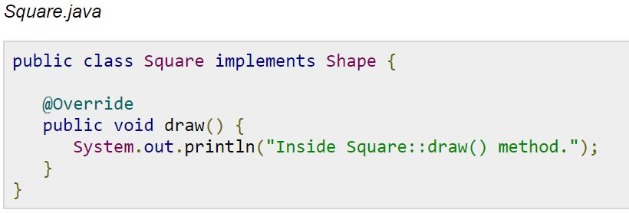
Step 2 : Concrete classes

Slide 9
Step 3 : Shape Factory
To keep the implementation simple, we can define our factory class as shown in picture. This will return appropriate object.

Slide 10
Step 4 : Test
We can easily test our pattern by just writing this code in our main function. First, create a shape factory and use its getShape method to draw new objects.

Slide 11
Step 5 : Results

Slide 12
Advantages and Usage
Advantages:
Factory Method Pattern allows the sub-classes to choose the type of objects to create.
It promotes the loose-coupling by eliminating the need to bind application-specific classes into the code. That means the code interacts solely with the resultant interface or abstract class, so that it will work with any classes that implement that interface or that extends that abstract class.
Usage:
When a class doesn't know what sub-classes will be required to create
When a class wants that its sub-classes specify the objects to be created.
When the parent classes choose the creation of objects to its sub-classes.

Slide 13
Disadvantages: A potential disadvantage of Factory methods is that clients might have to sub-class the creator class just to create a particular concrete product object. Sub classing is fine when the client has to subclass the creator class anyway, but otherwise, the client now must deal with another point of evolution. In Factory Method pattern, the factory used for creating the objects is bound with the client code, i.e., it is difficult to use a different factory for creating objects

Slide 14
Factory Method vs Abstract Factory
The methods of an Abstract Factory are implemented as Factory Methods. Both the Abstract Factory Pattern and the Factory Method Pattern decouples the client system from the actual implementation classes through the abstract types and factories. The Factory Method creates objects through inheritance where the Abstract Factory creates objects through composition.
With the Factory pattern, you produce implementations (Apple, Banana, Cherry, etc.) of a particular interface -- say, IFruit. With the Abstract Factory pattern, you produce implementations of a particular Factory interface -- say, IFruitFactory. Each of those knows how to create different kinds of fruit.
Factory method: You have a factory that creates objects that derive from a particular base class. Abstract factory: You have a factory that creates other factories, and these factories in turn create objects derived from base classes. You do this because you often don't just want to create a single object (as with Factory method) - rather, you want to create a collection of related objects.

