Slide 1
Morphology and Anatomy of Halophytes

Slide 2
Habit
A great majority of halophytes in the tropical and subtropical regions are shrubs
A few of them are herbaceous (Example: Acanthus ilicifolius)
In temperate zones, halophytic vegetation is purely herbaceous
The shrubs are generally dome-shaped in appearance because of their cymose branching

Slide 3
Acanthus ilicifolius

Slide 4
Roots
Develop many shallow normal roots
In addition to normal roots, many stilt or prop roots develop from the aerial branches of stem for efficient anchorage in muddy or loose sandy soil
Sometimes, a large number of adventitious root buttresses develop from the basal parts of tree trunks. These root buttresses provide sufficient support to the plants
In order to compensate the lack of soil aeration in coastal areas, the hydro-halophytes develop special type of negatively geotropic roots, called pneumatophores or breathing roots

Slide 5
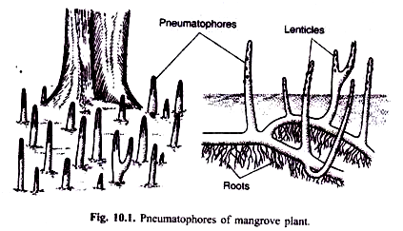

Slide 6
Roots
The pneumatophores usually develop from the underground roots and project in the air well above the surface of mud and water
They appear as peg-like structures. The tips of these respiratory roots may be pointed
They possess numerous lenticels or pneumathodes on their surface and prominent aerenchyma enclosing large air cavities internally. The gaseous exchange takes place in these roots through the lenticels.
The aerenchyma helps in the conduction of air down to the subterranean or submerged roots

Slide 7
Stem
Stems in several halophytes develop succulence
Examples: Salicornia herbacia and Suaeda maritima
According to Arnold (1955) the succulence depends on the ratio of absorbed to free ions in the plant cells rather than absolute amounts of sodium chloride or sulphate present.
Succulence is induced only after the accumulation of free ions in an organ increases above a critical level

Slide 8
Leaves
Leaves are thick, entire, succulent, generally small-sized, and are often glassy in appearance
Some species are aphyllous
Leaf surface of aero-halophytes are densely covered with trichomes
Leaves of submerged marine halophytes are thin and have very poorly developed vascular system and frequently green epidermis
They are adapted to absorb water and nutrients from the medium directly

Slide 9
Fruits and Seeds
The fruits and seeds are generally light in weight
Fruit walls have a number of air chambers and the fruits, seeds, and seedlings can float on the water surface for pretty long time
Dispersed to distant places by water current
A number of stiff bractiolar bristles of the inflorescence help in the dancing and somersaulting of the inflorescence
When the seeds mature the globular and hairy inflorescence becomes bodily detached from the creeping plant and trails on the sandy substratum dropping its seeds at places
Finally the inflorescence with rest of fruits becomes buried in the mud

Slide 10
Vivipary
High degree of salinity in the soil or water checks the germination of seeds
So the viviparous germination is a very significant adaptation in these plants to avoid the retarding effects of salinity on seed germination
Some common examples are: Rhizophora, Aegiceras, Avicennia, Cassula, Ranansatia vivipara

Slide 13
Peculiar Anatomical Features
Specific land typical structural characteristics which make halophytes distinguishable from other groups of plants are:
1. Large cells and small intercellular spaces,
2. High elasticity of the cell walls,
3. Extensive development of water storing tissues,
4. Smaller relative surface area (surface/volume ratio),
5. Small and fewer stomata, and
6. Low chlorophyll content

Slide 14
