Slide 1
Enterprise Architecture Definition, Applications, Technology
Lecture 5

Slide 2
The Architecture Continuum
If enterprises were cities
An enterprise architecture (EA) is a conceptual blueprint that defines the structure and operation of organizations. The intent of enterprise architecture is to determine how an organization can effectively achieve its current and future objectives

Slide 3
Continued..
An Architecture Portfolio is simply a document that conveys your professional story through imagery, text, composition, and format. You can learn a lot about yourself in the process of creating a portfolio, just as you can understand more about your peers if know how to 'read' theirs.

Slide 4
A system architecture is the conceptual model that defines the structure, behavior, and more views of a system. An architecture description is a formal description and representation of a system, organized in a way that supports reasoning about the structures and behaviors of the system

Slide 5
Enterprise and enterprise architecture
Classically, EA is the “planning” function between strategy formulation and delivery
Enterprise architecture has always had a strong information focus and a focus on the systems and technology around information. The term 'enterprise' is intended to reflect a holistic view of the information needs as opposed to a domain-specific view.

Slide 6
What is Enterprise Architecture?
MIT Center for Information Systems Research (2007)
Enterprise architecture is the organizing logic for business processes and IT infrastructure reflecting the integration and standardization requirements of the company's operating model

Slide 7
Enterprise Architecture Research Forum
Continuous practice of describing the essential elements of a socio-technical organization, their relationships to each other and to the environment, in order to understand complexity and manage change

Slide 8
Gartner (2013)
Discipline for proactively and holistically leading enterprise responses to disruptive forces by identifying and analyzing the execution of change toward desired business vision and outcomes. EA delivers value by presenting business and IT leaders with signature-ready recommendations for adjusting policies and projects to achieve target business outcomes that capitalize on relevant business disruptions.
EA is used to steer decision making toward the evolution of the future state architecture.

Slide 9
The Open Group
Enterprise architecture (EA) is the definition and representation of a high-level view of an enterprise‘s business processes and IT systems, their interrelationships, and the extent to which these processes and systems are shared by different parts of the enterprise

Slide 10
US Federal Enterprise Architecture Framework (FEAF)
Enterprise architecture is a management practice to maximize the contribution of an agency’s resources, IT investments, and system development activities to achieve its performance goals.
Architecture describes clear relationships from strategic goals and objectives through investments to measurable performance improvements for the entire enterprise or a portion (or segment) of the enterprise.

Slide 11
What is Enterprise Architecture?
Simple definition:
Enterprise Architecture is a strategy to minimize IT and business mistakes

Slide 12
What is NOT Enterprise Architecture?

Slide 13
Enterprise Architecture Objectives
The primary goal of EA is to make the organization as efficient and effective as possible!

Slide 15
Enterprise Architecture Benefits

Slide 16
Enterprise Architecture Frameworks

Slide 18
Zackman framework

Slide 19
EA Frameworks - TOGAF
The Open Group Architecture Framework (TOGAF) is a framework for enterprise architecture that provides an approach for designing, planning, implementing, and governing an enterprise information technology architecture.

Slide 21
Enterprise Architecture Components
Enterprise Architecture consists of several logical components – Each component must identify its own strategies, reference models, and directions
EA serves as a governance function – Architecture Review Board – Processes and policies – Technology – Funding
EA Repository – Central repository for all EA artifacts

Slide 23
Enterprise Architecture Lifecycle

Slide 24
EA and IT Governance
IT governance is a set of processes and policies that dictate how IT work should be performed
EA governance is a set of processes and policies that dictate how technology decisions are made
IT and EA governance domains intersect in the project delivery space

Slide 25
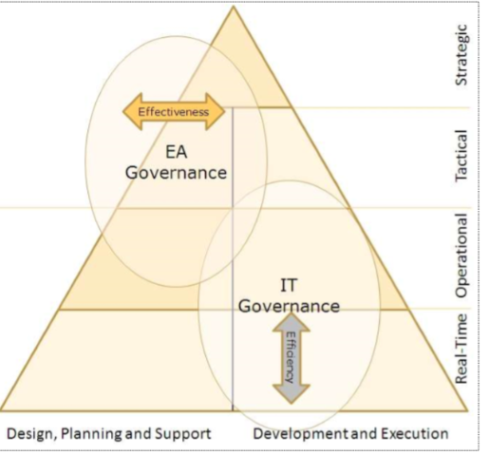

Slide 26
EA Governance - Technology

