Slide 1
THE INTERNET AND WORLD WIDE WEB

Slide 2
Objectives Overview
Discuss the evolution of the Internet
Identify and briefly describe various broadband Internet connections and state differences between broadband Internet connections and dial-up connections
Describe the types of Internet access providers
Describe the purpose of an IP address and its relationship to a domain name
Explain the purpose of a Web browser and identify the components of a Web address
Describe how to use a search engine to search for information on the Web and differentiate between a search engine and a subject directory
See Page 73
for Detailed Objectives

Slide 3
Objectives Overview
Describe the types of Web sites
Explain how Web pages use graphics, animation, audio, video, virtual reality, and plug-ins
Identify and briefly describe the steps required for Web publishing
Describe the types of e-commerce
Explain how e-mail, mailing lists, instant messaging, chat rooms, VoIP, newsgroups and message boards, and FTP work
Identify the rules of netiquette
See Page 73
for Detailed Objectives

Slide 4
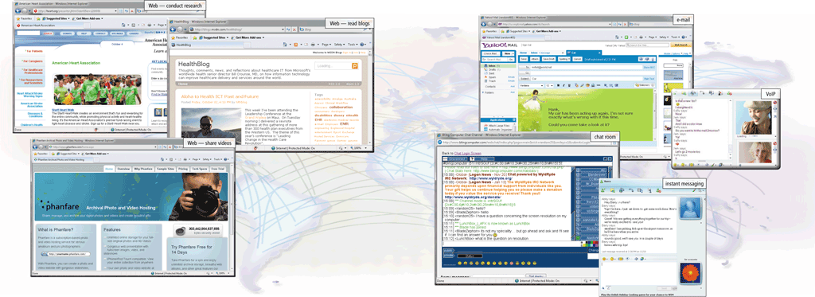
The Internet
The Internet is a worldwide collection of networks that connect millions of businesses, government agencies, educational institutions, and individuals
Page 74
Figure 2-1

Slide 5
Evolution of the Internet
The Internet originated(created) as ARPANET in September 1969 and had two main goals:
Allow scientists at different physical locations to share information and work together
Function even if part of the network were disabled or destroyed by a disaster
Page 75

Slide 6
Evolution of the Internet
1969 ARPANET becomes functional
1984 ARPANET has more than 1,000 individual computers linked as hosts
1986 NSF(National Science
Foundation) connects NSFnet to ARPANET and becomes known as the Internet
1995 NSFNet terminates its network on the Internet and resumes status as research network
Today More than 550 million hosts connect to the Internet
1996 Internet2 is founded
Pages 75 - 76

Slide 7
Internet2 : the goal of Internet2 is to develop and test advanced network technologies that will benefit Internet users in the short-term future.

Slide 8
Evolution of the Internet
Each organization is responsible only for maintaining its own network
The World Wide Web Consortium (W3C) oversees research and sets guidelines and standards
Internet2 connects more than 200 universities and 115 companies via a high-speed private network
Page 76

Slide 9
Connecting to the Internet
Many home and small business users connect to the Internet via high-speed broadband Internet service
Cable Internet service
DSL
(Digital Subscriber line)
Fiber to the Premises (FTTP)
Fixed wireless
Cellular Radio Network
Wi-Fi
wireless fidelity
Satellite Internet Service
Page 76

Slide 10
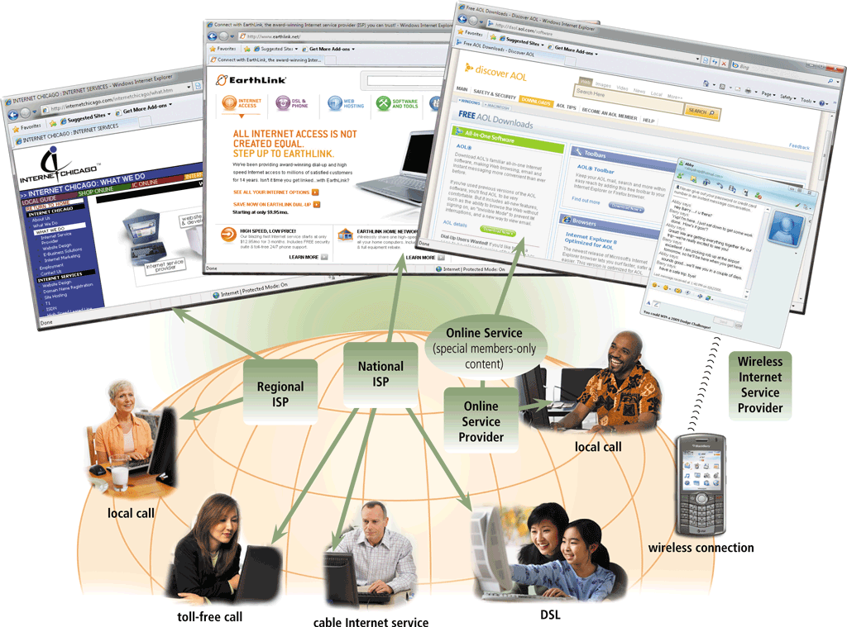
Evolution of the Internet
An access provider is a business that provides individuals and organizations access to the Internet free or for a fee
Page 77
Figure 2-2

Slide 11
cable television network
DSL (digital subscriber line) provides high-speed Internet connections using regular copper telephone lines.
Fiber to the Premises (FTTP) uses fiber-optic cable
Fixed wireless :using a dish-shaped antenna on your house or business.
Wi Fi : network uses radio signals to provide high-speed Internet connections

Slide 12
Evolution of the Internet
ISP (Internet service provider)
Online service provider (OSP)
Wireless Internet service provider
Regional ISPs provide Internet access to a specific geographical area
National ISPs provide Internet access in cities and towns nationwide
Has many members-only features
Popular OSPs include AOL (America Online) and MSN (Microsoft Network)
Provides wireless Internet access to computers and mobile devices
May require a wireless modem
Page 78

Slide 13
Evolution of the Internet
Page 79
Figure 2-3

Slide 14
Evolution of the Internet
An IP address is a number that uniquely identifies each computer or device connected to the Internet
A domain name is the text version of an IP address
Top-level domain (TLD)
A DNS server translates the domain name into its associated IP address
Pages 79 – 80
Figure 2-4

Slide 15
Evolution of the Internet
Page 80
Figure 2-5

Slide 16
The World Wide Web
The World Wide Web, or Web, consists of a worldwide collection of electronic documents.
Each electronic document on the Web is called a Web page, which can contain text, graphics, animation, audio, and video (Web pages).
A Web site is a collection of related Web pages and associated items
A Web server is a computer that delivers requested Web pages to your computer
Pages 80 - 81

Slide 17
The World Wide Web
A Web browser, or browser, allows users to access Web pages and Web 2.0 programs
Internet Explorer
Firefox
Opera
Safari
Google Chrome
Page 81

Slide 18
The World Wide Web
A home page is the first page that a Web site displays
Downloading is the process of receiving information
Some Web pages are designed specifically for microbrowsers
Pages 82 - 83
Figure 2-7

Slide 19
The World Wide Web
There are thirteen types of Web sites
Portal
News
Informational
Business/Marketing
Blog
Online Social Network
Educational
Wiki
(User accont)
Pages 88 – 91
Figure 2-15

Slide 20
The World Wide Web
Entertainment
(Movies)
Advocacy
(legal information about law)
Web Application
Content Aggregator
(collect data and provide data across all over the word)
Personal
(own websites)
Pages 91 – 92
Figure 2-15

Slide 21
E-Commerce
E-commerce is a business transaction that occurs over an electronic network.
Users can purchase product or service on the Web, including groceries, flowers, books, computers, music, movies, cars, airline tickets, and concert tickets. They also can pay bills, invest in stocks, make airline reservations, reserve a hotel or car.
M-commerce identifies e-commerce that takes place using mobile devices
Page 98

Slide 22
E-Commerce
Consumer-to-consumer (C2C)
Business-to-business (B2B)
Business-to-consumer (B2C)
E-commerce
Pages 98 - 99

Slide 23
Consumer-to-consumer (C2C) e-commerce occurs when one consumer sells directly to another, such as in an online auction.
business-to-business (B2B) e-commerce. Businesses often provide goods and services to other businesses, such as online advertising, recruiting, credit, sales, market research, technical support, and training.
Business-to-consumer (B2C) e-commerce consists of the sale of goods and services to the general public

Slide 24
E-Commerce
Page 99
Figure 2-25

Slide 25
Other Internet Services
E-mail is the transmission of messages and files via a computer network
An e-mail program allows you to create, send, receive, forward, store, print, and delete e-mail messages
Page 101
Figure 2-26

Slide 26
Other Internet Services
Page 102
Figure 2-27

Slide 27
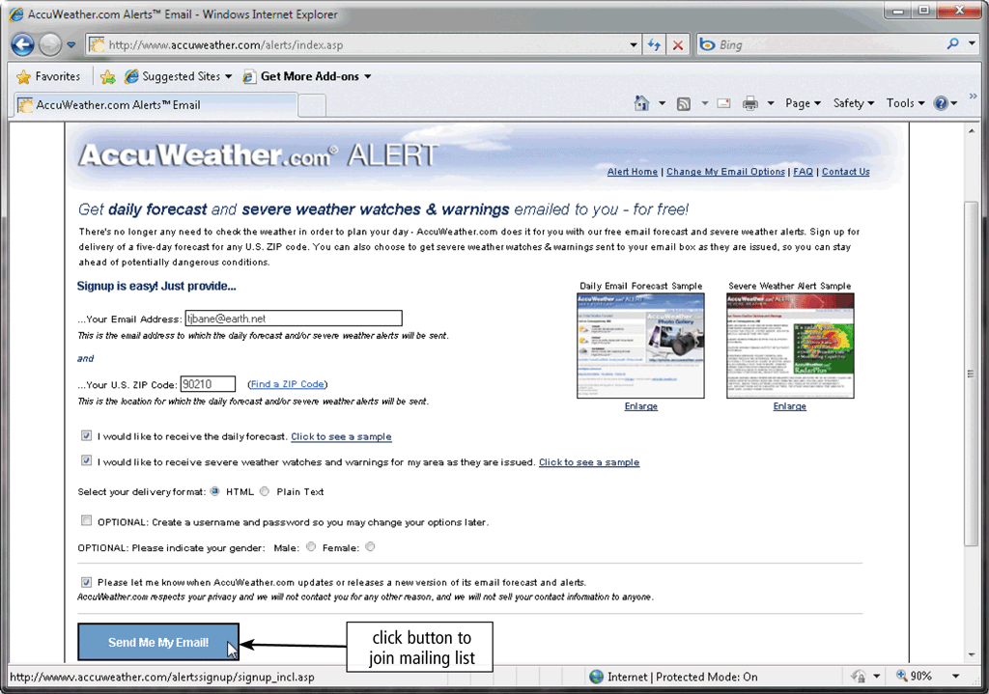
Other Internet Services
A mailing list is a group of e-mail names and addresses given a single name
Subscribing adds your e-mail name and address
Unsubscribing removes your name
Page 103
Figure 2-28

Slide 28
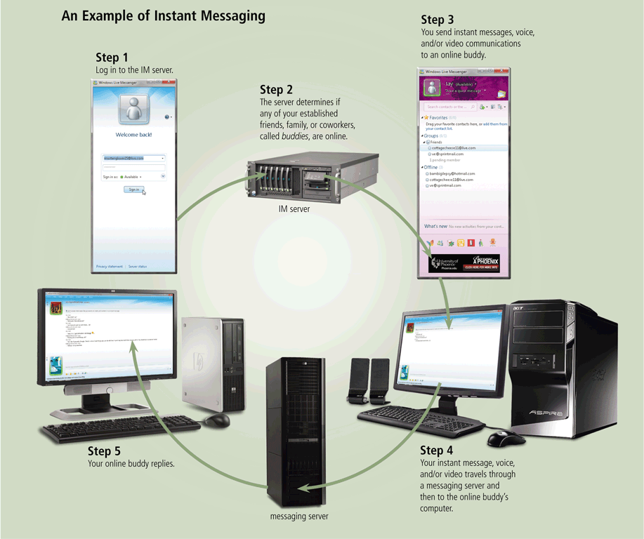
Other Internet Services
Instant messaging (IM) is a real-time Internet communications service
Page 104
Figure 2-29

Slide 29
Other Internet Services
A chat is a real-time typed conversation that takes place on a computer
A chat room is a location on an Internet server that permits users to chat with each other
Page 105
Figure 2-30

Slide 30
Other Internet Services
VoIP (Voice over IP) enables users to speak to other users over the Internet
Also called Internet telephony
Page 106
Figure 2-31

Slide 31
Other Internet Services
A newsgroup is an online area in which users have written discussions about a particular subject
Typically requires a newsreader
A message board is a Web-based type of discussion group
Page 107
Figure 2-32

Slide 32
Other Internet Services
FTP (File Transfer Protocol) is an Internet standard that permits file uploading and downloading with other computers on the Internet
Many operating systems include FTP capabilities
An FTP server is a computer that allows users to upload and/or download files using FTP
Page 107

Slide 33
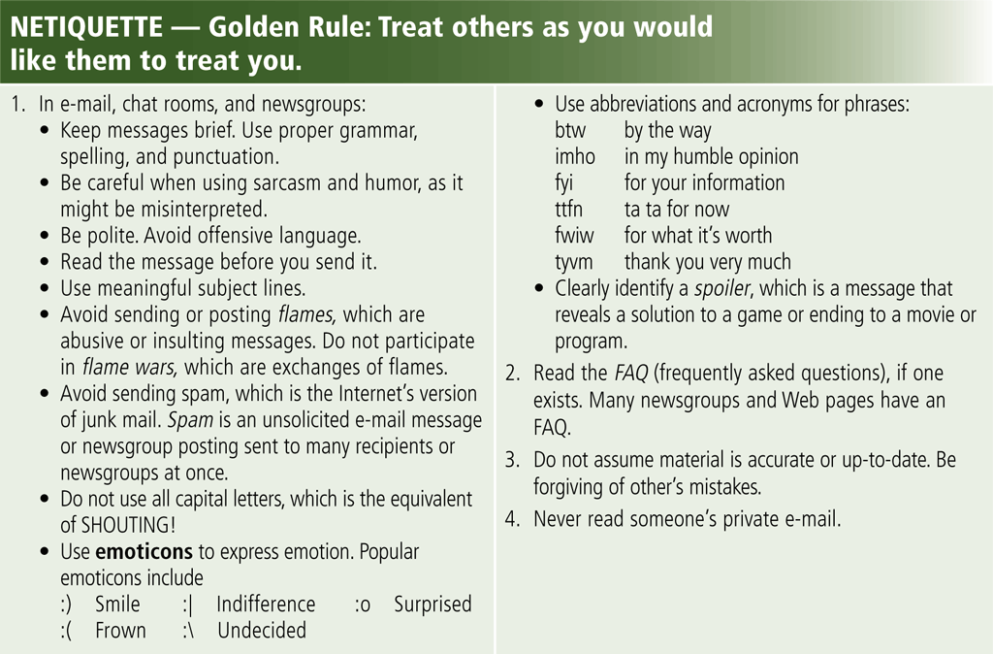
Netiquette
Netiquette is the code of acceptable Internet behavior
Page 108
Figure 2-33

Slide 34
Summary
History and structure of the Internet
World Wide Web
Browsing, navigating, searching, Web publishing, and e-commerce
Other Internet services: e-mail, instant messaging, chat rooms, VoIP, newsgroups and message boards, and FTP
Rules of netiquette
Page 109

Slide 35
Chapter 2 Complete

