Slide 1
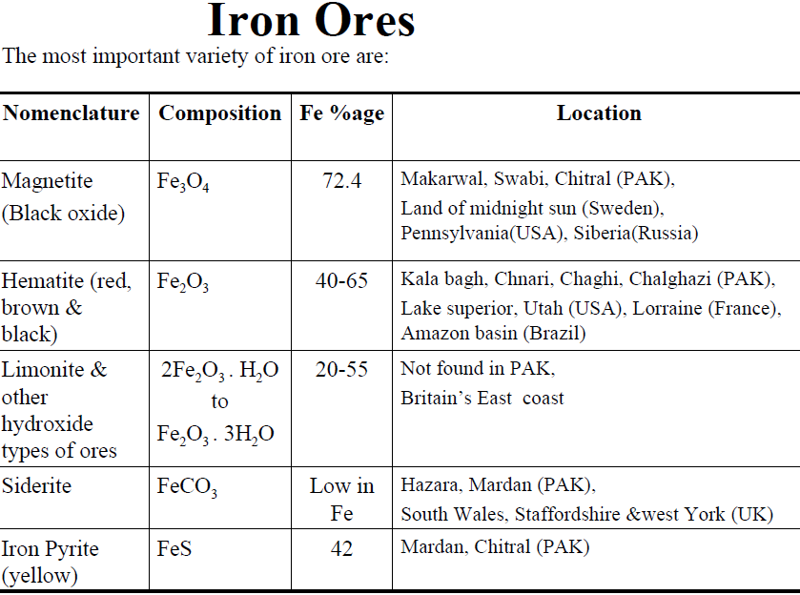

Slide 2
After refining ores: Pig iron
Pig iron---- Crude /impure
Pig iron is use as a raw material ---steel, cast iron, wrought iron
Manufacturing Procedure of pig iron:
Iron ore----Concentrated---Gravitation floation-----Magnetic seperation---Roasting---calcination----Blast furnace

Slide 3
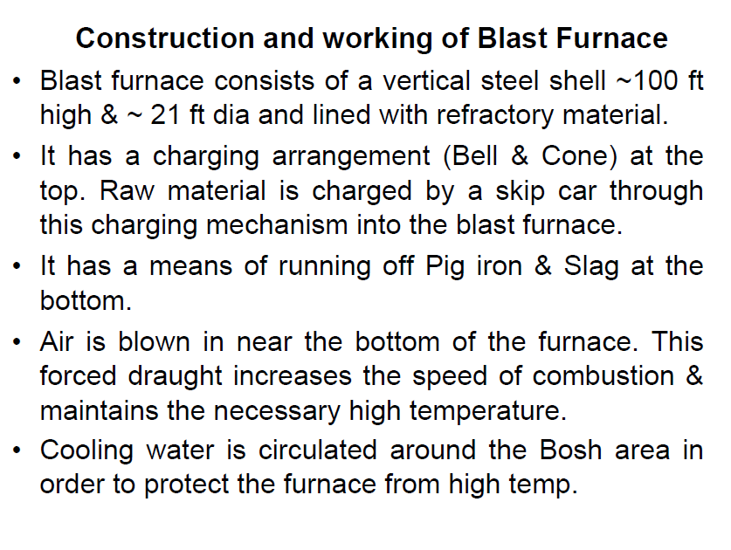

Slide 4
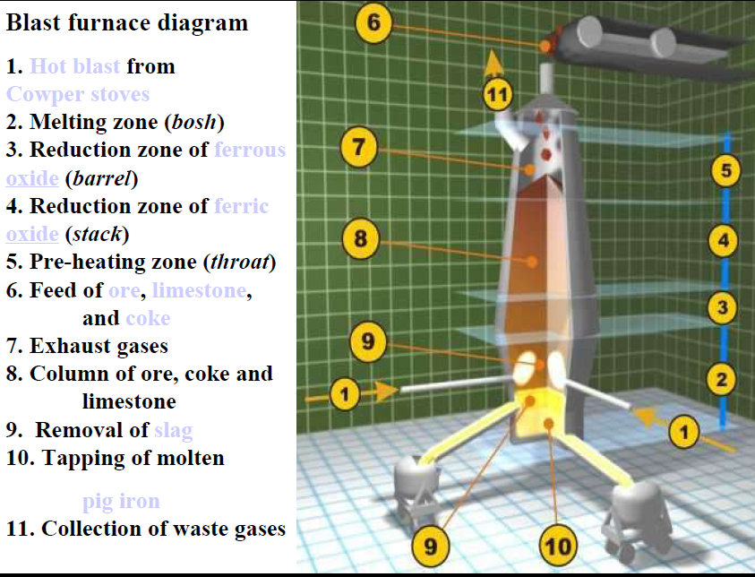

Slide 5
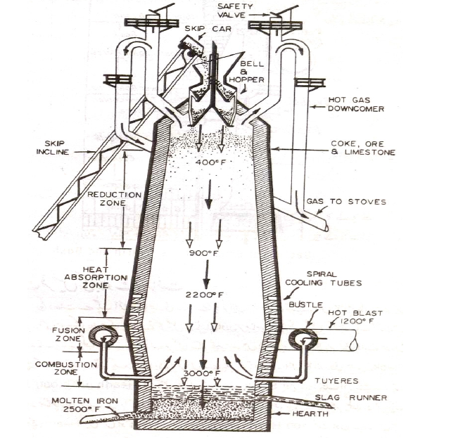

Slide 9
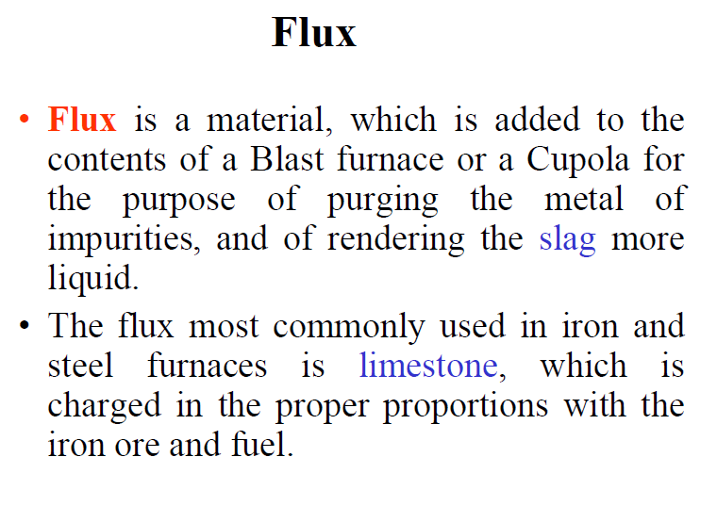

Slide 13
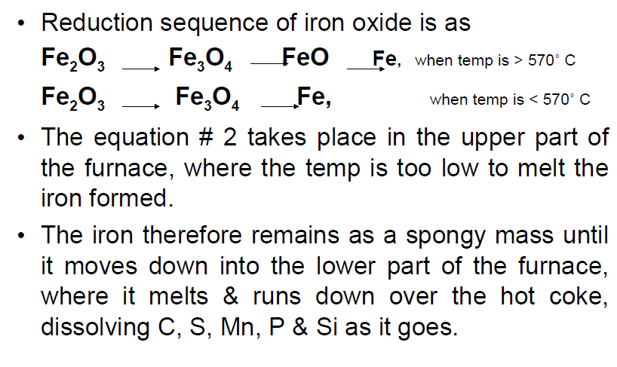

Slide 14
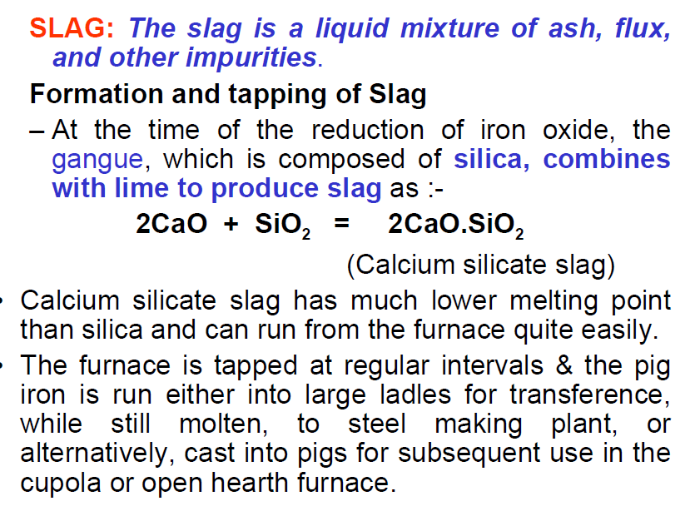

Slide 17
