Slide 1
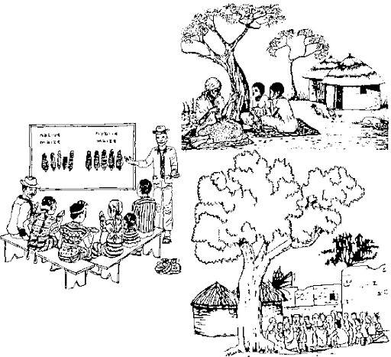
EXTENSION TEACHING METHODS

Slide 2
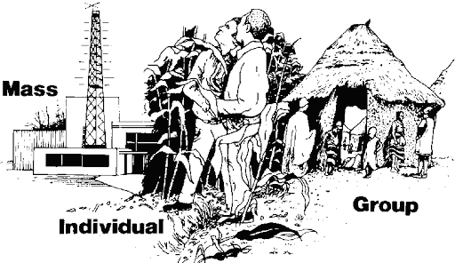
EXTENSION TEACHING METHODS
Extension methods comprise the communication techniques between extension agent and target group (farmer/s).
To facilitate farmers decisions to adopt farming practices.
Methods by Nature of Contact
Individual Contact Methods
Group Contact Methods
Mass Contact Methods

Slide 3
OBJECTIVES OF EXTENSION TEACHING METHODS
Approaching village peoples/farmers.
Working with village peoples/farmers
Encouraging village peoples/farmers
Influencing village peoples/farmers.
Attracting their attention toward modern practices.
Arousing and developing their interest.
Convincing the farmers to use modern technology.
To involve farmers to make farmers organizations
Spread of information about new innovations.

Slide 4
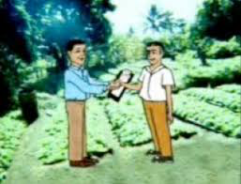
EXTENSION METHODS BY NATURE OF CONTACT
Individual Contact Methods
Farm and home visit
Office Visit
Office calls
Telephone calls
Personal Letter/ Correspondence
E Mail
Video Calling

Slide 12
RALLIES

