Slide 1
INTRODUCTION TO CARDIAC SURGERY & CPR
DR ALLAH NAWAZ
MBBS(K.E),FCPS(PAK)
Consultant general & laparoscopic surgeon
Assistant Professor surgery
TSU DHQ Hospital (UOS)

Slide 2
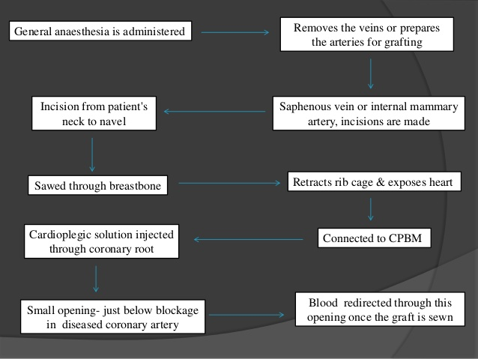
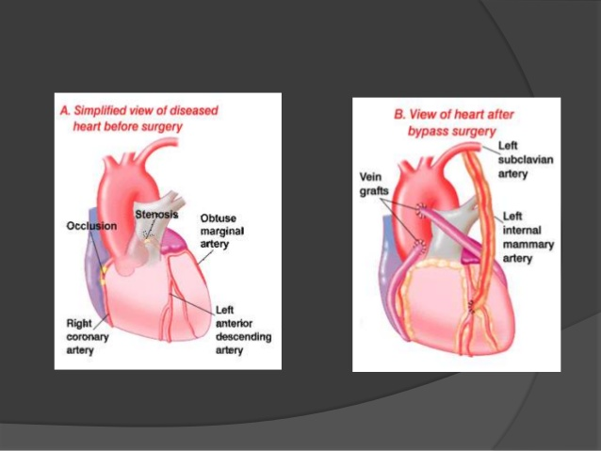
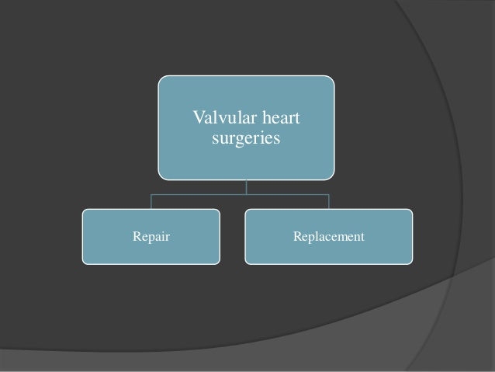

Slide 4
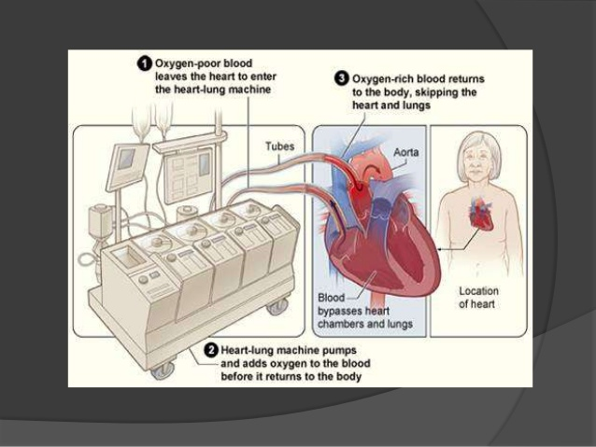

Slide 44
VIDEO OF CPR

Slide 45
THANKS

