Slide 1
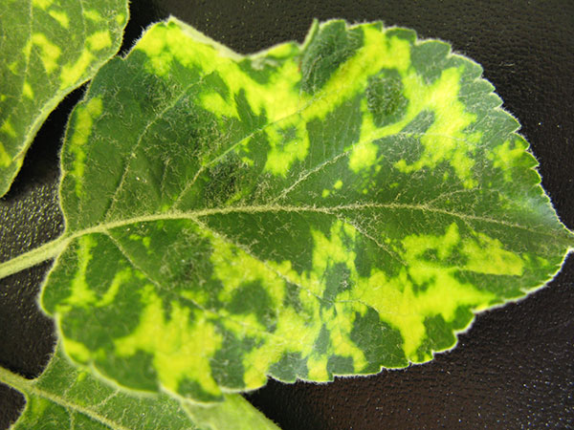
Apple mosaic Virus (Chestnut Mosaic)
Distribution
Apple mosaic virus is one of the oldest known and most widespread apple viruses.
Occur in Bangladesh, Japan, Turkey, Africa, North and south America and many European countries.
Host Range
65 woody and herbaceous species in 19 families.

Slide 2
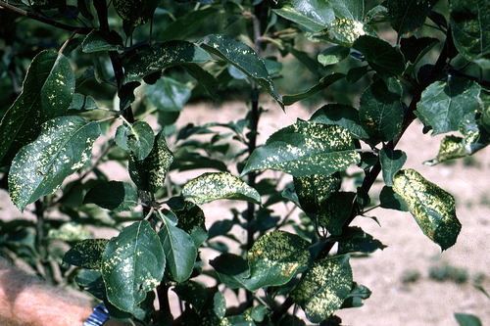
Symptoms
Infected trees develop pale to bright cream spots, bandings or pattern on leaves.
These spots may become necrotic after exposure to summer sun and heat.
Premature defoliation may occur when infection is severe.
Except in severe cases, infected trees can still produce a crop with yield reductions from no reduction to 50%.

Slide 3
Transmission
Virus is transmitted by grafting, budding and by vegetative propagated rootstocks.
No reported insect vectors for virus
Management
Use healthy propagated material.
For inactivating the virus, cutting, heat therapy.
Heat treatment at 36C for 3 to 10 weeks.
Cross protection

Slide 4
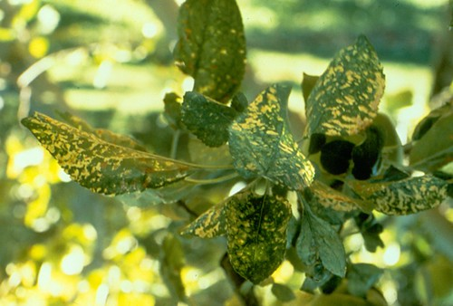
Apple Ringspot
Distribution
This disease has been known in New Zealand in 1935.
Disease first described in 1954.
Disease occurs only sporadically, so its economic importance is slight.
Host range
Malus pumila, Chenopodium quinoa (seed)

Slide 5
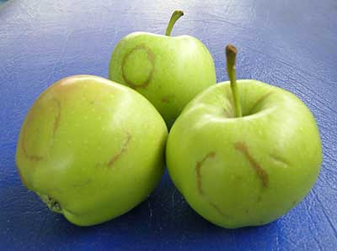
Symptoms
Small yellow spots, sometimes chlorotic rings on the leaves
Darker green spots or irregular rings on the fruits
The skin around the lesions light green or yellow color
In ripening fruit, the surface of the spots become 7 5
rough and rusty.
Flavor and storage properties of the fruits are not affected.
The spots decrease their marketability

Slide 6
Transmission
Virus is transmitted by grafting, budding and by vegetative propagated rootstock.
Management
Use healthy propagated material.
Removal of infected trees

Slide 7
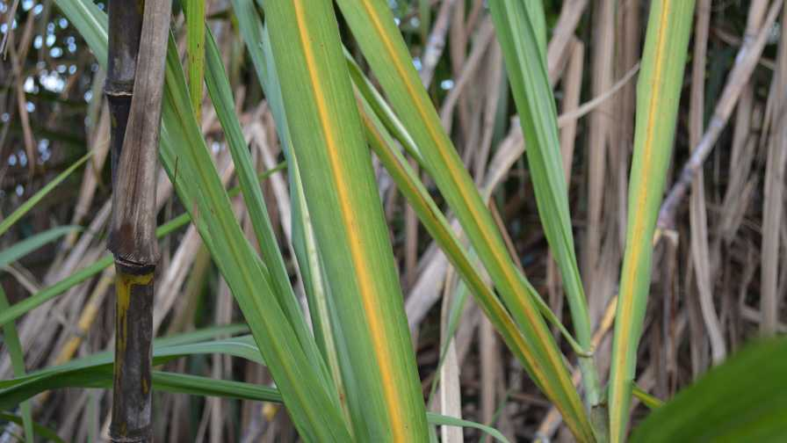
Mosaic of sugarcane
Distribution
Widely distributed and best known of virus disease
Initially reports in Java in [892
Now occur in India, North and South America and many Pacific and Atlantic islands.
Host range
Its host range is very wide.
Sugarcane, Maize, Sorghum, elephant grass etc.

Slide 8
Host Range
Its host range is very wide.
Sugarcane, maize, sorghum, elephant grass etc.
Transmission
Transmission by disease cane sets used as seed.
About 7 species of aphid are involved in virus transmission

Slide 9
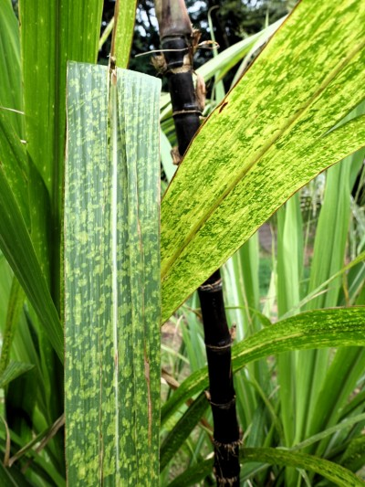
Symptoms
Small yellow spots, sometimes chlorotic rings on the leaves
Darker green spots or irregular rings on the fruits
The skin around the lesions light green or yellow color
In ripening fruit, the surface of the spots become 7 5
rough and rusty.
No internal fruit symptoms.
Flavor and storage properties of the fruits are not affected.
The spots decrease their marketability.

Slide 10
Control measures
Use of selected healthy sets for seed
Heat therapy is effective against certain strains
Elimination of the grass hosts
Use resistant or tolerant varieties.

Slide 11
Apple Flat Virus
Distribution
This disease has been known in Spain, New York, America, Eastern Washington and Hood river oregon.
Host Range
Malus pumila and Cheery
Management
Plant virus indexed trees.
If replanting in virus infected areas of the orchard, use both rootstocks and scions that are tolerant of the virus.

Slide 12
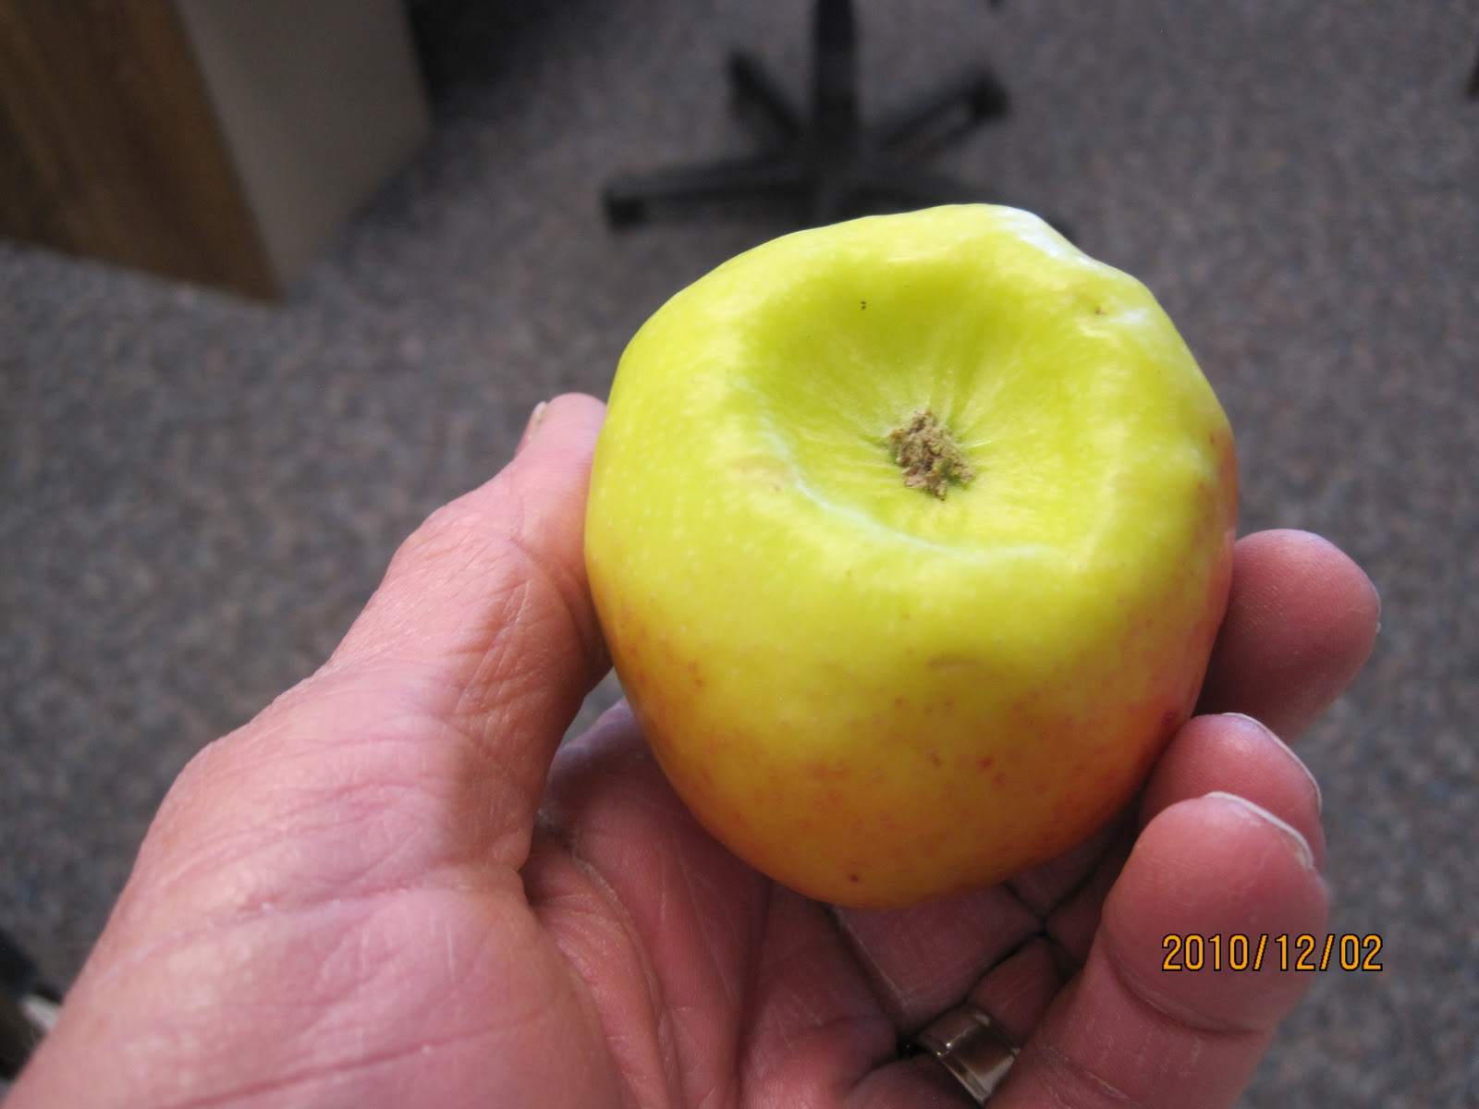
Symptoms
This may cause cell death at graft union.
The resulting symptoms are those of decline, collapse or tree breakage.
Fruits are smaller, flatter and show low tendency.

Slide 13
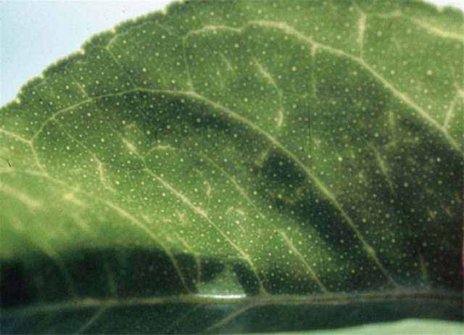
Citrus Tristeza Virus
Distribution
CTV is one of the well known and most widespread citrus virus.
Occur in Spain, France , Australia and US.
Host Range
CTV infect several species of plant genus, citrus, orange and lime.
Transmission
CTV transmitted by several aphid species in a semi persistent manner
Management
Avoid illegally import citrus.
Infected trees must be removed

Slide 14
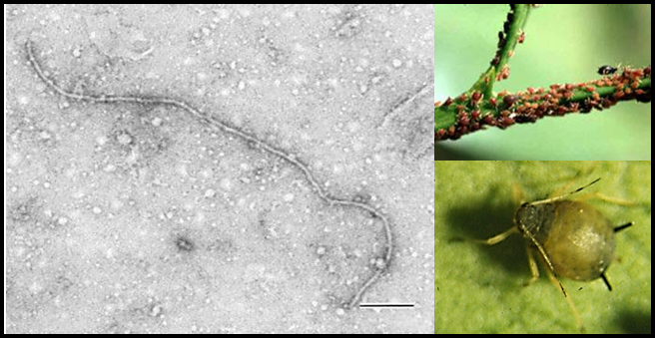
Symptoms
CTV symptoms are associated with viral disruption of phloem and its function.
There are three distinct syndromes of CTV infection quick decline, stem pitting, and seedling yellows.
Affects the cambium layer below the bud union and prevents the normal development of cambium cells.
In severe case, leaving fruit shriveled on the tree and leaves brown and
dehydrated.

Slide 15
Banana Bunchy Top
Distribution
Occur in India, Congo, Kerala state, Irian Jaya, Indonesia.
Host Range
BBTV infects several species of plant genus, Citrus, orange, sweet orange, grapefruit, lime and Seville.
Transmission
Transmitted by banana aphid Pentalonia nigeronervosa.
Management
Eradication of diseased plants and spraying with power kerosene to control aphid population.

Slide 16
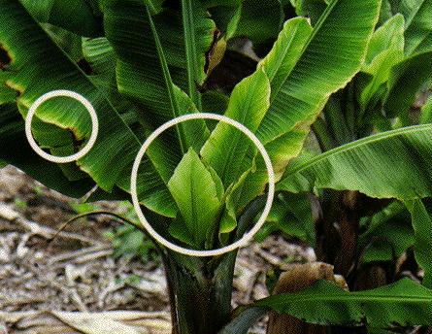
Symptoms
Disease may become apparent at any stage.
Symptoms appear in the second leaf to emerge after inoculation.
Few dark green streaks or dots on the minor veins on the lower portion of lamina.
The leaf display whitish streaks along the secondary veins.
These streaks become dark green.
Leaves become smaller, both in length and width of lamina.
Abnormal shape of fruit produced.

Slide 17
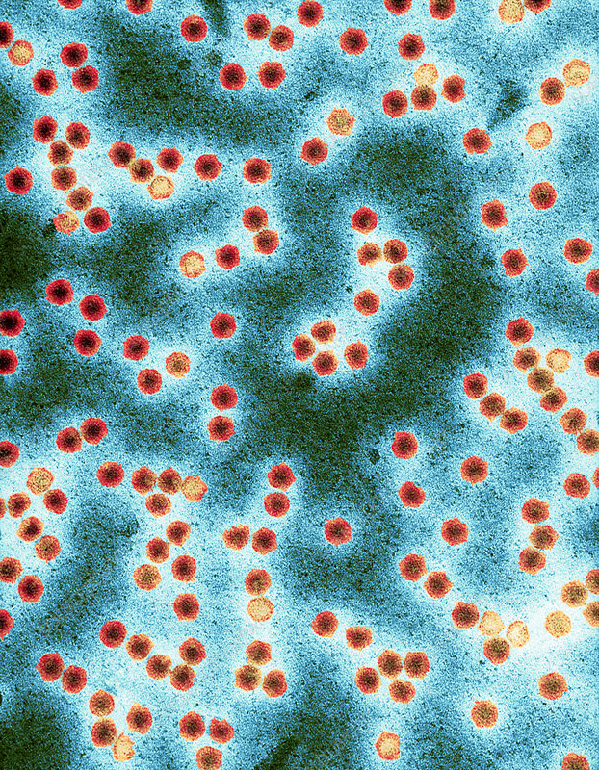
Tobacco Necrosis Virus
Distribution
This virus spread worldwide particularly in Europe.
Host Range
Its host range s very wide.
Bean, melon, cucumber and tulip
Transmission
TNV is transmitted by zoo spores of fungus.
The vector properties of fungus can be attributed to absorption of virus particles to the member of zoo spore.
.

Slide 18
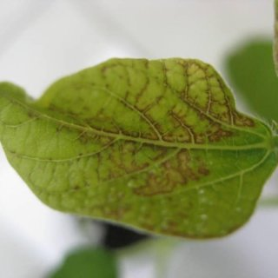
Symptoms
Brown necrotic spots appear near the veins.
Occasionally young seedlings die.
Dark sunken lesions formed on.
On mature plants, the symptoms are mainly located on the lower leaves.
Control Measures
Sterilization of soil if herbaceous host are grown in green house

Slide 19
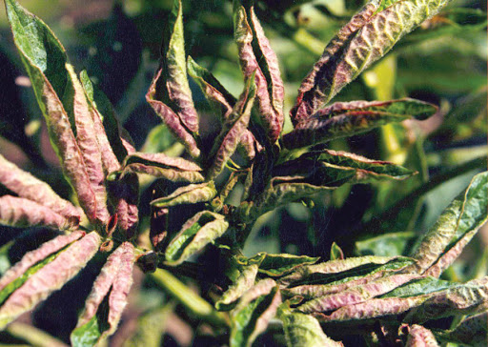
Leaf roll of Potato
Distribution
Reported in India, Canada, Russia, South Africa and all over the world
It causes 16 to 64% losses in tuber yield.
Host Range
Potato and also attack on tomato but no economically.
Transmission
Infected seed tubers and some aphid species.

Slide 20
Symptoms
The leaflets of infected plants roll up along margin.
In infected seed tubers, rolling of leaves starts in lower leaves and progressed upward.
Rolled leaves becomes stiff, rigid, thick and leathery.
Control Measures
Use healthy selected seed tubers for seed.
Heat therapy is effected against certain strains
Use resistant and tolerant varieties.

Slide 21
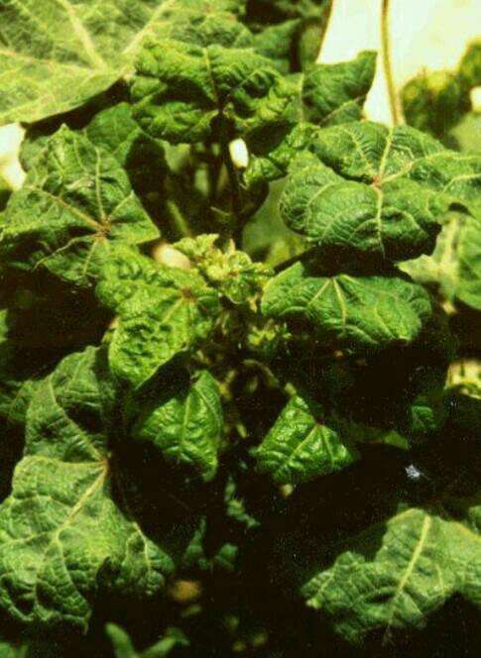
Cotton Leaf Curl Virus
Distribution
In Asia and Africa major diseases of cotton caused by cotton leaf curl.
This virus devasted Pakistan cotton industry in early 1990s where it caused an estimated yield reduction of 30-35%
Host Range
Tomato , pepper, eggplant, okra, tobacco, beans, cotton and cucurbits
Transmission
This disease is transmitted by whitefly.

Slide 22
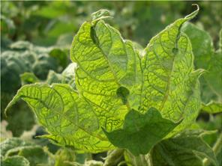
Symptoms
Upward or downward curling of leaf.
Vein thickening
Infected plants become dark green.
Plant become stunted in growth with no proper yield.
Petioles become twisted or deform.
Control Measures
Use resistant and tolerable cultivators.
Protect seedlings form whiteflies.
Use acephate at every seven days

Slide 23
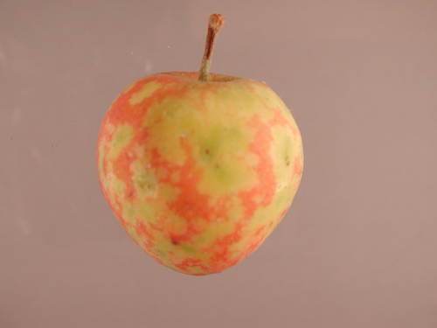
Apple Dapple Virus
Distribution
This disease has been known in China and japan
Host Range
Malus pumila
Management
Use virus tested certified materials.
Temperature therapy of infected stock

Slide 24
Symptoms
Effect fruit bears small circular spots near the calyx end of the fruit.
As the fruits mature, the spots enlarge and increases.
In severe case, the circular patches becomes brown.
The affected fruit is smaller then the unaffected trees

Slide 25
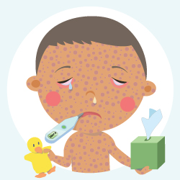
Measles
Symptoms
Measles symptoms appear 7 to 14 days after contact with the virus and typically include high fever, cough, runny nose, and watery eyes.
Measles rash appears 3 to 5 days after the first symptom.

Slide 26
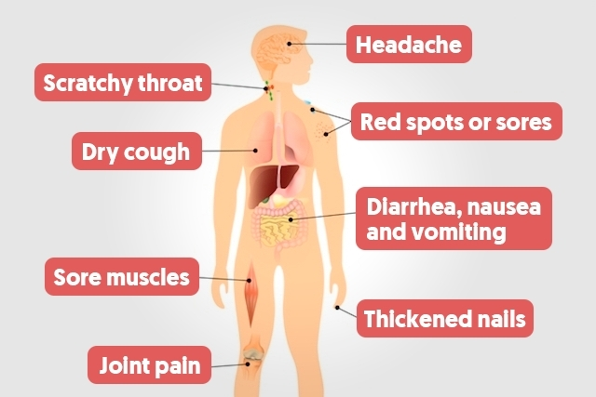
Aids
Symptoms
Rapid weight loss.
Recurring fever or profuse night sweats.
Extreme and unexplained tiredness.
Prolonged swelling of the lymph glands in the armpits, groin, or neck.
Diarrhea that lasts for more than a week.
Sores of the mouth, anus, or genitals.
Pneumonia.

Slide 27
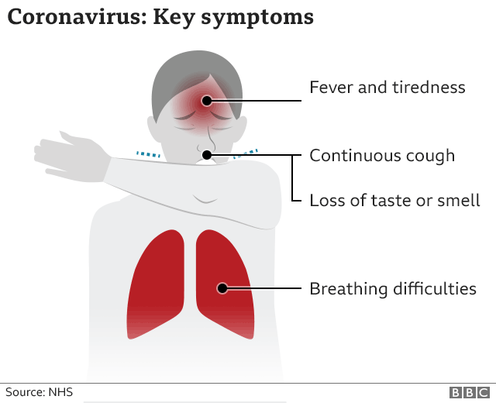
Corona Virus
Symptoms
Most common symptoms:
fever
dry cough
tiredness
Less common symptoms:
aches and pains
sore throat
diarrhea
conjunctivitis
headache
loss of taste or smell
a rash on skin, or discoloration of fingers or toes
Serious symptoms:
difficulty breathing or shortness of breath
chest pain or pressure
loss of speech or movement

Slide 28
Reference
Ong, ca. And Y. Dool . 1988. Virus Diseases of Malaysian Fruit Trees. Seminar on ttopicalfitscultivation and pest & disease management, Kota
Niyeogere. c. 2012. Occurrence and Distribution of Banana Bunchy Top Disease. Tree
and Forestry Science and Biotechnology
Adsuar, J. 1950. On the Physiacal properties of Sugarcane mosaic virus. Phytopathology
40: 214-215
Singh, R.G. Plant disease 9" edition
Naimat, M. Virus Disease of Plants
https://www.cdc.gov/coronavirus/2019-ncov/symptoms-testing/symptoms.html
https://www.hiv.gov/hiv-basics/overview/about-hiv-and-aids/symptoms-of-hiv
https://www.cdc.gov/measles/symptoms/signs-symptoms.html#:~:text=Measles%20symptoms%20appear%207%20to,days%20after%20the%20first%20symptoms.

