Slide 1
DAMS
SAEED HASSAN

Slide 2
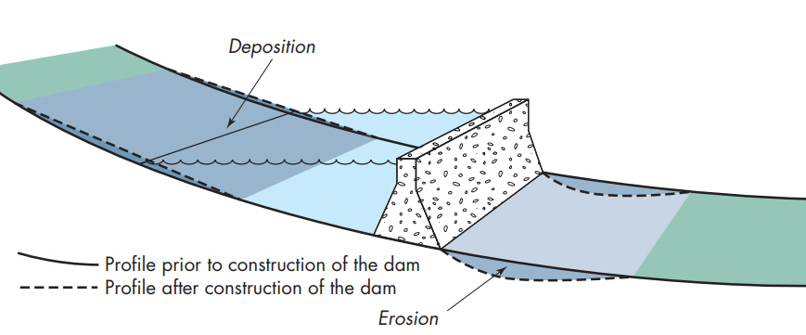

Slide 3
A dam is a barrier across flowing water that obstructs, directs or retards the flow often creating a reservoir, lake or impoundments.
A dam is an artificial barrier usually constructed across a stream channel to impound water.
Dams are made from a variety of materials such as rock, steel, wood, concrete or a combination of these materials.

Slide 4
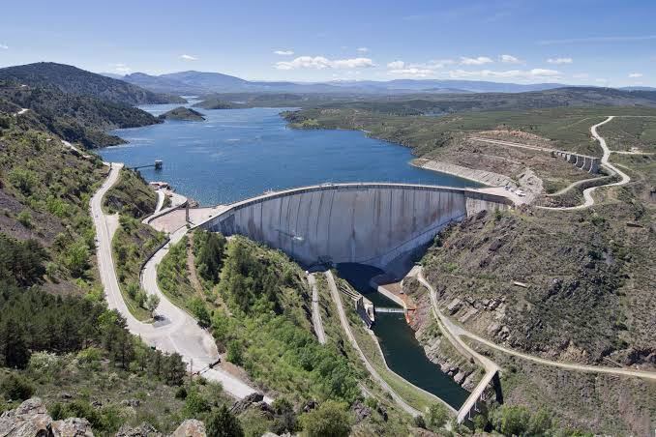
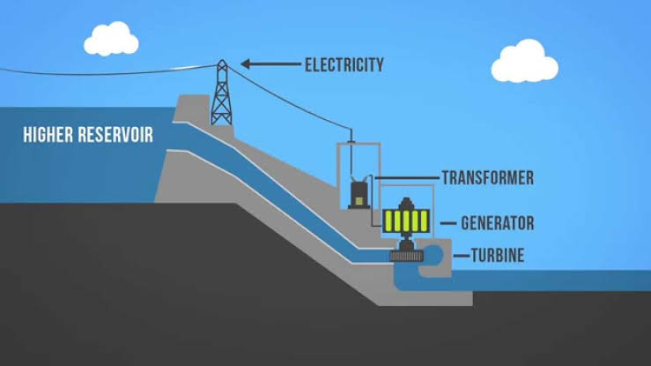
Why we built dams ?????
Water storage
hydropower

Slide 5
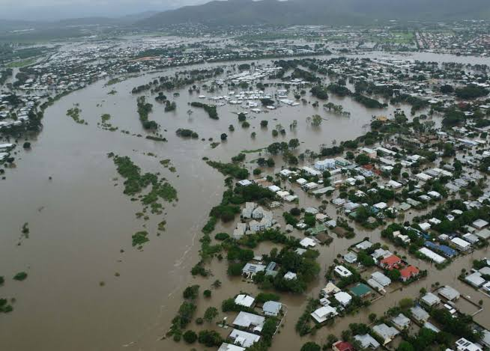
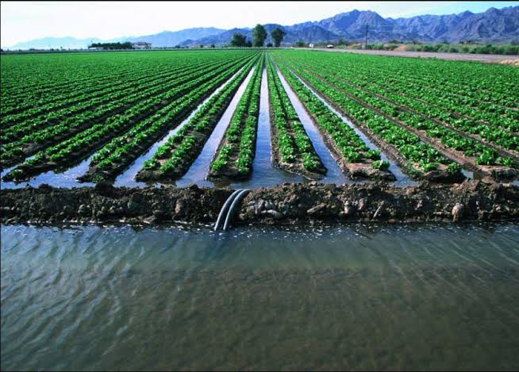
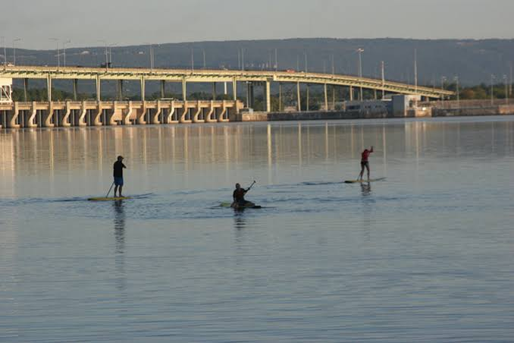
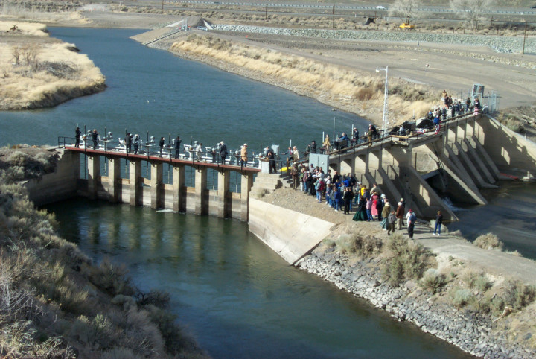
hydropower
Irrigation
Flood control
Water diversion
Recreational area

Slide 6
We know we need to move away from fossil fuels and most of the world is committed — to some extent — to do so. Within our ongoing thirst for growth, there is an underlying fear that we need more energy to fuel our future needs. To some extent, this works in favor of accelerating investment in renewables, However, when it comes to taking energy from rivers, we are still creating large, negative environmental and social impact because we haven’t redefined what is, and is not, renewable energy.

Slide 8
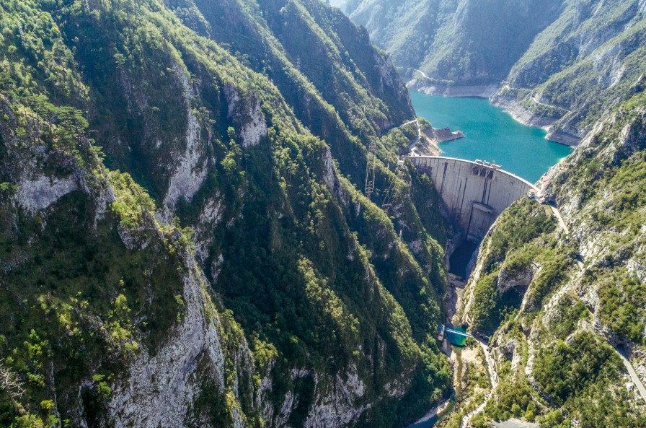

Slide 9
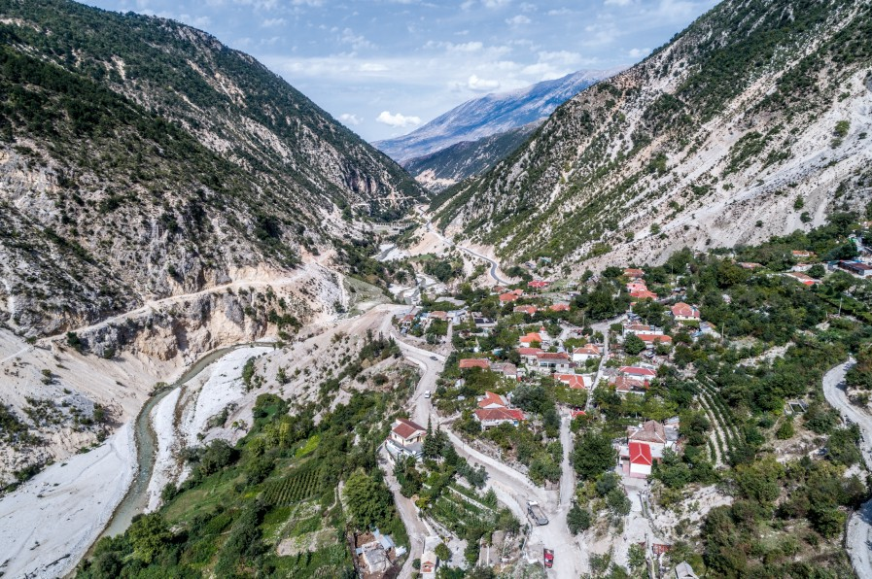

Slide 11
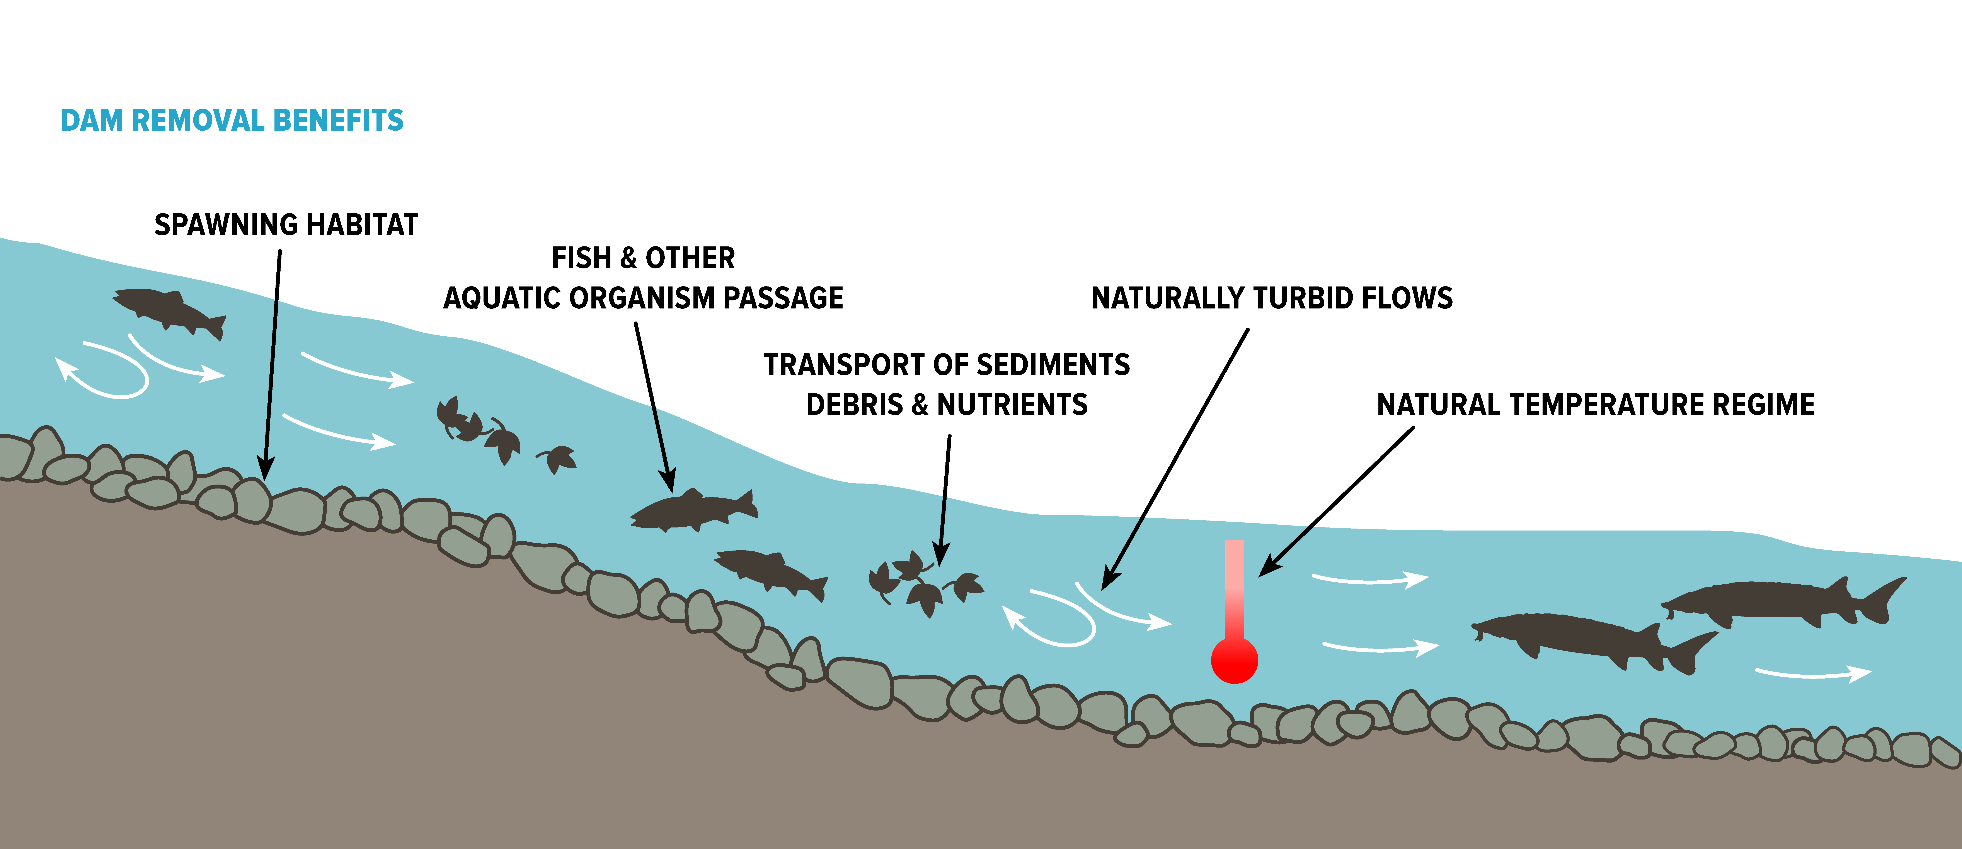

Slide 12
Impacts of dams….
Dams disrupt river flows,
degrade water quality,
block the movement of a river’s vital nutrients and sediment,
destroy the habitat of fish and wildlife
eliminate recreational opportunities
Ecosystem destruction
Spread of Disease
Species Extinction
With changing weather patterns, hydro-power is also becoming unreliable, due to lower levels of rain and snowfall.
“Rivers are the arteries of our planet; they provide clean water for millions of people, they flush carbon from land, into the ocean, effectively taking it out of the atmosphere.”

