Slide 1
Software Testing & Quality Engineering
Chapter 13
Test Documentation
Linda Westfall Quality Press

Slide 2
Objectives
Test Execution Documentation:
Test Execution
Test Case
Test Procedure
Test Log
Problem Report
Test Result Data and Metrics
Test Report

Slide 3
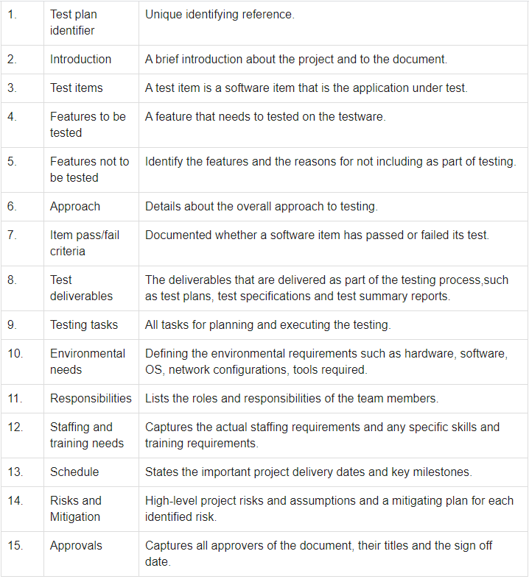
Test Plan/Test Procedure
Test Plan Identifier
Test planning, the most important activity to ensure that there is initially a list of tasks and milestones in a baseline plan to track the progress of the project. It also defines the size of the test effort.
It is the main document often called as master test plan or a project test plan and usually developed during the early phase of the project.

Slide 4
Test Planning Activities:
To determine the scope and the risks that need to be tested and that are NOT to be tested.
Documenting Test Strategy.
Making sure that the testing activities have been included.
Deciding Entry and Exit criteria.
Evaluating the test estimate.
Planning when and how to test and deciding how the test results will be evaluated, and defining test exit criterion.
The Test artefacts delivered as part of test execution.
Defining the management information, including the metrics required and defect resolution and risk issues.
Ensuring that the test documentation generates repeatable test assets.
Notes:
What is Test Strategy?
Test Strategy is also known as test approach defines how testing would be carried out. Test approach has two techniques:
Proactive - An approach in which the test design process is initiated as early as possible in order to find and fix the defects before the build is created.
Reactive - An approach in which the testing is not started until after design and coding are completed.
Factors to be considered:
- Risks of product or risk of failure or the environment and the company
- Expertise and experience of the people in the proposed tools and techniques.
- Regulatory and legal aspects, such as external and internal regulations of the development process
- The nature of the product and the domain

Slide 5
Test Documentation
Test documentation is documentation of artifacts created before or during the testing of software. It helps the testing team to estimate testing effort needed, test coverage, resource tracking, execution progress, etc. It is a complete suite of documents that allows you to describe and document test planning, test design, test execution, test results that are drawn from the testing activity.
The degree of test formality depends on
The type of application under test
Standards followed by your organization
The maturity of the development process.
Notes:
*It's easy to assume that Testing is executing the various section of code on an ad-hoc basis and verifying the results. But in the real world, Testing is a very formal activity and is documented in detail. Test Documentation makes planning, review, and execution of testing easy as well as verifiable.
* Testing activities generally consume 30% to 50% of software development project effort. Documentations help to identify Test process improvement that can be applied to future projects.

Slide 6
Test Execution
Test execution is the process of executing the code and comparing the expected and actual results. Following factors are to be considered for a test execution process:
Based on a risk, select a subset of test suite to be executed for this cycle.
Assign the test cases in each test suite to testers for execution.
Execute tests, report bugs, and capture test status continuously.
Resolve blocking issues as they arise.
Report status, adjust assignments, and reconsider plans and priorities daily.
Report test cycle findings and status.

Slide 7
Test Case
It is a group of input values, execution preconditions, expected execution post conditions and results. It is developed for a Test Scenario.
Test Case acts as the starting point for the test execution, and after applying a set of input values, the application has a definitive outcome and leaves the system at some end point or also known as execution post condition.
Test Case Parameters:
Test Case ID Test Scenario
Test Case Description Test Steps
Prerequisite Test Data
Expected Result Test Parameters
Actual Result Environment Information
Comments

Slide 8
Test case Example
Let us say that we need to check an input field that can accept maximum of 10 characters.
While developing the test cases for the above scenario, the test cases are documented the following way. In the below example, the first case is a pass scenario while the second case is a FAIL.
If the expected result doesn't match with the actual result, then we log a defect. The defect goes through the defect life cycle and the testers address the same after fix.

Slide 9
Test Log
IEEE 829 Definition for Test Log: “To provide a chronological record of relevant details about the execution of tests, e.g. recording which tests cases were run, who ran them, in what order, and whether each test passed or failed.”
Test log is one of the crucial test artifact prepared during the process of testing. It provides a detailed summary of the overall test run and indicates the passed and failed tests. Additionally, test log also contains details and information about various test operations, including the source of issues and the reasons for failed operations. The focus of this report/document is to enable post execution diagnosis of failures and defects in the software.
Testers play an extremely vital role in creating test logs, which should be created whenever test are executed or possibly when test scripts are implemented by the team. Moreover, apart from offering information about various tests, test log also includes images of the test application, links to files, and other various entries. It helps
If you want to prove what you tested “two” days ago;
Traceability. You can mark every test case you have tested and be sure that you won’t check it the second time or that you won’t miss something important.
Senior QAs/Mentors/Leads can verify that the most junior people tested everything needed and didn’t skip any important test cases.
Notes:
Test artifacts and deliverables are an integral part of software testing life cycle. From enabling knowledge transfer and sharing experiences with various team members, management, and clients for improvement, to reducing ambiguity and distractions, test artifacts offer various benefits to the testing team. Test log, a type of test artifact, is created during test execution and provides detailed information regarding the success of each test performed to validate the quality, performance, & functionality of the software

Slide 10
Problem Report/Bug Report/Defect Report
A Defect in Software Testing is a variation or deviation of the software application from end user’s requirements or original business requirements. A software defect is an error in coding which causes incorrect or unexpected results from a software program which does not meet actual requirements. Testers might come across such defects while executing the test cases.
A Bug Report in Software Testing is a detailed document about bugs found in the software application. Bug report contains each detail about bugs like description, date when bug was found, name of tester who found it, name of developer who fixed it, etc. Bug report helps to identify similar bugs in future so it can be avoided.
While reporting the bug to developer, your Bug Report should contain the following information
Defect_ID - Unique identification number for the defect.
Defect Description - Detailed description of the Defect including information about the module in which Defect was found.
Version - Version of the application in which defect was found.
Steps - Detailed steps along with screenshots with which the developer can reproduce the defects.
Date Raised - Date when the defect is raised
Reference- where in you Provide reference to the documents like . requirements, design, architecture or maybe even screenshots of the error to help understand the defect
Detected By - Name/ID of the tester who raised the defect
Status - Status of the defect , more on this later
Fixed by - Name/ID of the developer who fixed it
Date Closed - Date when the defect is closed
Severity which describes the impact of the defect on the application
Priority which is related to defect fixing urgency. Severity Priority could be High/Medium/Low based on the impact urgency at which the defect should be fixed respectively

Slide 11
Test Metrices
"We cannot improve what we cannot measure" and Test Metrics helps us to do exactly the same.
Software Testing Metrics are the quantitative measures used to estimate the progress, quality, productivity and health of the software testing process. The goal of software testing metrics is to improve the efficiency and effectiveness in the software testing process and to help make better decisions for further testing process by providing reliable data about the testing process.
The ideal example to understand metrics would be a weekly mileage of a car compared to its ideal mileage recommended by the manufacturer.
Software testing metrics or software test measurement is the quantitative indication of extent, capacity, dimension, amount or size of some attribute of a process or product.
Example for software test measurement: Total number of defects
Why Test Metrics are important
Take decision for next phase of activities
Evidence of the claim or prediction
Understand the type of improvement required
Take decision or process or technology change

Slide 12
Types Metrices
Process Metrics Product Metrics Project Metrics
Identification of correct testing metrics is very important. Few things need to be considered before identifying the test metrics
Fix the target audience for the metric preparation
Define the goal for metrics
Introduce all the relevant metrics based on project needs
Analyze the cost benefits aspect of each metrics and the project lifestyle phase in which it results in the maximum output
Notes:
Process Metrics: It can be used to improve the process efficiency of the SDLC ( Software Development Life Cycle)
Product Metrics: It deals with the quality of the software product
Project Metrics: It can be used to measure the efficiency of a project team or any testing tools being used

Slide 13
Test Metrics Life cycle
How to calculate Test Matrics
Different stages of Metrics life cycle | Steps during each stage
Analysis | Identification of the Metrics Define the identified QA Metrics
Communicate | Explain the need for metric to stakeholder and testing team Educate the testing team about the data points to need to be captured for processing the metric
Evaluation | Capture and verify the data Calculating the metrics value using the data captured
Report | Develop the report with an effective conclusion Distribute the report to the stakeholder and respective representative Take feedback from stakeholder
Sr# | Steps to test metrics | Example
1 | Identify the key software testing processes to be measured | Testing progress tracking process
2 | In this Step, the tester uses the data as a baseline to define the metrics | The number of test cases planned to be executed per day
3 | Determination of the information to be followed, a frequency of tracking and the person responsible | The actual test execution per day will be captured by the test manager at the end of the day
4 | Effective calculation, management, and interpretation of the defined metrics | The actual test cases executed per day
5 | Identify the areas of improvement depending on the interpretation of defined metrics | The Test Case execution falls below the goal set, we need to investigate the reason and suggest the improvement measures

Slide 14
Test Metrics Glossary
Rework Effort Ratio = (Actual rework efforts spent in that phase/ total actual efforts spent in that phase) X 100
Requirement Creep = ( Total number of requirements added/No of initial requirements)X100
Schedule Variance = ( Actual efforts – estimated efforts ) / Estimated Efforts) X 100
Cost of finding a defect in testing = ( Total effort spent on testing/ defects found in testing)
Schedule slippage = (Actual end date – Estimated end date) / (Planned End Date – Planned Start Date) X 100
Passed Test Cases Percentage = (Number of Passed Tests/Total number of tests executed) X 100
Failed Test Cases Percentage = (Number of Failed Tests/Total number of tests executed) X 100
Blocked Test Cases Percentage = (Number of Blocked Tests/Total number of tests executed) X 100
Fixed Defects Percentage = (Defects Fixed/Defects Reported) X 100
Accepted Defects Percentage = (Defects Accepted as Valid by Dev Team /Total Defects Reported) X 100
Defects Deferred Percentage = (Defects deferred for future releases /Total Defects Reported) X 100
Critical Defects Percentage = (Critical Defects / Total Defects Reported) X 100
Average time for a development team to repair defects = (Total time taken for bugfixes/Number of bugs)
Number of tests run per time period = Number of tests run/Total time
Test design efficiency = Number of tests designed /Total time
Test review efficiency = Number of tests reviewed /Total time
Bug find rote or Number of defects per test hour = Total number of defects/Total number of test hours

Slide 15
Test Reports
Do you know the root cause of this problem? Why does the website still has defects even when your Team has already tested it?
The problem is you ignored the reporting & evaluation phase in Test Management. The boss has no information to evaluate the quality of this website. They just trusted what you said and released the website without knowing its testing performance.

Slide 16
Test Report is a document which contains a summary of all test activities and final test results of a testing project. Test report is an assessment of how well the Testing is performed. Based on the test report, stakeholders can evaluate the quality of the tested product and make a decision on the software release.
For example, if the test report informs that there are many defects remaining in the product, stakeholders can delay the release until all the defects are fixed.
Typical Benefits of a Test Report
The current status of the project and quality of product are informed
Stakeholders and customer can take corrective action if necessary
It is a final document which is used to determine whether the product is ready for release

Slide 17
