Slide 1
Nutritional and medicinal value of mushrooms

Slide 2
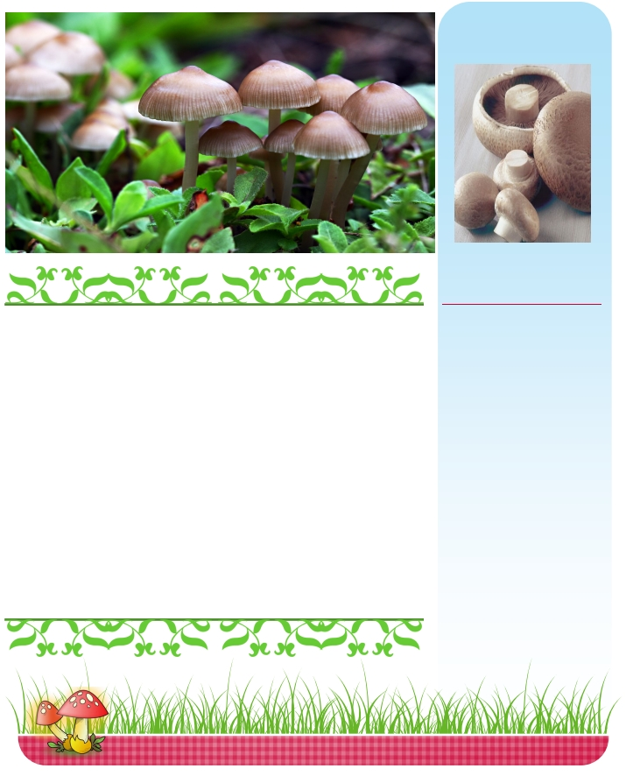
Nutritional and Medicinal Benefits of Mushrooms
Mushrooms are nature's hidden treasures of nutrition. Many
people like them for their satisfying meaty taste and their ver-
satility. But are they really good for you? The answer is yes! In
fact, you will be surprised to learn about the nutritional bene-
fits of mushrooms. For thousands of years, mushrooms have
been used in eastern medicine for their various health benefits.
In this Healthy Eating Tip of the Month, learn about the health
and nutritional benefits of mushrooms There are also two deli-
cious recipes , some more helpful resources, and a prize givea-
way at the end!

Slide 3
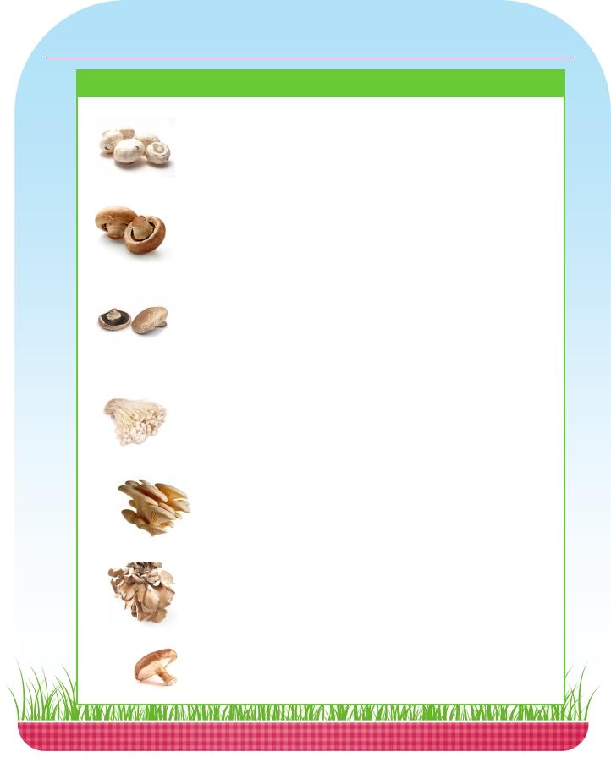
Some Popular Mushroom Varieties
Variety
Flavor
Uses
Preparation
White Button
Fairly mild taste and
pairs well with almost
Sauté or cook in any way Try them sliced and
or even enjoy raw in a sautéed in pasta or
anything! Flavor
intensifies the longer
they are cooked.
salad.
quesadillas.
Cremini
Deeper, earthier flavor
than white button.
Sauté, broil, microwave, Hearty and full - bodied
or cook in almost any taste makes them an
way.
ideal addition to beet
and vegetable dishes.
Portabella
Deep, meat - like texture
and flavor
Grill, broil, or roast;
serve as appetizers,
entrees or side dishes
Hearty taste and texture
makes them a flavorful
vegetarian substitute.
Grill and serve them as a
‘burger’ on warm toast-
ed buns.
Enoki
Mild taste and crunchy
texture
Trim roots at base
before using. Before
serving them, separate
the stems
Eat raw in salads and
sandwiches. Can be
used as an ingredient in
soup stock with soy
sauce and tofu.
Oyster
Mild, delicate flavor
Sautéing with butter
and onion brings out
their best flavor.
Add to linguine with
sliced steak and
sprinkle with parmesan
cheese
Lightly sauté in butter or For a richer taste in any
Maiitake
Distinctive aroma and
rich, woody taste.
Rich and woody when
cooked
oil
These taste best when
cooked
recipe, use maiitakes.
Can be a main dish
ingredient or in side
dishes and soup
Try them in stir - fries,
pastas, soups, entrees,
Shiitake
and sides for a meaty
flavor.

Slide 4
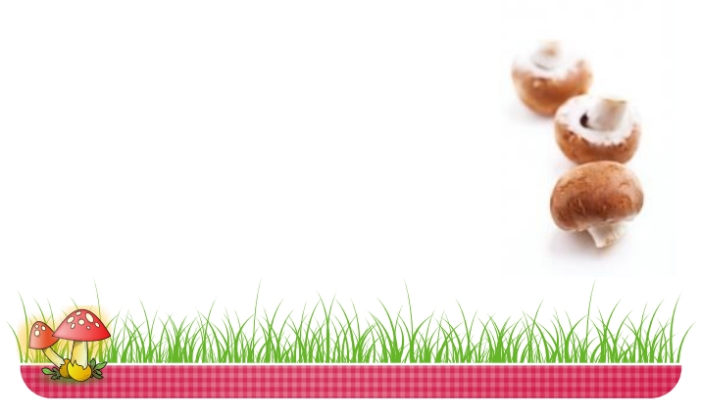
Mushrooms: Nature’s Hidden Treasures
Ergothioneine: An
important antioxidant
Ergothioneinie is a nat-
urally occurring antiox-
idant that protects the
body's cells against
oxidative stress which
may slow down the
aging process.
Mushrooms are the
richest source of
erogthioneinine. In
fact, one serving of
white, portabella, or
cremini mushrooms
provide around 2.8 -
Less colorful but still nutrient dense vegetables like mushrooms are
often ignored and more brightly colored vegetables and fruits are
often kept in the spotlight. This is unfortunate since mushrooms also
provide a wide range of essential nutrients.
Mushrooms are good sources of some B vitamins like Riboflavin or
Vitamin B2, Pantothenic acid or Vitamin B5, and Niacin or Vitamin
B3
These B vitamins play an essential role in the nervous system and
provide energy by breaking down carbohydrate, fat, and protein.
Mushrooms are also a good source of some important minerals like
selenium, potassium, and copper.
4.9mg of ergothi-
oneinine (Gerger 2013).
→
→
→
Selenium , an antioxidant, can keep the body ’s cells healthy
and prevent heart disease and cancer. Selenium also promotes a
strong immune system and fertility in men. Mushrooms are the
richest vegetable source of selenium . This is especially good news
for vegetarians since selenium is often found in animal foods .
Copper keeps our bones and nerves healthy. Moreover, copper
helps make red blood cells which carry oxygen throughout the
body.
Potassium helps control blood pressure since it helps maintain
normal fluid and mineral balance. It also helps the nerves, the
heart, and other muscles function normally.

Slide 5
Meaning of Mushrooms:
Mushrooms are the fruit bodies of edible fungi, commonly belonging to Basidiomycotina (Agaricus campestris, A. brunnescens, Pleurotus sajor-caju, Volvariella volvacea etc.) and rarely to Ascomycotina (Morchella conica, M. esculenta).
The mushrooms were used as food since long back, probably from 3000 B.C. as per ancient Indian literature.
Since that time, the mushrooms are being consumed in different countries like Greece, Egypt, France etc.
The Greeks and Romans described mushrooms as “food for the god”. During that period, people consumed the mush­rooms after collecting them from their natural habitat.

Slide 6
The cultivation was started in the early part of 18th century in France. In India, the first successful experimental cultivation of mushroom (A. bisporus) was initiated at Solan (Himachal Pradesh) in 1961.
Assessment of nutritional value of mush­rooms has been demonstrated that they comple­ment and supplement the human diet and these are considered as “delight of the diabetic”. Mushrooms have rightly been referred to as the “ultimate health food”.
But there is no definite test to confirm whether a mushroom is poisonous or edible.

Slide 7
Nutritive Value:
Mushrooms became popular for their food value. The food values of mushrooms are as follows:
Mushrooms are the richest source of vege­table protein.
The protein content varies from 1.1-4.98% in common cultivable mushroom (much higher than pulses, vegetables and fruits).
All the essential amino acids including lysine (550 mg/gm) are present in much higher amount than even egg.

Slide 8
Mushrooms contain sufficient quantities of mineral elements such as Na, K, Ca, P and Fe.
Mushrooms contain folic acid.
Mushrooms contain vitamins like B, C, D and K.
They contain little amount of fat (0.35- 0.65% dry wt.) and starch (0.02% dry wt.).

Slide 9
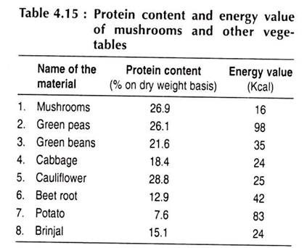
Different chemical contents of mushrooms and other foods are given in Table

Slide 11
Medicinal Value:
Most of the mushrooms have high medicinal value to reduce blood pressure, obesity (to be fatty), constipation, atherosclerosis (fat deposi­tion inside blood vessel) etc. Medicinal value of some mushrooms are given in Table 4.19.

Slide 12
Role of Fungi in Medicine:
Some fungi produce substances which help to cure diseases caused by the pathogenic microorganisms. These substances are called the antibiotics.
The term antibiotic, therefore, denotes an organic substance, produced by a microorganism, which inhibits the growth of certain other microorganisms. The most important antibiotics are produced by the moulds, actinomycetes or bacteria.
They are used to combat the evil effects of pathogenic bacteria and viruses. The use of antibiotics is not limited to disease treatment.

Slide 13
The addition to certain antibiotics in small amounts to the feed of slaughter animals promotes rapid growth and improves the quality of the meat products. Application of an antibiotic to surface of freshly killed poultry preserves the fresh-killed taste during long periods of refrigeration.
The discovery of antibiotic agents as drugs is comparatively a recent history. The role of fungi m producing antibiotic substances was first established by Sir Alexander Fleming in 1929.
He extracted the great antibiotic drug Penicillin from Penicillium notatum. It was the first antibiotic to be widely used. Penicillin is an organic substance lethal to microbes. It is far more effective than ordinary drugs and germicides.
It has no adverse effect on human protoplasm but kills bacteria especially gram-positive type

Slide 14
Streptomycin is obtained from Streptomyces griseus. It is of great value in medicine.
It destroys many organisms which are not killed by penicillin particularly the gram-negative organisms. A numbers of antibiotics have also been extracted from Aspergillus cultures.
However, these have not been proved so effective as penicillin.
Some of the actinomycetes which are not considered to be true filamentous bacteria are the sources of many antibiotics such as chloromycetin, aureomycin, terramycin, etc.

Slide 15
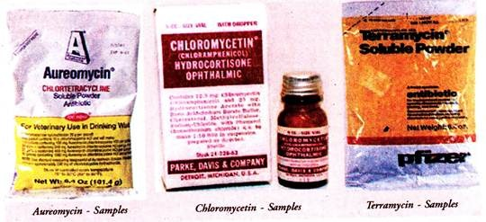
They inhibit the growth of many pathogenic bacteria and are also used successfully in the treatment of various virus diseases.
Many animal and human diseases which do not respond readily to other antibiotics are effectively cured by aureomycin.
The plasmodia of certain species of Myxogastres have been reported to yield soluble antibiotics. These check the growth of certain bacteria and yeasts in culture. The antibiotics play an important role to combat plant diseases as well.

Slide 16
Griseofulvin which is recovered from mycelium of Penicillium griseofulvum and many other species has antifungal properties.
It acts on the hyphae by interfering with wall formation Consequently the hyphal tips curl and cease to grow.
When administered orally it is absorbed into the body where it accumulates in the keratinized tissues of the epidermis and hair.
It is thus effective against fungal skin diseases such as ringworms and athlete’s foot disease.

Slide 17
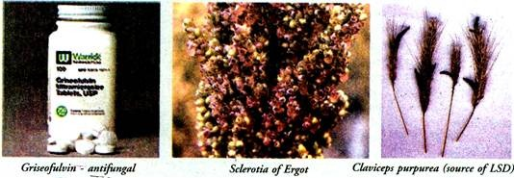
Claviceps purpurea produces sclerotia in the ovaries of the flowers of grasses such as rye The sclerotium is called the ergot of rye. Ergot is used in veterinary and human medicine.
It contains a mixture of alkaloids which cause rapid and powerful contractions of the uterus. The medicine is thus used to control bleeding during child birth. Ergot is highly poisonous. A derivative of ergot known by the name of lysergic acid (LSD) is used in experimental psychiatry.
The giant puff ball Clavatia contains an anti-cancer substance calvacin. The eating of these fungi prevents stomach tumours.

Slide 18
Role of Fungi as Food and as Food Producers:
Many species of fungi are edible, about 2000 species of them have been reported from all over the world..
Many edible fungi are of great economic value as food. They are regarded as delicacies of the table. There are said to be over 200 species of edible fungi.
The fructifications of some fungi such as the field mushroom Agaricus campestris (dhingri), Podaxon podaxis (Khumb), the honey coloured mushrooms, the fairy ring mushrooms, the puff balls (Lycoperdon and Clavatia), morels (Morchella, guchhi), and truffles are edible.
The content of available food in them is not high but they supply vitamins and are valuable as appetisers. Yeasts and some filamentous fungi are valuable sources of vitamins of the B-complex.

Slide 19
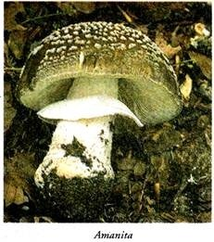
A few of the mushrooms are fatally poisonous, some cause only discomfort. To the former category belong Amanita.
The fungi are also important as producers of foodstuffs. Certain species of Penicillium are active in the refining of certain kind of cheeses. Some fungi, such as red bread mold, Neurospora sitophila and others, complete their sexual life cycle in a few days and thus make ideal organisms for the study of the laws of heredity.
The slime molds (Physarum polycephalum) are now widely used in research. P. polycephalum has proved an excellent experimental organism for the study of DNA synthesis, meiotic cycle and the mechanism of protoplasmic streaming.

Slide 20
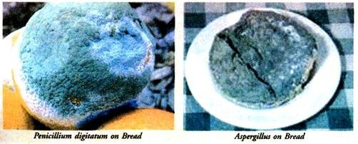
Many fungi are responsible for spoilage of food stuffs. Penicillium digitatum causes rotting of citrus fruits. Milk and milk products are spoiled and made unfit for human use due to the growth of several fungi such as Mucor, Aspergillus, Penicillium, Oidium and Fusarium Mucor mucedo and spp. of Aspergillus grow on bread and spoil it. Oidium lactis develops the fishy odour of butter causing damage to the butter.

Slide 21
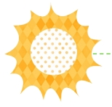
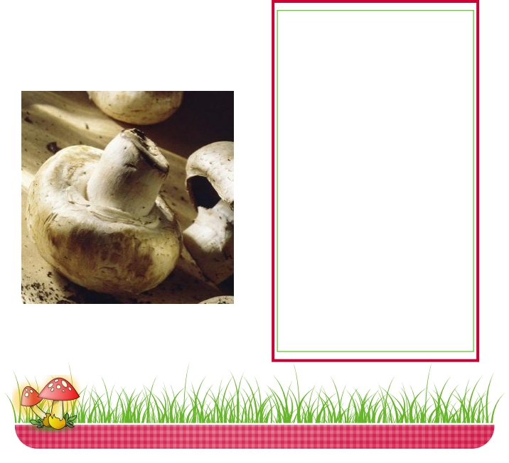
Mushrooms and Vitamin D
Vitamin D is important for strong and healthy bones since it helps us absorb the
calcium from our diet . Deficiencies in vitamin D can lead to soft, thin, and brittle
bones; a condition called osteomalacia in adults and rickets in children. However,
emerging research has suggested the role of vitamin D in various other conditions
like cancer, cardiovascular disease, hypertension, immunity, neuropsychological
functioning, physical performance, and reproduction. Limited sun exposure, darker
skin, and insufficient vitamin D levels in the diet can cause vitamin D deficiency.
Vitamin D is only present in a few
foods including: milk, fatty fish like
salmon, fortified cereal, and juice.
However, mushrooms are the only
food from the produce aisle that
have vitamin D. The vitamin D
content in mushrooms is often
increased by exposing them to
ultraviolet light, and these new
varieties of mushrooms are
available in grocery stores. In fact,
some light - exposed mushrooms
found in a few stores have up to
400 IU of vitamin D in 1 serving of
mushrooms (4 - 5 white button
cremini mushrooms or 1 portabella!)
(Vitamin D, 2010)

Slide 22
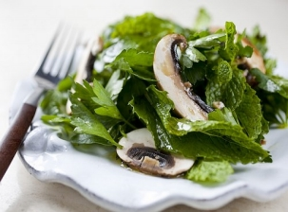
Weight Management and Satiety
Mushrooms are lower in calo-
ries and fat and are a great
substitute for red meat. In
addition, they are very filling
due to their meaty and ful-
filling nature!
A recent study in 2013 examined the effect
of substituting red meat with mushrooms.
The results of this interesting study showed
that the participants who consumed mush-
rooms instead of red meat showed more
weight loss, lower waist circumference,
lower blood pressure, and they were also
able to maintain their weight when
compared to the participants who ate red
meat! (Ren, Perera, and Hemar)

Slide 23
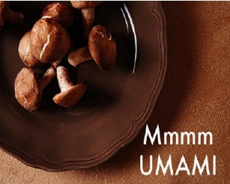
There’s more…….
Umami and Sodium
Mushrooms are a good source of umami,
the pleasant savory and ‘earthy’ taste.
Mushrooms are naturally low in sodium
and their umami flavor makes up for the
lack of saltiness. Hence, less salt can be
used in a dish with mushrooms without
compromising the taste. A collaborative
report from the Department of Nutrition
at Harvard School of Public Health and
the Culinary Institute of America
suggests cooking with foods rich in
umami, like mushrooms!
Additional Research
Mushrooms have long been considered as functional
foods. They are currently under research for their
effects on cancer. They have special bioactive com-
pounds called Beta - Glucans that have been known
to exhibit anti - tumor activity. However, more re-
search is needed and currently researchers are con-
ducting human clinical trials.

Slide 24
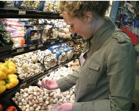
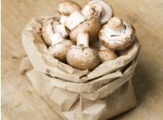
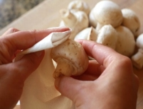
Selecting, Storing, and Cleaning Fresh Mushrooms
Selecting
•
•
•
•
•
•
Buy mushrooms that are firm and have a
smooth, fresh appearance.
The surface of the mushroom should be dry
enough but not too dried out and should
appear plump.
The veil under the mushroom indicates the
depth of flavor. If the veil is closed under the
cap then this indicates a delicate flavor.
If the veil under the cap is exposed then this
means a richer flavor.
Storing
Mushrooms can be refrigerated for up to 1
week in their original packaging
Once open, store in a paper brown bag for a
longer shelf - life; do not store in an air tight
container, which can cause spoilage due to
condensation.
•
•
•
•
Fresh mushrooms should never be frozen, but
cooked mushrooms can be frozen for up to a
month.
Cleaning
Brush away any dirt off fresh mushrooms using
a damp paper towel or your fingers.
Rinse under running water for a few seconds
and pat dry with a dry paper towel.
Mushrooms absorb water so never soak them!
•
Before using, trim the end of the stem.

Slide 25
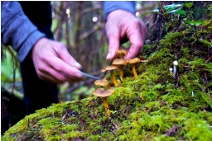
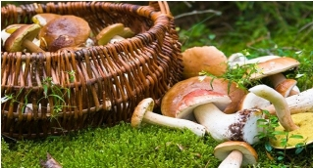
Mushroom Hunting and Safety
Mushrooms in the Wild
Never eat mushrooms in the wild unless they have been identified as safe to eat by a specialist or a mycologist.
Eating unsafe, wild mushrooms can result in toxic reactions ranging from mild gastric distress to hospitalization and even death.
It is advisable to cook the wild mushrooms thoroughly. Some mushrooms contain toxins that can be destroyed by cooking.
Young children, the elderly, and the sick should avoid wild mushrooms since they are generally more susceptible to toxic reactions than other people.
!

Slide 26
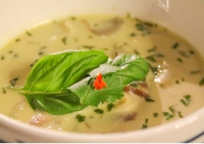
Nutrition in The News!
At Yale University, mushrooms were the secret
ingredient in a recent culinary competition. Twelve resi-
dential colleges competed in “Iron Chef style” where
they had one hour to make an appetizer and entrée
using mushroom as the main ingredient. The recipes
were judged by a panel of esteemed judges. The first
prize went to Berkeley College for their Thai Soup dish.
The second place was won by Branford College for their
Mushroom Risotto and Grilled Salmon with Caramel-
ized Mushrooms and Brussels Sprouts. Trumbull College
came in third with their Pesto Salmon with Couscous
and Mushroom Crepe.
The winning dish, Thai Soup. Picture Courtesy:
www.Mushroominfo.com
For more Information, Visit these great websites:
•
Fresh Mushrooms, www.mushroominfo.com/
•
Mushroom Council, Research and Information Website, www.mushroomcouncil.org/
•
For more great recipes, www.mushroominfo.com/search -recipes/
•
Easy Grown Mushrooms and Composting, www.easygrowmushrooms.com/
•
The Mycological Society of America, www.msafungi.org/
•
Academy of Nutrition and Dietetics, www.eatright.org/default.aspx

Slide 27
Thanks for watching
UNIVERSITY OF SARGODHA

