Slide 1
THERAPEUTIC DRUG MONITORING
Dosage forms and Dose interval Determination
Submitted to:
Dr. Shazia Akram
Ph.D Pharmaceutics

Slide 2
Submitted By: Muhammad Usman Khan Roll no. 02 PhD. Pharmaceutics 2019-22

Slide 3
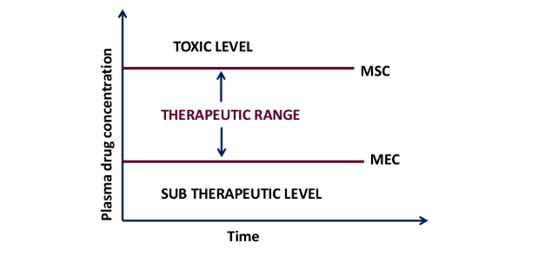
Therapeutic Drug Monitoring (TDM)
It refers to the measurement of drug concentrations in biological fluids with the purpose of optimizing a patient’s drug therapy.
TDM refers to the tool that is used to individualize dosage regimen by maintaining plasma or blood drug concentrations within the therapeutic range.

Slide 4
CRITERIA OF DRUGS IN TDM
Drug with narrow therapeutic index.
Drug should exhibit non-linear kinetics.
Drug should have a beneficial concentration response relationship between the blood drug concentration and pharmacological effects with respect to both efficacy and toxicity.

Slide 5
INDICATIONS
Drugs which have narrow therapeutic index
Drugs which exhibit poor and erratic response.
Drugs which exhibit relatively wider inter-individual variation in drug metabolism.
Patient exhibiting the signs and symptoms of toxicity (Theophylline intake and persistent nausea)

Slide 6
INDICATIONS
5. To minimize the risk of toxicity. 6. To identify the poison and to determine the severity. 7. Drugs for which signs of overdose or under dose are difficult to distinguish. 8. When patients are receiving multiple drug therapy.

Slide 7
CLINICAL APPLICATIONS
To confirm adequate serum concentrations where clinical response is inadequate. TDM can be used to maintain the minimum concentration required to exhibit efficacy.
To avoid drug toxicity.
To individualize dosing of some drugs with an unpredictable dose-response curve; Phenytoin
To assess medication compliance.

Slide 8
CLINICAL APPLICATIONS
To help predict a patients dose requirements.
To minimize the time period needed for dose adjustment.
To identify poisons and to assess the severity of poisoning on an emergency basis in a poisoned patient.
To assist dose adjustment in various disease states.

Slide 9
EXAMPLES OF DRUGS FOR TDM
Bronchodilators: Theophylline
Antibiotics:
Aminoglycosides: Gentamicin, Amikacin
Others: Vancomycin
Immunosuppressants: Cyclosporine
Anti-cancers: Methptrexate
Cardiac Drugs: Digoxin, Lidocaine
Psychoactive Drugs: Lithium, TCA

Slide 10
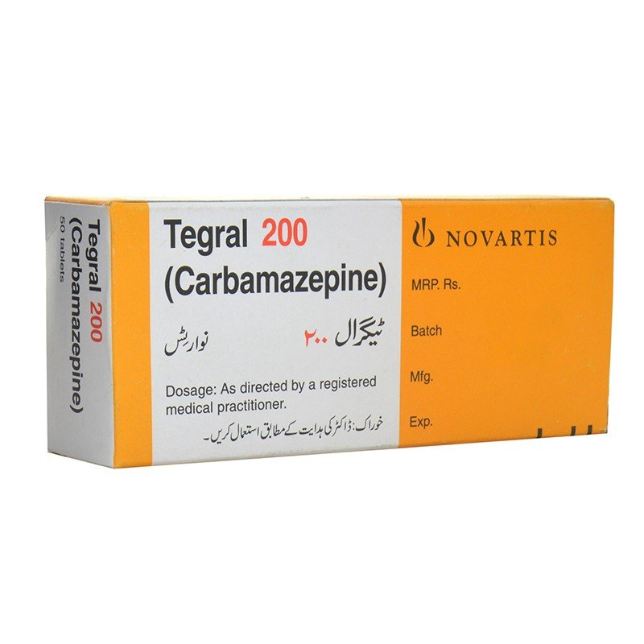
1. Carbamazepine
Dosage forms: Oral, Rectal
Plasma concentration-response relationship
<5 µg/mL: Sub-therapeutic effect
5 to 10 µg/mL: Therapeutic range
12 µg/mL or more: Toxic effects
Route of elimination: 98% hepatic metabolism with some active metabolites.

Slide 11
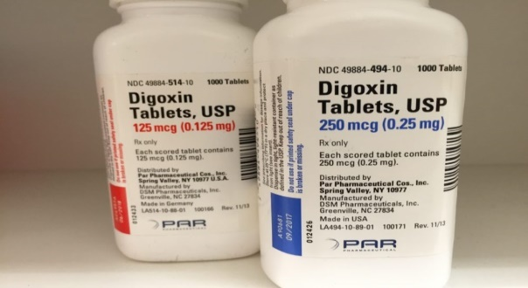
2. Digoxin
Dosage forms: Oral, intravenous infusion.
Major route of excretion: Mainly excreted unchanged in the urine.
Plasma concentration-response relationship
0.5 µg/L: No therapeutic effect
0.7 µg/L: Some increase in force of contraction of heart
0.8-2 µg/L: Optimum therapeutic range
2-2.5 µg/L: increased risk of toxicity
>2.5 µg/L: Gastrointestinal, Cardiovascular and CNS toxicity

Slide 12
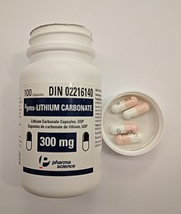
3. Lithium
Dosage form: Oral.
Plasma concentration-response relationship
< 0.4 mmol/L: Little therapeutic effect
0.4 to 1mmol/L: Optimum range for prophylaxis of mania
0.8-1.2 mmol/L: Optimum range for acute mania
1.2-1.5 mmol/L: Cause possible renal impairment
1.5-3 mmol/L: renal impairment, weakness, drowsiness, thirst and diarrhoea
3-5 mmol/L: confusion, spasticity, convulsions, coma and death.

Slide 13
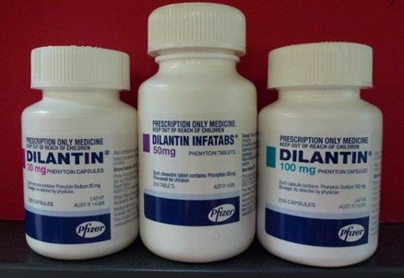
4. Phenytoin
Dosage form: Oral, slow intravenous injection (rate not exceeding 50mg/min).
Plasma concentration-response relationship
0.5 mg/L: No therapeutic effect
5-10 mg/L: Some anti-convulsant action
10-20 mg/L: Optimum concentration for anticonvulsant effect
20-30 mg/L: Nystagmus, blurred vision
>30 mg/L: Ataxia, drowsiness, coma
Major route of elimination: Hepatic

Slide 14
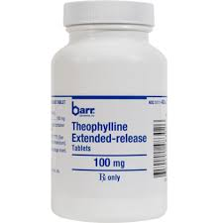
5. Theophylline
Dosage form: Oral
Plasma concentration-response relationship
<5 mg/L: No bronchodilation
5-10 mg/L: Some bronchodilation and possible anti-inflammatory action
10-20 mg/L: Optimum bronchodilation, minimum side effects
20-30 mg/L: increased incidence of nausea, vomiting and cardiac arrhythmias
>30 mg/L: Cardiac arrhythmias and seizures
Major route of elimination: 90% hepatic

Slide 15
References:
Clinical Pharmacy and Therapeutics, Roger-Walker and Cate Whittlesea.
Kang JS, Lee MH. Overview of therapeutic drug monitoring. The Korean journal of internal medicine. 2009 Mar;24(1):1.
Patsalos PN, Berry DJ, Bourgeois BF, Cloyd JC, Glauser TA, Johannessen SI, Leppik IE, Tomson T, Perucca E. Antiepileptic drugs—best practice guidelines for therapeutic drug monitoring: a position paper by the subcommission on therapeutic drug monitoring, ILAE Commission on Therapeutic Strategies. Epilepsia. 2008 Jul;49(7):1239-76.
Bertilsson L. Clinical pharmacokinetics of carbamazepine. Clinical pharmacokinetics. 1978 Apr 1;3(2):128-43.

