Slide 1
Goals of Psychology
Description
Prediction
Determine cause of behavior
Explain Behavior

Slide 2
Definition
Experimental psychology is an area of psychology that utilizes scientific methods to research the mind and behavior.
the branch of psychology concerned with the scientific investigation of the responses of individuals to stimuli in controlled situations.
a method of studying psychological phenomena and processes.

Slide 3
Experimental Psychologist?
A psychological scientist who:
primarily uses the experimental method to study behavior
answers questions about the when, where, and why of behavior by careful manipulation and control of relevant variables
carefully records and conducts quantitative analysis of the behavioral data
insists on the cautious and parsimonious interpretation of those empirical data in the light of both familiar and innovative theoretical interpretations

Slide 4
Science and Psychology
Psychologist tend to study thoughts and behaviors
Basic assumption:
there is an underlying reality to beh and thought that may be revealed through scientific inquiry
The human is a system that may be understood and explained through scientific experimentation and rational analysis of results of these experiments.

Slide 5
Applying assumptions of the scientific method to E.P
Order
Psychological and physical nature is ordered;
Phenomena are related systematically
Events follow an orderly sequence (e.g., preparation of exams then good grades)
Determinism
All events have a cause
Difficult to assess whether actually an IV caused DV
Empiricism
Relying on observation and experimentation, through scientific method
Not all empirically collected data are valid
If data are selected to support a previous information; only supporting data is gathered
Scientists is unaware of the causes
Parsimony
Things are related in most simple way. therefore, most simple explanation is considered
Law of parsimony: things are usually connected or behave in the simplest or most economical way, especially with reference to alternative evolutionary pathways

Slide 6
History of experimental psychology
HowE.P evolved

Slide 7
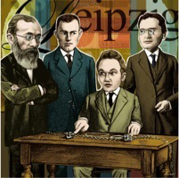
Wundt; A father of Experimental psychology?
Year of birth of EP: 1879
Place of Birth: the University of Leipzig
Parent: Wilhelm Wundt
Purpose: unofficial explorations of study of mind and behavior through from empirical, accepted science
But is this the actual case?

Slide 8
Foundations of Experimental Psychology
Calls for more empirical physics-emulating psychology came thick and fast around 1750s.
The books of various scientists called for application of the empirical attitudes found in other branches of science whether physics, or botony etc.
These books refered to some early quantitative experiments on sensory phenomenon
These attempted to change psy from a branch of old natural philosophy into an independent empirical science

Slide 9
Gustav Fechner
First experimenter in psychology as early as 1839
the law of the connection between the mind and the body can be found in a statement of quantitative relation between mental sensation and material stimulus
Weber–Fechner law
In order that the intensity of a sensation may increase in arithmetical progression, the stimulus must increase in geometrical progression.
three methods for finding the difference between two separate sensations:
just noticeable differences,
right and wrong cases, (method of constant stimuli)
average error
The techniques he invented opened the door to the scientific study of mind, combining manipulation of quantifiable, physical, stimuli with subjective reports of stimulus perception. The success of this approach influenced Wilhelm Wundt.

Slide 10
Weber
Founder of sensation, physiology and psychophysics
Just Noticeable difference
Weber’s Law
The law states that the change in a stimulus that will be just noticeable is a constant ratio of the original stimulus. It has been shown not to hold for extremes of stimulation.

Slide 11
Wilhelm Wundt
According to Wundt, psychology was a science of conscious experience and that if you became a trained observer, you could tell precisely about emotions, thoughts and feelings through a process he called introspection.
First laboratory
In 1883, award its first doctoral degree, to the first of Wundt’s advisees, Max Friedrich
Wundt’s experiment with reaction time
The reaction time was one of the earliest and most important experiments in experimental psychology. It measured how long it takes an individual to respond to different stimuli. The experiment needs three devices – device for presenting stimulus (a sound, a light, a word), device for responding (a hand key, a voice key, or knee jerk), and device for measuring the time between the stimulus and the response.

Slide 12
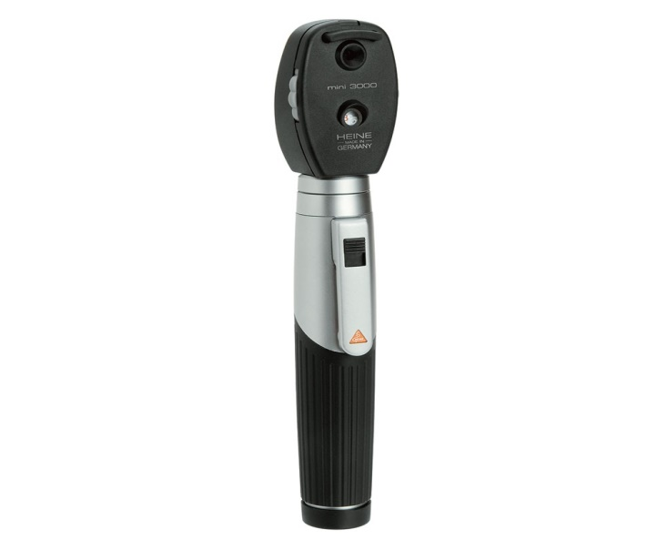
Hermann von Helmholtz
Speed of neural impulse
measurable physical stimuli and their correspondent human perceptions
Helmholtz measured the speed at which the signal is carried along a nerve fibre.
Opthalmascope
an instrument used to examine the inside of the human eye
Trichromatic theory of colour vision
there are three receptors in the retina that are responsible for the perception of color
Blue (short-wavelength), Green (Medium wave length), and red (long-wave-length)
people are able to distinguish between as many as seven million different colors

Slide 13
Pierre Flourens
damaging different parts of animals’ brains resulted in various types of movement deficits
Flourens pioneered the experimental method of carrying out localized lesions of the brain in living rabbits and pigeons and carefully observing their effects on motricity, sensibility and behavior. His intention was to investigate localisationism, i.e., whether different parts of the brain had different functions
experiments led Flourens to the conclusion that the cerebral hemispheres are responsible for higher cognitive functions, that the cerebellum regulates and integrates movements, and that the medulla controls vital functions, such as circulation, respiration and general bodily stability. On the other hand, he was unable (probably because his experimental subjects have relatively primitive cortices) to find specific regions for memory and cognition, which led him to believe that they are represented in a diffuse form around the brain. So, different functions could indeed be ascribed to particular regions of the brain, but that a finer localization was lacking.

Slide 14
Paul Broca
who demonstrated that damage to a specific area of the brain (which now bears his name) results in a loss of speech—but not a loss of understanding
His work revealed that the brains of patients suffering from aphasia contained lesions in a particular part of the cortex, in the left frontal region. This was the first anatomical proof of the localization of brain function.

Slide 15
J. B. Watson
According to John Watson, psychology should be the science of observable behavior
the "Little Albert" experiment,

Slide 16
B. F. Skinner
Principles of reinforcement
operant conditioning chamber,
A pigeon is brought to a stable state of hunger by reducing it to 75 percent of its weight when well fed. It is put into an experimental cage for a few minutes each day. A food hopper attached to the cage may be swung into place so that the pigeon can eat from it. A solenoid and a timing relay hold the hopper in place for five sec. at each reinforcement.

Slide 17
Ivan Pavlov
Classical conditioning
Experiment of dog

Slide 18
Experimental Psychology Today
Given advances and the diversification and specialization of psychological science, fewer psychologists today would use the general term “experimental psychology” to describe their primarily field of study.
Some might not even use the phrase “psychologist” in describing themselves!
They might call themselves a behavioral neuroscientist, a cognitive neuroscientist, a sensory scientist, a cognitive scientist.
They might describe their field of study as sensation, perception, comparative cognition, animal learning, cognition, memory, psycholinguistics, etc.

