Slide 1
Specialized Chromosome Structures
Two DNA structures that provided early information about chromosome organization are the
Polytene chromosome and the
Lampbrush chromosome

Slide 2
Giant Chromosome
Certain tissues salivary gland, gut epithelium,
Two hundred times larger
Discovered by Balbiani, 1881
Homolgue integrated together

Slide 3
Polytene Chromosome
They are composed of several strands of DNA side by side produced when the DNA undergoes many rounds of replication without separating.

Slide 4
Polytene Chromosome
Specialized chromosome found in fly larvae. It is actually a pair of
homologues, which is unusual (chromatin is the norm)

Slide 5
Polytene chromosome
Five long and one short arms deeply
Centromeric region and Y chromosome of male drosophilla
Chromosome IV forms chromocentre, long arm X chromosome,
Chromosome II, and III
Total length 2000µ as compared to 7.5 µ
Total 5000 bands, thickness about 0.05-0.5 µ
1,024 strands of DNA representing 8-10 rounds of replications

Slide 6
Band
Genes are located within band
Band had increased diameter with rest of chromosome arms and thus called as “PUFF” or Balbiani ring
The strands present in bands undergo local uncoiling, called a puff.
Some hormone called as ecdysome induce “Puff”
Puffs are areas of high transcriptional activity.

Slide 7
Polytene Puff

Slide 8
Lampbrush Chromosome
Chromosome characteristic of vertebrate oocytes.
They are found during the diplotene stage of Prophase I in meiosis.
They are synapsed homologue pairs that do not condense like regular chromosomes.
More than one pair of loop upto 9 extend from chromosome
800- 1000 µ in length, 30 times less packaged

Slide 9
Lampbrush Chromosome
They are composed of a center strand (two strands of DNA) with lateral loops (one strand of DNA).
The lateral loops are transcriptionally active.

Slide 10
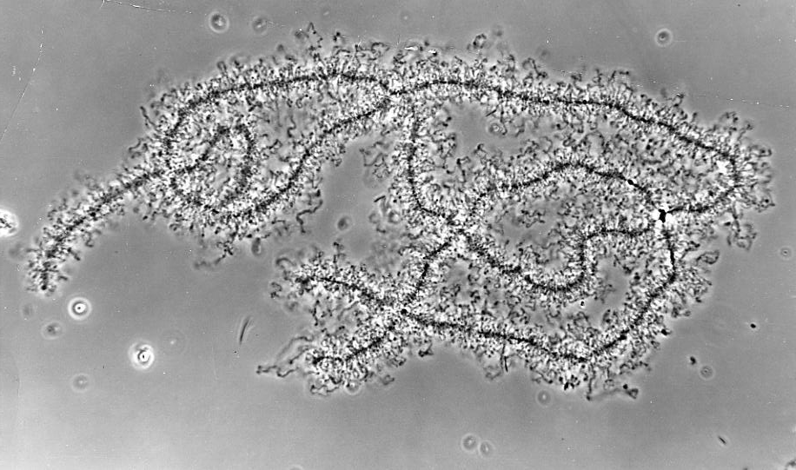
Lampbrush Chromosome

