Slide 1
RSA and KEY MANAGEMENT

Slide 2
RSA
The RSA scheme
􀂉Key generation
􀂄Choose two odd primes p,q –keep private
􀂄Compute n=pq–make public
􀂄Choose e, 1<e<φ(n) with gcd(φ(n),e)=1 –make public
􀂄Compute d≡e-1mod φ(n) –keep private
i.e find d such that phi divides ed-1.
􀂄Private key is {d,n}
􀂄Public key is {e,n}
􀂉Encryption
􀂄Plaintext: block of k bits, where 2k<n≤2k+1–can be considered a number M with M<n
􀂄Ciphertext: C=M^emod n
􀂉Decryption:
􀂄Ciphertext: C
􀂄Plaintext: C^dmod n = Mdemod n = M

Slide 3
RSA Example
Select primes p=17, q=11
􀂉Compute n=pq=187
􀂉Compute φ(n)=(p-1)(q-1)=160
􀂉Select e=7
􀂉Compute d: d=23 (use the extended Euclid’s algorithm)
􀂉KU={7,187}
􀂉KR={23,187}
􀂄Encrypt M=88: 88^7mod 187
􀂉88^7mod 187 = 11
􀂄Decrypt C=11: 11^23mod 187
􀂉M=11^23 mod 187=88
Further read RSA topic from ch 31 DCN behrouz

Slide 4
Symmetric-Key Distribution
Symmetric-key cryptography is more efficient than asymmetric-key cryptography for enciphering large messages
If Alice needs to exchange confidential messages with N people, she needs N different keys. What if N people need to communicate with each other?
A total of N(N− 1) keys is needed if we require that Alice and Bob use two keys for bidirectional communication; only N(N− 1)/2 keys are needed

Slide 5
Problem
The number of keys is not the only problem; the distribution of keys is another. If Alice and Bob want to communicate, they need a way to exchange a secret key; if Alice wants to communicate with one million people, how can she exchange one million keys with one million people?

Slide 6
Key-Distribution Center: KDC
A practical solution is the use of a trusted third party, referred to as a key-distribution center (KDC). To reduce the number of keys, each person establishes a shared secret key with the KDC
1. Alice sends a request to the KDC stating that she needs a session (temporary)secret key between herself and Bob.
2. The KDC informs Bob about Alice’s request.
3. If Bob agrees, a session key is created between the two.

Slide 7
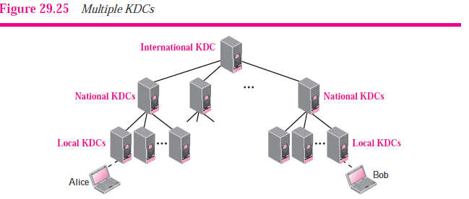
Multiple KDCs
When the number of people using a KDC increases, the system becomes unmanageable and a bottleneck can result. To solve the problem, we need to have multiple KDCs. We can divide the world into domains. Each domain can have one or more KDCs (for redundancy in case of failure)

Slide 8
Authentication using Kerberos
Kerberos is an authentication protocol used in many systems, including Windows 2000, using the KDC-based approach
􀂉Kerberos was the name of a multi head dog in Greek mythology that used to guard the entrance to Hades
􀂄Designed at MIT to allow workstation users to access network resources securely
􀂉As such, it relies on the assumption that all clocks are fairly well synchronized
􀂄Kerberos v4 is the most widely used version –the one we discuss here
􀂄Includes three servers that communicate with Alice (at the workstation)
􀂉Authentication server (AS) –verifies the user during login
􀂄It shares a secret password with each user (plays the role of the KDC)
􀂉Ticket-granting server (TGS) –issues “proof of identity tickets”
􀂄Tickets will be used by the user to perform various jobs
􀂉Bob the server –actually does the work Alice needs to do, based on the identity ticket
􀂄Based on the identity ticket will grant Alice the right she is entitled to

Slide 9
Authentication using Kerberos
A sits down at an arbitrary public workstation and types her name
􀂉Workstation sends her name to the AS in plaintext
AS sends back a session key KS and a ticket KTGS(A,KS) for TGS –both encrypted with A’s secret key
􀂉At this point the workstation asks for A’s password
􀂄Password is used to generate the secret key and decrypt the message, obtaining the ticket for TGS

Slide 10
Authentication using Kerberos

Slide 11
Authentication using Kerberos
A tells the workstation she needs to contact the file server Bob
3. Workstation sends a message to TGS asking for a ticket to use Bob
􀂉Key element here is the ticket for TGS received from AS –this proves to TGS that the sender is really A
4. TGS creates and sends back a session key KAB for A to use with B
􀂉TGS sends a message encrypted with KS so that A can read and get KAB
􀂉TGS also includes a message intended only for Bob, sending A’s identity and the key KAB
􀂄If Eve replays message 3 she will be foiled by the timestamp t
􀂉Even if she replays the message quickly she will only get a copy of message 4 that she cannot read
5 Alice can now communicate with Bob using KAB
Bob confirms he has received the request and is ready to do the work

Slide 12
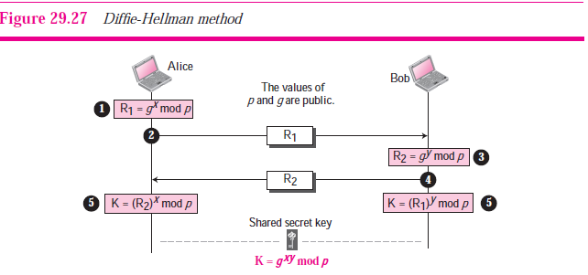
Diffie-Hellman Key Agreement
In the Diffie-Hellman protocol two parties create a symmetric session key without the need of a KDC. Before establishing a symmetric key, the two parties need to choose two numbers p and g.

Slide 13
The steps are as follows:
1. Alice chooses a large random number x such that 0 ≤ x ≤ p − 1 and calculates
R1 = g^{x} mod p.
2. Alice sends R1 to Bob. Note that Alice does not send the value of x; she sends only
R1.
3. Bob chooses another large random number y such that 0 ≤ y ≤ p − 1 and calculates
R2 = g^{y} mod p.
4. Bob sends R2 to Alice. Again, note that Bob does not send the value of y, he sends only R2.
5. Alice calculates K = (R2)^{x} mod p. Bob also calculates K = (R1)^{y} mod p.

Slide 14
Example
Let us give a trivial example to make the procedure clear. Our example uses small numbers, but note that in a real situation, the numbers are very large. Assume that g = 7 and p = 23. The steps are as follows:
1. Alice chooses x = 3 and calculates R1 = 7³ mod 23 = 21.
2. Alice sends the number 21 to Bob.
3. Bob chooses y = 6 and calculates R2 = 7⁶ mod 23 = 4.
4. Bob sends the number 4 to Alice.
5. Alice calculates the symmetric key K = 4³ mod 23 = 18. Bob calculates the symmetric key K = 21⁶ mod 23 = 18.
The value of K is the same for both Alice and Bob; g^{xy} mod p = 7¹⁸ mod 23 = 18.

Slide 15
Public-Key Distribution
Public Announcement
Bob can put his public key on his website or announce it in a local or national newspaper
it is subject to forgery.
Certification Authority
Bob wants two things; he wants people to know his public key, and he wants no one to accept a forged public key as his.

Slide 16
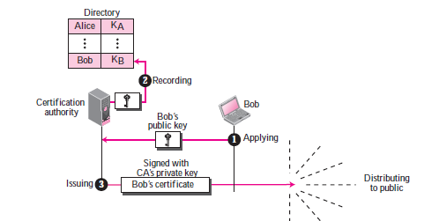
Bob can go to a certification authority (CA), a federal or state organization that binds a public key to an entity and issues a certificate
X.509
Each certificate may have a different format. Anything that needs to be used universally must have a universal format. ITU has designed X.509 recommendation that has been accepted by the Internet with some changes. X.509 is a way to describe the certificate in a structured way

