Slide 1
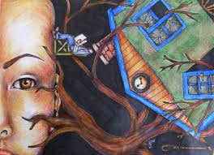
THE HOUSE-TREE-PERSON TEST

Slide 2
Types of Psychological Testing
Objective Tests
A test consisting of factual questions requiring extremely short answers can be quickly and unambiguously scored by anyone with an answer key, thus minimizing subjective judgments by both the person taking the test and person scoring it.
Projective Tests
Any psychological test the subject is asked to respond to vague material. It is thought that unconscious ideas are thus projected, which when the responses are interpreted, reveal hidden aspects of the subject’s personality.
Examples: word association tests, inkblot tests, sentence completion tests, storytelling in response to pictures, the thematic apperception tests (TAT).

Slide 3
House-Tree-Person Projective Drawing Technique

Slide 4
History of House-Tree-Person Projective Drawing Technique
The House-Tree-Person (H-T-P) projective technique developed by John Buck.
The House-Tree-Person was developed in 1948 and updated in 1969.
These test was designed to measure personality’s aspects, was originally based on Goodenough scale of intellectual functioning. The H-T-P is both qualitative and quantitative measurement of intellectual ability.
The administration and scoring manual is consist of 350 pages because the scoring and interpretation is mostly subjective which is difficult.

Slide 5
Purpose of H-T-P
The test is a diagnostic tool for clinical psychologists, educators, and employers
Measure aspects of a person’s personality.
Assess brain damage and general mental functioning.
Projecting inner world onto the page.
Measure overall neurological functioning in brain.

Slide 6
Description to Use with
Use in combination with other projective measurement instruments, usually given first as an “ice-breaker”
Test taker should be over the age of three, mostly children and adolescents because this test requires drawing.
The test usually requires 150 minutes but take less time with normally functioning adults and much more time neurologically impaired individuals.
Especially appropriate for individuals who are non-English-speaking, culturally different, educationally deprived, or developmentally disabled

Slide 7
Precautions
It is mostly subjective,
Scoring and interpreting the HTP is difficult.
Anyone administering the HTP must be properly trained.
The test publishers provide a detailed 350-page administration and scoring manual.
Use three pieces of plain white 8.5x11 paper.

Slide 8
Administration
Phases
First phase
Second phase

Slide 9
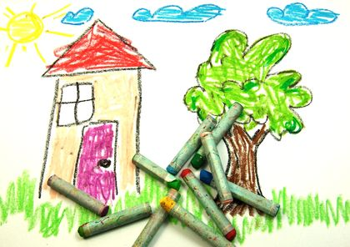
First Phase
Test takers are asked to use a crayon to draw pictures of a house, a tree, and a person.

Slide 10
First Phase
Each drawing is done on a separate piece of paper and the test taker is asked to draw as accurately as possible.
Upon completion of the drawings, test takers are asked questions about the drawings.
There are a total of 60 questions that examiners can ask.
Examiners can also create their own questions or ask unscripted follow-up questions.

Slide 11
Questions
Ask questions after each picture is drawn:
House
Who lives here?
are they happy?
What goes on inside?
What's it like at night?
Do people visit here?
What else do the people in the house want to add to the drawing?

Slide 12
Questions
Tree
What kind of tree is this?
How old is it?
What season is it?
Has anyone tried to cut it down?
What else grows nearby?
Who waters the tree?
Trees need sunshine to live so does it get enough sunshine?

Slide 13
Questions
Person
Who is this person?
How old are they?
What's their favorite thing to do?
What's something they do not like?
Has anyone tried to hurt them?
Who looks out for them?

Slide 14
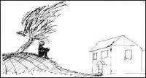
Second Phase
During the second phase of the test, test takers are asked to draw the same pictures with a pencil.

Slide 15
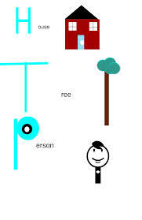
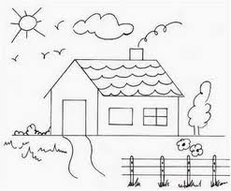
Second Phase
The questions that follow this phase are similar to the ones in the first phase.
Some examiners give only one of the two phases, choosing either a crayon, a pencil, or some other writing instrument.

Slide 16
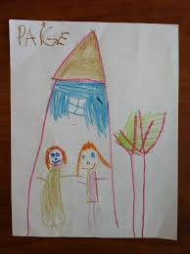
Variation
One variation of test administration involves asking the individual to draw two separate persons, one of each sex.

Slide 17
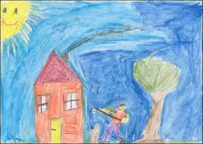
Variation
Another variation is to have test takers put all the drawings on one page.

Slide 18
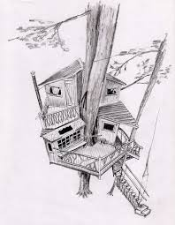
How to Start
Use three pieces of plain white 8.5x11 paper, give the first and say "Here I want you to draw as good a house as you can "

Slide 19
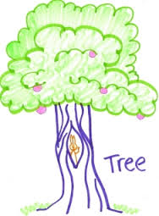
How to Start
Question, give the next sheet. "Draw as good a tree as you can"

Slide 20
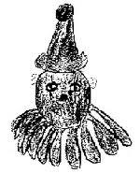
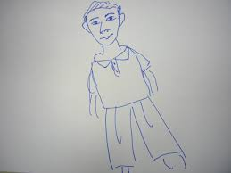
How to Start
Question, give the next sheet. "Draw as good a person as you can," (if a profile or head only, say, "Wait, I want you to draw a whole person, not just the head or profile").

Slide 21
Drawing Analysis
Drawings are interpreted using two “paths”; intra-subjective and inter-subjective
First path, intra-subjective, considers the content and quality of the three drawings; also explores the depth of material behind the drawing
Lack of many details, incomplete wholes, and use of very faint lines are a combination found in subjects who are deeply depressed.

Slide 22
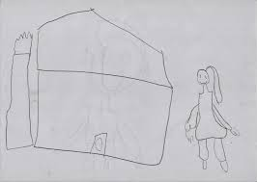

Slide 23
Drawing Analysis
II. A ground line sloping downward and away from the drawn whole on either side may reflect a feeling of isolation, exposure, and helplessness in the face of environmental pressures.
Second path, inter-subjective, considers features indicative of a certain emotional tendency

Slide 24
House interpretations
Associations concerning home-life
Interfamilial relationships
Attitude toward their home situation (children)
Relationships to parents and siblings
Married adults
A very small house might indicate rejection of one's home life

Slide 25
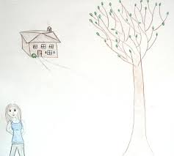

Slide 26
Lines and walls
the walls might represent the test taker's degree of ego strength
Represent boundaries and strengths of the ego,
Weak lines in the structure of the house are weaknesses in the ego,
Strong lines are problems with anxiety and a need to reinforce boundaries.

Slide 28
Roof
The roof might represent one's intellectual side
Symbolizes the fantasy life, and
Extra attention to it can indicate extra attention to fantasy and ideation,
An extremely large roof suggests that a person is highly withdrawn or extremely involved with an inner world fantasy.

Slide 29
Roof
If windows are drawn on the roof, the person might tend to view the environment through a world of fantasy images.
While incomplete, tiny, or burning roofs can indicate avoidance of overpowering and frightening fantasies (think about fears of ghosts in the attic - these are based on the association for us) a highly constricted, concrete orientation.

Slide 31
Windows and doors
The doors and windows are the portions of the house that relates to the outside world.
Small bolted' up houses, or barred windows are doors suggest that the person might be withdrawn, and inaccessible, or possibly suspicious or even hostile.
This is further exaggerated if the doors and windows are entirely missing.
An open door and/or many windows suggest strong needs for contact with others. are all ways that others enter or see into the house, they relate to openness , willingness to interact with others, and ideas about the environment.

Slide 32
Windows and doors
However, if the indicators of openness are overdone, the person might be highly dependant.
Very large windows , especially in the bedroom, or bathroom, suggests exhibitionism.
The absence of windows on the HTP, in combination with several other features such as enlarged heads, absence of feet, and extremely geometric figures, have frequently been found in the drawings of abused children

Slide 34
Pathways
Pathways that are wide and lead directly to the door suggest the client is accessible, open and direct.
In contrast, the absence of a pathway indicates the client may be closed, distant removed.
Pathways that are long, and winding may reflect someone who is initially aloof, but can later warm up and become accessible.
If the pathway is extremely wide, the client might initially express a superficial sense of friendliness but later become aloof and distant.

Slide 35
Pathways
The presence of Fences suggests defensiveness.
If many irrelevant details are included, the client might be indicating strong needs to exercise a high degree of structure over his or her environment, perhaps because of an inner sense of insecurity
hades, shutters, bars, curtains, and long and winding sidewalks indicate some unwillingness to reveal much about yourself (think about expression like windows to the soul or the door to the mind).

Slide 37
Chimney
A chimney can relate either to a person’s availability and warmth, or the degree of power and masculinity he or she feels.
A missing chimney suggests passivity or a lack of psychological warmth in a person’s home life.
Whereas normal amounts of smoke highlight warmth in the home.
An excessive amount of smoke suggest inner tensions , pent-up aggression, emotional turbulence, and conflict.
However, interpretations or chimneys need to take into consideration biasing factors, such as geography (e.g., tropics)and season (summer vs. winter).

Slide 38
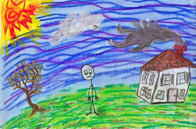

Slide 39
Accessories of the House
Cars could be signs of visitors coming or people in the home leaving.
Lights could be signs to welcome visitors or reveal prowlers.
Locks and knobs Defensive personality and poor interpersonal relationship with siblings
Sun Need of warmth and attraction

Slide 40
Accessories of the House
Mountain Show depression and anxiety, some sort of sexual role conflict in female and in males it is breast fixation.
WATER PONDS Need of having sexual relations at unconscious level.
DOUBLE STORY HOUSE Double standards of the person.
BACK DOOR: Shows some secretes in life and don’t want to express these, also guilt feelings in males shows sexual relations.
LAWN AND FLOWERS Some sort of pleasant personality, good interpersonal relations. Person is satisfied family life.

Slide 41
Accessories of the House
COMPARTMENTS MEANS ROOMS: Tight boundaries at home.
TIGTHLY LOCKED DOORS: Pathological tendency, tight boundaries at home.
BARS ON WINDOWS: Higher level of pathological tendency.
SHADING: Anxiety, depression.
KITCHEN: Also indicate warmth and affection, in some cases shows nourishment.
DOUBLE HOUSE: Psychotic personality, dual personality in forensic cases

Slide 42
Accessories of the House
SNOW ON ROOF: Indication of severe depression.
PERSON WALKING ON WALKWAY TOWARD HOME: Good interpersonal relationship.
WALKING AWAY FROM HOME: Poor interpersonal relationship.
SWINGS, CARS, POTS ETC..: Good interpersonal relations.
BIRDS: Anxiety
CLOUDS, SKY (SHADING): Anxiety
SWING WITHOUT CHILD: Issue

Slide 43
Psychotics
Psychotics tends to show
ground lines (their need for grounding),
clear visions of the insides of the house (they believe their thoughts and mind are open to view by others),
strange angles (like their strange thought processes), or
a house on the verge of a collapse (like their ego).

Slide 44
Tree interpretations

Slide 45
Tree interpretations
The tree has been the symbol for life and growth.
A tree that has a slender trunk but has large expansive branches might indicate a need for satisfaction.
The branches might indicate the test taker's relation to the outside world and the trunk might indicate inner strength.

Slide 47
Tree interpretations
Initially, a general impression of the tree can be obtained by noting its overall feel and tone. Based on this impression, an idea of the relationship the person has with his or her environment can be obtained.
If the tree is withered by the environment it might reflect a person who has been broken by external stress.
A tree with no branches suggests the person has little contacted with people.

Slide 49
Tree interpretations
SPLIT: Spilt in ego, dual personality
CLOUD LIKE TREE: Confused thinking.
HUMAN LIKE TREE OR BUG LIKE TREE: Tendency of schizophrenia and high pathological risk
FRUIT AND FLOWER: Strong tendency to have children
MORE BEAUTIFICATION: Very high tendency to have children.
BASELINE: Strong thinking, desire to be independent.

Slide 50
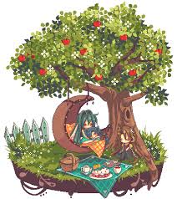

Slide 51
The trunk
The trunk can be seen as representing inner strength, self-esteem, and intactness of personality.
The use of faint sketchy lines to represent the trunk indicates a sense of vulnerability, passivity, and insecurity.
These same concerns might also be represented by shading on the trunk, or lines that are heavily reinforced (defensiveness) or perforated.
Scars or knot-holes suggest traumatic experiences, and the age when the trauma occurred can often be determined by the relative height of the scar or knot-hole (i.e., a knot-hole halfway up the trunk, drawn by a ten year‘s old suggests the trauma occurred at age five).

Slide 52
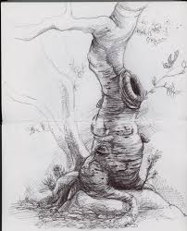

Slide 53
The trunk
Very thin trunks suggest a unstable level of adjustment.
If the bark on the trunk is drawn very heavily, it suggests anxiety! bark that is extremely carefully drawn might reflect a rigid, compulsive personality.
If the tree is split down the middle, a sever disintegration of the personality is suggested
small trunks are limited ego strength,
large trunks are more strength... (think about the saying that a tree that bends lasts through the wind, but one that doesn't snaps, like the ego that is flexible and healthy lasts through the world, but the inflexible and neurotic ego ends up broken).

Slide 55
Limbs
Limbs are the efforts our ego makes to "reach out" to the world and support "things that feed us" what we need.
Limbs detached are
difficulties reaching out, or
efforts to reach out that we can't control.
Small branches are limited skills to reach out,
While big branches may be too much reaching out to meet needs.

Slide 57
Branches
The branches function as a means by which the tree extends itself out into and related to its environment.
They reflect a person’s growth and degree of perceived resource.
If the branches are moving upward, the person might be ambitious, and “reaching” for opportunities.
Theresa downward reaching (weeping willows) branches suggest low levels of energy.
Branches that are cut represent a sense of being traumatized, and dead branches indicate feelings of emptiness, and hopelessness.

Slide 58
branches
Tiny branches suggest that the person experiences difficulty getting attention from his or her environment, and small branches might represent either new personal growth or psychological immaturity.
If a tree house is drawn in the branches, the person might be expressing a need to escape from a threatening environment.
Big branches may be too much reaching out to meet needs.
Club shaped branches or very pointy ones represent aggressiveness.
Gnarled branches are "twisted" and represent being "twisted" in some efforts to reach out.

Slide 60
Leaves
Leaves are signs that efforts to reach out are successful
leaves growing mean the tree is reaching out to the sun and getting food and water.
No leaves could mean feeling barren,
Leaves detached from the branches mean the nurturing we get is not very predictable.
Pointy leaves could be aggression, obsessive attention to detail on the leaves could be Obsessive Compulsive tendencies.

Slide 62
Root
The roots refer to the person’s hold on reality but also reflect a relationship to the past issues.
If a person’s is having a difficult time “getting a grip” on life, the roots my be small and ineffective, or the drawing might compensate by making them piercing.
No roots can mean insecurity and no feeling of being grounded,
Overemphasized roots can be excessive concern with reality testing,
Dead roots often indicate emptiness, and anxiety consistent with obsessive-compulsive, especially if there us excessive detailing in other areas.

Slide 63
Roots

Slide 64
Other details
Christmas trees after the season is over can mean regressive fantasies (thinking about holidays and family and good times to make yourself feel better).
Knots or twists in the wood, like gnarled limbs, indicate some part of the ego is twisted around some issue.
Knotholes are an absence of trunk, and thus an absence of ego control.
Sometimes they are seen as indicating a trauma,

Slide 65
Other details
Height up the tree represents the age of the trauma (so, halfway up for a 10 year old is at age 5).
Squirrels and small animals are an Id intrusion into an area free from ego control.
Research does show that weeping willow trees are more common in depressed people.
People with high needs for nurturance draw apples.

Slide 66
Person interpretations
A drawing of a person that has a lot of detail in the face might indicate a need to present oneself in an acceptable social light.

Slide 67
Person interpretations
Here, the idea is that the person of the same sex is like you, and the person of the opposite sex is what you may not admit is like you, the opposite sex is the anima or animus.
Typically, the person is centered or just below vertical center on the page, is symmetrical, pleasing to look at, and sufficiently detailed. They tend to be clothed, although pregnant women or women who have recently given birth may draw naked women, and women having recently seen the gynecologist may draw naked women.

Slide 68
Erasures led to improvements, and the person seems contented with the drawing, perhaps laughing at it a bit. Usually the same-sex person is drawn first, and the opposite-sexed person second.
Drawing the opposite-sex first as a sign of gender confusion, which has not been well-supported.

Slide 69
Arms and hands
Arms are the way we reach out to the environment
Open arms indicate willingness to engage,
closed arms are defensiveness, disconnected arms are powerlessness
Hands are the way we effect it.
pointed fingers or balled fists can be aggression,
hidden or gloved hands can be anxiety or antisocial tendencies... It could also be difficulty drawing good hands.

Slide 70
Legs and feet
Legs and feet are also like the roots of trees,
represent grounding and power too.
If cut off at the bottom of the paper (think of cutting someone off at the knees) it can mean loss of autonomy,
small feet (inadequate base) can indicate a need for security,
big feet can indicate the same.

Slide 71
neck
The neck separates the head (cognition) from the body (drives and needs), so
no neck is no separation,
long neck is desire for more separation of the two, etc...

Slide 72
Mouth
Mouth is how we get needs met (think Freud and oral stuff),
Big or open mouth is neediness, cupid bow o
Luscious lips is sexualized needs,
Closed tight mouth is denial of needs or some passive-aggression, and frowns, sneers, and
Smiles mean with they do in real life.
There is limited support for oral-dependency themes, and more for slash mouths and teeth to be consistent with verbal aggression

Slide 73
Genitalia, breasts, etc... are seldom drawn, and indicate sexual concerns and discomfort.
Emphasis on breasts though are not uncommon in prepubescent girls, and both disturbed and non-disturbed boys emphasize pectorals.

Slide 74
Drawing clowns (hiding face and person), robots (loss of emotions in a psychotic way), cowboys (masculinized needs), snowmen (rounded bodies, regressive themes), stick man (childish or regressive themes) etc... can mean what is noted in parenthesis above. Excessive details are consistent with some obsessiveness when dealing with anxiety, while a marked lack of detail can indicate withdrawal, low energy, or boredom.

Slide 75
Evaluation of the HTP
Nonverbal technique = greater applicability to children.
Also good for patients with limited education, limited intellectual ability, low SES, culturally deprived backgrounds, or those who are shy and withdrawn; those who dk speak English, or who are mute.

Slide 76
Other advantages
Requires little time and is simple to administer.
Culture-free technique – do not need elaborate command of language to get information.

Slide 77
Disadvantages
Verbal patients are less responsive to graphic techniques than to other projectives, like the TAT or Rorschach.
Psychomotor difficulties such as physical handicaps or tremulousness (geriatric patients) impede the analysis. Their personality expression is held back by their motoric handicap.

Slide 78
Disadvantages
Patients with a paucity of inner life, such as the schizoid patient, provide a barren personality profile. These patients need something external to stimulate their mental processes

