Slide 1
Flag Smut of Wheat
Urocystis agropyri

Slide 2
History and Importance
Losses 5-20%
First report 1868 (Austrailia)
Sporadic
Sori between leaf veins
Epidemic ---100% losses

Slide 3
Disease Cycle
Harvest________
Before emergence_______________
Early sowing_______________
Temperature________ 5-28 (20)
Inter & Intracellular

Slide 4
Disease Cycle

Slide 5
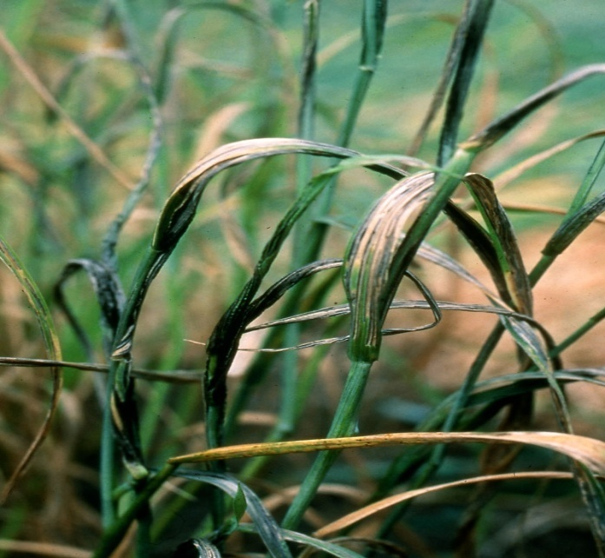
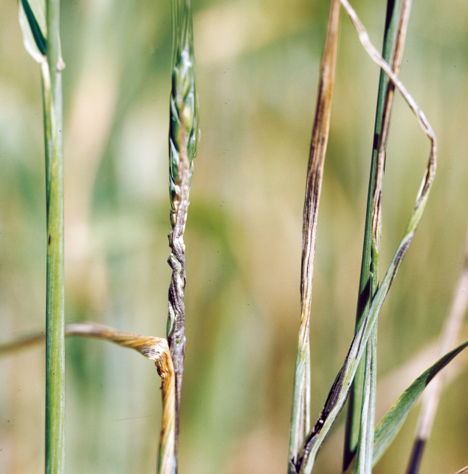
Symptoms
Leprous spot
Bending/Twisting of Coleoptiles
Reduced heads/leaf expansion

Slide 6
Management
Copper carbonate
Seed treatment----Thiram @ 3 g/kg seed, Topsin-M @2 g/kg seed.
Seeds are soaked in water (1:1 w/v) in a galvanised tub which is tightly covered with a transparent polythene sheet and placed under the sun.

