Slide 1
Lecture 8
Using Business-Driven Data Mapping for Integrated Data

Slide 2
Sub-Topics
Data Modeling
Types of Data Model
Data Mapping
A Simple Data Map
Data Entity
Data Attributes
Data Association
Association Degree
Association Nature

Slide 3
What Is Data Modeling?
A data model is a pictorial representation of structure of Relational Database system
OR
It is a process of identifying data objects and the relationship between them.
OR
A data model is a diagram that uses text and symbol to represent data to give the reader to better understanding of data.
OR
Data Model is collection of conceptual tools for describing data(incorporate sub component into a model), data relationships, data semantics(overall look ) and consistency constraints(pk,fk).

Slide 4
Types of Data Model
Three types of data model:
1.Conceptual Data Model
It’s a representation of the “real word “ not technical implementation of it.
Describe “what” the system contain.
2. Logical Data Model
A logical data model provides all the information about the various entities and the relationship between the entities present in a database.
Describe How the system will be implemented, regardless of the DBMS.
A logical data model describes the data in as much detail as possible, without regard to how they will be physical implemented in the database.

Slide 5
Types of Data Model
3.Physical Data Model.
A physical data model describe each entity in details, including information about how you would implement the model using a particular product.
Describe how the system will be implemented using specific DBMS.

Slide 6
What is Data Mapping?
Is a creation of data elements and mapping two distinct data model.
OR
Is a technique that use to show how data of one information system is mapped with data of another information system.
Data mapping is used for :
Data Migration
Data Integration

Slide 7
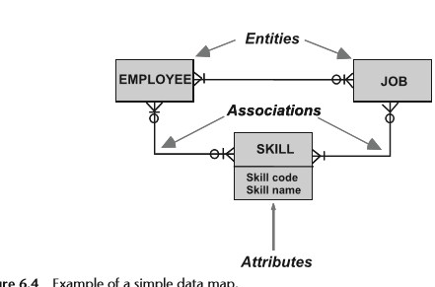
A Simple Data Map:
A schematic data map shows each entity as a rectangular box.

Slide 8
A Simple Data Map:
The name of the entity is written within the entity box.
Entity box to show the data that we need to know about each employee.
Attributes may optionally be listed within the entity box.
Two entities that are related in some way are joined by a connecting line that is called an association.
Symbols drawn on each end of an association line describe the relationship that exists between the two entities.

Slide 9
Definition of a Data Entity:
It is a logical representation of data to be stored in a database in a computer , or in a manual register file or some other storage format if not yet on computer.
It is only during physical database design that we decide how the entity will be physically stored.
An entity is always written in the singular, for a single occurrence of the data that it represents.
It is also written in capitals to distinguish it from attributes(which are in lowercase).
Examples of entities and the data they represent are:
• EMPLOYEE: Data we need to store about each employee.
• JOB: Data we need to store about each job.
• SKILL: Data we need to store about each skill.

Slide 10
Definition of data Attributes:
Data attributes are contained in data entities.
Attributes provide additional details that describe the entity in which they reside.
An attribute name is not always singular,
It is also written in lowercase to distinguish it from entities(which are in uppercase).

Slide 11
Definition of Data Associations:
An association is shown by a line joining two entity boxes, to represent a relationship that exists between the relevant entities.
association is to be used in physically implementation.
A name may optionally be written on an association line to define the meaning of the connection between related entities.
Business-driven data mapping shows only one association line between a pair of entities.
It is use more than one association but it is vague and unambiguous so use separate associations between entities.

Slide 12
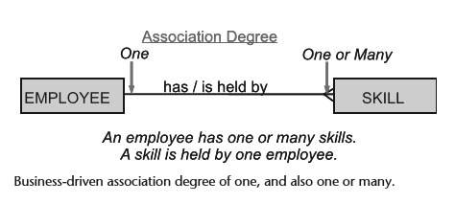
Types of Association Degree:
There are two types of association degree data mapping:
1. Association Degree in Business-Driven Data Mapping.

Slide 13
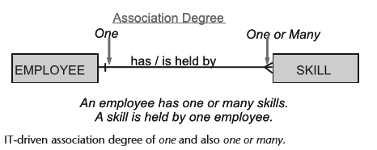
Types of Association Degree:
2. Association Degree in IT-Driven Data Mapping.

Slide 14
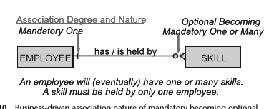
Association Nature
There are two types of association nature data mapping:
1. Association nature in Business-Driven Data Mapping.

Slide 15
Association Narure
2. Association nature in IT-Driven Data Mapping.

Slide 16
Summary
An entity box represents data stored for later reference, and is shown in uppercase letters.
• Attributes describe more detail of the entity in which they reside, and are shown in lowercase letters.
• An association is a line showing that the two entities joined by it are related. The association may optionally be named.
• Only one association line is used between each pair of entities.
A crow’s-foot indicates an association degree of one or many.
• The absence of a crow’s-foot indicates a degree of one.
• A bar across the line always indicates a nature of mandatory, and means “must.” A zero across the line always indicates a nature of optional, and means “may.”
A zero and bar always indicate a nature of optional becoming mandatory and means “will.

Slide 17
Summary

