Slide 1
Fusarium Wilt of Cotton

Slide 2
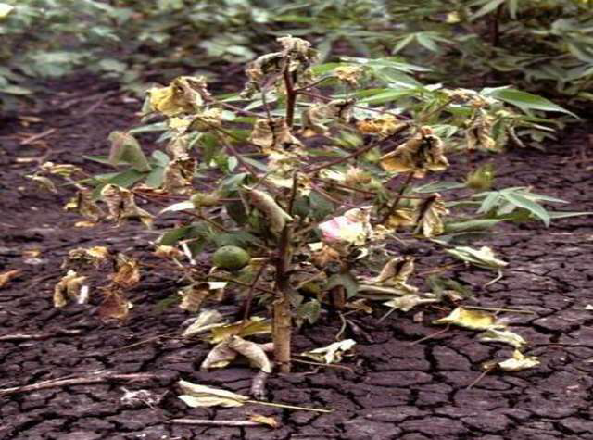

Slide 3
Causal Organism
Fusarium oxysporum f. sp. Vasinfectum
Order: Hypocreales
Family: Nectriaceae

Slide 4
Origin
Wilt is one of major disease of cotton, found wherever this crop is grown.
Fusarium wilt have been originated in Mexico or Central America.

Slide 5
Alternate Hosts
Bhendi,
Tobacco,
Brinjal
Chillli.

Slide 6
PATHOGEN
The fungus is present both inter and intra cellularly in the host tissue.
The Mycelium plugs the xylem vessels partially or completely.
The macro conidia are 1-5 septate, hyaline, thin walled, linear to falcate, tapering ends.

Slide 7
Micro conidia are hyaline, thin elliptical to spherical, single or two celled.
Fungus also produces vivotoxin, fusaric acid which is partially responsible for the wilting.

Slide 8
Microconidia
b) Macroconidia
c) Chlamydospores

Slide 9
SYMPTOMS
Yellowing and browning of the cotyledons.
Leaves lose their turgidity.
First turn yellow and then brown and finally drop off.
The tap root stunted and laterals are less abundant.

Slide 10
Browning and blackening of vascular tissues.
Discolorations of leaves starts from the margins and spread towards midribs.
Wilting may be complete or partial.

Slide 11
Yellowing and Drying of Leaves

Slide 12
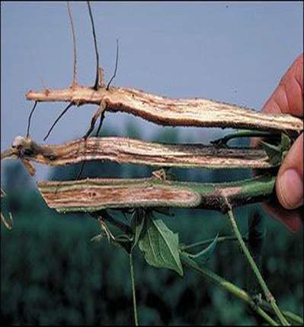
Browning of Vascular Tissues

Slide 17
FAVOURABLE CONDITION
Soil temperature of 20-30˚C.
Hot and dry periods followed by rains.
Heavy black soils with an alkaline reaction.
Increased doses of nitrogen and phosphatic fertilizers.

Slide 18
F. oxysporum f. sp. vasinfectum grows and develops at temperatures from 10 to 35°C.
Optimum conditions are temperatures 18- 27°C.
Soil humidity 40 to 70% and acidity of environment near pH=5.3.

Slide 19
MODE OF SPREAD
Fusarium wilt is spread over long distances in contaminated soil.
Contaminated soil can be carried on the roots of host plants, boots and clothing, vehicles, machinery and equipment.
Fusarium can also be carried in contaminated plant material, or on seeds.

Slide 21
MANAGEMENT
Treat the acid delinted seeds with Carboxin or Carbendazim at 2 g/kg.
Remove and burn the infected plant debris.
Apply increased doses of potash with a balanced dose of nitrogenous and phosphatic fertilizers.

Slide 22
Apply heavy doses of farm yard manure or other organic manures.
Spot drench with Carbendazim 1g/litre.

