Slide 1
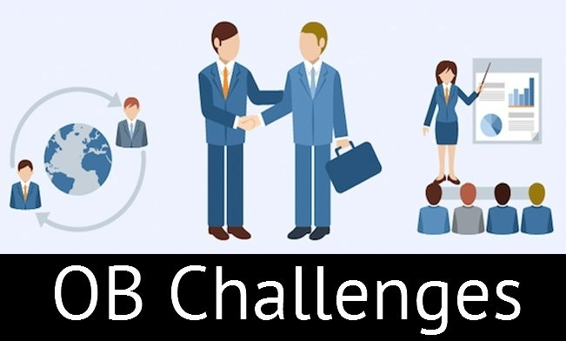
Organizational Behavior Course code EDUC 6326
Sofia Khakwani

Slide 2
OB challenges and opportunities

Slide 3
1.9. Challenges and opportunities for study of OB
Ethical Challenges
OB research finds that the most important determinant of whether a company acts ethically is not necessarily related to the policies and rules regarding ethical conduct but instead whether it has a culture of consistently ethical behavior and if leaders are committed to this ethical behavior.

Slide 4
Cont…
2. Lack of Employee Engagement
Engaged employees are those who are performing at the top of their abilities and happy about it. if 100% of an organization’s employees were fully engaged: what happened?

Slide 5
Cont…
3. Technology
Technology has changed the way work gets done and has created many great opportunities. As computers get faster, new software is written to capitalize on the increased computing power.
(Now with technology it is possible for teachers to apply online leave). Technology has also brought a great deal of challenges to individuals and organizations alike. E.g online classes

Slide 6
Cont…
4. Flattening World
Internet has “flattened” the world and created an environment in which there is a more level playing field in terms of access to information. This access to information has led to an increase in innovation, as knowledge can be shared instantly across time zones and cultures. It has also created intense competition, as the speed of business is growing faster and faster all the time.
A major challenge for individuals in the flattened world is learning how to evaluate the quality of the information they find.

Slide 7
Cont…
5. Managing Workforce Diversity:
This refers to employing different categories of employees who are heterogeneous in terms of gender, race, ethnicity, relation, community, etc. The primary reason to employ heterogeneous category of employees is to tap the talents and potentialities, harnessing the innovativeness, obtaining synergetic effect among the divorce workforce. In general, employees wanted to retain their individual and cultural identity, values and life styles even though they are working in the same organization with common rules and regulations. The major challenge for organizations is to become more accommodating to diverse groups of people by addressing their different life styles, family needs and work styles. Implications for Managers: Managers have to shift their philosophy from treating everyone alike to recognizing individual differences and responding to those differences in ways that will ensure employee retention and greater productivity while, at the same time not discrimination.

Slide 8
Cont…
6. Empowering People Empowerment:
Defined as putting employees in charge of what they do by eliciting some sort of ownership in them. The main issue is delegating more power and responsibility to the lower level cadre of employees and assigning more freedom to make choices about their schedules, operations, procedures and the method of solving their work-related problems.

Slide 9
2.1. What is an organization?
A coordinated social unit composed of two or more people, those functions on a relatively continuous basis to achieve a common goal or set of goals.
According to James D monny
“Organization is form of every human association for the attainment of a common purpose”
According to Milward “organization structure is a pattern of interrelated posts connected by time of delegated authority.

Slide 11
Cont…
According to Luther Golick “organization is formal structure of autority through which works subdivision are arranged, defined and coordinate for defined objectives”
So it is a work of connecting interdependent parts so each has special function, act , or relation to the whole.

Slide 12
2.2 Types of organization
Formal:
The part of the organization that has legitimacy and official recognition
Rules regulations, planned, Time bound, hierarchy.
Informal:
The unofficial part of the organization.
Unplanned, no rules regulations, charity clubs, no time bound, No hierarchy,

Slide 13
2.3 components of organization
Task - an organization’s mission, purpose, or goal for existing
People - the human resources of the organization
Structure - the manner in which an organization’s work is designed at the micro level; how departments, divisions, & the overall organization are designed at the macro level
Technology - the intellectual and mechanical processes used by an organization to transform inputs into products or services that meet

Slide 14
The basic system view of an organization

Slide 15
Cont…
The organizational environment is the set of resources surrounding an organization, including inputs (e.g., raw materials and skilled employees); resources to transform inputs (e.g., computers, buildings, and machinery); and resources (e.g., customers)

Slide 16
Factors affecting organization
(internal and external factors)
Organizational Environment
Technological Environment

Slide 18
Define the key biographical characteristics.
Understanding the Basics of Human Behavior
An organization’s human resource policies and practices represent important forces for shaping employee behavior and attitudes.
The influence of selection practices, training and development programs, performance evaluation systems, and the existence of a union. Human resource policies and practice influence organizational effectiveness. Human resource management includes: employee selection, training performance management, and union-management relations and how they influence organizations effectiveness.

Slide 19
Cont…
Biographical Characteristics
Finding and analyzing the variables that have an impact on employee productivity, absence, turnover, and satisfaction is often complicated.
Data that can be obtained from an employee’s personnel file and would include characteristics such as: Age ,Gender ,Marital status ad Length of service, etc.

Slide 20
Cont…
1. Age: The relationship between age and job performance is increasing in importance.
• First, there is a widespread belief that job performance declines with increasing age.
• Second, the workforce is aging; workers over 55 are the fastest growing sector of the workforce.
• They see a number of positive qualities that older workers bring to their jobs, specifically experience, judgment, a strong work ethic, and commitment to quality.
• Older workers are also perceived as lacking flexibility and as being resistant to new technology.

Slide 21
Cont…
• In general, older employees have lower rates of avoidable absence. However, they have higher rates of unavoidable absence, probably due to their poorer health associated with aging and longer recovery periods when injured.
There is a widespread belief that productivity declines with age and that individual skills decay over time.

Slide 22
Cont…
Reviews of the research find that age and job performance are unrelated. • This seems to be true for almost all types of jobs, professional and nonprofessional.
The relationship between age and job satisfaction is mixed.
Most studies indicate a positive association between age and satisfaction, at least up to age 60.

Slide 23
Cont…
2. Gender
1. There are few, if any, important differences between men and women that will affect their job performance, including the areas of:
• Problem-solving
• Analytical skills
• Competitive drive
• Motivation
• Sociability
• Learning ability

Slide 24
Cont…
2. Women are more willing to conform to authority, and men are more aggressive and more likely than women to have expectations of success, but those differences are minor.
3. There is no evidence indicating that an employee’s gender affects job satisfaction.
Mothers of preschool children are more likely to prefer part-time and flexible work schedules, in order to accommodate their family responsibilities.

Slide 25
Cont…
5. Absence rates
The research on absence consistently indicates that women have higher rates of absenteeism.
The logical explanation: cultural expectation that has historically placed home and family responsibilities on the woman

Slide 26
Cont…
3. Marital Status
There are not enough studies to draw any conclusions about the effect of marital status on job productivity.
Research consistently indicates that married employees have fewer absences, undergo fewer turnovers, and are more satisfied with their jobs than are their unmarried coworkers.
More research needs to be done on the other statuses besides single or married, such as divorce, domestic partnering, etc..

Slide 27
Cont…
4. Tenure
The evidence indicates that tenure and satisfaction are positively related.
Individual differences can be divided into personality and ability differences. Understanding the nature, determinants, and consequences of individual differences is essential for managing organizational behavior.
An appreciation of the nature of individual differences is necessary to understand why people behave in certain ways in an organization.

