Slide 1
Gel Exclusion Chromatography

Slide 2
Introduction
Also called gel filtration, molecular-sieve chromatography, or gel permeation chromatography
Molecular weight
Purification of thousands of proteins, nucleic acids, enzymes, polysaccharides, and other biomolecules

Slide 3
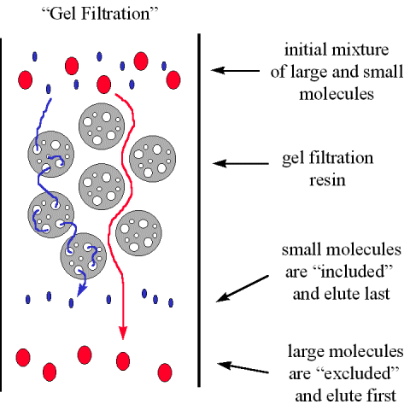
Theory of Gel Filtration

Slide 4
Physical Characterization of Gel Chromatography
1. Exclusion Limit - molecular mass of the smallest molecule that cannot diffuse into the inner volume of the gel matrix.
2. Fractionation Range- Sephadex G-50 has a fractionation range of 1500 to 30,000 daltons.
3. Water Regain and Bed Volume - The weight of water taken up by 1 g of dry gel is known as the water regain. For G-50, this value is 5.0 g.
4. Gel Particle Shape and Size – spherical and variable size
5. Void Volume - This is the total space surrounding the gel particles in a packed column
6. Elution Volume

Slide 5
Chemical Properties of Gels
Dextran, polyacrylamide, agarose, and combined polyacrylamide-dextran.

Slide 6
Selecting a Gel
Group separations or fractionations
Sephadex G-25, Bio-Gel P-6, and Sephacryl S-100HR are recommended for most group separations
Gel fractionation - separation of groups of molecules of similar molecular weights in a multicomponent mixture
The recommended gel grade for most fractionations is 100–200 or 200–400 mesh

Slide 7
Gel Preparation and Storage
Dehydrated forms, 3-4h, 20ºC
sodium azide (0.02%)

Slide 8
Operation of a Gel Column
Column Size- not greater than 100cm long, group separations, columns less than 50 cm long are sufficient
Eluting Buffer- Dextran and polyacrylamide gels are stable in the pH range 1 to 10, whereas agarose gels are limited to pH 4 to 10
Sample Volume- group separations, 10 to 25% of the column total volume is suitable, fractionation procedures should be between 1 and 5% of the total volume
Column Flow Rate- small-pore-size gels is 8 to 12ml/cm2, large-pore-size gels, a value of 2 to 5ml/cm2

Slide 9
Applications of Gel-Exclusion Chromatography
Desalting
Purification of Biomolecules
Estimation of Molecular Weight
Gel Chromatography in Organic Solvents

