Slide 1
Artificial Intelligence
Dr. Qaiser Abbas
Department of Computer Science & IT,
University of Sargodha, Sargodha, 40100, Pakistan
qaiser.abbas@uos.edu.pk

Slide 2
ADVERSARIAL SEARCH
In which we examine the problems that arise when we try to plan ahead in a world where other agents are planning against us.
In this lecture we will cover competitive environments, in which the agents’ goals are in conflict, giving rise to adversarial search problems—often known as games.
We will cover the followings:
GAMES
OPTIMAL DECISIONS IN GAMES
MiniMax Algorithm
ALPHA–BETA PRUNING

Slide 3
Games
A game can be defined as a search problem with the following elements:
S₀: Initial state which specifies how the game is set up at the start.
PLAYER(s): Defines which player has the move in a state s.
ACTIONS(s): Returns set of legal moves in a state s.

Slide 4
Games
RESULT(s,a): The transition model defines the result of a move from state s with action a.
TERMINAL-TEST(s): A terminal test at a state s, which is true when the game is over and false otherwise.
U T I L I T Y (s, p): A utility function also called an objective function or payoff function, defines the final numeric value for a game that ends in terminal state s for a player p.

Slide 5
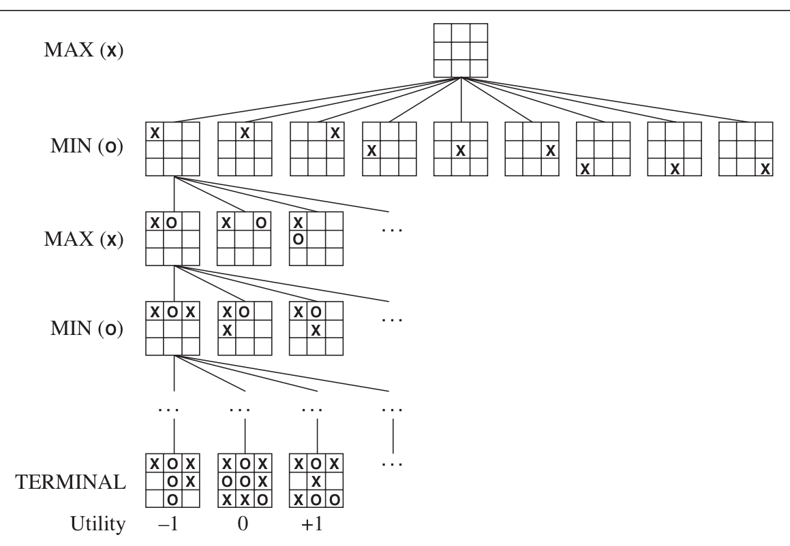
Games
The initial state, ACTIONS function, and RESULT function define the game tree—a tree where the nodes are game states and the edges are moves. Figure shows part of the game tree for Tic-Tac-Toe.

Slide 6
Simple Approach in Tic-Tac-Toe
In simple algorithm, calculate all the possible moves from the current position. For a game of Noughts and Crosses the result might look like:
Expand each of these new possible moves for the other player.
Continue this expansion until a winning position for the player is found.

Slide 7
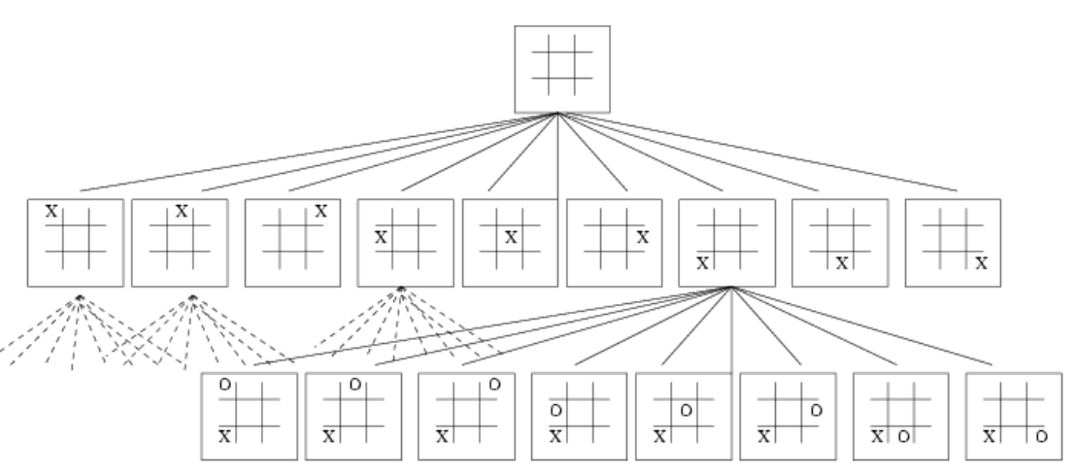
Simple Approach in Tic-Tac-Toe
This algorithm will work and locate a series of winning moves at the cost of enormous calculation e.g. one board at first, 9 at the next level, 9∗8 next and so on. In total:
This is not so big that we cannot calculate it, but it is alarming since Noughts and Crosses is such a simple game.

Slide 8
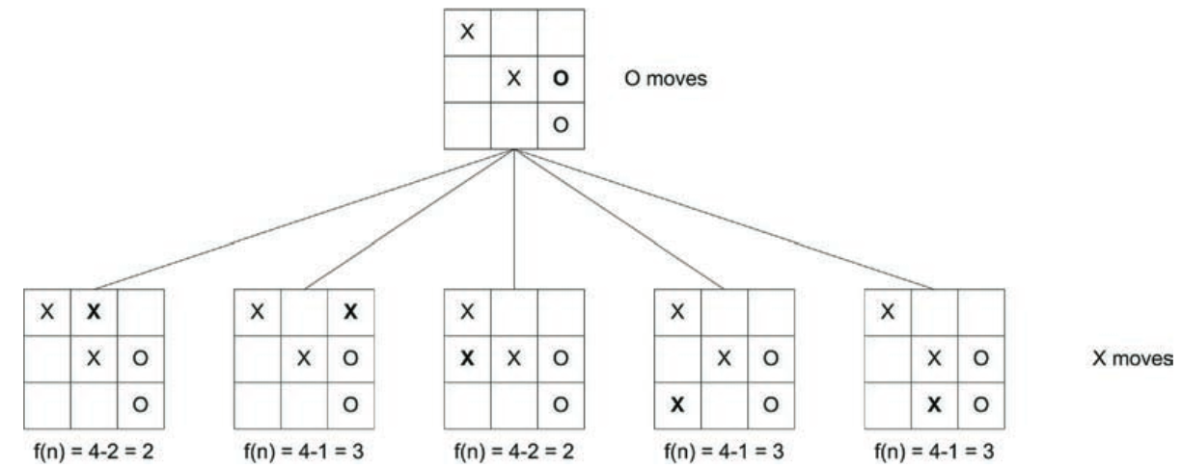
OPTIMAL DECISIONS IN GAMES
An optimal strategy leads to outcomes at least as good as any other strategy when one is playing an infallible opponent.
Two Player Games:
Consider a Zero-Sum game in which gain of one player is balanced exactly by the loss of other player.
Static Evaluation Function f(n) = Complete R/C/D open positions for X – Complete R/C/D open positions for O

Slide 9
OPTIMAL DECISIONS IN GAMES
Higher the result of f(n), the closer the move towards a win. Three moves result in 3 but only one move results a win for X in Figure.
This f(n) is useful but another heuristics is necessary to pick the move with highest f(n) while protecting against a loss in the next move.
For this purpose, a Minimax algorithm given next, in which the algorithm's opponent will be trying to minimize whatever value the algorithm is trying to maximize (hence, ”Minimax").
Thus, the computer should make the move which leaves its opponent capable of doing the least damage.

Slide 10
Minimax algorithm
Minimax uses one of the two basic strategies:
Entire game tree is searched to the leaf nodes
Tree is searched to a predefined depth and then evaluated.
Can pursue the tree by making guesses as to how the opponent will play.
Cost function can be used to evaluate how the opponent is likely to play.

Slide 11
Minimax algorithm
After evaluating some number of moves ahead we examine the total value of the cost to each player.
The goal is to find a move which will maximize the value of our move and will minimize the value of the opponents moves.
The algorithm used is the Minimax search procedure presented next.

Slide 12
The Minimax algorithm

Slide 13
Partial Example Tree For Minimax Algorithm

Slide 14
ALPHA–BETA PRUNING
Minimax search is exponential like DFS and couldn’t be eliminated but can be effectively cut in half.
Idea of Pruning to eliminate large parts of the tree can be used and the particular technique we examine is called Alpha–Beta Pruning.
When applied to a standard Minimax tree, it returns the same move as Minimax would, but prunes away branches that cannot possibly influence the final decision.

Slide 15
ALPHA–BETA PRUNING
Consider, the two-ply game tree from Figure given next.
Let’s go through the calculation of the optimal decision once more, this time paying careful attention to what we know at each point in the process.

Slide 16
ALPHA–BETA PRUNING

Slide 17
ALPHA–BETA PRUNING
Idea of pruning after applying it on the previous figure is described below . No need to evaluate two successors of node C.
Suppose they have values x and y. Then the value of the root is:
MINIMAX(root) = Max(Min(3,12,8),Min(2,x,y),Min(14,5,2)) = Max(3,Min(2,x,y),2)
= Max(3,z,2) where z = Min(2,x,y) ≤ 2
= 3.
Alpha–beta pruning can be applied to trees of any depth, and it is often possible to prune entire subtrees rather than just leaves.
α = the value of the best (i.e., highest-value) choice we have found so far at any choice point along the path for MAX.
β = the value of the best (i.e., lowest-value) choice we have found so far at any choice point along the path for MIN.
The detailed steps are explained in Figure next.

Slide 18
ALPHA–BETA PRUNING

Slide 19
ALPHA–BETA PRUNING
Alpha–beta search updates the values of α and β as it goes along and prunes the remaining branches at a node (i.e., terminates the recursive call) as soon as the value of the current node is known to be worse than the current α or β value for MAX or MIN, respectively.
The complete algorithm is given next. It will be good to trace its behavior when applied to the tree in Figure.

Slide 20
ALPHA–BETA PRUNING

Slide 21
Lab Project #7
Implement the Tic-Tac-Toe game using any adversarial searching algorithm
Visit the following link: https://www.geeksforgeeks.org/minimax-algorithm-in-game-theory-set-3-tic-tac-toe-ai-finding-optimal-move/
Perform the following operations over it.
Download it.
Configure and execute it.
Submit the final report.

