Slide 1
Organizational Behavior 15th Ed
Chapter 4
Robbins and Judge
Emotions and Moods
Notes:
Chapter 4 introduces us the the concepts of emotions and moods and their effects on Organizational Behavior. These are concepts that have only recently received increased attention in research and practice. Here we will see the results of study and new applications to help make the work place more successful.

Slide 2
Chapter 4 Learning Objectives
After studying this chapter you should be able to:
Differentiate emotions from moods and list the basic emotions and moods.
Discuss whether emotions are rational and what functions they serve.
Identify the sources of emotions and moods.
Show the impact emotional labor has on employees.
Describe affective events theory and identify its applications.
Contrast the evidence for and against the existence of emotional intelligence.
Be able to identify strategies for emotion regulation and their likely effects.
Apply concepts about emotions and moods to specific OB issues.
Notes:
We begin this chapter with a definition of the seven learning objectives defined for chapter’s contents. We will discuss each of these in some detail.

Slide 3
Differentiate Emotions from Moods, List the Basic Emotions and Moods
LO 1
Why Were Emotions Ignored in OB?
The “Myth of Rationality”
Emotions were seen as irrational
Managers worked to make emotion-free environments
View of Emotionality
Emotions were believed to be disruptive
Emotions interfered with productivity
Only negative emotions were observed
Now we know emotions can’t be separated from the workplace
Notes:
As mentioned, emotions and moods were dismissed by OB for a long time. One of the primary reasons was the “Myth of Rationality” that suggested that OB comprised rational concepts and applications and emotions and moods were seen as highly irrational. Emotions were thought to be disruptive of organizational activity and decreased productivity. Because they were perceived as irrational the belief was that they were unpredictable and therefore not easily influenced. We now know this is untrue.

Slide 4
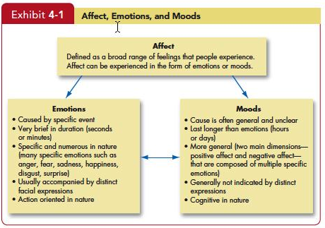
Differentiate Emotions from Moods, List the Basic Emotions and Moods
LO 1
Insert Exhibit 4-1
Notes:
Affect is a generic term that covers a broad range of feelings people experience. This includes both emotions and moods. Emotions are intense feelings that are directed at someone or something. Moods are the feelings that tend to be less intense than emotions and that lack a contextual stimulus.

Slide 5
Differentiate Emotions from Moods, List the Basic Emotions and Moods
LO 1
While not universally accepted, there appear to be six basic emotions:
Anger
Fear
Sadness
Happiness
Disgust
Surprise
Notes:
Not all psychologists agree; however, there do seem to be six basic emotions that emerge in studies: anger, fear, sadness, happiness, disgust, surprise. All other emotions fall under these six. So, sometimes as many as twelve emotions are identified.

Slide 6
Differentiate Emotions from Moods, List the Basic Emotions and Moods
LO 1
May even be placed in a spectrum of emotion:
Happiness
Surprise
Fear
Sadness
Anger
Disgust
Notes:
Some psychologists even place these basic six on a spectrum of emotion. These range from Happiness to Surprise to Fear to Sadness to Anger and to Disgust. This continuum suggests that a person moves from left to right and back as he or she experiences emotions during the day. And the emotions transition from one to the next. For example, a person can feel Happiness. Or may feel Surprise/Happiness or may be merely Surprised.

Slide 7
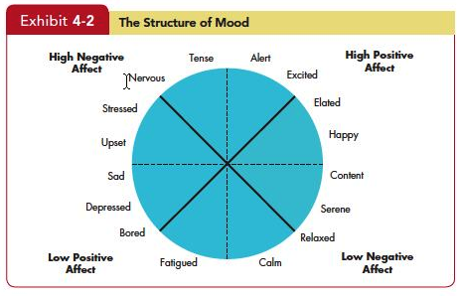
Discuss Whether Emotions Are Rational and What Functions They Serve
LO 2
Insert Exhibit 4-2
Notes:
Our basic moods carry positive and negative affects, they cannot be neutral. Emotions are grouped into general mood states. These states impact how employees perceive reality and thereby the moods can impact the work of employees.

Slide 8
Discuss Whether Emotions Are Rational and What Functions They Serve
LO 2
Decision-Making
Thinking
Feeling
Notes:
There are some who think that emotions are linked to irrationality and that expressing emotions in public may be damaging to your career or status. However, research has shown that emotions are necessary for rational thinking. They help us make better decisions and help us understand the world around us. If we are going to make decisions, we need to incorporate both thinking and feeling.

Slide 9
Identify the Sources of Emotions and Moods
LO 3
Personality
There is a trait component – affect intensity
Day and Time of the Week
There is a common pattern for all of us
Happier in the midpoint of the daily awake period
Happier toward the end of the week
Notes:
There are many things that impact our mood and emotions. Personality is a key component and will definitely impact the intensity of the emotions we feel. The day and time of the week is a common pattern for all of us. Many are happier toward the end of the week.

Slide 10
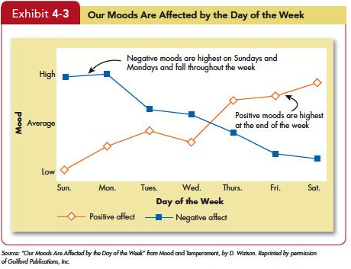
Identify the Sources of Emotions and Moods
LO 3
Insert Exhibit 4-3
Notes:
In Exhibit 4-3 we can see what research has found as the effect of the day of the week on emotions. As the day week progresses, positive affects of emotions increases while negative affects decrease. So positive emotions are considerable higher toward the end of the week than they are at the beginning.

Slide 11
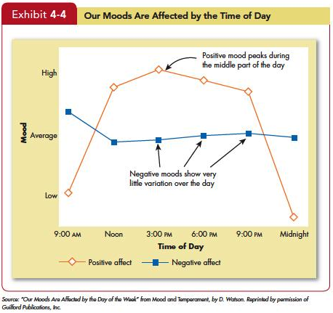
Identify the Sources of Emotions and Moods
LO 3
Insert Exhibit 4-4
Notes:
Exhibit 4-4 shows the results of research that has found patters in the daily experience in emotional changes. Positive emotions have their greatest affect during the afternoon before decreasing into the evening. This suggests that afternoon activity can be the most productive as affected by emotions.

Slide 12
Identify the Sources of Emotions and Moods
LO 3
Weather
Illusory correlation – no effect
Stress
Even low levels of constant stress can worsen moods
Social Activities
Physical, informal, and dining activities increase positive moods
Notes:
Weather is thought to have an impact on our emotions, but there is no proven effect. Stress is an important factor and even at low levels it can cause our mood to change. It is important to maintain a low level of stress to help us control our psychological as well as our physical health. Social activities have been shown to have a positive impact on our moods. This could be physical outlets such as playing in a basketball league or it can be going out to dinner with friends. These types of activities are found to have a positive impact on our mood.

Slide 13
Identify the Sources of Emotions and Moods
LO 3
Sleep
Poor sleep quality increases negative affect
Exercise
Does somewhat improve mood, especially for depressed people
Notes:
Some additional sources of emotion and mood include such factors as sleep and exercise. It is important to get enough and high-quality levels of sleep. Physical activity can also aid in keeping our moods upbeat.

Slide 14
Identify the Sources of Emotions and Moods
LO 3
Age
Older folks experience fewer negative emotions
Sex
Women tend to be more emotionally expressive, feel emotions more intensely, have longer-lasting moods, and express emotions more frequently than do men
Due more to socialization than to biology
Notes:
Some characteristics that are beyond our control can impact our moods, such as age and sex. Elderly people tend to have fewer negative emotions. And, women tend to express their emotions readily and their moods tend to last longer. Research has shown that this is due more to cultural socialization than to biology.

Slide 15
Show the Impact Emotional Labor Has on Employees
LO 4
Emotional Labor-An employee’s expression of organizationally desired emotions during interpersonal transactions at work.
Emotional Dissonance:
Employees have to project one emotion while simultaneously feeling another
Can be very damaging and lead to burnout
Notes:
In many jobs there is an implied agreement on the types of emotions that should be expressed. For example, waitresses are supposed to be friendly and cheerful, whether they are currently feeling that emotion or not. When employees don’t feel the emotion they are required to express, they may experience emotional dissonance. This can lead to burnout and frustration with the job.

Slide 16
Show the Impact Emotional Labor Has on Employees
LO 4
Types of Emotions:
Felt: the individual’s actual emotions
Displayed: required or appropriate emotions
Surface Acting: displaying appropriately but not feeling those emotions internally
Deep Acting: changing internal feelings to match display rules - very stressful
Notes:
An employee’s actual emotions are their felt emotions and this is in contrast to the emotions that are required or deemed appropriate, which are called displayed emotions. There are two levels of displayed emotions that can be expressed. They are both appropriately called acting. Surface acting is when an employee displays the appropriate emotions even when they don’t feel those emotions. Deep acting is when the employee actually changes their internal feelings to match displayed rules; this level of acting can be very stressful.

Slide 17
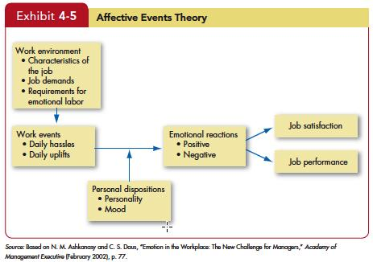
Describe Affective Events Theory and Identify Its Applications
LO 5
Insert Exhibit 4-5
Notes:
Affective Events Theory demonstrates that employees react emotionally to things that happen to them at work and this can influence their job performance and job satisfaction. The intensity of these responses will be based on emotion and mood.

Slide 18
Describe Affective Events Theory and Identify Its Applications
LO 5
An emotional episode is actually the result of a series of emotional experiences triggered by a single event
Current and past emotions affect job satisfaction
Emotional fluctuations over time create variations in job performance
Emotion-driven behaviors are typically brief and variable
Both negative and positive emotions can distract workers and reduce job performance
Notes:
AET has a number of implications. When an employee has an emotional episode, it is actually the result of a series of emotional experiences that are triggered by a single event. Your job satisfaction is impacted by current and past emotions. As your emotions fluctuate over time, it will create variations in job performance. Behaviors that are driven by emotions are typically brief and variable. Both positive and negative emotions can distract workers and reduce job performance.

Slide 19
Describe Affective Events Theory and Identify Its Applications
LO 5
Emotions provide valuable insights about behavior
Emotions, and the minor events that cause them, should not be ignored at work; they accumulate
Notes:
In summary, emotions do provide very valuable information and predict factors about behavior. In addition, it is important not to ignore minor events as they will accumulate over time.

Slide 20
Contrast the Evidence For and Against the Existence of Emotional Intelligence
LO 6
Emotional Intelligence is a person’s ability to:
Be self-aware
Recognizing own emotions when experienced
Detect emotions in others
Manage emotional cues and information
Notes:
Emotional Intelligence is a person’s ability to be self–aware, that is, recognizing his or her own experienced emotions and to understand them. More significantly is the ability to observe and detect emotion in others. And to regulate the emotions in a cascading relationship.

Slide 21
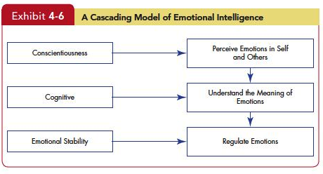
Contrast the Evidence For and Against the Existence of Emotional Intelligence
LO 6
Insert Exhibit 4-6
Notes:
Exhibit 4-6 illustrates the “Cascading Model of Emotional Intelligence.” Here we see the suggested relationship between Conscientiousness. Cognitive, and Emotional Affects and the outcomes of detecting others’ emotions, understanding what they mean, and regulating the emotions successfully.

Slide 22
Apply Concepts About Emotions and Moods to Specific OB Issue
LO 7
Motivation
Positive mood affects expectations of
success; feedback amplifies this effect.
Leadership
Emotions are important to acceptance of messages from organizational leaders.
Notes:
Positive mood affects expectations of success by all people which contributes to their motivation for performance. Leadership is affected by mood and emotion as those in positive emotional state are found to be more receptive of messages from leaders.

Slide 23
Apply Concepts About Emotions and Moods to Specific OB Issue
LO 7
Negotiation
Emotions, skillfully displayed, can affect negotiations
Customer Services
Emotions affect service quality delivered to customers which affects customer relationships
Emotional Contagion: “catching” emotions
Job Attitudes
Can carry over to home, but dissipate overnight
Notes:
Emotions, both those held and those displayed, are effective contributors to negotiation as the potential impact of displayed emotion on negotiation is large. Emotions affect customer service in a number of ways ranging from attitude of employee, communication effectiveness with customer, to overall feeling about the outcome. Research has found that people who are on an emotional high at the end of a day take the positive feelings home with them.

Slide 24
Apply Concepts About Emotions and Moods to Specific OB Issue
LO 7
Deviant Workplace Behaviors
Negative emotions lead to employee deviance (actions that violate norms and threaten the organization)
Safety and Injury at Work
Don’t do dangerous work when in a bad mood
Manager’s Influence
Leaders who are in a good mood, use humor, and praise employees increase positive moods
Notes:
Negative emotions can lead to Deviant Workplace Behaviors. These are actions that violate norms and threaten the organization. In addition, research has found that workers asked to do dangerous work while in negative emotional states are more likely to have accidents. And lastly, managers who are in a good mood tend to use humor and praise to employees that results in increased positive mood among employees.

Slide 25
Managerial Implications
Emotions and moods are a natural part of an individual’s makeup.
Ignoring co-workers’ and employees’ emotions and assessing others’ behavior as if they were completely rational is wrong.
“You can’t divorce emotions from the workplace because you can’t divorce emotions from people.”
Managers who understand the roles of emotions and moods will significantly improve their ability to explain co-workers’ and employees’ behaviors.
Notes:
To summarize the managerial implications of this chapter, we can say that emotions and moods are a natural part of an individual’s makeup. Managers who ignore some workers’ emotions while addressing others creates a sense of unfair treatment that has implications for job productivity. One observer said, “You can’t divorce emotions from the workplace because you can’t divorce emotions from people.” So, managers who understand the roles of emotions and moods will find their abilities to explain and predict coworker behaviors more effectively.

Slide 26
All rights reserved. No part of this publication may be reproduced, stored in a retrieval system, or transmitted, in any form or by any means, electronic, mechanical, photocopying, recording, or otherwise, without the prior written permission of the publisher. Printed in the United States of America.
Copyright © 2013 Pearson Education, Inc. publishing as Prentice Hall
Notes:
All rights reserved. No part of this publication may be reproduced, stored in a retrieval system, or transmitted, in any form or by any means, electronic, mechanical, photocopying, recording, or otherwise, without the prior written permission of the publisher. Printed in the United States of America.

