Slide 1
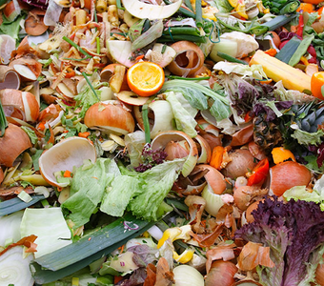
Biological treatments of waste

Slide 2
Biological treatments of waste
Biological treatment uses living micro-organisms to decompose organic wastes into either water, CO2 and simpler organics such as aldehydes and acids.

Slide 3
Types of Biological Treatment
Aerated lagoons
Activated Sludge
3.Aerobic Digestion
4.Anaerobic Digestion
5.Composting
6.Enzyme Treatment
7.Trickling Filters
8.Waste Stabilization Ponds
Biological treatments of waste

Slide 4
Aerated lagoons
An aerated lagoon or aerated basin is a treatment pond provided with artificial aeration to promote the biological oxidation of wastewaters.
Types of aerated lagoons
Suspension mixed lagoons, where there is less energy provided by the aeration equipment to keep the sludge in suspension.
Facultative lagoons, where there is insufficient energy provided by the aeration equipment to keep the sludge in suspension and solids settle to the lagoon floor.
The biodegradable solids in the settled sludge then degrade as in an anaerobic lagoon.
Biological treatments of waste

Slide 5
Methods of aerating lagoons
There are many methods for aerating a lagoon or basin:
Motor-driven submerged aerators
Motor-driven floating surface aerators
Motor-driven fixed-in-place surface aerators
Injection of compressed air through submerged diffusers
Biological treatments of waste

Slide 6
2. Activated Sludge
The activated sludge process is a process for treating sewage and industrial wastewaters using air and a biological floc composed of bacteria and protozoa
(Floc is a mass formed in a fluid through precipitation or aggregation of suspended particles).
In a sewage (or industrial wastewater) treatment plant, the activated sludge process is a biological process that can be used for one or several of the following purposes:
Oxidizing carbonaceous biological matter
Oxidizing nitrogenous matter: mainly ammonium and nitrogen in biological matter
Removing nutrients (nitrogen and phosphorus).
Biological treatments of waste

Slide 7
3. Aerobic Digestion
Aerobic digestion is a process in sewage treatment designed to reduce the volume of sewage sludge and make it suitable
It is a bacterial process occurring in the presence of oxygen.
Bacteria rapidly consume organic matter and convert it into carbon dioxide, water and a range of lower molecular weight organic compounds.
Biological treatments of waste
This stage of the process is known as endogenous respiration and it is process that reduces the solid concentration in the sludge.

Slide 8
Process……
The process is usually run in digester tank.
Air is pumped through the tank and the contents are stirred to keep the contents fully mixed.
Carbon dioxide, waste air and small quantities of other gases including hydrogen sulfide are given off.
The digestion is continued until the percentage of degradable solids is reduced to between 20% and 10% depending on local conditions
Where non sewage waste is being processed, organic waste such as food, cardboard and horticultural waste and be significantly reduced in volume leaving an output that can be used as soil improver or biomass fuel.
Biological treatments of waste

Slide 9
4. Anaerobic Digestion
Anaerobic digestion is a processes by which microorganisms break down biodegradable material in the absence of oxygen.
The digestion process begins with bacterial hydrolysis of the input materials. Insoluble organic polymers, such as carbohydrates, are broken down to soluble derivatives that become available for other bacteria.
Anaerobic digestion is used to treat biodegradable waste and sewage sludge.
Anaerobic digestion is widely used as a source of renewable energy. The process produces a biogas, consisting of methane, carbon dioxide and traces of other ‘contaminant’ gases.
Biological treatments of waste

Slide 10
Process….
The four key stages of anaerobic digestion are,
1. Hydrolysis
Acidogenesis
Acetogenesis
Methanogenesis.
Biological treatments of waste

Slide 11
1. Hydrolysis
It is usually means the cleavage of chemical bonds by the addition of water. Through hydrolysis the complex organic molecules are broken down into simple sugars, amino acids, and fatty acids.
2. Acidogenesis
A biological reaction where volatile fatty acids are converted into acetic acid, carbon dioxide, and hydrogen
Biological treatments of waste
3. Acetogenesis
It is a process through which acetate is produced from CO₂ and an electron source (Formate, etc.) by anaerobic bacteria.
4. Methanogenesis
Methanogenesis or biomethanation is the formation of methane by microbes known as methanogens. Methanogenesis is sensitive to both high and low pHs.

Slide 12
5.Composting
Composting of waste is an aerobic (in the presence of air) method of decomposing solid wastes.
The process involves decomposition of organic waste into humus known as compost which is a good fertilizer for plants.
With the proper mixture of water, oxygen, carbon, and nitrogen, micro-organisms are able to break down organic matter to produce compost.
There are many types of microorganisms found in active compost of which the most common are:
Bacteria (Mesophilic or thermophilic bacteria)
Actinobacteria
Fungi, molds and yeast Protozoa
Rotifers
Small protozoans.
Biological treatments of waste

Slide 13
Composting organisms require four equally important ingredients to work effectively:
Carbon for energy
Nitrogen to grow and reproduce.
Oxygen for oxidizing the carbon, the decomposition process.
Water in the right amounts to maintain activity without causing anaerobic conditions.
Biological treatments of waste

Slide 14
6.Enzyme Treatment
Specifically, enzymes are biological catalysts that regulate the chemical reactions
They carry out such cellular processes as energy conversion, food digestion and biosynthesis.
Biological treatments of waste
Due to their high specificity to individual species or classes of compounds, enzymatic processes can be developed to specifically target selected compounds that are detrimental to the environment.

Slide 15
It is suggested that the following situations are those where the use of enzymes might be most beneficial:
Removal of specific chemicals from a complex industrial waste mixture prior to on-site or off-site biological treatment.
Removal of specific chemicals from dilute mixtures, for which conventional mixed culture biological treatment might not be feasible.
Polishing of a treated wastewater or groundwater to meet limitations on specific pollutants or to meet whole effluent toxicity criteria.
Treatment of wastes generated infrequently or in isolated locations, including spill sites and abandoned waste disposal sites.
Biological treatments of waste

Slide 16
7.Trickling Filters
A trickling filter , also called trickling biofilter, biofilter, biological filter and biological trickling filter , is a fixed-bed, biological reactor that operates under (mostly) aerobic conditions.
Pre-settled wastewater is continuously 'trickled' or sprayed over the filter.
A trickling filter is a type of wastewater treatment system first used by Dibden and Clowes.
It consists of a fixed bed of rocks, lava, coke, gravel, slag, polyurethane foam, sphagnum peat moss, ceramic, or plastic media over which sewage or other wastewater flows downward and causes a layer of microbial slime (biofilm) to grow, covering the bed of media.
Biological treatments of waste

Slide 17
Aerobic conditions are maintained by splashing, diffusion, and either by forced-air flowing through the bed or natural convection of air if the filter medium is porous.
The treatment of industrial wastewater may involve specialised tricking filters which use plastic media and high flow rates.
Wastewaters from a variety of industrial processes have been treated in trickling filters. Such industrial wastewater trickling filters consist of two types:
Biological treatments of waste
Large tanks or concrete enclosures filled with plastic packing or other media.
Vertical towers filled with plastic packing or other media.

Slide 18
8.Waste Stabilization Ponds
Wastewater Stabilization Ponds are large, man-made water bodies in which blackwater, grey water are treated by natural occurring processes and the influence of solar light, wind, microorganisms and algae.
There are three types of ponds,
Biological treatments of waste
(1) anaerobic pond
(2) Facultative pond
(3) aerobic (maturation) pond

Slide 19
1- Anaerobic Treatment Ponds (APs)
The main function of anaerobic ponds is BOD removal, which can be reduced 40 to 85 %.
As a complete process, the anaerobic pond serves to:
Settle undigested material and non-degradable solids as bottom sludge
Dissolve organic material
Break down biodegradable organic material
Biological treatments of waste

Slide 20
2- Facultative Treatment Ponds (FPs)
Facultative Treatment Ponds are consist of an aerobic zone close to the surface and a deeper anaerobic zone.
They are designed for BOD removal and can treat water in the BOD range of 100 to 400 kg/ha/day corresponding to 10 to 40 g/m2/day at temperatures above 20°C
Biological treatments of waste

Slide 21
3- Aerobic / Maturation Ponds (MPs)
Anaerobic and facultative ponds are designed for BOD removal
While
Maturation or polishing ponds are essentially designed for pathogen removal and retaining suspended stabilised solids

Slide 22
Special Techniques

Slide 23
INTRODUCTION
PHYTOREMEDIATION:
Using green plants to reduce environmental problems without the need to dig off the contaminant material and dispose of elsewhere.
Natural process an effective remediation method at a variety of sites and on number of contaminants.
Selected plant species possess the genetic potential to remove, degrade, metabolize, or immobilize a wide range of contaminants (~350 species).
Biological treatments of waste

Slide 24
PHYTOREMEDIATION MECHANISMS
Relies on types of contaminant, bioavailability and soil properties.
Uptake of contaminants occurs primarily in root system
There are several ways by which plants clean up contaminated sites:
Phytoextraction
Phytostabilization
Phytodegradation/Phytotransformation
Phytostimulation/Rhizodegradation
Phytovolatilization
Rhizofiltration
Biological treatments of waste

Slide 25
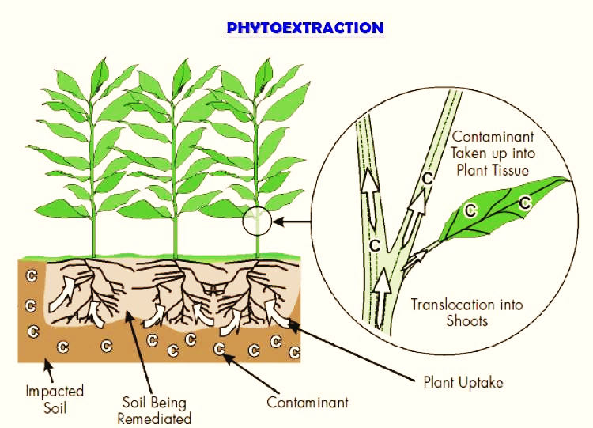
PHYTOEXTRACTION
The uptake of contaminants by plant roots and movement of these contaminants from roots to the above part of plants by absorbing, concentrating and precipitating the contaminants.
Biological treatments of waste

Slide 26
PHYTOSTABILIZATION
Refers to the immobilization of contaminants in the soil through:
Absorption and accumulation by roots,
Precipitation within the roots.
Eventually, the mobility of the contaminant is reduced, migration to groundwater is prevented and thus bioavailability of metal into food chain is reduced
Biological treatments of waste

Slide 27
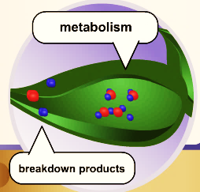
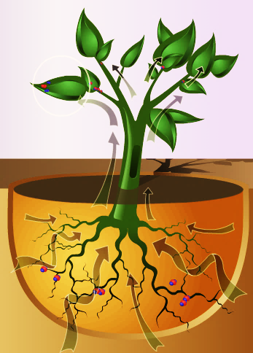
PHYTOTRANSFORMATION
Breakdown of contaminants taken up plants by metabolic processes within the plant.
Remediate some organic contaminants, such as chlorinated solvents & herbicides etc
It can address contaminants in soil, sediment, or groundwater
Biological treatments of waste

Slide 28
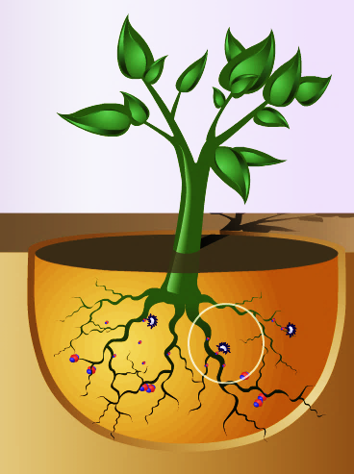
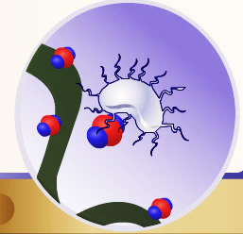
PHYTOSTIMULATION
Breakdown of contaminants within the plant root zone, or rhizosphere
Also Called as Rhizodegradation
Carried out by bacteria or other microorganisms flourishing in the rhizosphere.
Microbes in rhizosphere transform contaminant to non-toxic products
Works well in the removal of petroleum hydrocarbons
Biological treatments of waste

Slide 29
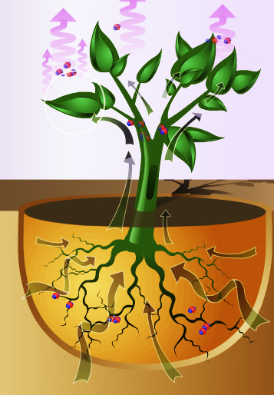
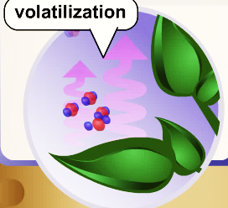
PHYTOVOLATILIZATION
Involves plants taking up contaminants from soil transforming them into volatile forms and then transpire them into the atmosphere
Works on organic compounds and heavy metal contaminants, Tetrachloroethylene as well.
This process has been used for primary metal contaminant i.e. Mercury
Biological treatments of waste

Slide 30
RHIZOFILTRATION
Adsorption or precipitation onto plant roots or absorption of contaminants in the solution surrounding the root zone
Used to remediate extracted groundwater, surface water and waste water with low contaminants
In Comparison with Phytoextraction , the plants are used to address the groundwater rather than soil
Biological treatments of waste

Slide 31
PLANTS SELECTION
Plant species are selected for use based on factors such as:
Ability to extract or degrade the contaminants of concern
Adaptation to local climates
High biomass
Deep root structure
Compatibility with soils
Growth rate
Ease of planting and maintenance
Ability to take up large quantities of water through the roots
Biological treatments of waste

Slide 32
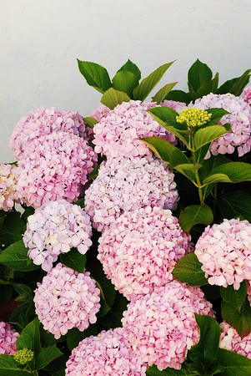
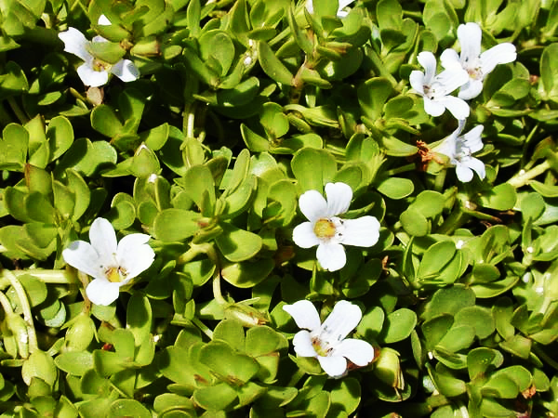
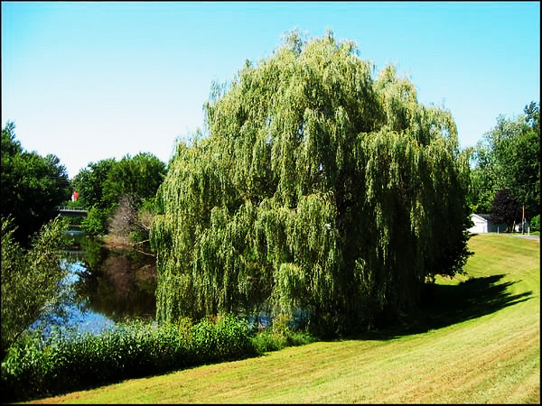
Hydrangeas:
Popular ornamental plants grown for their large clumps of flowers. Their other speciality is that they are responsible for drawing aluminium out of the soil
Water Hyssop
Removes lead, mercury, cadmium and chromium from marshes and wetland
Willow trees
Absorb cadmium, zinc and copper
Biological treatments of waste

Slide 33
ADVANTAGES
In situ and ex situ
Responsive to a variety of organic and inorganic compounds
Suited to remediation of large areas of soil
Costs effective as compared to conventional methods
Easy to implement and maintain
Fewer spread of contaminant via air and water
Conserves natural resources
Environment friendly and aesthetically pleasing to the public
Biological treatments of waste

Slide 34
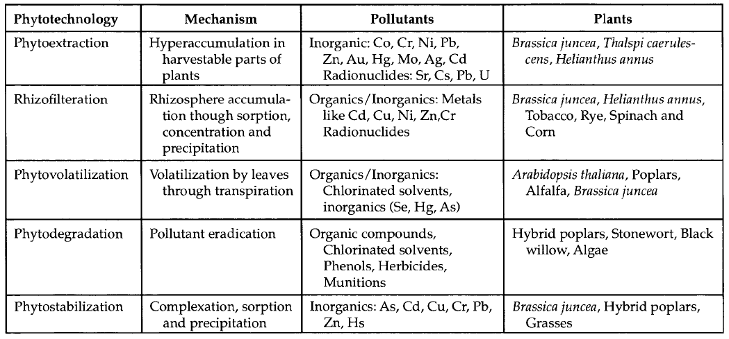
Biological treatments of waste

