Slide 1
Technique and practice
Andleeb Rana

Slide 2
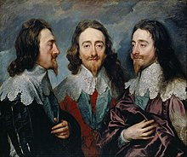
Anthony van dyck, charles I in three positions, 1635–1636, shows profile, full face and three-quarter views, to send to bernini in rome, who was to sculpt a bust from this model

Slide 3
A well-executed portrait is expected to show the inner essence of the subjectnot just a literal likeness. As Aristotle stated, "The aim of Art is to present not the outward appearance of things, but their inner significance

Slide 4
In most cases, this results in a serious, closed lip stare, with anything beyond a slight smile being rather rare historically. Even given these limitations, a full range of subtle emotions is possible from quiet menace to gentle contentment. However, with the mouth relatively neutral, much of the facial expression needs to be created through the eyes and eyebrows. tTe eyes are the place one looks for the most complete, reliable, and pertinent information" about the subject. And the eyebrows can register, "almost single-handedly, wonder, pity, fright, pain, cynicism, concentration, wistfulness, displeasure, and expectation, in infinite variations and combinations.

Slide 5
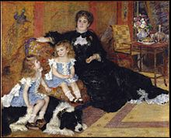
Portrait painting can depict the subject "full-length"), "half-length" (from head to waist or hips), "head and shoulders" (bust), or just the head. The subject's head may turn from "full face" (front view) to profile (side view); a "three-quarter view"

Slide 6
Among the other possible variables, the subject can be clothed or nude; indoors or out; standing, seated, reclining; even horse-mounted. Portrait paintings can be of individuals, couples, parents and children, families, or collegial groups. They can be created in various media including oils, watercolor, pen and ink, pencil, charcoal, pastel, and mixed media.

Slide 7
Creating a portrait can take considerable time. Managing the sitter's expectations and mood is a serious concern for the portrait artist. After putting the sitter at ease and encouraging a natural pose, the artist studies his subject, looking for the one facial expression, out of many possibilities, that satisfies his concept of the sitter's essence. The posture of the subject is also carefully considered to reveal the emotional and physical state of the sitter, as is the costume. To keep the sitter engaged and motivated, the skillful artist will often maintain a pleasant demeanor and conversation.

Slide 8
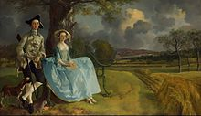
Central to the successful execution of the portrait is a mastery of human anatomy. Human faces are asymmetrical and skillful portrait artists reproduce this with subtle left-right differences. Artists need to be knowledgeable about the underlying bone and tissue structure to make a convincing portrait.

Slide 9
Thank You

