Slide 1
Determination of fat in milk
Method-1 - Gerber Method

Slide 2
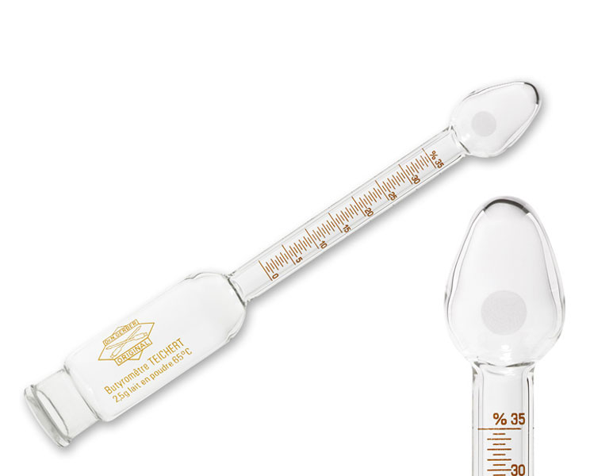
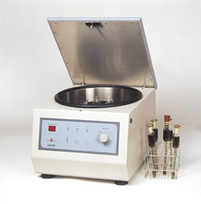
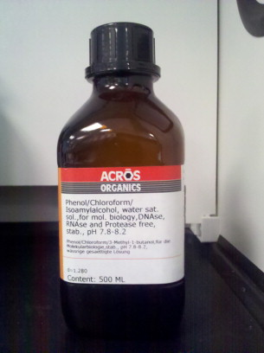
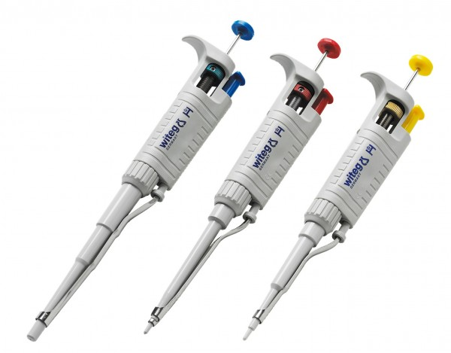
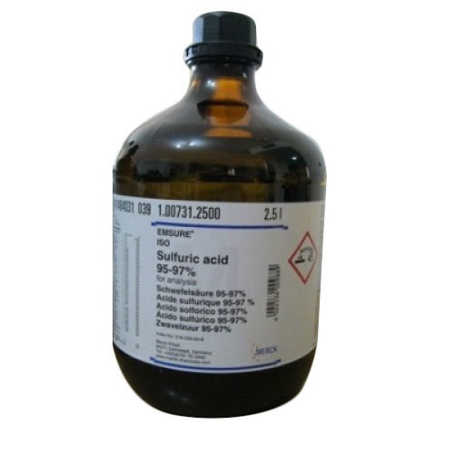
Gerber tube (butyrometer)
Centrifuge for Gerber method
Sulphuric acid
Pipette
Iso-amyl alcohol

Slide 3
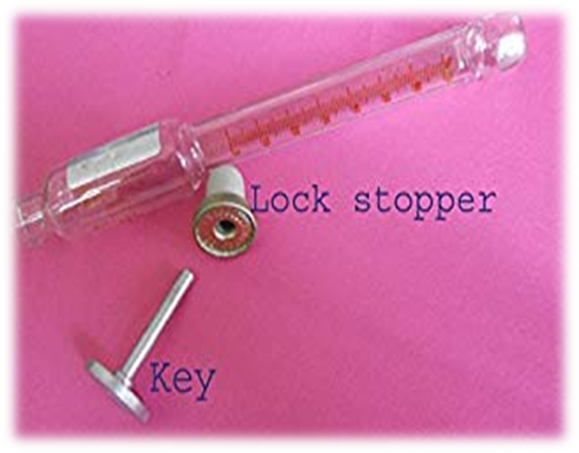
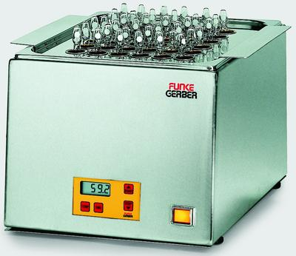
Water bath for butyrometer
Lock stopper and key for butyrometer

Slide 4
Reagents and apparatus
Sulphuric acid (density- 1.812g/ml, concenration-90-91%)
Iso-amyl alcohol (0.818g/ml, furfural free)
Gerber butyrometer- 6, 8 and 10 percent
Pipette- 10ml for sulphuric acid
Pipette- 10.75ml for milk
Pipette- 1ml for iso-amyl alcohol
Lock stoppers for butyrometer
Lock stopper key
Water-bath
Gerber-Centrifuge

Slide 5
Method
The milk is mixed with sulphuric acid and iso-amyl alcohol in a Gerber tube, permitting dissolution of protein and release of fat
The tubes are centrifuged and the fat rising into calibrated part of the tube is measured as percentage of fat content of milk sample
This method is suitable as a routine or screening test

Slide 6
WATER-BATH
Water-bath shall be made of suitable material (stainless steel)
Capable of being maintained at 65 ± 2º C temperature
Shall have sufficient depth to support butyrometer in vertical position with their scale completely immersed
The bath shall be fitted with horizontal perforated plates to hold the butyrometers
Shall also carry suitable thermometers

Slide 7
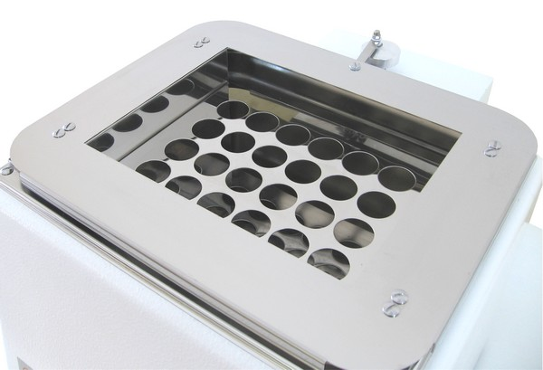

Slide 8
Gerber-centrifuge
The centrifuge may be hand driven or electric driven
Shall be capable of producing within 2 min when fully loaded, a relative centrifugal acceleration of 350 ± 50 gn at the outer end of butyrometer stopper

Slide 9
Procedure
Measure 10 ml of sulphuric acid in butyrometer tube without wetting the neck of butyrometer
Run the milk sample into butyrometer tube along the side wall without wetting the neck
Add 1 ml of iso-amyl alcohol, close with the lock stopper, shake until homogenous, invert it for complete admixture of the acid
Keep in a water bath for 5 minutes at 65 ± 2º C
Centrifuge for 4 minutes at 1100 rpm
Allow the centrifuge to come to rest
Remove the butyrometer tubes and place in water bath for 5 minutes

Slide 10
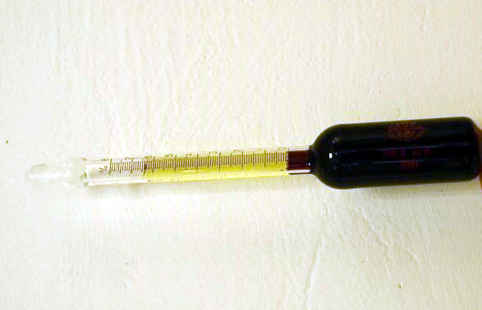
Procedure
Read the percentage of fat after adjusting the height in the tube as necessary by movements of lock stopper with the key
Note the scale reading corresponding to the lowest point of the fat meniscus and the surface of separation of fat and acid
When readings are being taken, hold the butyrometer vertical, read the butyrometer to the nearest half of the smallest scale division

Slide 12
Note
Butyrometer must always be emptied without delay and highly acidic waste dispose off completely
Tubes must be cleaned with chromic acid
In homogenized milk, fat separates with more difficulty and centrifuging more than once may be required
In case of old samples, the concentration of sulphuric acid may be increased to facilitate better dissolution

Slide 13
