Slide 1
Asphyxia & Drowning
Lesson 4(mechanical Asphyxia overview ,their medicolegal aspects &others)
Dr Nadir Ali

Slide 2
COMMON MECHANISMS OF MECHANICAL ASPHYXIA
Obstruction Of External Respiratory Passages (Nose, Mouth):
Suffocation:
Smothering.
Gagging.
Overlaying.
Obstruction Of Internal Respiratory Passage (Larynx, Trachea, Bronchi):
Choking:

Slide 3
I. Foreign Body Obstruction.
II. Laryngeal Edema.
III. Laryngospasm.
Neck Compression:
Manual Strangulation (Throttling).
Ligature Strangulation (Garotting).
Hanging (Suspension).
Chest Compression:
Traumatic Asphyxia.

Slide 4
SUFFOCATION
Types
1.Smothering.
2. Gagging.
Autopsy Findings:
A. General Asphyxial Findings
B. Specific findings.

Slide 5
Specific Findings of suffocation
Bruise (mouth, nose, cheeks, lips & mucosal surfaces).
Distribution of Lividity.
Abrasion around nose/mouth.
Rupture of lips.
Fracture of nasal bone/teeth.
Tape/cloth may be found in smothering and gagging respectively.

Slide 6
Suffocation

Slide 7
Suffocation

Slide 8
Suffocation

Slide 9
Suffocation

Slide 10
STRANGULATION (Circumferential Squeezing of Neck))
Types:
Manual Strangulation (Throttling)
Ligature Strangulation (Garroting)
Hanging (Suspension)
Manual Strangulation (Throttling)
Constriction of the neck of a person by pressure from hands/forearm of another person.

Slide 11
MECHANISM / MODE OF DEATH
Cerebral Hypoxia.
Anoxic Anoxia.
Reflex Cardiac Inhibition.
AUTOPSY FINDINGS:
General Asphyxial Findings:
More the agonal period more prominent are the finding. In complete obstruction, time is less – so less prominent Asphyxial findings. In partial obstruction, time is more – so more prominent findings like cyanosis, congestion, petechiae.

Slide 12
Specific Findings of Throttling
Disc-like fingertip bruises.
Nail Marks (abrasions from assailant or victim).
Bruising of neck and underlying soft tissues.
Fracture of Hyoid bone or Thyroid cartilage are common.

Slide 13
Throttling

Slide 14
Throttling

Slide 15
Throttling

Slide 16
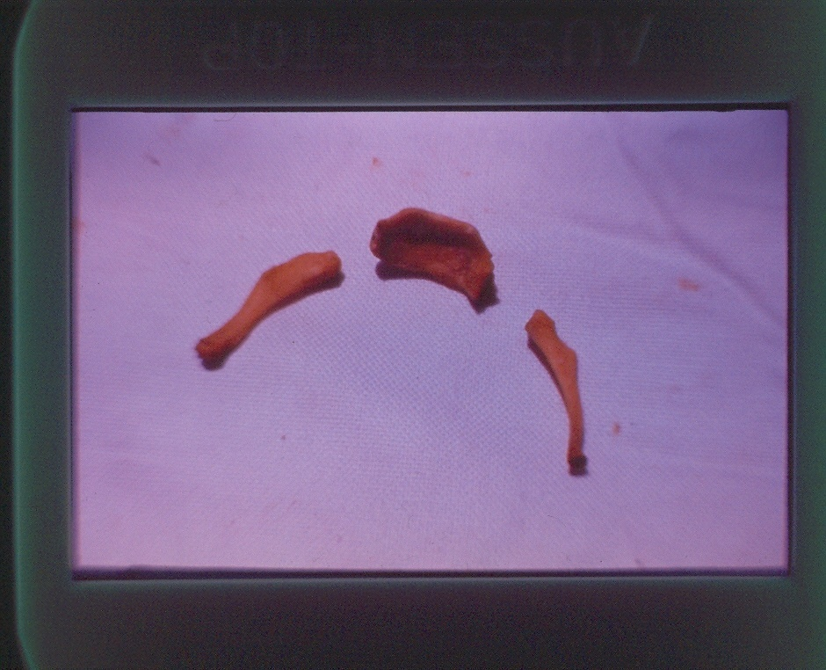
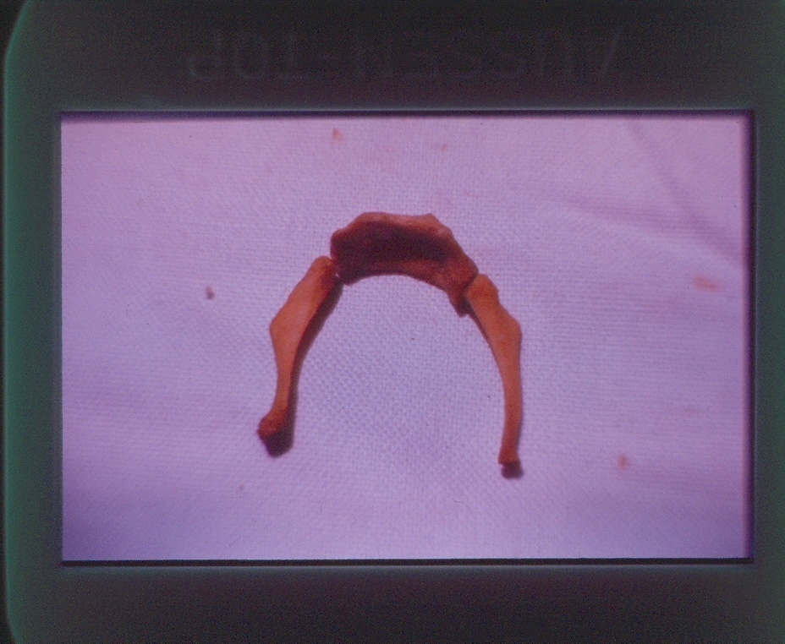
Hyoid Bone

Slide 17
Ligature Strangulation (Garroting )
Constriction of the neck by a Ligature the constricting force being applied directly to the ligature.
Mechanism Of Death:
Cerebral Hypoxia.
Hypoxic Hypoxia.
Reflex Cardiac Inhibition.

Slide 18
AUTOPSY FINDINGS:
1)General Asphyxial Findings:
Cyanosis.
Gross Congestion.
Generalized edema.
Petechiae in the face.

Slide 19
Specific Findings of garroting
1. Ligature mark
It is generally in the midline of the neck and is continuous all around the neck horizontally.
Soft Ligature e.g., Dupatta leaves a diffuse mark while
hard Ligature e.g., wire or rope, leaves a more defined, deeper mark.

Slide 20
Specific Findings: (cont.)
2. Finger mark abrasions in attempt to relieve the constriction.
3. Bruising of the soft tissue.
4. Fracture of Hyoid bone may occur

Slide 21
Ligature Mark
Hard Ligature & Soft Ligature.

Slide 22
Ligature Strangulation

Slide 23
Ligature Strangulation

Slide 24
Ligature Strangulation

Slide 25
HANGING

Slide 26
HANGING
Mechanisms of death
Anoxic Anoxia.
Reflex Cardiac Arrest.
Fracture dislocation of cervical vertebrae (compression of floor of 4th ventricle).

Slide 27
Specific Findings of Hanging
:
LIGATURE MARK is in upper part of the neck, usually depressed below the skin surface.
Usually running obliquely upwards towards the point of suspension and may be missing near the peak.

Slide 28
However, if a running knot is used, the ligature mark may be horizontal all around the neck and can be confused with that of Garotting.
Usually no evidence of injury surrounding the ligature mark is present.
Patches of lividity may be found above the ligature mark.

Slide 29
2) Soft tissue injuries may be present.
Fracture of hyoid bone and thyroid cartilage are uncommon.
Distribution of Post Mortem staining may be characteristic (Stocking & Glove distribution).
Fracture of cervical vertebra in case of sudden drop.

Slide 30
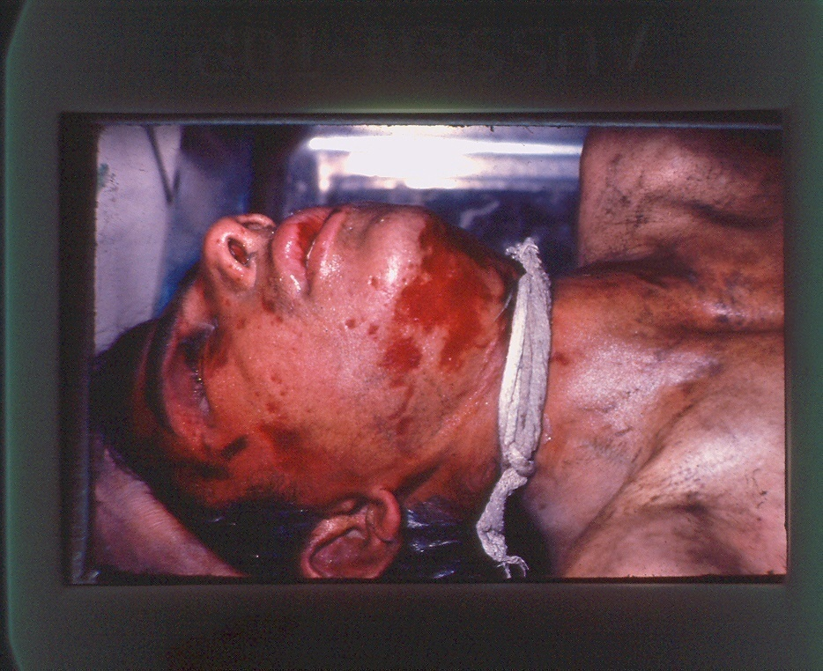
Difference Between Ligature Pattern Of Garroting & Hanging

Slide 31
Hanging- Ligature Mark

Slide 32
Hanging- Ligature Mark

Slide 33
Hanging

Slide 34
Hanging- Ligature Mark with Running Noose

Slide 35
Hanging

Slide 36
No | Features | Hanging | Strangulation
1. | Manner of death | Mostly suicidal | Mostly homicidal
2. | Ligature Length Application Knot | Long Single turn On the back of neck | Short More than 01 turn In front of neck
3. | Ligature mark Site Direction Extent Knot imprint Depth of the groove | High up in the neck Oblique Incomplete At the occiput or side of the face Decreases towards the knot | Middle of the neck Horizontal Complete In front of neck if present Uniform

Slide 37
No | Features | Hanging | Strangulation
4. | Others Nail marks Cyanosis Facial congestion Petechael haemorrhage Saliva Bleeding from nose and mouth Fracture dislocation of cervical vertebrae | Absent Mild or absent May be present Scanty Running out of the angle of the mouth Rare Common in judicial hanging | Usually present. Intense. Marked. Numerous. Usually absent but if present, is blood mixed. Common. Rare

Slide 38
TRAUMATIC ASPHYXIA
Traumatic immobilization of the chest with stoppage of respiratory function. Commonly seen in compression of chest due to building collapse after mass disasters, collapse of trenches and by weight of grains or soil etc.
MECHANISM OF DEATH:
Anoxic Anoxia.

Slide 39
AUTOPSY FINDINGS:
Cyanosis, intense congestion of face and upper chest and petechiae are present.
Specific:
MEDICOLEGAL ASPECTS:
Almost always accidental.
Homicidal – rare, in sadative sexual Adventure.

Slide 40
Specific Finding of Traumatic Asphyxia
No external injury may be visible. However, bruises on the chest may be present.
Soft tissue damage (respiratory muscles).
Rib fractures.
Lung tear / laceration.
A clear cut demarcation line between the areas above the level of pressure (congested area) and the one below (normal area).

Slide 41
Traumatic Asphyxia

Slide 42
Traumatic Asphyxia

Slide 43
Medicolegal aspects of different types of asphyxia
Suffocation
It is manly homicidal and accidental. Suicie is not possible.
Homicidal:
Closing the mouth and nostrils with hands, tap or cloth during dacoity, sexual assaults or in infanticide.

Slide 44
Medicolegal importance of suffocation (contd…)
B. Accidental:
In infants:
May be found dead in prone position with face buried in a soft pillow
Death may be due to overlaying by mothers in sleep or going to sleep while feeding.
b) In children:
Children when playing, use a polythene bag as helmet over his face to identify with a space man which will get molded to nose and mouth.
c) An old infirm or intoxicated man:
May fall facing downwards in mud & die in this position

Slide 45
Medicolegal importance of Asphyxia (contd…)
2. Throttling
Mostly Homicidal
3. Garroting
Mostly Homicidal
4. Hanging
Mostly suicidal. Careful examination should be done for antemortem or postmortem hanging.
In antemortem hanging with other vital signs, you may find their a letter or a note by the deceased.

Slide 46
Medicolegal importance of Asphyxia (contd…)
5. Choking
Causes of death in choking may be:
Asphyxia
Vagal inhibition
Laryngeal spasm
Bronco spasm

Slide 47
Medicolegal importance of choking (contd…)
Coins, buttons in children, slipping down in to respiratory tracts
Dentures may go into air passages and block them
Food boles may go into respiratory tract in mentally ill or in intoxicated persons
Inhalation of vomited material under the influence of alcohol, anesthetic drugs or in coma.
Bleeding into respiratory passages during tonsillectomy or tooth extraction.

Slide 48
Café coronary
It is a condition of accidental choking when a bolus of food completely obstructs the larynx.
It is so called because it occur in a cafe and its suddenness and associated collapse mimic a coronary heart attack.
The condition occurs commonly when gag reflex is suppressed in intoxicated individuals or after heavy doses of tranquillizers.
Death may occur due to asphyxia or reflex cardiac arrest.

Slide 49
6. Traumatic asphyxia
A. Mostly accidental e.g.
In collapse of buildings (Earthquake)
In heavy crowed as during HAJJ performance
In RTA
An obese mother may roll over a child during sleep

Slide 50
B. Rarely Homicidal
As Burking Method in U.K
This procedure was used in U.K by two murderers, Burke & Hare, to kill their victims and to sell their bodies for dissection to the Edinburgh Medical College students. Burke used to sit on the chest of his inebriated victim covering with one hand the mouth and nostrils and pushing up the jaw with the other hand while Hare used to pull him round the room by the feet. The method provides a mixed example of smothering and traumatic asphyxia.

Slide 51
7. Autoerotic/Sexual Asphyxia
It is a special form of sexual deviation and accidental asphyxia which is seen usually in young males involved in masochism and transvestism.
Sexual pleasure can be enhanced by partial reduction of blood supply to the brain.
The dead body is partially dressed in female clothes and is tied with ropes in a complicated fashion with a noose around the neck over a soft pad and another around the penis.

Slide 52
7. Autoerotic/Sexual Asphyxia (contd…)
There is a fine line between the compression necessary to produce sexual pleasure and that which produces unconsciousness, the victim may place himself in a position of accidental blackout and unexpected death.
The scene of incidence is usually an isolated spot. overt sexual elements like pornographic literature are present at the scene. Death is due to accidental asphyxia and takes place in an attempt to enhance orgasm, which ends life.

