Slide 1
Customer Relationship Management (CRM)

Slide 2
Data Elements in SAP ERP
Todays we will discuss
How data is managed in SAP ERP?
Understanding the components of creating a sales order in ERP.
Understanding the steps involved in creating the standard order in SAP ERP.
The overall order management process in ERP.
Importance of CRM in ERP Systems.
Notes:
If SAP ERP is a vendor then what data elements they need to be save
What are the types of data even if using a customized data

Slide 3
Master Data
Long-term data represent entities associated with various processes
Customer
Vendor
Material
Centrally stored and is processed to eliminate data redundancy.
Typically includes
General Data (across company’s code)
Financial Data
Area-Specific Data

Slide 4
Transactional Data
Data generated during execution of a process is termed as transactional data.
It requires
Organizational Data
Master Data
Situational Data (What, when and how is it happening?)
Example: Sales Order Creation
Organizational elements:
Client,
Company Code
Sales Area
Master Data
Customer
Material
Situational Data (What, when and how is it happening?)
Date
Time
Person date

Slide 5
Example of SAP ERP Data
Notes:
Organizational and master data is stored once so it is visible across the board
Situational data means who has placed the order
All this data will create one transaction.

Slide 6
Creating Order in ERP
The three types of master data critical to sales order processing
Customer – Shared with Financial Module
Material – Shared with Material Management and Production Planning
Pricing

Slide 7
Creating Order in ERP
When sales order is created
Customer Master
Material Master
Condition records for Pricing
Tables in Configuration for shipping point and route
Data can also be manipulated from an inquiry or quote.
Notes:
We need to populate this information

Slide 8
Standard Order in SAP ERP
Task is completed by
Order entry screen in SAP ERP’s Enterprise System
A unique number is assigned by the company to each customer
For most data entry fields, SAP ERP systems determines whether an entry is valid

Slide 9
Standard Order in SAP ERP

Slide 10
Standard Order in SAP ERP
Data Entry Fields
Sold-To Party: Identification number assigned to the customer
PO number: The number assigned by the customer to the sales transaction. In paper process the purchase order number is sequential number on order form.
Material: The identification number assigned in the SAP ERP to item requested by the customer.
Order Quantity: The number of units of the material requested by the customer.

Slide 11
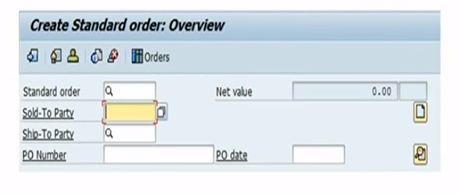
Standard Order in SAP ERP

Slide 12
Standard Order in SAP ERP
When sales order is saved, SAP ERP System assigns a document number to the sales order transaction.
SAP ERP System keeps track of the documents number for the sales order.
Employees can track status of the order.

Slide 13
Order Management Process

Slide 14
What is CRM?
CRM stands for Customer Relationship Management.
It is a software system that is used to effectively manage the
sales process,
track customer interactions,
store information about customers (including purchase history, revenue generated, up-selling and cross-selling opportunities, etc.), and
ultimately strengthen relations with customers.
CRM, however, is not just about software systems. It is a philosophy for interacting with your clients to make sure that they are happy and that they keep coming back to use your products and services.

Slide 15
CRM Sales Management Functionality
A CRM system supports your sales team at every stage of the sales cycle, from leads to customer management. Below are a few use cases:
View and manage account activity and communications
Use reports to forecast sales, measure business activity, identify trends
Qualify leads and track prospective customers
Centralize customer data
Access, update, and share information across teams and departments.

Slide 16
Core Activities of CRM
The core activities of CRM system may include:
One-to- One Marketing
Call Center Automation
Sales Forecast Automation (SFA)
Sales Campaign Management
Contact Management Tool
Sales Activity Manager
Notes:
Contact Management Tool : To make sure information about sales contact is available across the organization
Sales Activity Manager: Supports a strategic and organized approach to sales activity planning and follow-up activities.

Slide 17
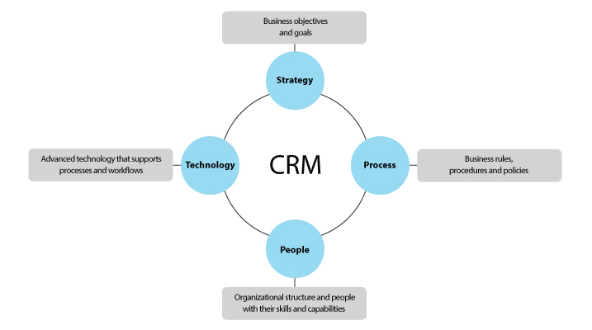
Key components of a successful CRM

Slide 18
SAP CRM System
SAP’s Business Warehouse: It is a system for reporting and analyzing transactional data relationship with the customer.
Advance Planner and Optimizer (APO): It is a system that supports efficient planning of the supply chain SAP’s view of CRM to provide a set of tools to manage the three basic task areas:
Marketing,
Sales, and
Service.

Slide 19
SAP CRM System

Slide 20
Marketing Automation
Marketing Automation
It can be described as event-based trigger marketing that is used to launch messaging and offer presentations to customers at particular points in time. CRM helps not only trigger the communications, but also measure the results.

Slide 21
Double Opt-in
The double opt-in process implies that a subscriber fills out your signup form first and then confirms subscription to your list. In other words, the double opt-in works as follows:
A prospect signs up to receive emails via your website, at a tradeshow etc.
You send a confirmation email to him/her asking them to click on a link that confirms that they have opted to subscribe to your messages.
You get the double opt-in permission from prospects.
This eliminates the chance of abuse where somebody submits somebody else’s email address without their knowledge or against their will.
Note that every communication you send must have the option for the contact to unsubscribe at any time.

Slide 22
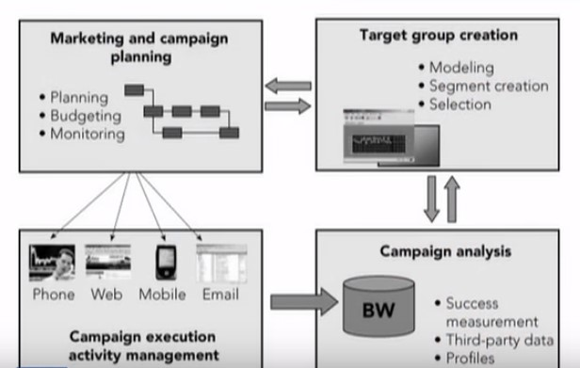
SAP CRM System
Four phases of the cultivation of the customer relationship:
Prospecting,
Acquiring,
Servicing,
Retaining

Slide 23
Key Differences between CRM and SFA
From a software perspective, SFA (Sales Force Automation) often refers to a primary component of CRM.
SFA is typically used by sales people and managers and covers functions such as
contact management,
account management,
activity management and
opportunity management.
Sometimes SFA systems also include capabilities such as
sales order processing,
Partner Relationship Management (PRM), etc.

Slide 24
Key Differences between CRM and SFA

Slide 25
Benefits of CRM System
A CRM system can help you
recognize prospective customers,
learn more about current customers,
understand their preferences,
frequently anticipate their needs and respond to their requests quickly and effectively.
In other words, with a CRM system, you can track, organize, and consolidate your interactions with clients.
Note:
When should I start tracking my customers' activities? This is best to start doing before they actually become your customers. This will help you maximize the ROI and retain each customer.

Slide 26
Benefits of CRM for Businesses
With a CRM system, your organization will be able to improve productivity, reach out to more prospects and close more sales. CRM can help you:
Raise customer satisfaction
Increase customer retention
Reduce marketing expenses
Anticipate customer needs and preferences
Increase operating efficiencies
Improve targeted marketing efforts of customers and prospects
Provide quicker service to customers.
Note:
Is CRM required for small business with limited customers?
CRM software can benefit small businesses by consolidating customer data into a single system. As your business grows, keeping a record of all transactions can become very challenging. CRM will allow you to manage customer interactions more efficiently, so you have more time to focus on your service or product.

Slide 27
E-mail Management through CRM
CRM software may provide workflow-enabled email processing capabilities.
It can retrieve emails sent from your customers,
automatically route them to appropriate users based on workflow rules,
send auto replies back to your customers,
automatically associate emails with incidents and customers,
manage multiple attachments in emails, etc.
Examples of Automated Messages:
Automated welcome messages to new customers, personalized with their most recent transactions
Thank-you messages to recognize your customers' activities
Lapsed messages with an irresistible offer to re-activate former highly valuable customers
Cross-sell messages based on previous purchases
Run marketing campaigns that rely on repeated contact or several 'touches' with potential customers (ideal for high-value products with a long sales cycle).

Slide 28
Difference between on-premise and cloud-based CRM solutions
What is “cloud”?
The 'cloud' is a popular word for using the Internet to access data, stored on remote servers, i.e. like somewhere in the cloud. The cloud makes it convenient to get at information and services from anywhere.
Difference between on-premise and cloud-based CRM solutions.
As the name suggests, on-premise CRM software is run on computers within the premises of an organization.
In this case all the data and information is stored inside the premises of the company, too.
In recent years there has been a steady growth in the popularity of web-based solutions.
Cloud-based software implies that the software and all relevant data, is accessible through the Internet and is displayed in a web browser.
According to Gartner, 35% of all CRM implementations today use SaaS, growing to over 50% by 2020.

Slide 29
Advantages of using CRM on mobile devices
The major benefits include:
Increased sales values
Shortened sales cycle
Accelerated cash flow
Collection of data at its source
Increased productivity
Improved insight.
Please find more details in the infographic on next slide.

Slide 30
Advantages of Mobile CRM

