Slide 1
Subject: Population Studies
Class: MSc 4th
Lecture: 5th week
Topic: Life Tables

Slide 2
Types of Life Tables
1. The Complete Life Table
The Complete Life Tables provide estimates of life expectancy at exact ages up to the age of 80 years old, using as reference the date of July 1 of the previous year.
The main indicators extracted from the Complete Life Tables are the probabilities of death between two exact ages, in particular, the probability of a newborn dying before completing the first year of life, also known as infant mortality rate; and life expectancy at each age, in particular, life expectancy at birth.
The Complete Life Tables are obtained from the Abridged Life Tables, using appropriate methodologies to transform the five-year intervals used in them into one-year intervals in the Complete Life Tables.

Slide 4
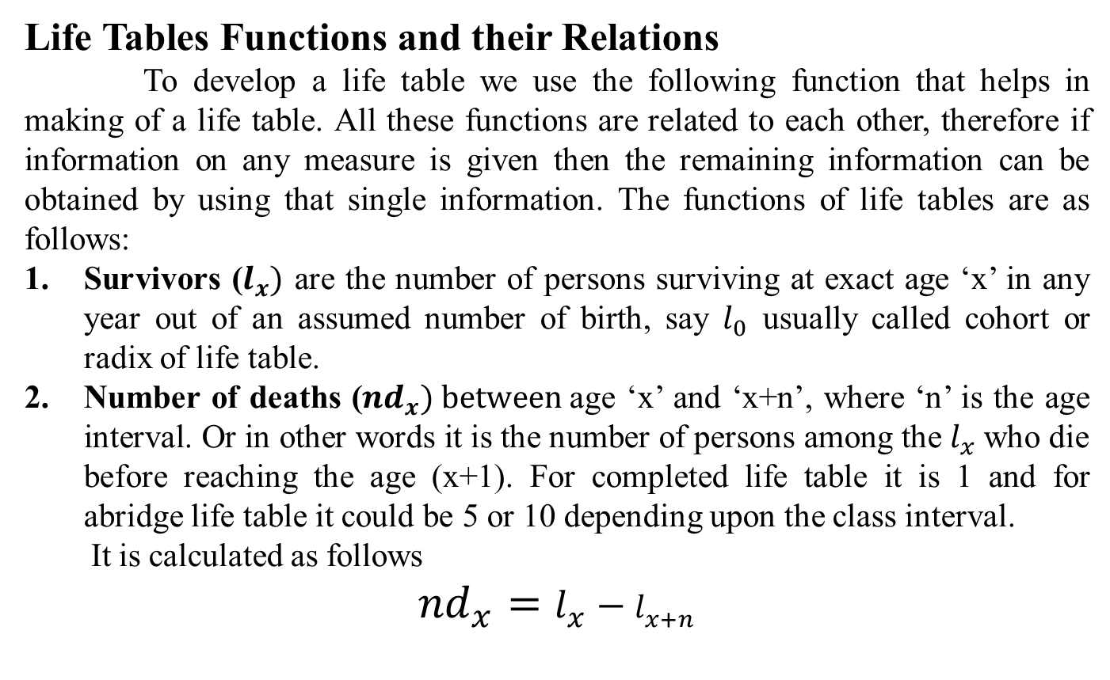
Life Tables Functions and their Relations
To develop a life table we use the following function that helps in making of a life table. All these functions are related to each other, therefore if information on any measure is given then the remaining information can be obtained by using that single information. The functions of life tables are as follows:
Survivors ($l_{x})$ are the number of persons surviving at exact age ‘x’ in any year out of an assumed number of birth, say $l_{0}$ usually called cohort or radix of life table.
Number of deaths (${nd}_{x}) between$age ‘x’ and ‘x+n’, where ‘n’ is the age interval. Or in other words it is the number of persons among the $l_{x}$who die before reaching the age (x+1). For completed life table it is 1 and for abridge life table it could be 5 or 10 depending upon the class interval.
It is calculated as follows
$${nd}_{x}=l_{x}−l_{x+n}$$

Slide 5
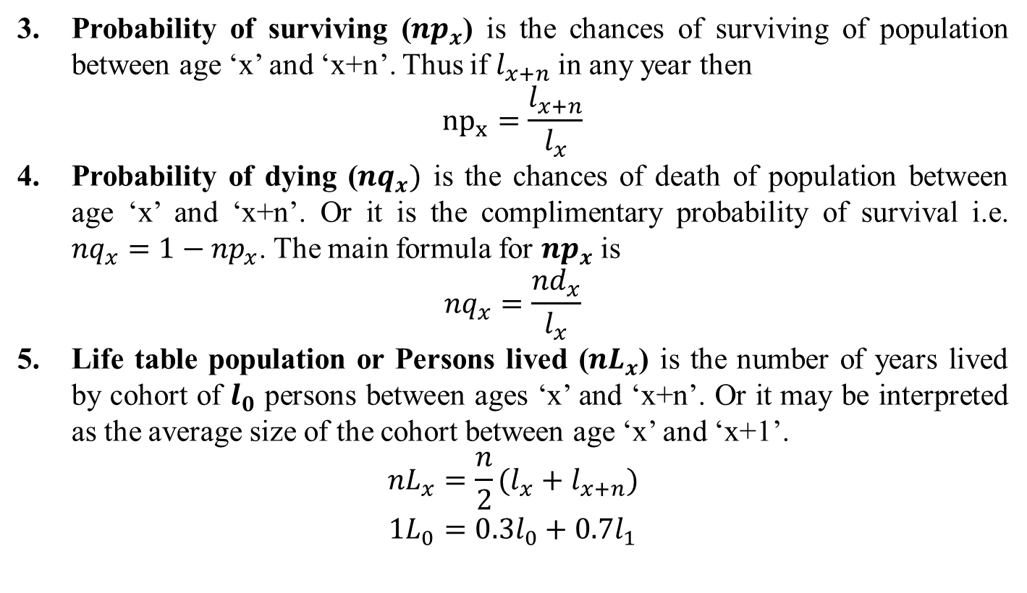
Probability of surviving (${np}_{x}$) is the chances of surviving of population between age ‘x’ and ‘x+n’. Thus if $l_{x+n}$ in any year then
$${np}_{x}=\frac{l_{x+n}}{l_{x}}$$
Probability of dying (${nq}_{x})$ is the chances of death of population between age ‘x’ and ‘x+n’. Or it is the complimentary probability of survival i.e. ${nq}_{x}=1−{np}_{x}$. The main formula for ${np}_{x}$ is
$${nq}_{x}=\frac{{nd}_{x}}{l_{x}}$$
Life table population or Persons lived (${nL}_{x}$) is the number of years lived by cohort of $l_{0}$ persons between ages ‘x’ and ‘x+n’. Or it may be interpreted as the average size of the cohort between age ‘x’ and ‘x+1’.
$${nL}_{x}=\frac{n}{2}(l_{x}+l_{x+n})$$
$${1L}_{0}=0.3l_{0}+0.7l_{1}$$

Slide 6
Total persons years lived ($T_{x}$) is the total number of years lived by the cohort $l_{0}$ after attaining the age ‘x’, i.e. it is the total future life time of the $l_{x}$ persons who reach age ‘x’.
$$T_{x}=L_{x}+L_{x+1}+L_{x+2}+…….$$
Life expectancy ($e_{x}$) is the average number of years lived by cohort from exact age ‘x’ till death of all members of the cohort. It is estimated by dividing $T_{x}$ with $l_{x}$.
$$e_{x}=\frac{T_{x}}{l_{x}}$$

