Slide 1
ENTO-306
Agricultural pests and their management
Identification of important agricultural pests
Their mode of damages
Control measures
By: Dr. Muhammad Zeeshan Majeed

Slide 2
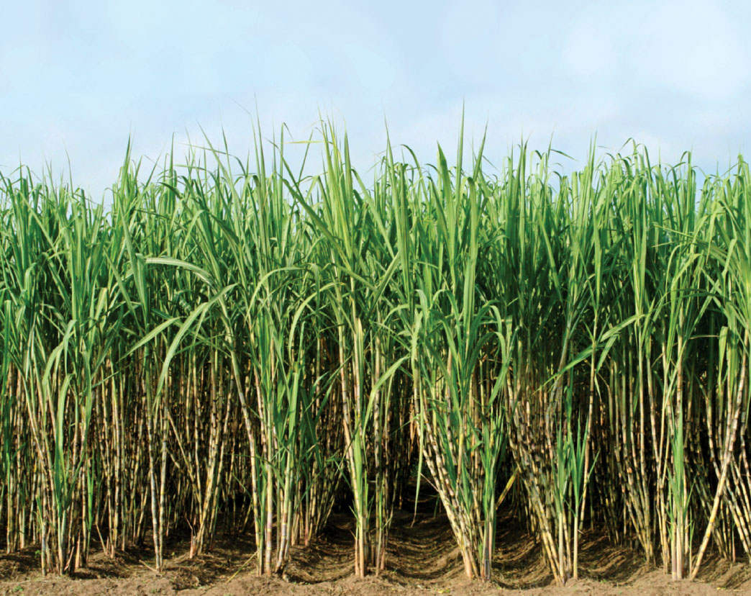
Major Insect Pests of Sugarcane Crop in Pakistan
Notes:
Important cash crop of Pakistan (Saccharum officinarum / S. spontaneum) tropical and sub-tropical climate crop. source of income and employment for the farming community.
fifth position in cane acreage and production and almost 15th position in sugar production. Brazil India China (with about 60 t/ha and sugar recovery 10-13 t/ha) Pakistan 35 t/ha with sugar recovery of 5 t/ha.
Provides essential items for industries like sugar, chip board, paper, barrage, confectionery, uses in chemicals, plastics, paints, synthetics, fiber, insecticides and detergents.
According to officials, total sugarcane cultivated area in 2019-20 was 1.06 million hectares against an area of 1.1 million hectares the year before; Pakistan's Marketing Year 2019/20 sugar production is forecast at 5.2 million tons, 2017-18 it was 6.5 million tons
2012-2013_area 1.13 million ha (India 4.5million) and production 63.7 million tonnes (India more than 300) with 5.05 million tonnes sugar at end of crushing season. Domestic needs of sugar in country is about 4.5 millon tonnes.
Per capita sugar consumption in Pakistan is 25 Kg. Global is 24.8 Kg. In India it is 20 kg
Almost 200 species of insects pests have been reported to attack sugarcane crop in Indo-PaK. Cause 15-35% yield loss.

Slide 3
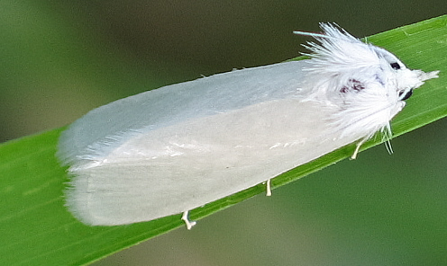
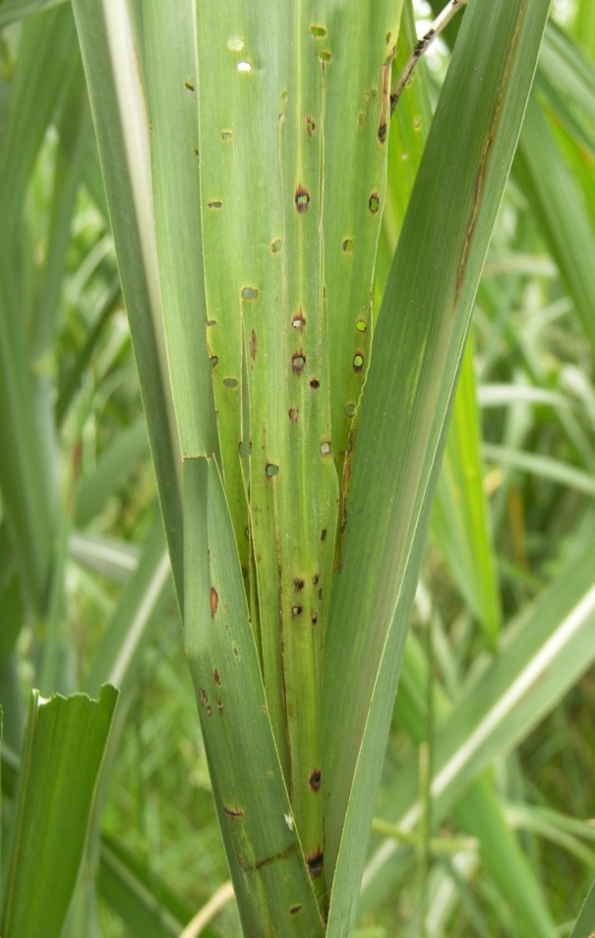
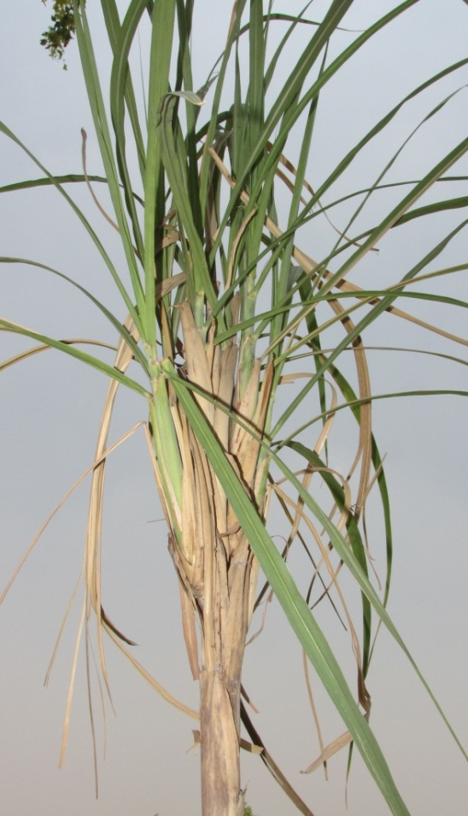
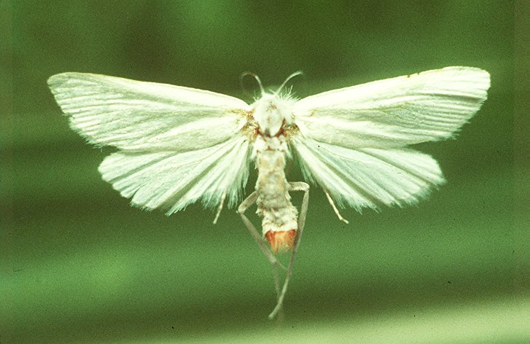
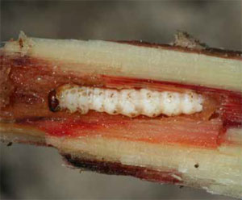
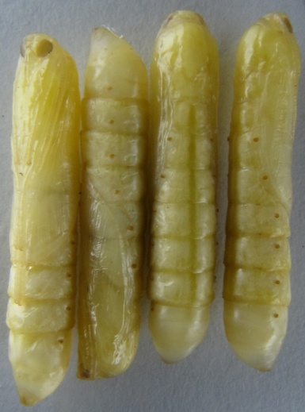
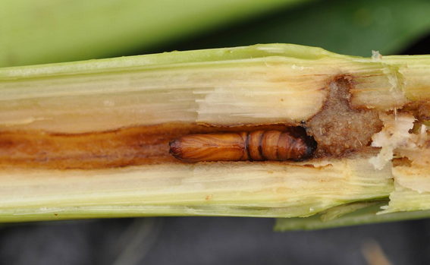
ENTO-306 Agricultural pests and their management 4(3-1)
Insect pests of Sugarcane Top borer (Scirpophaga nivella Pyralidae, Lepidoptera)
Dead-heart formation
then
Bunchy top (by side shoots development)
Notes:
Scirpophaga nivella
Larva is creamy white, 25-30mm long. Adults are pure silky white often found sitting on sugarcane tops in the morning. Females with reddish or orange or brownish tuft of silken hairs with which it covers its egg masses (30-60 eggs_total about 150 to 200 eggs/female) on lower leave surface of top leaves.
Usually, active period of all borers is March to November and dormant period is December to February. Overwinters (hibernates) as larva in cane tops. Pupation occurs in Feb.
Usually, borer moths are short-lived (4-5 days), larvae 4-5 weeks, eggs hatch in 4-5 days. 4-5 generations per year. 4-5 larval instars.
First two broods (generations) damage young cane plants and can cause major damage to crop. Subsequent broods cause dead-heart and bunchy tops and can cause 25% damage to crop weight and 0.3 to 3 units to sugar recovery units.
Larvae bore through lower side via mid rib of leaves, bores into the central core (growing point) and thus unfolded shot-holes on leaves show pest attack.
Full grown larva makes a pupal chambers with an emergence hole in rind between nodes.
Dead-heart and later on becomes bunchy-top.
In attacked young plants, there is presence of the reddish mid-rib streaks on the crown leaf indicates top-borer infestation
Control: Trichograma chilonis (egg parasitoids) Telenomus (Scelionidae) egg parasitoid
Mechanical/cultural: Collect and destroy egg clusters and moths after trapping by light.
Cut and burn attached shoots in April to June (young crop).
Chemical: Carbofuran granules application following irrigation

Slide 4
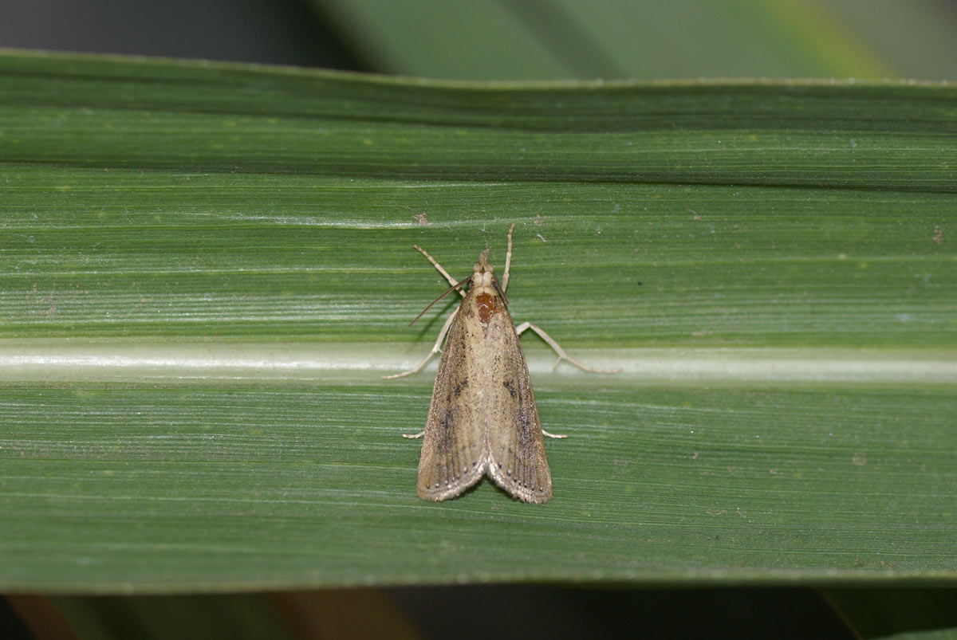
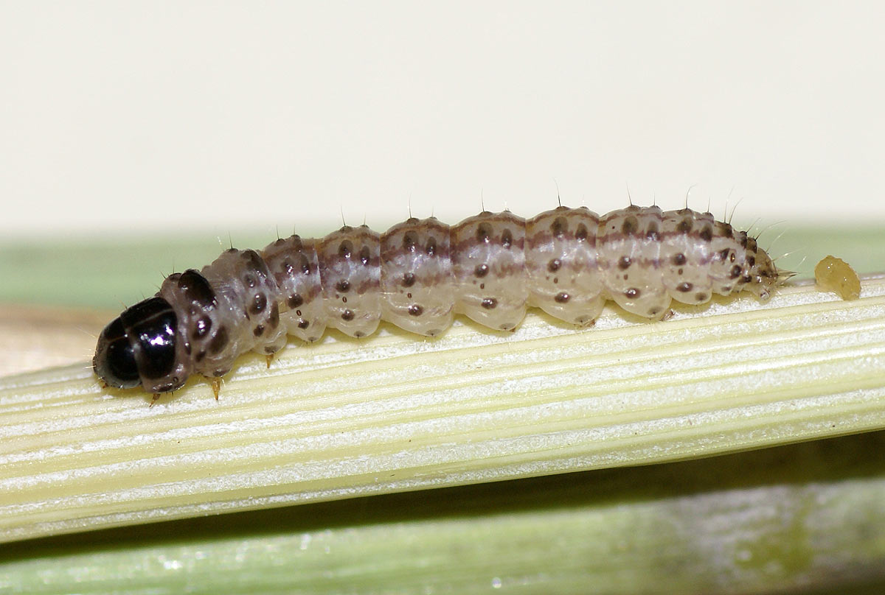
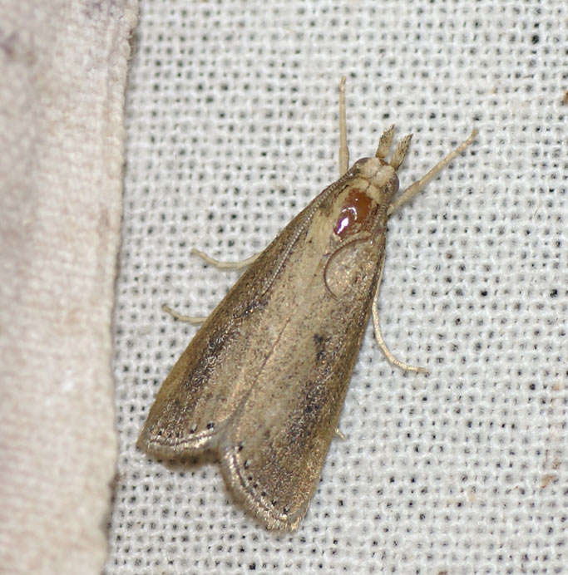
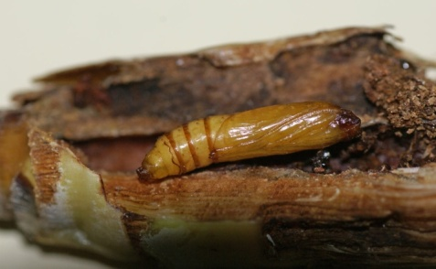
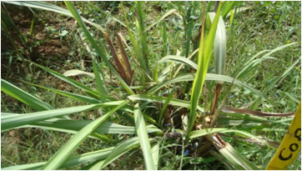
ENTO-306 Agricultural pests and their management 4(3-1)
Insect pests of Sugarcane Stem borer (Chilo infuscatellus Pyralidae, Lepidoptera)
Notes:
Chilo infuscatellus
The larva is dirty white (20-25mm) with five violet longitudinal stripes.
Moths have brownish grey-colored forewings and whitish hindwings.
In young crop (from April to June), the larvae bore into the plants by one or more holes and kill the growing point, resulting in the characteristic 'dead-heart' that emits a foul smell and can be easily pulled out.
the upper portion of the cane dries up completely (dead-heart formation mostly from April to June). After cane formation, attach does not results in to dead-hearts and remain confined to few inter nodes.
Losses about 15-25% of cane yield and 2% sugar recovery rate.
4-5 generations per annum and overwinters as full-grown larva in crop stubbles. Female lays 300-400 eggs in clusters on lower leaf surfaces.
Control:
Egg parasitoids Tricho
Larval parasitoid Apanteles flavipes
Pupae parasitoid Tetrastichus sp. (Eulophidae)
Chemcial: Carbofuran/carbaryl
Cane settes treatment with systemic pesticide before sowing.
Earthening up and irrigation of crop after granular application.

Slide 5
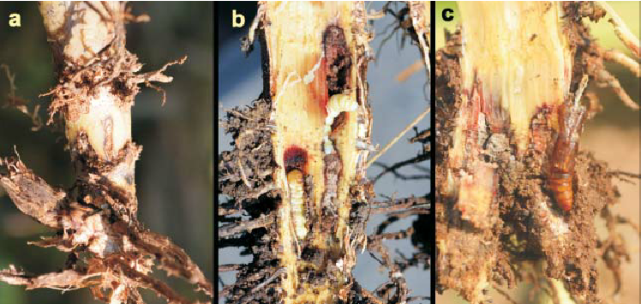
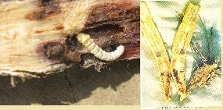
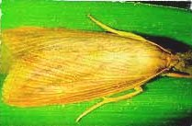
ENTO-306 Agricultural pests and their management 4(3-1)
Insect pests of Sugarcane Root borer (Emmalocera depressella Pyralidae, Lepidoptera)
Notes:
Emmalocera depressella
Larvae have creamy white body (30mm long) with yellowish brown head and with a somewhat wrinkled body.
Moths are pale yellowaqzxish brown forewings and white hindwings.
4 genetrations in an year and overwinters as full growin larva in crop stubbles in Feb. pupates after making an emergence hole just near stem root.
Female lays 200-300 scale like creamy white eggs on leaves, stems or on the ground near stem.
There is only one entry hole near the base of the shoot.
Dead hearts and general yellowing of the leaves. The dead hearts cannot be pulled easily and does not emit any offensive smell.
Damage can be upto 10% and sugar recovery upto 0.3 unit.
Control:
Egg parasitoids Tricho
Larval parasitoid Apanteles flavipes and Braconid wasps.
Chemcial: not needed.
Canes should be harvested deeply and soil should be deeply ploughed after harvesting.
Earthening up and irrigation of crop after granular application.

Slide 6
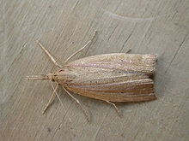
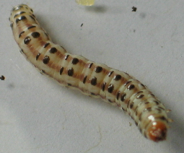
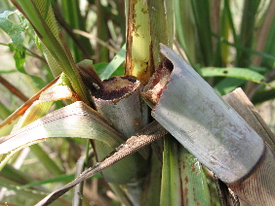
ENTO-306 Agricultural pests and their management 4(3-1)
Insect pests of Sugarcane Gurdaspur borer (Acigona stenniella Pyralidae Lepidoptera)
Notes:
Acigona steniella
1st time recorded in District Sialkot in 1923.
Larva creamy white 30-35 mm long with 4 longitudinal reddish white/violet strips. Orange brown head,
Adult dull brown forewings with tiny black spots in between veins along out margin. Hind wings white.
Active in July to October months.
100 to 300 flattened scale-like eggs laid in 5-20 eggs per mass on leave upper sides near veins. Larvae enter bore make spiral gallier and 3rd instar emerge and enter new canes besides. Voltinisim = 3
Young larvae enter the top portion of a cane through a single hole just above the node. They feed gregariously by making spiral galleries which run upwards.
Dried cane patches in the field is an indication of the pest attack
20-25 % crop loss could occur in some areas
Sugar contents recovery decline
Easily break off of infested canes by wind etc.
Removal of cane with maximum close to base.
Light traps
Deep ploughing after harvesting followed by flood irrigation mixed with some insecticide or kerosene oil etc.
Crop rotation

