Slide 1
Non-Conventional Technique for Crop Improvement
Dr. Saeed Rauf
Assistant professor

Slide 2
Bioinformatics
Genetics
Molecular Breeding
Plant Breeding
Molecular Genetics
Genomics
Recombinant DNA Technology
GMO
(Plant Biotechnology)

Slide 3
Modern Techniques in Plant Breeding
Marker assisted selection (QTL mapping)
Haploid breeding techniques
In vitro techniques
Recombinant DNA technology

Slide 4
Marker assisted selection (MAS) refers to the use of DNA markers that are tightly-linked to target loci as a substitute for or to assist phenotypic screening
Assumption: DNA markers can reliably predict phenotype

Slide 5
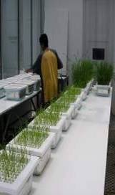
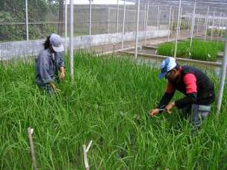
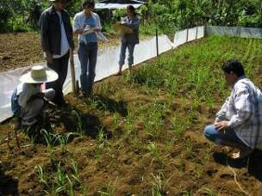
CONVENTIONAL PLANT BREEDING
P₁
x
P₂
Recipient
Donor
F₁
large populations consisting of thousands of plants
F₂
PHENOTYPIC SELECTION
Salinity screening in phytotron
Bacterial blight screening
Phosphorus deficiency plot
Glasshouse trials
Field trials

Slide 6
MARKER-ASSISTED BREEDING
P₁
x
P₂
Susceptible
Resistant
F₁
large populations consisting of thousands of plants
F₂
MARKER-ASSISTED SELECTION (MAS)
Method whereby phenotypic selection is based on DNA markers

Slide 7
Advantages of MAS
Simpler method compared to phenotypic screening
Especially for traits with laborious screening
May save time and resources
Selection at seedling stage
Important for traits such as grain quality
Can select before transplanting in rice
Increased reliability
No environmental effects
Can discriminate between homozygotes and heterozygotes and select single plants

Slide 15
Plant cells are Totipotent
Totipotency: ability of a cell or tissue or organ to grow and develop into a fully differentiated organism.

Slide 17
Inter-specific fusions
Datura innoxia X D. stramonium = D. straubii (O. Schieder)
Tomate X Kartoffel = Tomoffel (G. Melchers)
Nuclei fusion
4x
Synkaryon
2n x 2n
Somatic hybrids
Nuclei separate
2x
Heterokaryon
Fusion of haploid protoplasts (derived from anther cultures)
n + n= 2n
Cybrid Technology
Mixing two cytoplasm without hybrid formation.

Slide 18
Invitro techniques for plant breeding
Embryo culture
“Young embryos are removed from developing, seeds and are placed on a suitable nutrient medium to obtain seedling”
Recovery of Distant Hybrids
Recovery of Haploid plants
Overcoming Dormancy

Slide 19
Meristem culture
Germplasm exchange
Germplasm conservation

Slide 20
Somaclonal Variation
Genetic variations in plants that have been produced by plant tissue culture and can be detected as genetic or phenotypic traits.

Slide 21
Mechanism of Somaclonal Variations
Genetic (Heritable Variations)
Pre-existing variations in the somatic cells of explant
Caused by mutations and other DNA changes
Occur at high frequency
Epigenetic (Non-heritable Variations)
Variations generated during tissue culture
Caused by temporary phenotypic changes
Occur at low frequency

Slide 22
Detection and Isolation of Somaclonal Variants
Analysis of morphological characters
Qualitative characters: Plant height, maturity date, flowering date and leaf size
Quantitative characters: yield of flower, seeds and wax contents in different plant parts
Variant detection by cytological Studies
Staining of meristematic tissues like root tip, leaf tip with feulgen and acetocarmine provide the number and morphology of chromosomes.
Variant detection by DNA contents
Cytophotometer detection of feulgen stained nuclei can be used to measure the DNA contents

Slide 23
Detection and Isolation of Somaclonal Variants
4. Variant detection by gel electrophoresis
Change in concentration of enzymes, proteins and chemical products like pigments, alkaloids and amino acids can be detected by their electrophoretic pattern
5. Detection of disease resistance variant
Pathogen or toxin responsible for disease resistance can be used as selection agent during culture.
6. Detection of herbicide resistance variant
Plantlets generated by the addition of herbicide to the cell culture system can be used as herbicide resistance plant.

Slide 24
Somatic hybridization
Development of hybrid plants through the fusion of somatic protoplasts of two different plant species/varieties is called somatic hybridization

Slide 25
Somatic hybridization technique
1. isolation of protoplast
2. Fusion of the protoplasts of desired species/varieties
3. Identification and Selection of somatic hybrid cells
4. Culture of the hybrid cells
5. Regeneration of hybrid plants

Slide 26
Advantages of somatic hybridization
Production of novel interspecific and intergenic hybrid
Pomato (Hybrid of potato and tomato)
Production of fertile diploids and polypoids from sexually sterile haploids, triploids and aneuploids
Transfer gene for disease resistance, abiotic stress resistance, herbicide resistance and many other quality characters

Slide 27
Advantages of somatic hybridization
Production of heterozygous lines in the single species which cannot be propagated by vegetative means
Studies on the fate of plasma genes
Production of unique hybrids of nucleus and cytoplasm

Slide 28
Limitations of Somatic hybridization
Poor regeneration of hybrid plants
Non-viability of fused products
Not successful in all plants.
Production of unfavorable hybrids
Lack of an efficient method for selection of hybrids
No confirmation of expression of particular trait in somatic hybrids

Slide 29
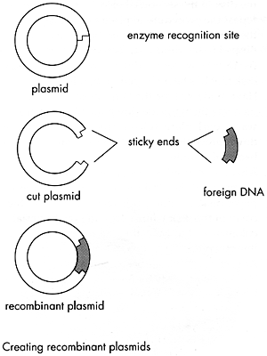
Recombinant DNA
The ability to combine the DNA of one organism with the DNA of another organism.
Recombinant DNA technology was first used in the 1970’s with bacteria.

Slide 30
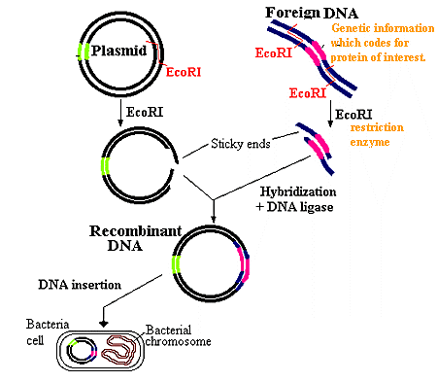
Recombinant Bacteria
Remove bacterial DNA (plasmid).
Cut the Bacterial DNA with “restriction enzymes”.
Cut the DNA from another organism with “restriction enzymes”.
Combine the cut pieces of DNA together with another enzyme and insert them into bacteria.
Reproduce the recombinant bacteria.
The foreign genes will be expressed in the bacteria.

Slide 31
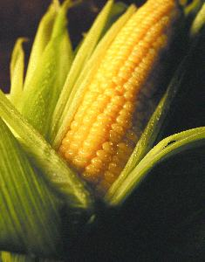
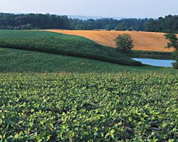
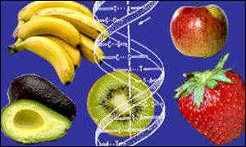
The DNA of plants and animals can also be altered.
PLANTS
disease-resistant and insect-resistant crops
2. Hardier fruit
3. 70-75% of food in supermarket is genetically modified.

Slide 32
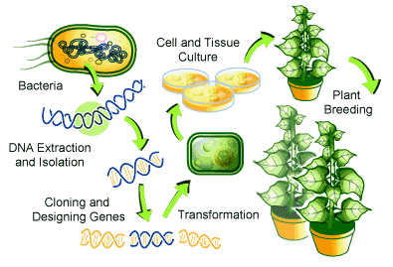
How to Create a Genetically Modified Plant
1.Create recombinant bacteria with desired gene.
2. Allow the bacteria to “infect" the plant cells.
3. Desired gene is inserted into plant chromosomes.

Slide 33
Global Area of GMOs, 1996 to 2009
 | Hectares (Million) | Acres (Million)
1996 | 1.7 | 4.3
1997 | 11.0 | 27.5
1998 | 27.8 | 69.5
1999 | 39.9 | 98.6
2000 | 44.2 | 109.2
2001 | 52.6 | 130.0
2002 | 58.7 | 145.0
2003 | 67.7 | 167.2
2004 | 81.0 | 200.0
2005 | 90.0 | 222.0
2006 | 102.0 | 250.0
2007 | 114.3 | 282.0
2008 | 125.0 | 308.8
2009 | 134.0 | 335.0
Total | 949.9 | 2,351.1
Increase of 7%, 9 million hectares (22.5 million acres) between 2008 and 2009. Source: Clive James, 2009.

Slide 34
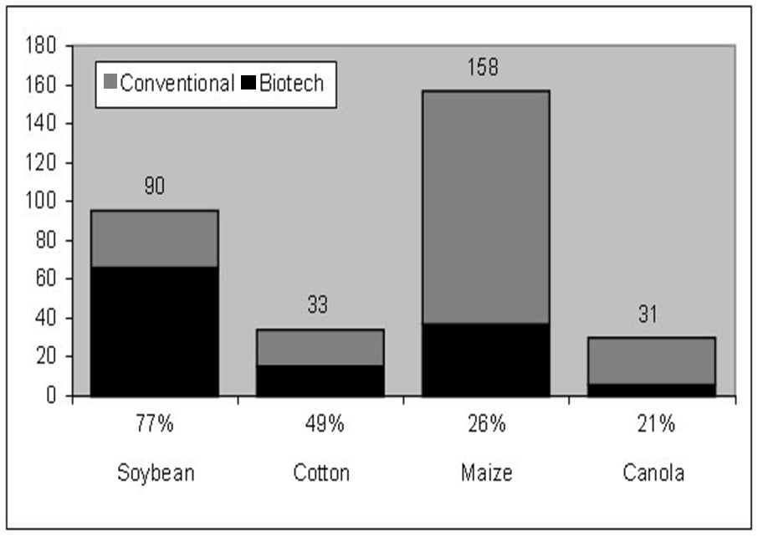

Slide 35
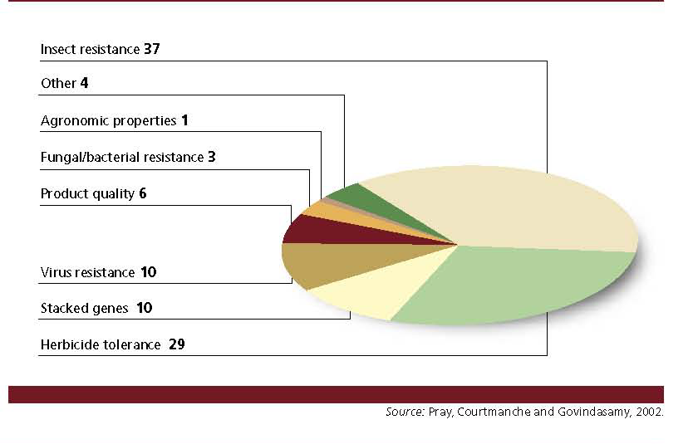

Slide 36
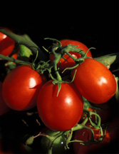
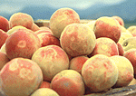
1) Economic crop
2) Energy plant
3) Biopharmaceutical farming
4) Industrial plant
5) Environmental application

Slide 38
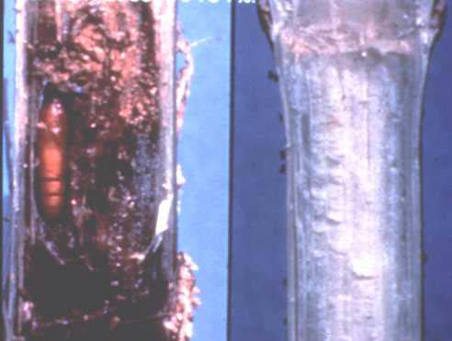
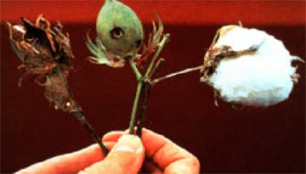
Insect resistance
Viral resistance
Fungal and bacterial disease resistance

Slide 39
Bacillus thuringiensis
cry1Aa, cry1Ab, cry1Ac
codes for Bt toxin
(δ-endotoxin)

Slide 40
This toxin is active against
Lepidoptera,
Diptera
Coleoptera
Bt toxin is consisting of 645 amino acids
http://www.bba.de/mitteil/presse/bt.jpg

Slide 41
Transgenic :potato, soybean, corn, canola
sugarcane, apple
Transgenes
- cystatin proteinase inhibitor (leafhopper)
- cysteine proteinase inhibitor (potato cyst nematode)
- proteinase inhibitor (PI) (light-brown apple moth)
Notes:
Proteinase inhibitors (PIs) are anti-metabolic proteins which interfere with the digestive process of insects. It
is one of the important defence strategies existing in plants against predators.

Slide 42
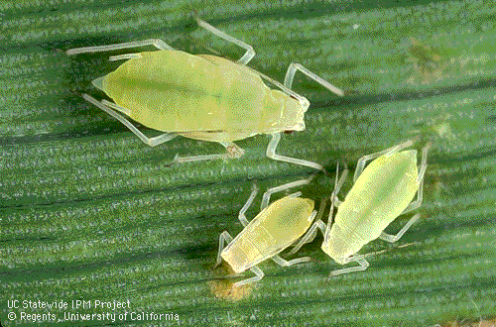
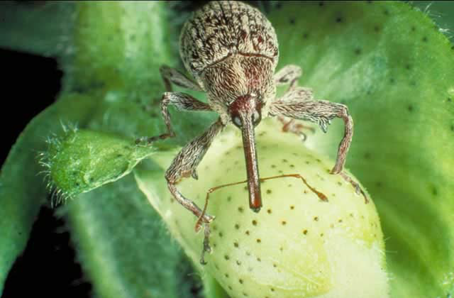
Transgenes
- cholesterol oxidase (Boll Weevil)
- lectin (brown plant hopper and green leaf hopper)
- β-glucosidase gene (BGL1) (whiteflies ; Bemisia tabaci)
Boll Weevil
Notes:
The aim of this work was to evaluate the influence of the enzyme cholesterol oxidase
(Coase) on emergence and viability of larvae of the cotton boll weevil (Anthonomus grandis Boheman,
1843).
Transgenic rice plants expressing snowdrop lectin (Galanthus nivalis agglutinin; GNA) were screened for resistance to green leafhopper (Nephotettix virescens; GLH), a major homopteran pest of rice. Survival was reduced by 29% and 53% (P<0.05) respectively, on plants where GNA expression was tissue-specific (phloem and epidermal layer) or constitutive. Similar levels of resistance in GNA-expressing transgenic rice were previously reported for rice brown planthopper (Nilaparvata lugens; BPH). GNA binding to glycoproteins in gut tissues showed that BPH contained more "receptors" than GLH, and that the binding affinity was stronger, particularly in the midgut. Subsequent toxicity of GNA is thus unlikely to be directly related to the amount of lectin bound.
Gibberellin (GA) levels were investigated because it is a known regulator of flowering time, plant height, and trichome development. Both GA₁ and GA₄ levels are 2-fold higher in BGL-1 leaves than in untransformed plants but do not increase in other organs. In addition, elevated levels of other plant hormones, including zeatin and indole-3-acetic acid, are observed in BGL-1 lines. Protoplasts from BGL-1 lines divide and form calli without exogenous hormones.
Whitefly (Bemisia tabaci) and aphid (Myzus persicae) populations in control plants are 18 and 15 times higher than in transplastomic lines, respectively. Lethal dose to kill 50% of the test population values of 26.3 and 39.2 μg per whitefly and 23.1 and 35.2 μg per aphid for BGL-1 and untransformed control exudates, respectively, confirm the enhanced toxicity of transplastomic exudates. These data indicate that increase in sugar ester levels in BGL-1 lines might function as an effective biopesticide. This study provides a novel strategy for designing plants for enhanced biomass production and insect control by releasing plant hormones or sugar esters from their conjugates stored within their chloroplasts.

Slide 43
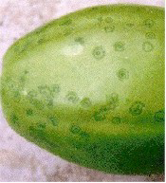
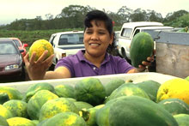
Transgenic : papaya, tomato, plum
Transgenes
- PRSV coat protein (Papaya ringspot virus)
- CymMV coat protein (Cymbidium Mosaic Virus )
Notes:
In plant species, infection by a mild virus can sometimes lead to resistance against a similar but more virulent virus. This principle is called cross protection. The immune systems of plants is very different from that of mammals - plants lack antibodies which can result in a similar effect in mammals. The exact mechanism by which cross protection works is unclear, but it may involve RNA silencing. To use cross protection to protect papaya from PRSV, a mild form of the virus was isolated and used to inoculate young trees in areas with high risk for PRSV. Infection of plants with the more virulent PRSV was reduced, but the mild strain did cause symptoms in the plants and the cross protection was primarily effective against only the most closely related viruses. The mild virus worked well in protecting trees in Hawaii from the Hawaii strain (from which the mild form was produced) but was less effective against the strain from Taiwan. Cross protection helped but was not an ideal solution.

Slide 44
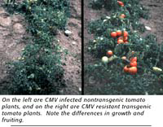
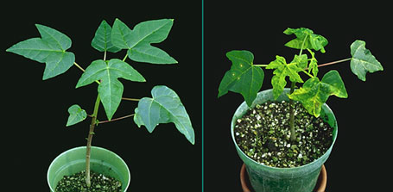
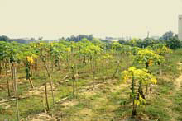
CMV resistance
Plum pox virus
Plantation severed
Papaya ring spot resistance

Slide 45
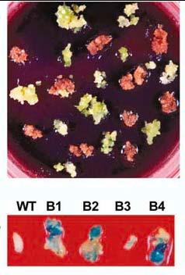
Transgenic : tobacco, potato,tomato,Phalaenopsis, Oncidium
Transgenes:
- ferredoxin-like protein (pflp) (Erwinia carotovora)
- wasabi defensin protein (Erwinia carotovora)
- thaumatin (Pythium aphanidermatum and Rhizoctonia solani)
- germin protein (oxalate oxidase) (Sclerotinia)
- chitinase
Notes:
The anti-microbial protein was frequently used to control the plant bacterial disease. In this study, it was investigated that the anti-microbial activity of recombinant plant ferredoxin-like protein (PFLP) both in vitro and in vivo. The in vitro assay demonstrated that PFLP produced by transformed Escherichia coli exhibited an anti-microbial activity against several bacteria strain including E. coli, Erwinia carotovora and Pseudomonas syringae. The effectiveness of this anti-microbial activity was depending on the FeSO₄ that was applied in the cultivated medium. PFLP lost its anti-microbial activity when it was mutated in the 86th cysteine residue that responding for iron binding. Besides, soft-rot symptom of tobacco plants infected by E. carotovora was reduced by application of recombinant PFLP. Transgenic tobacco ectopically over expressing PFLP in the cytoplasm protected plant from the infection of E. carotovora during the initial stage. These results indicate that PFLP is an anti-microbial protein that might be able to control the plant diseases via reducing the growth of bacterial pathogen.

Slide 46
drought resistance:
SacB (Levan sucrase ; Bacillus subtilis)
Fructan
salt tolerance:
PROCH, P5CS (γ-Pyrroline-5-carboxylate synthase)
Proline
GlyI (Glyoxylase I)

Slide 47
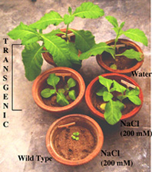
Cold Tolerance
Salt Tolerant

Slide 49
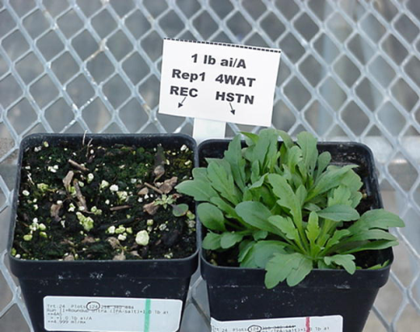
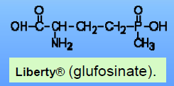
Herbicide Tolerance
Transgenic : soybean, canola, alfalfa, potato, cotton
Liberty link® (glufosinate).
Transgene
- modified EPSP synthase (Glyphosate; Roundup)
- phosphinothricin-N-acetyltransferase (ppt, bar)
(glufosinate, Basta)
- 2,4-D monooxygenase (tfdA) (2,4-D)- nitrilase (bromoxynil)

Slide 50
The Roundup Ready
Glyphosate: broad-spectrum herbicide
Active ingredient Inhibits a key enzyme (EPSP synthase) in an amino acid pathway
Plants die due to lack of key amino acids
A resistant EPSP synthase gene allows crops to survive spraying

Slide 54
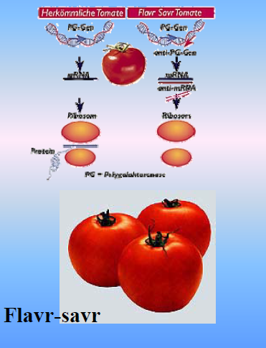
Quality improvement

Slide 55
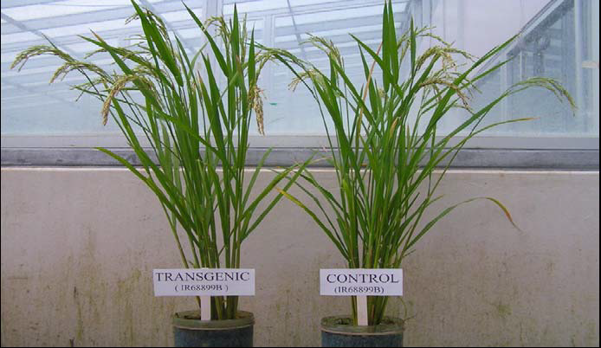
Enhanced photosynthesis rate
Transgenic : indica rice (C3)
Enhanced photosynthesis rate
Transgenes
Phosphoenolpyruvate carboxylase (pepc) gene cloned from maize (C4)

Slide 56
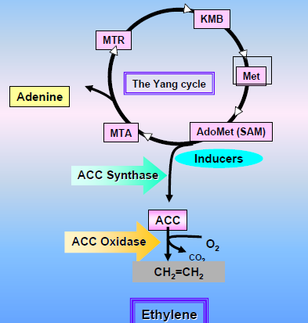
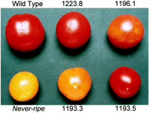
Flower senescence or fruit ripening is regulated by ethylene
http://www.colostate.edu/Depts/HLA/GHEX/newsletter/vol_12/senescence.jpg

Slide 57
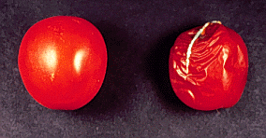
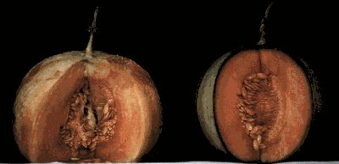
Prolong shelf-life or Delay ripening
Down regulated internal ethylene via sense or antisense
( ACC synthase or ACC oxidase)
2) Inhibited internal ethylene via RNA interference (RNAi)
( ACC synthase or ACC oxidase)
3) Inhibited external ethylene
Mutated or modified of ethylene receptor gene (ETR1)

Slide 58
Plants enhanced with nutrients and vitamins
Gene engineering is a possibility to add to a plant a totally new traits that are not characteristic for plant at all.

Slide 59
The golden rice

Slide 60
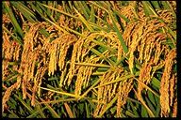
GOLDEN RICE
Precursor geranyl geranyl diphosphate Added
- Phytoene synthase ( from Daffodil) → phytoene, the first carotenoid precursor in the biosynthetic pathway leading to the production of beta-carotene.
- Phytoene desaturase ( bacteria)
- Lycopene cyclase (from Daffodil) → β-carotene
Iron - Ferritin, an iron-rich bean storage protein
phytase, an enzyme that breaks down phytate making Phosphorous available

Slide 61
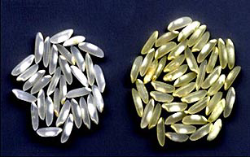
GM-Rice to prevent and treat vitamin A and iron deficiencies
Iron-enriched transgenic rice:
1 gene increases Fe content (ferritin)
2 genes increase Fe absorption (phytate, cysteine)
DOUBLE TRANSGENIC RICE
β-carotene-enriched rice crossed with iron-enriched

Slide 62
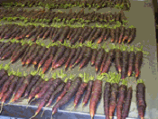
BetaSweet® carrot
Contains approximately 50% more Beta Carotene than normal carrot .Beta carotene is a potent cancer-fighting antioxidant
dark maroon-purple color
(as also anthocyanine (another antioxidant) is added)
Produced by Texas A&M University.

Slide 63
Enhanced antioxidant
Transgenic : tomato
Transgenes:
cinnamate 4-hydroxylase (CYP73A24)
rutin and naringenin

Slide 64
reduced lignin in forage crop
Transgenic : alfalfa
Transgenes (down regulation of lignin biosynthesis)
antisense caffeic acid 3-O-methyl- transferase (COMT)
caffeoyl coenzyme 3-O-methyltransferase (CCoAOMT)
cinnamate 4-hydroxylase (C4H)
coumaroyl shikimate 3-hydroxylase (C3H)
coniferaldehyde 5- hydroxylase (F5H)
hydroxycinnamoyl CoA : Shikimate
hydroxycinnamoyl transferase (HCT)
Guo et al

Slide 65
Designer oil-producing plants to decrease risk of cardiovascular disease and cancer
Transgenic : rapeseed, soybean
Transgenes
Streptomyces 3-hydroxysteroid oxidase
phytosterols phytostanols

Slide 66
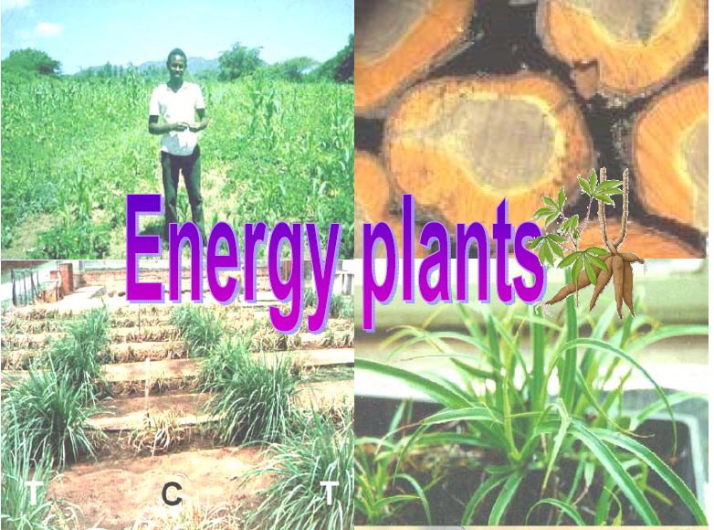

Slide 67
Energy plant researches
Transgenic : duckweed, oil palm,sugarcane, cassava
Characters :
1) Improvement of transformation efficiency
2) Added cellulolytic enzymes (Endoglucanase ; E1)
3) Added β or α amylase
4) biotic and abiotic resistance
5) Engineering Fatty acid metabolism

Slide 68
Engineering Fatty acid metabolism in oil palm
decrease palmitic acid and increase oleic acid
Increase b-ketoacyl-acyl carrier protein (ACP) synthase II
(KAS II activity and
Reduce thioesterase activity towards palmitoyl-ACP.
Transformation of oil palm with a sense copy of KAS II and an
antisense copy of palmitoyl-ACP thioesterase
under the control of a mesocarp-specific promoter
Increase in stearic acid
Antisense of D9-stearoyl-ACP desaturase (D9SAD)
Biochemical Society Transactions (2000), Volume 28 :196-198

Slide 69
Animal production
Improving production through cloning
Strategy:
Good producer
Clones
(identical copies)
Interbreed

Slide 70
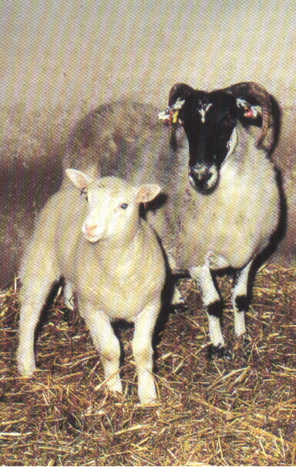
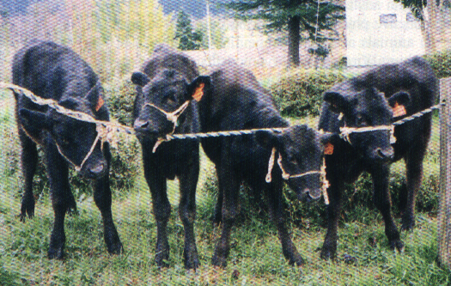
Cloned Animals
Dolly and Mom
Calf Clones

Slide 71
Using animals for pharmaceuticals: Molecular “pharming”
Proteins from milk of transgenic animals
Lactoferrin
Clotting factor IX
Insulin-like growth factor
Iron supplement in
infant formula
Treatment of hemophilia
Treatment of diabetes

Slide 73
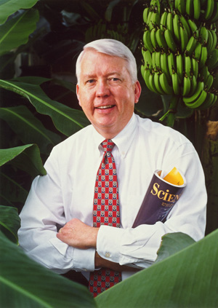
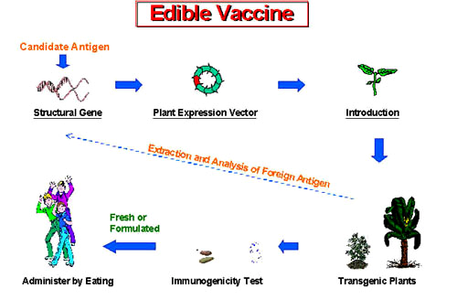
Biopharmaceutical Farming
1) Edible vaccines (Human & Livestock)
2) Plantibodies
3) Pharmaceutical protein production
Notes:
A plantibody (a portmanteau derived from Plant and antibody) is an antibody produced by genetically modified crops.

Slide 74
Edible vaccines

Slide 75
Pharmaceutical protein production

Slide 76
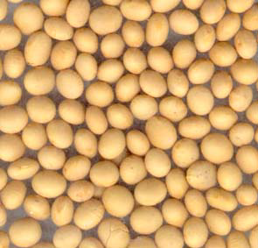
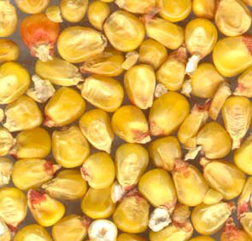
Pharmaceutical protein production
Transgenic : Tobacco, rice, potato, maize, mustard
Protein
- Human protein C (serum protease)
- Human hirudin
- N-acetyl- neuraminic acid
- Human secreted alkaline phosphatase
- Human serum albumin
- Human epidermai growth factor
Hppt://biotech.nature.com

Slide 77
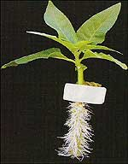
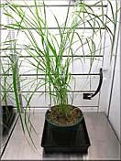
Current ‘Pharm’ Companies
Planet Biotechnology
Dental Caries: CaroRx™
Colds due to Rhinovirus: RhinoRx™
Drug-induced Alopecia: DoxoRx™
LEX System™
Lemna, (duckweed)
Biomass biorefinery based on switchgrass. Produce PHAs in green tissue plants for fuel generation.
Rhizosecretion
Monoclonal antibodies (Drake et al., 2003)
Recombinant proetins (Gaume et al, 2003)
Notes:
GeneWare® which involves growing a normal tobacco plant and then infecting it with a virus called Tobacco Mosaic Virus containing the foreign gene of interest. The virus has been tamed so that it does not spread or infect other plants. The foreign protein concentrates in the leaves. The leaves can be harvested and processed to isolate the therapeutic protein.
PLANET is focusing on the development of therapeutic and preventative drugs in four large, but significantly underserved medical markets:
Dental Caries: Tooth decay caused by bacterial infection results in approximately 70% of U.S. dental service expenditures, or approximately $50 billion annually, current "preventatives" notwithstanding. The combined treatable population in the U.S. and Europe is estimated at approximately 115 million people. For dental caries, Planet is developing CaroRx™.
Colds due to Rhinovirus: Rhinoviruses account for approximately half of all common colds and over 20 million doctors’ office visits a year. No readily available diagnostic exists to distinguish between rhinovirus-based colds and the myriad of other variants. Commonly prescribed antibiotics are completely ineffective in treating colds and available palliative preparations are generally ineffective after a single day of use. For rhinovirus colds, Planet is developing RhinoRx™.
Drug-induced Alopecia: Hair loss (alopecia) is one of the most disturbing side effects for cancer patients undergoing chemotherapy, and is commonly caused by doxorubicin and related anthracycline drugs. Over 250,000 patients in the U.S. receive anthracycline chemotherapy each year, and over 95% of these patients lose their hair. Currently, there is no way of preventing this side effect of chemotherapy. For chemotherapy drug-induced alopecia, Planet is developing DoxoRx™.

Slide 79
Industries
Transgenic : cassava, loblolly pine, silver brich
Tobacco
Characters :
Protein base material : spider silk, collagen
Biodegradable plastic production (PHB, PHA)
Produced amylose-free starch
Biotic and abiotic stress resistance
Notes:
Genetically engineered silkworms to make artificial spider silk.
Tissue Engineering using Synthetic Human Elastin Numerous skin replacements or substitutes have been developed that mimic skin epidermis & dermis by culturing skin cells on polymer scaffolds.
a genetic transformation approach to produce a biodegradable plastic, synthase and by the availability of acetyl-CoA and propoly-
-hydroxybutyrate (PHB), in the leaves of alfalfa plants.
Collagen (English pronunciation: /ˈkɒlədʒən/) is a group of naturally occurring proteins.

Slide 80
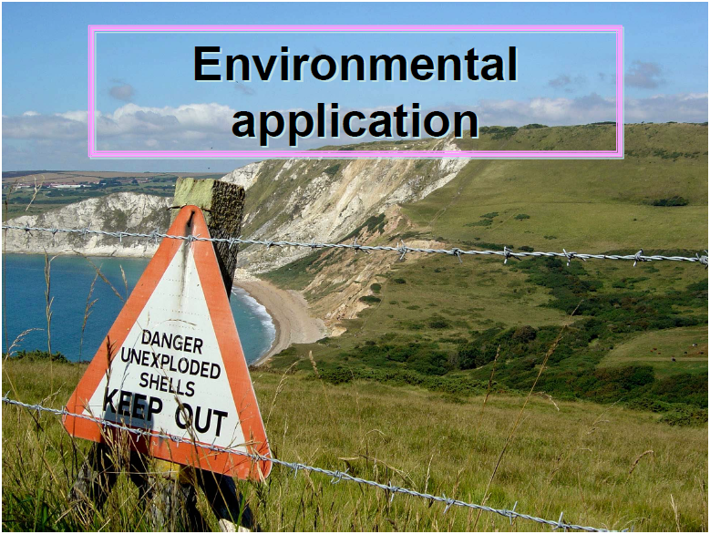

Slide 81
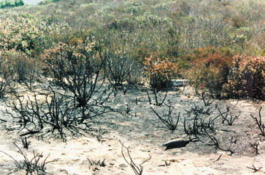
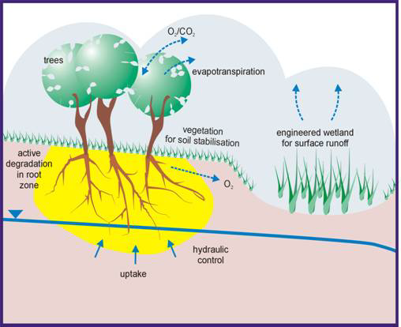
Environmental Applications
Insect resistance GM
- reduced pesticides contamination
Phytoremediation
- cleanup contaminated sites;
(ACC deaminase, Nitroreductase)
Ni, Cd, Zn, Cu, Hg, TNT etc.

Slide 82
Environmental detoxification: Phytoremediation
Types of contaminants detoxified
heavy metals
radionuclides
organic compounds
petroleum products
explosives
Mechanisms plants use to detoxify
Accumulating heavy metals
Breaking down organic compounds
Volatilizing organic compounds

Slide 83
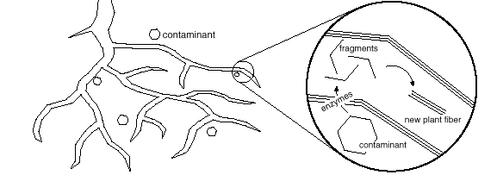
Phytodegradation
contaminant
Enzymes in plant roots break down (degrade) organic contaminants.
The fragments are incorporated into new plant materials.

Slide 85
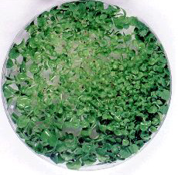
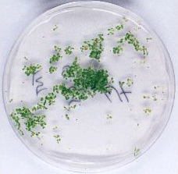
Toxicity studies with TNT
WT - No TNT
WT- 0.05 mM TNT
onr - 0.05 mM TNT
French et al. 1999. Nature Biotechnology 17: 491;

