Slide 1
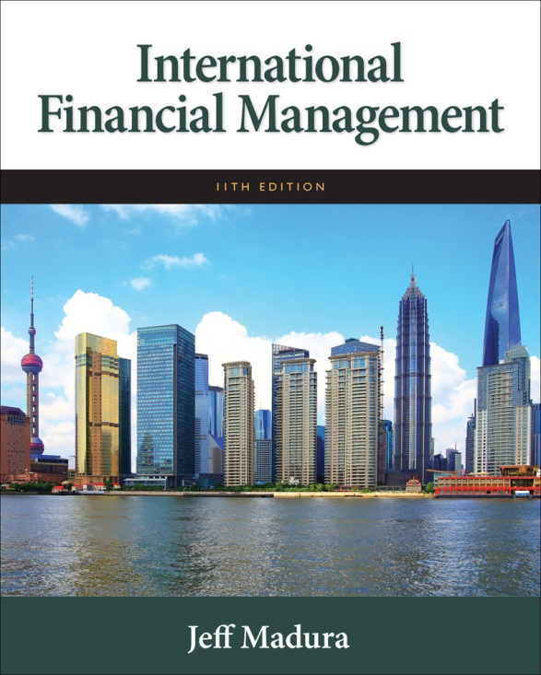

Slide 2
2
International Flow of Funds
Chapter Objectives
Explain the key components of the balance of payments,
Explain the growth in international trade activity over time,
Explain how international trade flows are influenced by economic factors and other factors,
Explain how international capital flows are influenced by country characteristics,
Introduce the agencies that facilitate the international flow of funds.
2

Slide 3
Balance of Payments
Definition:
Summary of transactions between domestic and foreign residents for a specific country over a specified period of time.

Slide 4
Balance of Payments
Components of the Balance of Payments Statement:
Current Account: summary of flow of funds due to purchases of goods or services or the provision of income on financial assets.
Capital Account: summary of flow of funds resulting from the sale of assets between one specified country and all other countries over a specified period of time.

Slide 5
Current Account
Payments for merchandise and services
Merchandise exports and imports represent tangible products that are transported between countries. Service exports and imports represent tourism and other services. The difference between total exports and imports is referred to as the balance of trade.
Factor income payments
Represents income (interest and dividend payments) received by investors on foreign investments in financial assets (securities).
Transfer payments
Represent aid, grants, and gifts from one country to another.

Slide 6
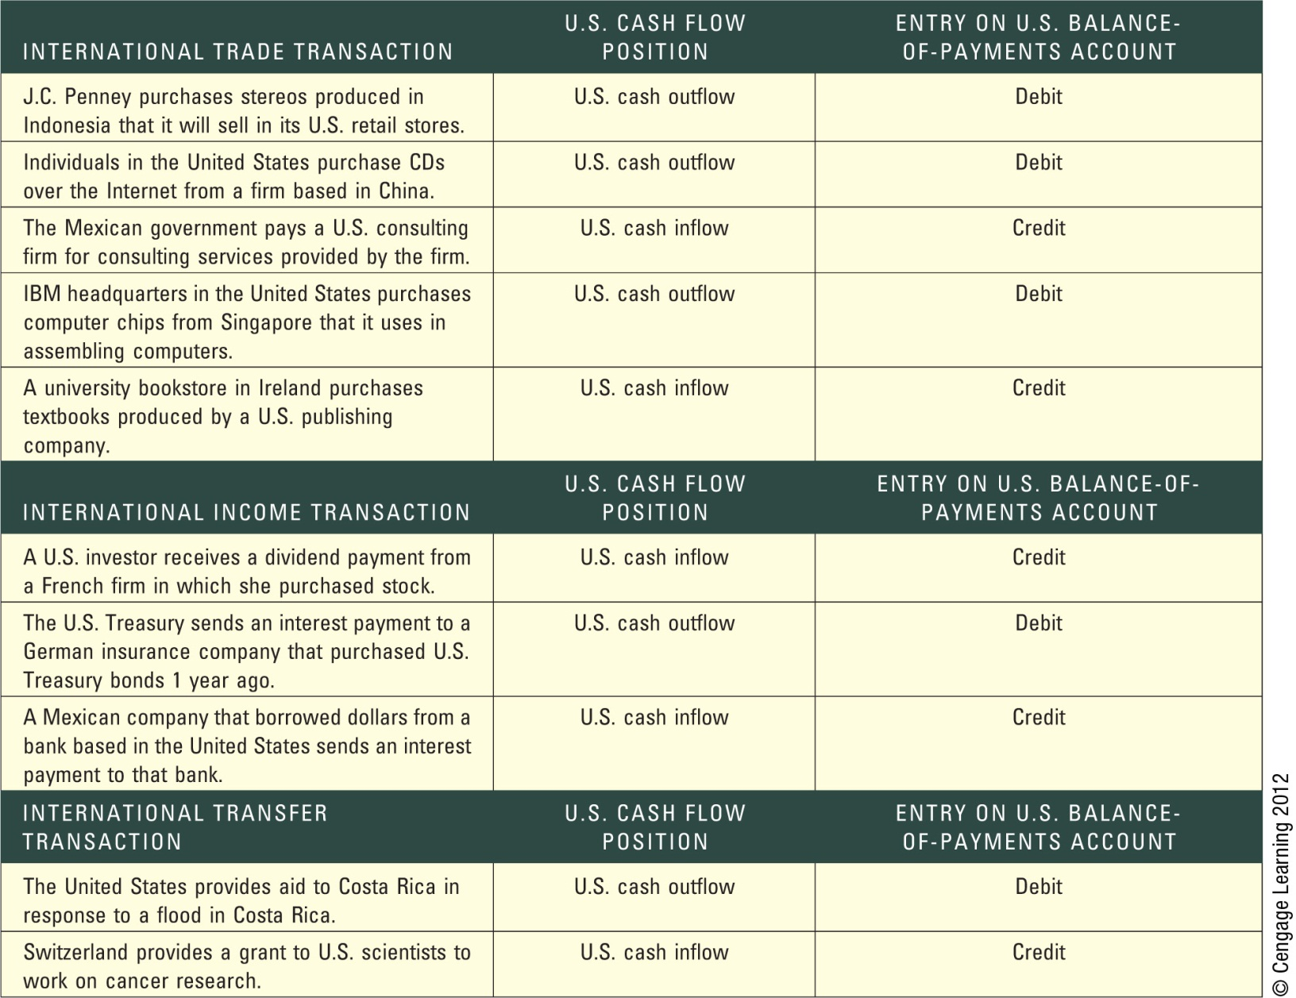
Exhibit 2.1 Examples of Current Account Transactions

Slide 7
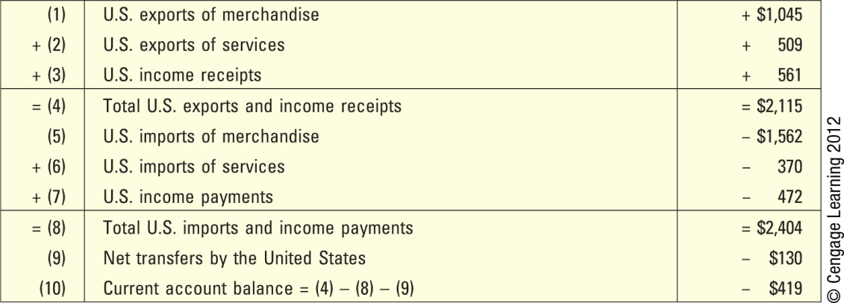
Exhibit 2.2 Summary of Current Account in the year 2010 (in billions of $)

Slide 8
Capital and Financial Accounts
Direct foreign investment
Investments in fixed assets in foreign countries
Portfolio investment
Transactions involving long term financial assets (such as stocks and bonds) between countries that do not affect the transfer of control.
Other capital investment
Transactions involving short-term financial assets (such as money market securities) between countries.
Errors and omissions
Measurement errors can occur when attempting to measure the value of funds transferred into or out of a country.

Slide 9
Events That Increased Trade Volume
Removal of the Berlin Wall: Led to reductions in trade barriers in Eastern Europe.
Single European Act of 1987: Improved access to supplies from firms in other European countries.
North American Free Trade Agreement (NAFTA): Allowed U.S. firms to penetrate product and labor markets that previously had not been accessible.
General Agreement on Tariffs and Trade (GATT): Called for the reduction or elimination of trade restrictions on specified imported goods over a 10-year period across 117 countries.

Slide 10
Events That Increased Trade Volume (cont.)
Inception of the Euro: Reduced costs and risks associated with converting one currency to another.
Expansion of the European Union: reduced restrictions on trade with Western Europe.
Other Trade Agreements: The United States has established trade agreements with many other countries.

Slide 11
Impact of Outsourcing on Trade
Definition of Outsourcing: The process of subcontracting to a third party in another country to provide supplies or services that were previously produced internally.
Impact of outsourcing:
Increased international trade activity because MNCs now purchase products or services from another country.
Lower cost of operations and job creation in countries with low wages.
Criticism of outsourcing:
Outsourcing may reduce jobs in the United States.

Slide 12
Managerial Decisions About Outsourcing
Managers of a U.S.–based MNC may argue that they create jobs for U.S. workers.
Shareholders may suggest that the managers are not maximizing the MNC’s value as a result of their commitment to creating U.S. jobs.
Managers should consider the potential savings that could occur as a result of outsourcing.
Managers must also consider the possible bad publicity or bad morale that could occur among the U.S. workers.

Slide 13
Trade Volume Among Countries
The annual international trade volume of the United States is between 10 and 20 percent of its annual GDP.
Trade volume between the United States and Other Countries:
About 20 percent of all U.S. exports are to Canada, while 13 percent are to Mexico.
Canada, China, Mexico, and Japan are the key exporters to the United States. Together, they are responsible for more than half of the value of all U.S. imports.

Slide 14
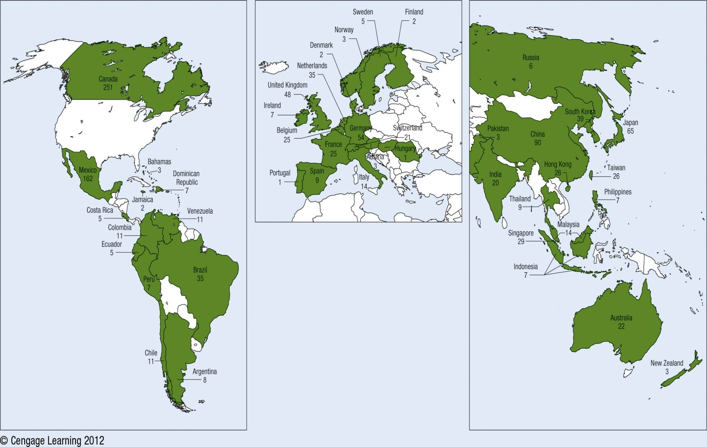
Exhibit 2.3 Distributions of U.S. Exports Across Countries (in billions of $)

Slide 15
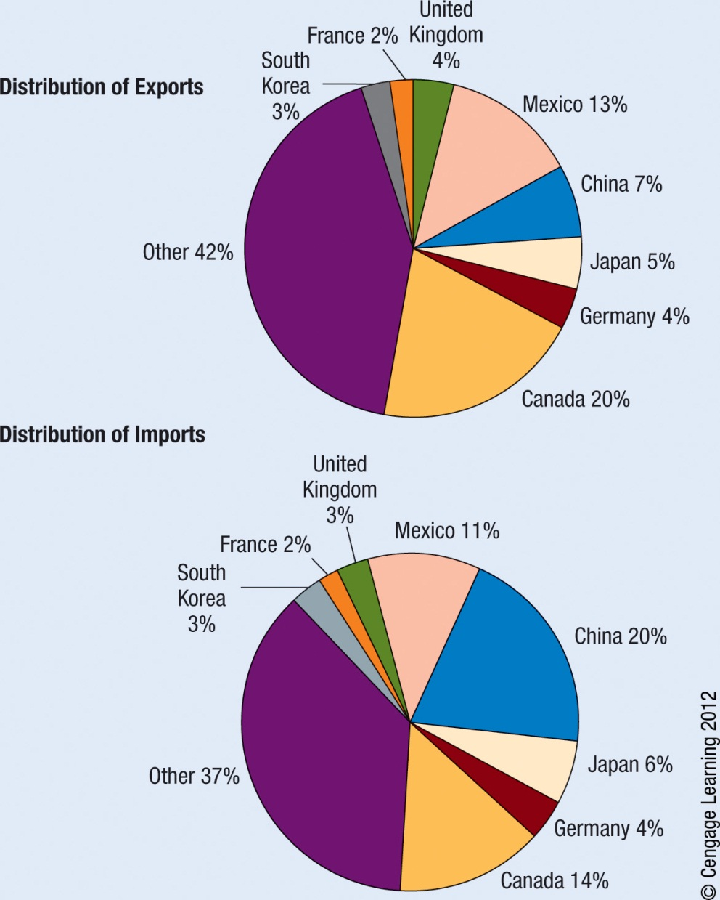
Exhibit 2.4 2008 Distribution of U.S. Exports and Imports
15

Slide 16
Trend in U.S. Balance of Trade
The U.S. balance of trade deficit increased substantially from 1997 until 2008.
In the 2008–2009 period, U.S. economic conditions weakened and the U.S. demand for foreign products and services decreased.
In recent years, the U.S. annual balance of trade deficit with China has exceeded $200 billion.
Any country’s balance of trade can change substantially over time.

Slide 17
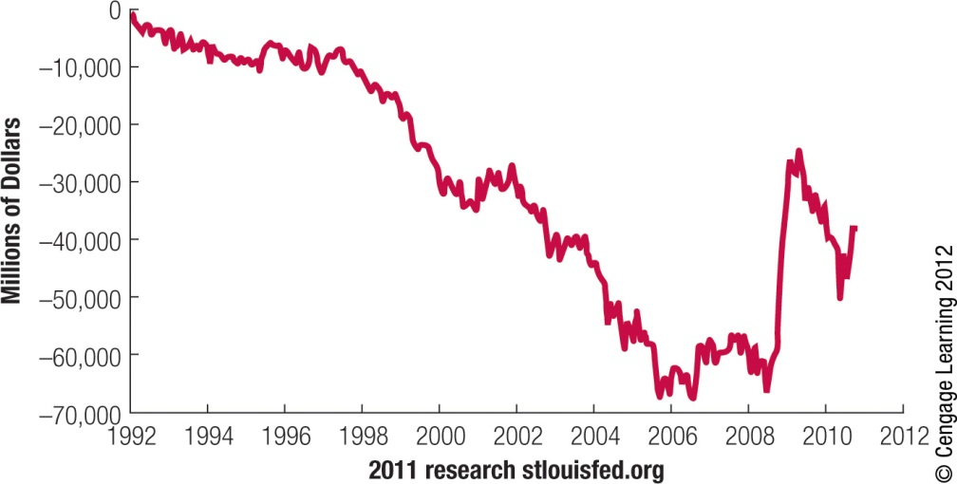
Exhibit 2.5 U.S. Balance of Trade Over Time (Quarterly)

Slide 18
Factors Affecting International Trade Flows
Cost of Labor: Firms in countries where labor costs are low commonly have an advantage when competing globally, especially in labor intensive industries
Inflation: Current account decreases if inflation increases relative to trade partners.
National Income: Current account decreases if national income increases relative to other countries.

Slide 19
Factors Affecting International Trade Flows (cont.)
Government Policies: can increase imports through:
Restrictions on imports
Subsidies for exporters
Lack of Restriction on piracy
Environmental restrictions
Labor laws
Tax breaks
g. Country security laws
Exchange Rates: current account decreases if currency appreciates relative to other currencies.

Slide 20
Impact of Government Policies
Restrictions on Imports: Taxes (tariffs) on imported goods increase prices and limit consumption. Quotas limit the volume of imports.
Subsidies for Exporters: Government subsidies help firms produce at a lower cost than their global competitors.
Restrictions on Piracy: A government can affect international trade flows by its lack of restrictions on piracy.
Environmental Restrictions: Environmental restrictions impose higher costs on local firms, placing them at a global disadvantage compared to firms in other countries that are not subject to the same restrictions.

Slide 21
Impact of Government Policies (cont.)
Labor Laws: countries with more restrictive laws will incur higher expenses for labor, other factors being equal.
Business Laws: Firms in countries with more restrictive bribery laws may not be able to compete globally in some situations.
Tax Breaks: Though not necessarily a subsidy, but still a form of government financial support that might benefit many firms that export products.
Country Security Laws: Governments may impose certain restrictions when national security is a concern, which can affect on trade.

Slide 22
Impact of Exchange Rates
How exchange rates may correct a balance of trade deficit:
When a home currency is exchanged for a foreign currency to buy foreign goods, then the home currency faces downward pressure, leading to increased foreign demand for the country’s products.
Why exchange rates may not correct a balance of trade deficit:
Exchange rates will not automatically correct any international trade balances when other forces are at work.

Slide 23
Limitations of a Weak Home Currency Solution
Competition: foreign companies may lower their prices to remain competitive.
Impact of other currencies: a country that has balance of trade deficit with many countries is not likely to solve all deficits simultaneously.
Prearranged international trade transactions: international transactions cannot be adjusted immediately. The lag is estimated to be 18 months or longer, leading to a J-curve effect.
Intracompany trade: Many firms purchase products that are produced by their subsidiaries. These transactions are not necessarily affected by currency fluctuations.

Slide 24
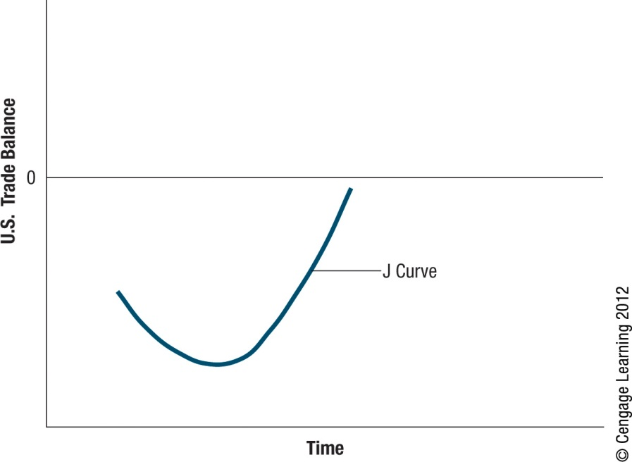
Exhibit 2.6 J-Curve Effect
24

Slide 25
Friction Regarding Exchange Rates
All governments cannot weaken their home currencies simultaneously.
Actions by one government to weaken its currency causes another country’s currency to strengthen.
Government attempts to influence exchange rates can lead to international disputes.

Slide 26
Factors Affecting Direct Foreign Investing (DFI)
Changes in Restrictions
New opportunities have arisen from the removal of government barriers.
Privatization
DFI is stimulated by new business opportunities associated with privatization.
Managers of privately owned businesses are motivated to ensure profitability, further stimulating DFI.

Slide 27
Factors Affecting Direct Foreign Investing (DFI) (Cont.)
Potential Economic Growth
Countries with greater potential for economic growth are more likely to attract DFI.
Tax Rates
Countries that impose relatively low tax rates on corporate earnings are more likely to attract DFI.
Exchange Rates
Firms typically prefer to pursue DFI in countries where the local currency is expected to strengthen against their own.

Slide 28
Factors Affecting International Portfolio Investment
Tax Rate on Interest or Dividends
Investors normally prefer to invest in a country where taxes are relatively low.
Interest Rates
Money tends to flow to countries with high interest rates, as long as the local currencies are not expected to weaken.
Exchange Rates
Investors are attracted to a currency that is expected to strengthen.

Slide 29
Impact of International Capital Flows
The United States relies heavily on foreign investment in:
U.S. manufacturing plants, offices, and other buildings.
Debt securities issued by U.S. firms.
U.S. Treasury debt securities
Foreign investors are especially attracted to the U.S. financial markets when the interest rate in their home country is substantially lower than that in the United States.

Slide 30
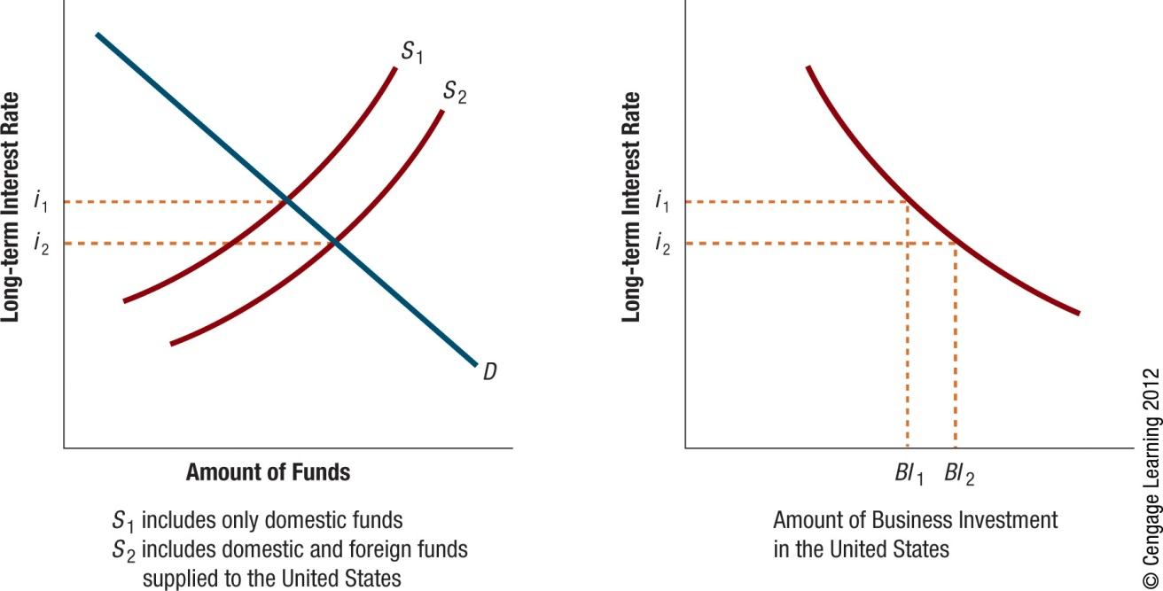
Exhibit 2.7 Impact of the International Flow of Funds on U.S. Interest Rates and Business Investment in the United States
30

Slide 31
Agencies that Facilitate International Flows
International Monetary Fund (IMF)
Major Objectives of the IMF
promote cooperation among countries on international monetary issues,
promote stability in exchange rates
provide temporary funds to member countries attempting to correct imbalances of international payments
promote free mobility of capital funds across countries
promote free trade. It is clear from these objectives that the IMF’s goals encourage increased internationalization of business
Its compensatory financing facility (CFF) attempts to reduce the impact of export instability on countries.
Financing is measured in special drawing rights (SDRs)

Slide 32
Agencies that Facilitate International Flows
World Bank (International Bank for Reconstruction and Development)
Major Objective- Make loans to countries to enhance economic development.
Structural Adjustment Loans (SALs) are intended to enhance a country’s long-term economic growth.
Funds are distributed through cofinancing agreements:
Official aid agencies
Export credit agencies
Commercial banks

Slide 33
Agencies that Facilitate International Flows
World Trade Organization (WTO)
Major Objective - Provide a forum for multilateral trade negotiations and to settle trade disputes related to the GATT accord.
Member countries are given voting rights that are used to make judgments about trade disputes and other issues.

Slide 34
Agencies that Facilitate International Flows
International Financial Corporation (IFC)
Major Objective - promote private enterprise within countries.
Provides loans to corporations and purchases stock
It traditionally has obtained financing from the World Bank but can borrow in the international financial markets.

Slide 35
Agencies that Facilitate International Flows
International Development Association (IDA)
Major Objectives - extends loans at low interest rates to poor nations that cannot qualify for loans from the World Bank.

Slide 36
Agencies that Facilitate International Flows
Bank for International Settlements (BIS)
Major Objectives - facilitate cooperation among countries with regard to international transactions.
Provides assistance to countries experiencing a financial crisis.
Sometimes referred to as the “central banks’ central bank” or the “lender of last resort.”

Slide 37
Agencies that Facilitate International Flows
Organization for Economic Cooperation and Development (OECD)
Major Objective - Facilitate governance in governments and corporations of countries with market economics.
It has 30 member countries and has relationships with numerous countries.
Promotes international country relationships that lead to globalization.

Slide 38
Agencies that Facilitate International Flows
Regional Development Agencies
Inter-American Development Bank: focusing on the needs of Latin America
Asian Development Bank: established to enhance social and economic development in Asia
African Development Bank: focusing on development in African countries
European Bank for Reconstruction and Development: created in 1990 to help the Eastern European countries adjust from communism to capitalism.

Slide 39
SUMMARY
The key components of the balance of payments are the current account and the capital account. Current account - broad measure of the country’s international trade balance. Capital account - measure of the country’s long-term and short-term capital investments.
International trade activity has grown over time. Outsourcing, subcontracting with a third party in a foreign country for supplies or services they previously produced themselves, has increased. Thus increasing international trade activity.
A country’s international trade flows are affected by inflation, national income, government restrictions, and exchange rates.

Slide 40
SUMMARY (Cont.)
A country’s international capital flows are affected by any factors that influence direct foreign investment or portfolio investment. Direct foreign investment tends to occur in those countries that have no restrictions and much potential for economic growth. Portfolio investment tends to occur in those countries where taxes are not excessive, where interest rates are high, and where the local currencies are not expected to weaken.
Several agencies facilitate the international flow of funds by promoting international trade and finance, providing loans to enhance global economic development, settling trade disputes between countries, and promoting global business relationships between countries.

