Slide 1
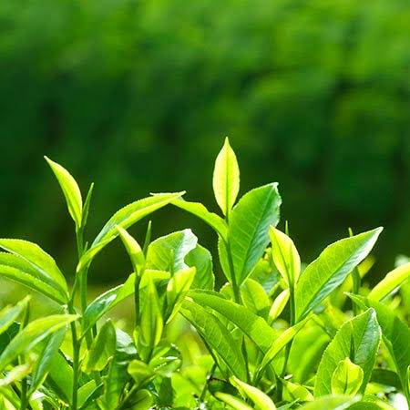
TEA

Slide 2
Tea Crop
Scientific Name:
Camellia sinensis
Genus Camellia
Family Theaceae.
Common names
"tea plant"
"tea shrub"
"tea tree"
chromosome number 2n = 45

Slide 3
Tea plant

Slide 4
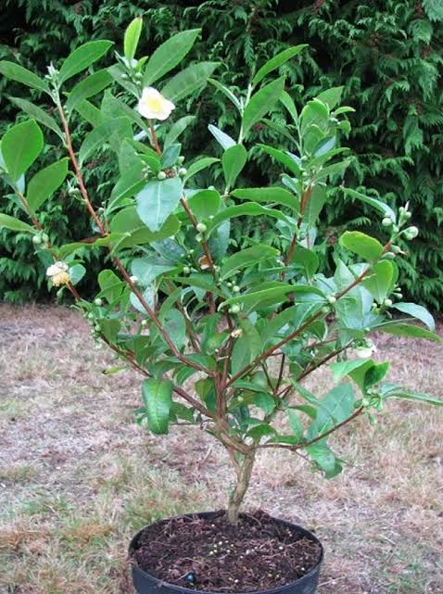
Tea Shrub

Slide 5
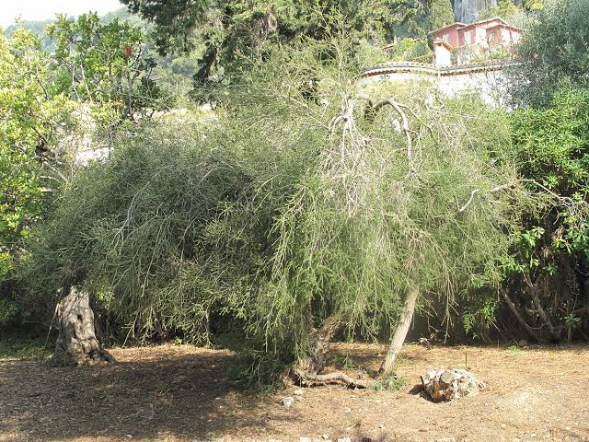
Tea Tree

Slide 6
Introduction
Tea is evergreen shrub or small tree whose leaves and leaf buds are used to produce tea.
Camellia sinensis and Camellia assamica, are two major varieties grown today .
Twig tea is also harvested from Camellia sinensis, but uses twigs and stems rather than leaves.

Slide 7
Source of Tea tree oil.

Slide 8
Origin
Camellia sinensis is native to East Asia, the Indian Subcontinent and Southeast Asia, but it is today cultivated across the world in tropical and subtropical regions.
China is the place of origin of tea plants, it has the broadest genetic variations in the world.
It also has bred more than 200 improved cultivars.

Slide 9
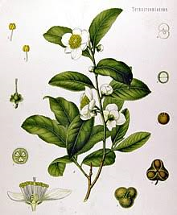
Plant Description
Camellia sinensis is an evergreen shrub or small tree.
That is usually trimmed to below 2 m (6.6 ft) when cultivated for its leaves.
It has a strong taproot.

Slide 10
Flowers
The flowers are yellow-white, 2.5–4 cm (0.98–1.57 in) in diameter.
with 7 to 8 petals.
The plant produces fragrant white flower singly or in small clusters.
Superior ovary

Slide 11
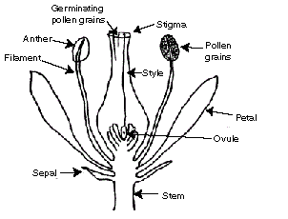
Flower

Slide 12
Seeds
About 4 to 12 years are needed for a plant to bear seed.
The seeds of Camellia sinensis and Camellia oleifera can be pressed to yield tea oil.
A sweetish seasoning and cooking oil that should not be confused with tea tree oil, an essential oil that is used for medical and cosmetic purposes, and originates from the leaves of a different plant.

Slide 13
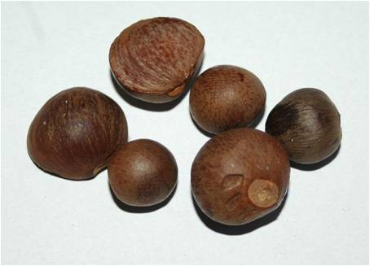

Slide 14
Leaves
The leaves are 4–15 cm (1.6–5.9 in) long and 2–5 cm (0.79–1.97 in) broad.
Biochemical pathway detailing caffeine synthesis in Camellia sinensis.
Fresh leaves contain about 4% caffeine.
The young, light-green leaves are preferably harvested for tea production; they have short white hairs on the underside.

Slide 15
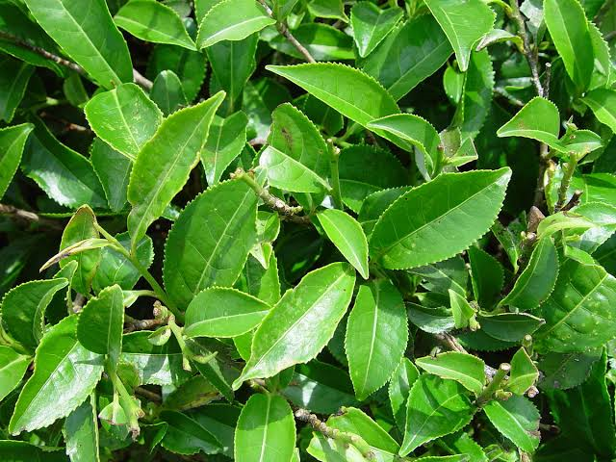

Slide 16
Older leaves are deeper green.
Different leaf ages produce differing tea qualities, since their chemical compositions are different.
Usually, the tip (bud) and the first two to three leaves are harvested for processing.
This hand picking is repeated every one to two weeks.

Slide 17
What does make it special
Caffeine:
A kind of drug which is found especially in tea and coffee plants and is a stimulant of the central nervous system.
You feel more active, fresh.
Different amount in different tea types

Slide 18
Legal Caffeine
caffeine as a food additive, the total caffeine content must not exceed 145 mg/L (36 mg/250 mL serve).
As such, the legal caffeine limit for a standard 250 mL energy drink in Pakistan is 80 mg

Slide 19
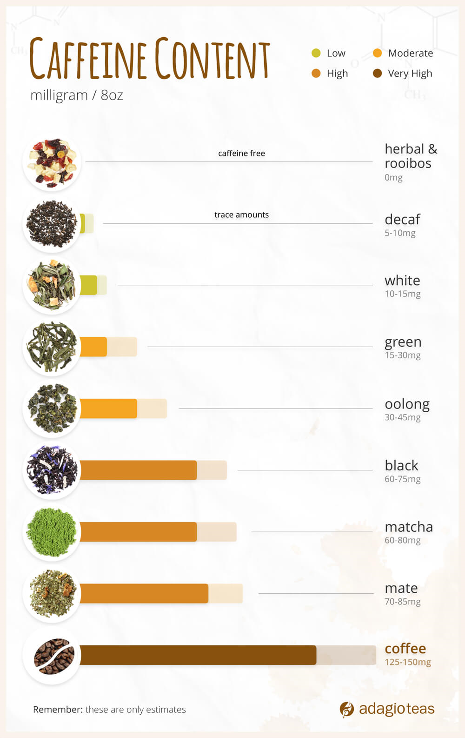

Slide 20
Cultivation
Tea is mainly cultivated in tropical and subtropical climates, in areas with at least 127 cm (50 inches) of rainfall a year.
Tea plants prefer a rich and moist growing location.
Tea plants will grow into a tree if left undisturbed, but cultivated plants are pruned to waist height for ease of plucking.

Slide 21
Tea plant are propagated from seed or by cutting: it takes about 4 to 12 years for a tea plant to bear seed

Slide 22
Propagation by seed
Good quality seeds are selected by immersing in water for 30 minutes and selecting the seeds which sink.
Seeds are commonly germinated by placing them between wet cloths.
Seeds which successfully germinate are transferred to a nursery bed to grow for 2–3 years.
Before transplanting to the field, the plants are cut back to a height of 15 cm (6.0 in).

Slide 24
Propagation by leaf cutting
Single node cuttings are taken from the desired variety and rooted in polyethylene bags containing soil by firmly pressing the stem into the soil.
The bags are then placed in a shaded area and watered regularly.
New tea plants produced from rooted cuttings are usually planted out in the field after 6–9 months.

Slide 26
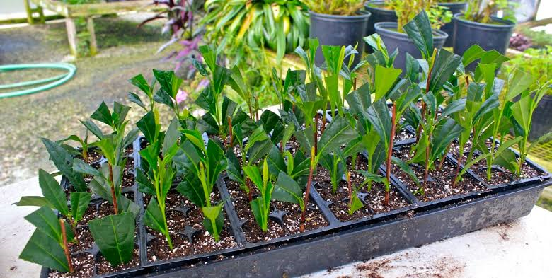

Slide 27
Climate And Soil
Tea grows best in warm and humid climates. It will tolerate temperatures between 14 and 27°C with 18–20°C being optimum.
Tea plants will not tolerate frost and mean temperatures should not fall below 13°C or exceed 29°C.
Tea soils must be acid; tea cannot be grown in alkaline soils.
Tea grows optimally in deep, well-draining, tropical red soils with an acidic pH between 4.5 and 6.0.

Slide 28
Production
Global production of tea was about 6 million tonnes.
led by China with 40% and India with 22% of the world total production.
Kenya, Sri Lanka, and Turkey were other major producers.

Slide 29
Health Benefits
Tea contains antioxidants
Tea has less caffeine than coffee
Tea may reduce your risk of heart attack and stroke
Tea may help with weight loss
Tea may help protect your bones

Slide 30
Tea may keep your smile bright
Tea may boost the immune system
Tea may help battle cancer
Herbal tea may soothe the digestive system

Slide 31
Pests and Diseases
Diseases:
Dieback
Canker
root rot
flower blight
Insects:
Spider mites
Aphids (Tea aphid)

Slide 33
Manufacturing process of tea
Plucking
Withering
Rolling
Fermentation
drying

Slide 34
Plucking

Slide 35
Withering

Slide 36
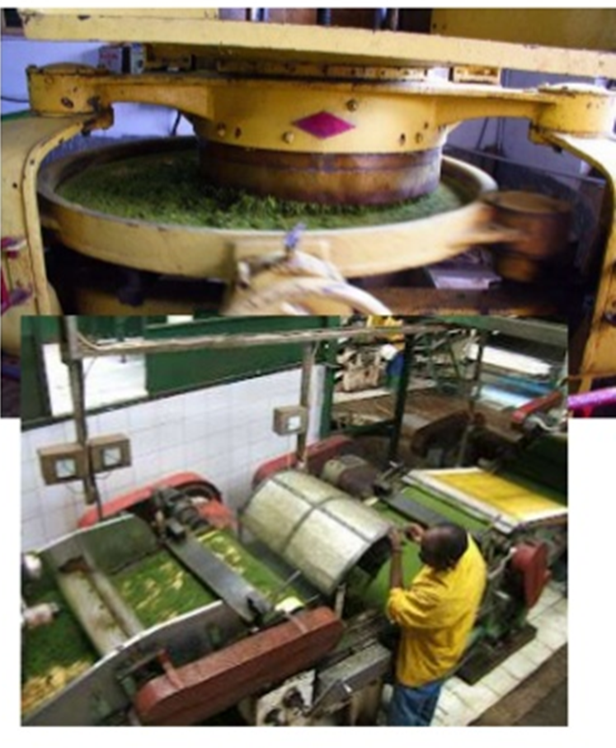
Rolling
Rolling imparts characteristic twist to the leaves.
It exposes the juice of the leaves in their surface to set on the fermentation process.
Rolling is done by special machines .
After rolling leaves are fully dried and called as green or unfermented tea.

Slide 37
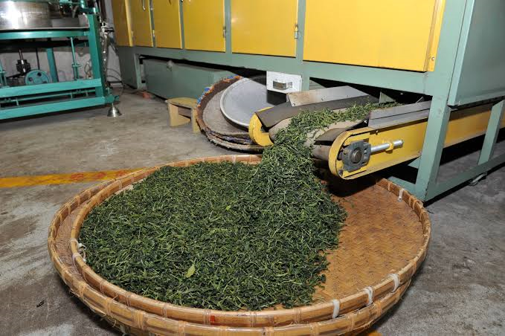

Slide 38
Fermentation

Slide 39
Drying
The main aim of this process is to stop the process of fermentation and to reduce the moisture content.
Drying is done in specially designed dryers at a temperature of 100 degree centigrade for half an hour.

Slide 41
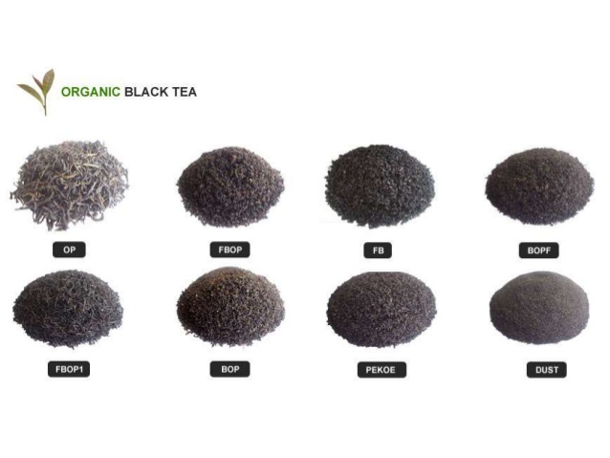

Slide 44
Tea Breeding
Tea is an important revenue source for the tea producing countries in the world.
Tea is one of the most important non-alcoholic beverage drinks worldwide and an important health drink.
It is served as morning drink for 2/3rd of world population daily.
China is the place of origin of tea plants, it has the broadest genetic variations in the world.
It also has bred more than 200 improved cultivars.

Slide 45
Although conventional breeding and propagation contributed significantly for last several decades but application of biotechnology becomes an alternative approach.

Slide 46
Biotechnological work
The present review deals with progress in-depth of various aspects of biotechnological works such as
Micro propagation and alternative approaches,
Cell and organ culture techniques,
Genetic transformation,
DNA markers
Organelle genome
Gene cloned

Slide 47
Objectives of tea breeding :
1. Higher yield
2. Improved quality
3. Abiotic resistance
4. Biotic resistance
5. Change in maturity Duration / Earliness

Slide 48
6 Dormancy
7. Desirable Agronomic Characteristics
8. Elimination of Toxic Substances
9.Photo and Thermo insensitivity
10.Wider adaptability

Slide 49
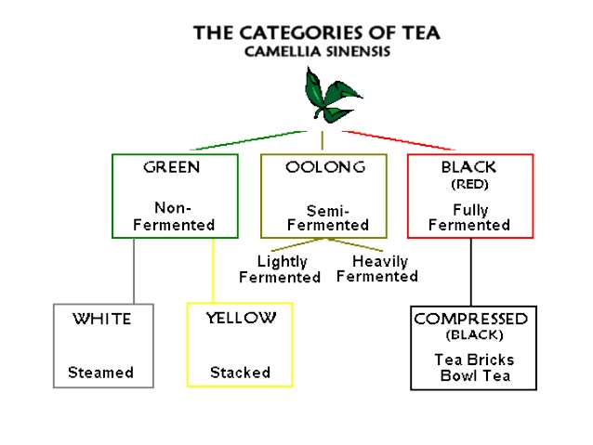

Slide 50
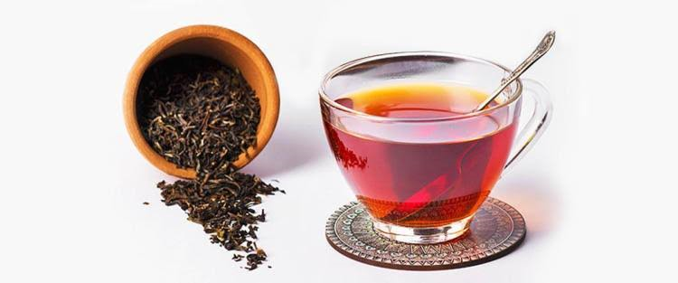
Black tea

Slide 51
Green tea

Slide 52
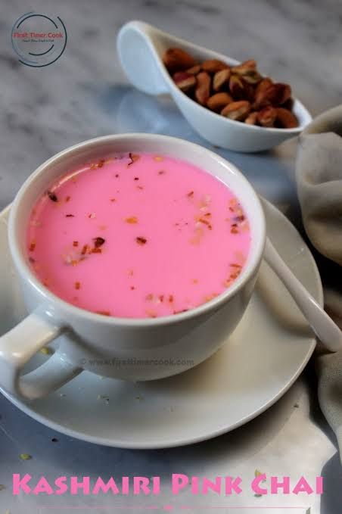
Kashmir noon chai

Slide 53
Oolong tea

Slide 54
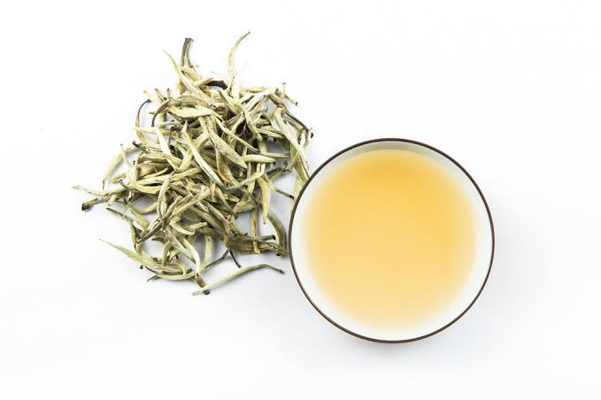
White tea

Slide 55
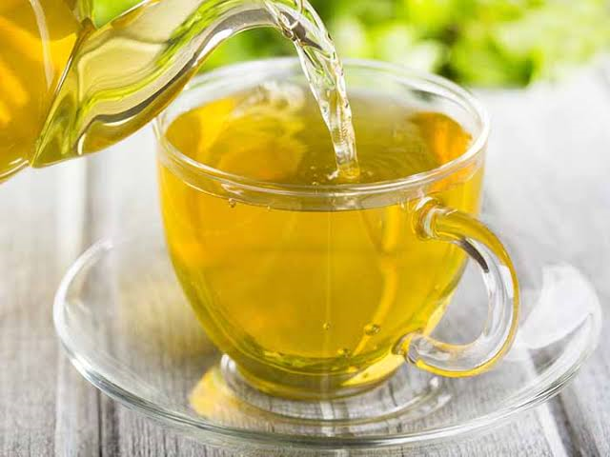
Yellow tea

Slide 56
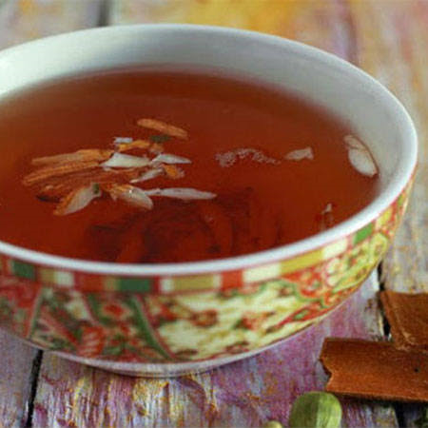
Kashmir kahwa

