Slide 1
Multiple Sclerosis

Slide 2
Multiple sclerosis (MS) is an autoimmune disease characterized by inflammation, selective demyelination, and gliosis.
It causes both acute and chronic symptoms and can result in significant disability and impaired quality of life.

Slide 3
Epidemiology
Worldwide MS affects approximately 2.1 million people.
The onset of MS typically occurs between the ages old 15 and 50 years, with the peak at age 30.
Rare in children and in adults older than the age of 50 years
Women to men ratio is 2:1 to 3:1
MS affects predominately white populations

Slide 4
Etiology
Familial trends; The risk is 3.0% for a sibling, 5.0% for a fraternal co-twin, and rises to 25.0% for an identical co-twin.
Genetic studies have revealed many interacting alleles that may contribute to MS susceptibility with mutations in the human leukocyte antigen major histocompatibility complex (MHC) gene most strongly correlated.
Genetic susceptibility to immune system dysfunction.
When persons with a genetic susceptibility are exposed to a viral agent, the immune system responds with activated myelin-reactive lymphocytes, a concept known as molecular mimicry.
The viruses may be retained in the body, resulting in a self-perpetuating autoimmune process.
Risk of MS may also be increased with vitamin D deficiency and smoking.

Slide 5
Pathophysiology
The immune response triggers activation of immune cells (e.g., T cells, CD4+ helper T cells, B cells) that cross the blood–brain barrier. In turn, these cells activate autoantigens, producing autoimmune cytotoxic effects within the central nervous system (CNS) (this process can be viewed as a form of “friendly fire”).
Phagocytic activity of macrophages may also contribute to demyelination.

Slide 6
Myelin serves as an insulator, speeding up the conduction along nerve fibers from one node of Ranvier to another (termed saltatory conduction). It also serves to conserve energy for the nerve because depolarization occurs only at the nodes.
Disruption of the myelin sheath and active demyelination slows neural transmission and causes nerves to fatigue rapidly. With severe disruption, conduction block occurs with resulting disruption of function.

Slide 7
An acute inflammatory event emerges. Edema and infiltrates (e.g., monocytes, macrophages, and microglia) surround the acute lesion and can cause a mass effect (abnormally high pressures), further interfering with the conductivity of the nerve fiber.
Conceivably, this inflammation (which gradually subsides) may, in part, account for the pattern of fluctuations in function that characterize this disease.
With repeat attacks, the anti inflammatory processes become less effective and are unable to keep up.

Slide 8
Demyelinated areas eventually become filled with fibrous astrocytes and undergo a process called gliosis.
Gliosis refers to the proliferation of neuroglial tissue within the CNS and results in glial scars (plaques).
At this stage, the axon itself becomes interrupted and undergoes neurodegeneration. This is believed to be the main cause of permanent neurological disability.

Slide 9
Brain atrophy, the loss of axons and myelin throughout the brain, is evident even in early stages of the disease and is progressive.
There are certain areas of predilection, such as the optic nerves, periventricular white matter, spinal cord (corticospinal tracts, posterior white columns), and cerebellar peduncles

Slide 10
Disease Course
MS is highly variable and unpredictable from person to person and within a given individual over time.
At one end of the continuum, there is benign MS, defined as disease in which the patient remains fully functional in all neurological systems 15 years after onset. Benign MS affects fewer than 20% of cases.
At the other end of the continuum, there is malignant MS (Marburg disease), a relatively rare disease course characterized by rapid onset and almost continual progression leading to significant disability or death within a relatively short time after onset.

Slide 11
Relapsing-Remitting MS (RRMS)
Characterized by discrete attacks of neurological deficits (relapse) with either full or partial recovery (remission) in subsequent weeks to months.
The periods between relapses are characterized by lack of disease progression.
The stable patient may have local inflammatory activity that is clinically silent.
Affects approximately 85% of patients with MS at diagnosis.

Slide 12
Secondary-Progressive MS (SPMS)
Characterized by an initial relapsing-remitting course, followed by a change in clinical course with progression to steady and irreversible decline with or without continued acute attacks.
May be the result of progressive axonal loss rather than new lesions.
Before newer treatments, the majority of patients with RRMS progressed to SPMS.

Slide 13
Primary-Progressive MS (PPMS)
Characterized by disease progression and steady functional decline from onset; patients may experience modest fluctuations in neurological disability but discrete attacks do not occur.
PPMS is associated with later onset (mean age 40 years) and more equal gender distribution.
Affects approximately 10% of patients with MS.

Slide 14
Progressive-Relapsing MS (PRMS)
Characterized by a steady deterioration in disease from onset (similar to PPMS) but with occasional acute attacks.
Intervals between attacks are characterized by continuing disease progression.
Affects approximately 5% of patients with MS.

Slide 15
Exacerbating Factors
MS relapses (exacerbations) are defined by new and recurrent MS symptoms lasting more than 24 hours but generally of longer duration that are unrelated to another etiology.
Viral or bacterial infections
Diseases of major organ systems
Both major life stress events (divorce, death, losing a job, trauma) and minor stresses (exhaustion, dehydration, malnutrition, and sleep deprivation).

Slide 16
Pseudoexacerbation
Temporary worsening of MS symptoms. The episode typically comes and goes quickly, usually within 24 hours.
The overwhelming majority of individuals with MS demonstrate an adverse reaction to heat, known as Uthoff’s symptom.
Anything that raises the body temperature can bring on a pseudoattack.
External heat stressors
Internal elevations in temperature
Most pseudo-attacks resolve within 24 hours of cooling off and/or the end of a fever.

Slide 17
Symptoms
Symptoms of MS vary considerably, depending on the location of specific lesions.
Early symptoms typically include minor visual disturbances (e.g., episodes of double vision) and paresthesias progressing to numbness, weakness, and fatigability.
In more advanced stages, patients demonstrate multiple symptoms with varying involvement.

Slide 18
The onset of symptoms can develop rapidly over a course of minutes or hours; less frequently, onset is insidious, occurring over a period of weeks or months.
An early remission may lead the individual to postpone initial neurological workup for months or longer.

Slide 19
Sensory Symptoms
Hypoesthesia, numbness
Paresthesias

Slide 20
Pain
Paroxysmal limb pain, dysesthesias
Headache
Optic or trigeminal neuritis
Lhermitte’s sign
Hyperpathia
Chronic neuropathic pain

Slide 21
Visual Symptoms
Blurred or double vision (diplopia)
Diminished acuity/loss of vision
Scotoma
Nystagmus
Lateral gaze palsy

Slide 22
Cognitive Symptoms
Short-term memory deficits

Slide 23
cognitive Symptoms
Diminished attention, concentration
Diminished executive functions
Diminished information processing
Diminished visual– spatial abilities

Slide 24
Affective Symptoms
Depression
Anxiety
Pseudobulbar affect
Anxiety

Slide 25
Motor Symptoms
Paresis or paralysis
Fatigue
Spasticity, spasms
Ataxia: incoordination, intention tremor ,postural tremor
Impaired balance and gait

Slide 26
Speech and Swallowing
Dysarthria
Diminished verbal fluency
Dysphonia
Dysphagia

Slide 27
Bladder Symptoms
Spastic bladder
Flaccid bladder
Dyssynergic bladder
Constipation
Diarrhea and incontinence

Slide 28
Sexual Symptoms
Impotence
Decreased libido
Impaired ability to achieve orgasm

Slide 29
Diagnosis
The diagnosis of MS is made by a neurologist based on history, clinical findings, and supportive clinical tests, including
Magnetic resonance imaging (MRI); highly sensitive for detecting MS plaques in the white matter of the brain and spinal cord, bright spots and black holes
CSF; elevated total immunoglobulin in spinal fluid
Evoked potentials (EP); slowed or abnormal conduction

Slide 30
Rehabilitation Framework
Restorative intervention
Preventative intervention
secondary prevention; early detection and early intervention
tertiary prevention; minimizing the degree of disability
Compensatory intervention
Maintenance therapy
A coordinated interdisciplinary team is necessary to oversee the comprehensive examination and management needed to address the patient’s complex and multifaceted problems.

Slide 31
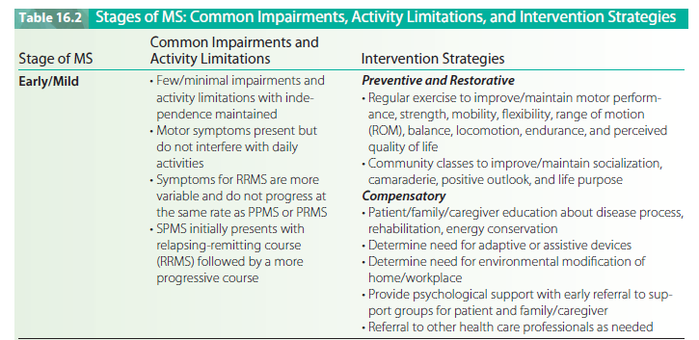

Slide 33
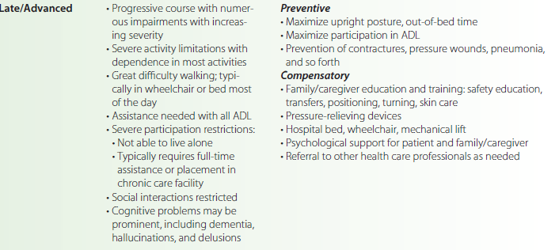

Slide 34
Physical Therapy Interventions

Slide 35
Management of Sensory Deficits and Skin Care
Compensatory training strategies(visual, sensory)
Tapping, verbal cueing, and/or biofeedback
Proprioceptive loading through exercise, light tracking resistance, resistance bands or weights, and the use of a pool

Slide 36
Ade­quate lighting and reducing clutter to improve safety.
Adding contrast between items in the environment (e.g., stair markings
Double vision : Eye patch­ing
Referral
Awareness, protection, and care of desensitized parts.
Regular pressure relief is essential.
Pressure-relieving devices (PRDs)
Prevention is the best strategy.

Slide 37
Management of Pain
Regular stretching or exercise, massage, and ultrasound.
Postural retraining and correction of faulty movement patterns
orthotic and/or adaptive seating devices can reduce mal-alignment and pain.
Stabbing pain from Lhermitte’s sign may be relieved with a soft collar to limit neck flexion.
Hydrotherapy or pool therapy using lukewarm water for painful dysesthesias
Pressure stockings or gloves can also be used to relieve pain, converting the sen­sation of pain to one of pressure.
Neutral warmth may be a factor in the pain relief experienced with stockings or gloves.
Patients with chronic pain will benefit from refer­ral
Stress management techniques, relaxation training, biofeedback, meditation are often helpful in reducing both anxiety and pain.
TENS; conflicting results, some MS patients experience improvement and some a worsening of symptoms.

Slide 38
Exercise Training
Muscle weakness and decreased endurance are common findings in patients with MS.
In addition, patients with MS often adopt a sedentary lifestyle and limit their physical activity, sometimes on the mistaken advice of health care professionals who seek to minimize relapses and symp­toms of fatigue.
The benefits of exercise have been firmly established in terms of producing meaningful physiologi­cal and psychological changes, improving function while lessening disability, and enhancing quality of life.
Individuals with minimal to moderate impairments (i.e., EDSS scores between 1 and 6) and stable disease demon­strate the best exercise tolerance.
This speaks to the need to institute exercises early in the course of the disease.
Exercise responses of the patient with MS are influenced by a host of factors that require careful attention during exercise, including fatigue,, spasticity, incoordination, impaired balance, sensory loss and numbness, tremor, and heat intolerance. Depression may affect adherence.
Therapists therefore need to provide constant reinforce­ment and a positive environment.

Slide 39
Strength and Conditioning
Determining an appropriate exercise prescription to improve strength and endurance is chal­lenging and needs to be carefully individualized for each patient.
Prescription is based on four interrelated ele­ments: frequency of exercise, intensity of exercise, type of exercise, and time or duration (the FITT equation).
The following guidelines can be used.
Exercise sessions should be scheduled on alternate (non-­endurance) days and during optimal times, such as in the morning, when body core temperatures tend to be lowest and before fatigue sets in.
Patients with greater neuro­logical involvement may require more frequent exercise (e.g., daily exercise time).

Slide 40
Circuit training, in which improved work capacity is developed through the use of various different stations that alternate work between upper and lower extremities, distributes the load among muscles and may prove best for reducing the likelihood of fatigue.¹¹⁸
■ Sessions should involve discontinuous work, carefully balancing exercise with adequate rest periods.

Slide 41
Tactile and proprioceptive losses or incoordination and tremors may make the use of some equipment (e.g., free weights) unsafe.
Visual feedback, when intact, should be used to monitor exercise performance. An alternate sug­gestion would be to use synchronized arm/leg ergometers to control limb movements.
Precautions should be taken with cognitive and memory impairments. Individuals may require written or posted exercise instructions/diagrams including reminders of the number of repetitions, proper form, and correct use of equipment.¹²⁶

Slide 42
Flexibility Exercises
Flexibility (stretching) and ROM exercises are necessary to ensure adequate joint ROM and to counteract the effects of spasticity. Sedentary or inactive persons who are dependent on wheelchairs often develop tightness in hip flexors, adductors, hamstrings, and heel cords. Limited overhead ROM is seen with tightness in ihe pectoral is major/minor, and latissimus dorsi and is associated with a slumped, forward posture. Patients confined to bed typi­cally present with tightness in hip/knee extensors and plan- tarflexors. Both PROM and AROM exercises should be per­formed daily for shot! periods. Supported positions (sealed or lying down) should be used to decrease the impact of bal­ance problems. More active patients may benefit from Tai
Chi that provides additional important benefits of relax­ation and balance training.¹²⁶ Goniometry is an appropriate outcome measure.

Slide 43
Management of Fatigue
Fatigue is one of the most debilitating symptoms of MS and is characterized by overwhelming sleepiness, exces­sive tiredness, and sense of weakness that comes on sud­denly and severely.
Aversion to activity for fear of bringing on fatigue is also common.
The resultant lowered activ­ity levels have important implications for diminished health status and deconditioning.
Therapists are faced with a balancing act, on one hand prescribing exercise, while on the other hand avoiding overwork and the development of fatigue.
Aerobic exercise training (previously discussed) and energy effectiveness strategies (ESS) are central to any intervention plan to lessen fatigue.

Slide 44
Activity pacing refers to the balancing of activity with rest periods interspersed throughout the day.
For the patient with chronic fatigue, rest-activity ratios are developed, with periodic rest periods planned in advance.
Time-outs with complete rest should be instituted if an activity becomes exhaustive.
Overall levels of energy can be improved if patients learn to set priorities and limit their activities, saving (heir energy for those activities that are truly important to them (e.g.. activities that are enjoy­able and meaningful in terms of the individual's lifestyle).

Slide 45
The OT/PT team should complete a direct environmental examination of the home and/or job site .
A number of adaptations may be considered to improve effi­ciency and safety, including air-conditioning, home or work modifications, or ergonomic equipment.
The patient/fam­ily/caregivers should be educated as to the importance of these recommendations for improved function. Periodic review of equipment and environmental modifications is also recommended.

Slide 46
During an acute exacerbation, the patient will fare bet­ter if he or she is allowed to rest for a few days. Allowing the patient to continue the same level of exercise or ambu­lation is not helpful.
Therapy can be reinstituted when the deterioration has stabilized and no new symptoms are appearing.
The focus and pace of therapy must be readjusted according to the patient’s specific abilities and needs at that time.
Finally, stress management techniques are impor­tant components of symptom management.

Slide 47
Management of Spasticity
Cryotherapy, hydrotherapy, therapeutic exercise, positioning, or any combination thereof.
The therapist must closely monitor the effects of the antispasticity medications prescribed and optimize physical ther­apy interventions with the dosing cycle.
For example, patients on baclofen will respond better to stretching tech­niques if they are applied in the middle of the dosing cycle rather than at the end or beginning.
Physical therapists must also recognize contributing factors that impact tone and respond appropriately. For example, infection or fever that increases tone may require a referral to the physician.
It is important to reduce or eliminate all factors that can aggravate spasticity (e.g., heat, humidity, stress).

Slide 48
Topical cold (ice packs or wraps) or hydrotherapy (cool bath) can temporarily reduce spasticity by decreasing ten­don reflex excitability and clonus, and by slowing conduc­tion of impulses in nerves and muscles.
The effects of cryotherapy are relatively short-lived, although some patients may experience enhanced ability to move that lasts for minutes or hours.
It is important to remember that some patients, particularly those with intact sensation, may react to the unpleasant sensation of cold with fight or flight (autonomic nervous system) responses, such as increased heart rate, respiratory rate, or nausea. Cryotherapy may be contraindicated in these patients.

Slide 49
ROM exercises begun early in the course of the disease and continued daily can help patients maintain joint integrity and mobility.
In the face of unremitting spasticity, stretching techniques are indicated to increase extensibility of the muscle tendon unit and connective tissue.
Intermittent static stretching held a minimum of 30 to 60 seconds should be applied, ideally for 5 to 10 repetitions.
Combining stretching movements with rhythmic rotation (gentle rota­tion of the limb) or PNF facilitated stretching techniques (hold-relax active contraction [HRAC], contract-relax active contraction [CRAC]) are also effective strategies to assist in gaining range.
Maintained stretch, held for 30 minutes to 3 hours, also can be used and has been shown to decrease stretch reflex activity. Maintained stretch can be achieved with prolonged positioning (e.g., tilt table standing with toe wedges), low-load weights applied using skin traction, or serial casts.

Slide 50
Air splints also provide an effective mechanism to maintain limbs in lengthened, out of spasticity positions.
Patients/family members/clients should be taught stretching exercises as part of a home exercise program (HEP).
Caution must be used to prevent fast, ballistic stretching movements, because spasticity is velocity sensitive. Stretching move­ments need to proceed slowly to gradually achieve the desired range.
Typically the LEs demonstrate stronger spas­ticity than the UEs, especially in the extensor antigravity muscles.
Although spasticity varies greatly from person-to- person, muscles that require particular emphasis during stretching include the quadriceps, adductors, and plantarflexors.
For patients who spend prolonged times sitting in a wheelchair, stretching should also address the hamstrings and hip flexors.

Slide 51
Active exercises at slow or self-selected speeds should focus on expanding the available ROM. Emphasis on con­tracting the antagonist muscles can assist through mecha­nisms of reciprocal inhibition.
Electrical stimulation of muscles antagonist to the spastic muscles can also be used to decrease spasticity. Movements that encourage or utilize abnormal postures should be discouraged.
In patients with minimal to moderate spasticity, exercise combined with low doses of baclofen resulted in significant improvements in overall levels of tone.
Patients with problems with abnormal co-contraction may benefit from exercises focused on improving motor control (timing exercises) or biofeedback. Tai Chi. yoga, and aquatic exercises com­bined with cool water temperatures (less than K5°F) can also be helpful in producing desired relaxation.

Slide 52
Functional activities aimed at reducing tone should con­centrate on trunk and proximal segments, as many patterns of hyper-tonus seem to be fixed from the action of the stronger proximal muscles.
Extensor tone seems to pre­dominate, so activities that stress LE flexion with trunk rotation are generally the most effective.
For example,- lower trunk rotation (LTR) in sideling or hook lying can be effective in reducing extensor tone.
One very effective strat­egy is to position the patient in hook lying with a therapy ball under the flexed legs and gently rock the ball back and forth.
Moving from quadruped position to side-sitting can also be effective in reducing extensor tone in some patients as the activity combines LTR with prolonged inhibitory pressure on the quadriceps.
A more generalized decrease in tone may be achieved through techniques aimed at decreasing overall CNS central activity while promoting relaxation (e.g., slow rocking, relaxation training).

Slide 53
Management of Coordination and Balance Deficits
Static postural control
Dynamic pos­tural control
Pool therapy and Water aerobics
Movement transitions (e.g., sit- to-stand transfers)
vestibular training exercises to reduce the effects of central vestibular dysfunction.
Frenkel’s exercises
Stress man­agement
Weights in control of ataxic movements

Slide 54
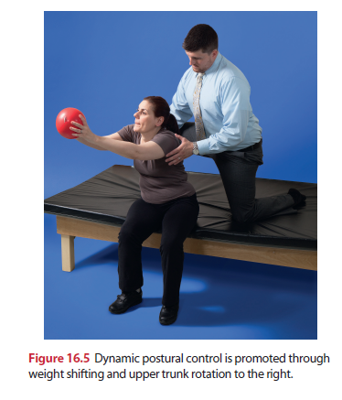

Slide 55
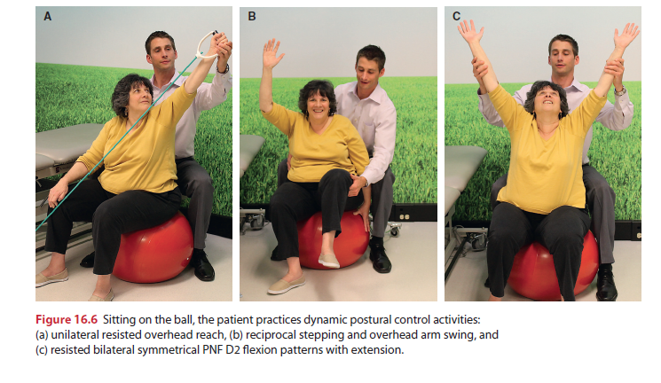

Slide 56
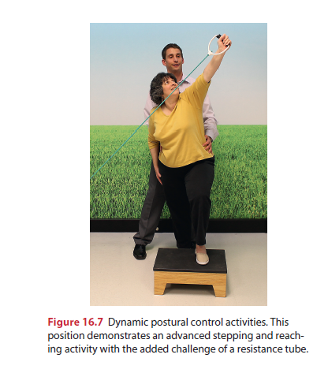

Slide 57
Locomotor Training
Early gait problems: poor balance and heaviness of one or more limbs, difficulty lifting their legs (Weak hip flexor dorsiflexors, Circumducted gait pat­tern.
Later problems evolve owing to clonus, spasticity, sen­sory loss, and/or ataxia. Weakness generally extends to include the quadriceps and hip abductors. Quadriceps weakness typically results in hyperextension of the knee and forward flexion of the trunk with increased lumbar lor­dosis. Hip abductor weakness results in a Trendelenburg gait pattern with a strong lateral lean to the weak side.
A well-designed exercise program of tone reduction, stretching, and strengthening exercises can improve gait.

Slide 58
Standing and walking activities
Walking in Pool
Locomotor training using an overhead harness to sup­port body weight and a motorized treadmill
AFO, KAFOs, Rocker shoes
Canes, forearm crutches, or a walker
Wheeled mobility device (powered scooter or wheelchair) in more advanced stage

Slide 59
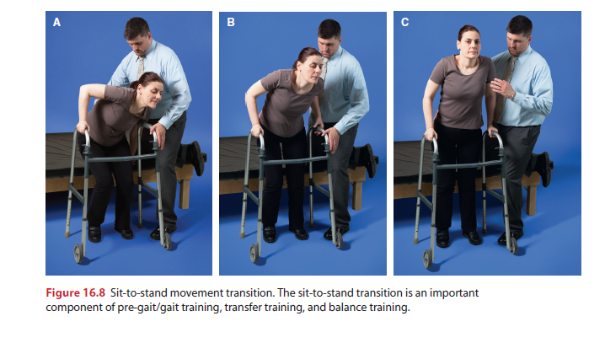

Slide 60
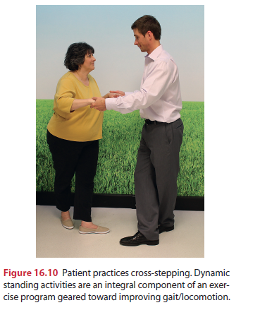
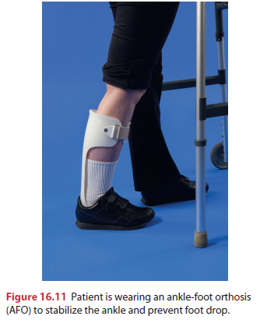

Slide 61
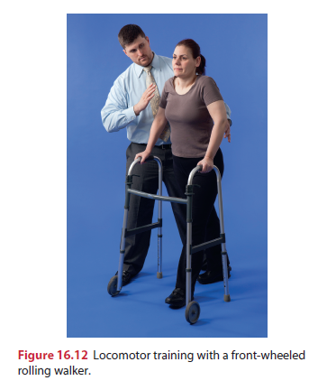
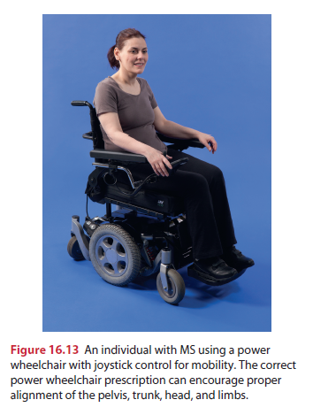

Slide 62
Functional Training
Functional training should focus on problem solving and the development of appropriate decision making skills required to meet the challenges of being disabled.
Skills should be adapted and practiced to ensure safe perform­ance in both the home and community environments.
Training in functional mobility skills (e.g., bed mobility, transfers, locomotion) is typically directed by the physical therapist while ADL training (e.g., dressing, personal hygiene, bathing, toileting, and feeding) is directed by the occupational therapist and training in communication skills by the speech-language pathologist.
Close commu­nication and coordination among team members is neces­sary to ensure that training methods are consistently applied and successful.
Full participation of the patient in all phases of planning and training will increase personal involvement, while decreasing dependency and passivity.

Slide 63
Appropriate prescription of devices and environmental modifications to assist the patient in conserving energy and maintaining function.
Bed or bathroom grab bars, overhead trapeze, raised seats, transfer board, or hydraulic lift. Wrist rests to facilitate writing or typing, and plates and cups with lips to minimize spills are often help­ful in assisting with hand function. Long-handled shoe horns, reachers. button hooks, sock aids, or Velcro® clo­sures can assist in dressing.
Effective communication may require built-up writing utensils or a universal cuff for writ­ten communication or more sophisticated computerized devices. Patients with severe speech problems may require voice amplification devices, electronic aids, or computer- assisted alternative communication systems.

Slide 64
Management of Speech and Swallowing
Shallow respiratory patterns contribute to speech difficul­ties and recurrent respiratory infections.
Respiratory muscle training combined with activities to improve trunk stability, head control, and sitting balance.
Respiratory patterns facilitation through the use manual contacts, resistance, and incentive spirometry.
Diaphragmatic and segmental chest expansion, expiratory training, and effective coughing.
When dysphagia or difficulty in swallowing is present, physical therapy efforts should be closely coordinated with those of the speech—language pathologist and occupational therapist. The physical therapist can assist in the management plan by improving sitting position, head control, and oral-motor coordination.
A detailed examination is necessary, including video-fluoroscopy for dysphagia.

Slide 65
Upright pos­ture with a slightly forward head position and chin parallel to table or slightly tucked is necessary to achieve good swal­lowing and avoid aspiration.
Oral-motor exercises can improve mouth function and include specific exercises for lip closure, tongue movements, and jaw control.
Stretch and resistance can be used to strengthen weak muscle actions.
Swallowing reflexes can be stimulated by using icy bev­erages such as a shake, sherbet, or fruit slush.
Begin meals with something cold and to take single small sips, avoid consecutive swallowing.
Resistive sucking through a straw can also be helpful.
Thicker liquids, which provide some resistance and there­fore some facilitation of muscle action, are generally easier to swallow than thin liquids such as water.

Slide 66
Moist foods (with sauces, broth, water, or milk) are easier to manage than dry ones. Semisolid and pureed foods are easier than regular solids.
Foods that irritate the throat (e.g., vinegar), stringy foods (e.g.. cake, cookies, potato chips, celery, cheeses) should be avoided.
Chewing food thoroughly and not attempt to talk during eating.
Fatigue can affect food intake.
Modification in food stuff; consistency and size.
The speech -language pathologist also teaches swallowing techniques, including the power swallow: This involves having the person first inhale and then hold his nr her breath, thereby closing the airway. The person then swallows, exhales, and swallows again.
Feeding tubes
Heimlich maneuver

Slide 67
Cognitive Training
Referral to a neuropsychologist may be indicated to deter­mine the patient’s strengths and weaknesses and to assist in the adaptive process.
Compensatory strategies for mem­ory deficits; mem­ory aids, timing devices, and environmental strategies. Making lists of things to do. using a memory notebook to log daily events and reminders, and listening to audiotapes.
A pill dispenser can assist the patient in maintaining a correct medication schedule.
Cueing devices such as an alarm clock, bell timer, or watch alarm
Structuring and labeling the environment is also an effective strategy to assist memory (e.g., labeled drawers, cabinets).

Slide 68
Complex tasks can be broken down with clear written directions pro­vided for each step.
Directions can be posted in different areas of the home (e.g.. steps for toilet or tub transfer posted in the bathroom).
Additional cognitive strategies that may be helpful include mental rehearsal, requesting assistance, maximizing alertness, avoidance of difficult situations, and mental exercises.

Slide 69
Psychosocial Issues
Individuals with MS and their families experience a variety of loses such as loss of social functioning, interpersonal relationships, employment status, independence, and func­tional skills.
Psychosocial adaptations; anger, denial, depression, and so forth
Attitudes of "wait and see" or "nothing can be done!!!
stress reduction techniques

Slide 70
Patient and Family/Caregiver Education
The disease process, clinical manifestations
Prevention of secondary complications
The rehabilitation process
The home exercise program (HEP)
Monitoring the effects and possible adverse reactions of medications.
Use of assistive devices and adaptive equipment.
General health and stress management techniques.
Community resources.
Family support, care for care givers

Slide 71
Thanks!!

