Slide 1
Lecture 1: Digital system & Binary numbers
Engr. Muhammad Saad Ullah
Master in Electrical Engineering from Sweden

Slide 2
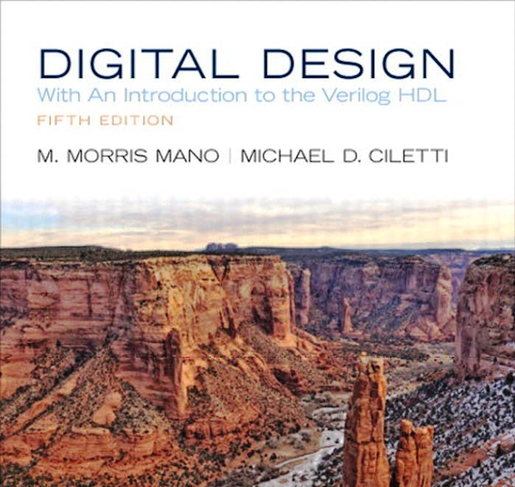
Digital Design
By M. Morris Mano

Slide 3
Out Line
Digital System
Binary Numbers
Numbers Base Conversion
Decimal to Binary Conversion
Binary to Decimal Conversion
Octal and Hexadecimal Numbers
Binary codes
Question & Answers

Slide 4
Digital Systems
Digital system is a system that manipulates discrete elements of information represented internally in binary form.
In today’s technology, binary systems are most practical because, as we will see, they can be implemented with electronic components.
Digital System have prominent role in everyday life.

Slide 5
Implementation / Application of Digital Systems
Digital systems are used in
Traffic control
Business transactions
Communication
Spacecraft guidance
Medical treatment
Weather monitoring,
Internet, and many other commercial, industrial, and scientific enterprises.

Slide 6
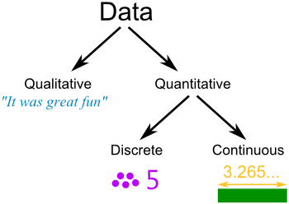
Discrete Elements / Discrete Information
Any set that is restricted to a finite number of elements contains discrete information.
Examples of discrete sets are:
The 10 decimal digits,
The 26 letters of the alphabet,
The 52 playing cards, and
The 64 squares of a chessboard

Slide 7
Signal & Binary Code
Signal
Discrete elements of information are represented in a digital system by physical quantities called signals.
Electrical signals such as voltages and currents are the most common.
The signals in most present‐day electronic digital systems use just two discrete values and are therefore said to be binary.
A binary digit, called a bit, has two values: 0 and 1
What Bit Stand for?
Binary Code
“Discrete elements of information are represented with groups of bits called binary codes.”
For example, the decimal digits 0 through 9 are represented in a digital system with a code of four bits (e.g., the number 7 is represented by 0111)

Slide 8
Number System
8 | 4 | 2 | 1
0 | 1 | 1 | 1
0 | 0 | 0 | 0
0 | 0 | 0 | 1
0 | 0 | 1 | 0
0 | 0 | 1 | 1
0 | 1 | 0 | 0
0 | 1 | 0 | 1
0 | 1 | 1 | 0
0 | 1 | 1 | 1
1 | 0 | 0 | 0
1 | 0 | 0 | 1
Result
7
0
1
2
3
4
5
6
7
8
9
(0111)₂ = (7)₁₀

Slide 9
Number System
Two Types of Number System are
Positional
Non-Positional
Positional Number System
The value of each digit is determined by
The digit itself
The Position of the digit in the number
The base of the number system
( Base= total number of digits in the number system )

Slide 10
Decimal Number System
Characteristics
A positional number system
Has 10 symbols or digits (0,1,2,3,4,5,6,7,8,9). Its Base is = 10
The maximum value of a single digit is 9 (one less than the value of the base)
Each position of a digit represents a specific power of base (10)

Slide 11
Binary, Decimal Numbers
The Decimal number system is base or radix 10
A decimal number 7,392
represents a quantity = 7 thousands, plus 3 hundreds, plus 9 tens, plus 2 units.
The thousands, hundreds, etc., are powers of 10 implied by the position of the coefficients (symbols) in the number.
To be more exact, 7,392 , should be written as
7 x 10³ + 3 x 10² + 9 x 10¹ + 2 x 10⁰
⁷⁰⁰⁰ ⁺ ³⁰⁰⁰⁺⁹⁰⁺² ⁼ 7392

Slide 12
Number Systems
Number systems include decimal, binary, octal and hexadecimal
Number System | Base | Symbol
Binary | Base 2 | B
Octal | Base 8 | O
Decimal | Base 10 | D
Hexadecimal | Base 16 | H

Slide 13
Decimal Number System
The Decimal Number System uses base 10. It includes the digits {0, 1,2,…, 9}. The weighted values for each position are:
10^4 | 10^3 | 10^2 | 10^1 | 10^0 | 10^-1 | 10^-2 | 10^-3
10000 | 1000 | 100 | 10 | 1 | 0.1 | 0.01 | 0.001
left of the decimal point
Right of decimal point
Left of decimal Point

Slide 14
Binary, Decimal Numbers
In general, a number with a decimal point is represented by a series of coefficients:
a₅a₄a₃a₂a₁a₀ . a₋₁a₋₂a₋₃
The coefficients a_{j} are any of the 10 digits (0, 1, 2,…..9), and the subscript value j gives the place value and, hence, the power of 10 by which the coefficient must be multiplied.
Thus, the decimal number can be expressed as 10⁵a₅ + 10⁴a₄ + 10³a₃ + 10²a₂ + 10¹a₁ + 10⁰a₀ + 10⁻¹a₋₁ + 10⁻²a₋₂ + 10-³a₋₃
_{So we can say ,}
with a₃ = 7, a₂ = 3, a₁ = 9, and a₀ = 2.
10³ x 7 + 10² x 3 + 10¹ x 9 + 10⁰ x 2 = 7392

Slide 15
The Binary Number Base Systems
Most modern computer system using binary logic.
The computer represents values(0,1) using two voltage levels (usually 0V for logic 0 and either +5V for logic 1).
The Binary Number System uses base 2 includes only the digits 0 and 1
The weighted values for each position are :
2^5 | 2^4 | 2^3 | 2^2 | 2^1 | 2^0 | 2^-1 | 2^-2
32 | 16 | 8 | 4 | 2 | 1 | 0.5 | 0.25

Slide 16
Binary to Decimal Conversion
The coefficients of the binary number system have only two possible values: 0 and 1. Each coefficient aj is multiplied by a power of the radix, e.g., 2j, and the results are added to obtain the decimal equivalent of the number
For example, the decimal equivalent of the binary
number 11010.11 is 26.75
1 x 2⁴ + 1 x 2³ + 0 x 2² + 1 x 2¹ + 0 x2⁰ + 1 x2⁻¹ + 1 x2⁻² = 26.75
16+8+0+2+0.5+.25=26.75

Slide 17
Binary to Decimal Conversion
Binary to Decimal: multiply each digit by its weighted position, and add each of the weighted values together or use expansion form directly.
Example the binary value 1100 1010 represents :
1*2^7 + 1*2^6 + 0*2^5 + 0*2^4 + 1*2^3 + 0*2^2 + 1*2^1 + 0*2^0
1 * 128 + 1 * 64 + 0 * 32 + 0 * 16 + 1 * 8 + 0 * 4 + 1 * 2 + 0 * 1
128 + 64 + 0 + 0 + 8 + 0 + 2 + 0 =202

Slide 18
Decimal to Binary another Method
Decimal to Binary
Another methods, that may be used to convert from integer number in decimal form to binary form:
Repeated Division By 2
For this method, divide the decimal number by 2,
If the remainder is 0, on the right side write down a 0.
If the remainder is 1, write down a 1.
When performing the division, the remainders which will represent the binary equivalent of the decimal number are written beginning at the least significant digit (right) and each new digit is written to more significant digit (the left) of the previous digit.

Slide 19
Example: convert the number 333 to binary.
Division | Quotient | Remainder | Binary
333/2 | 166 | 1 | 1
166/2 | 83 | 0 | 01
83/2 | 41 | 1 | 101
41/2 | 20 | 1 | 1101
20/2 | 10 | 0 | 01101
10/2 | 5 | 0 | 001101
5/2 | 2 | 1 | 1001101
2/2 | 1 | 0 | 01001101
1/2 | 0 | 1 | 101001101
LSB
MSB
101001101

Slide 20
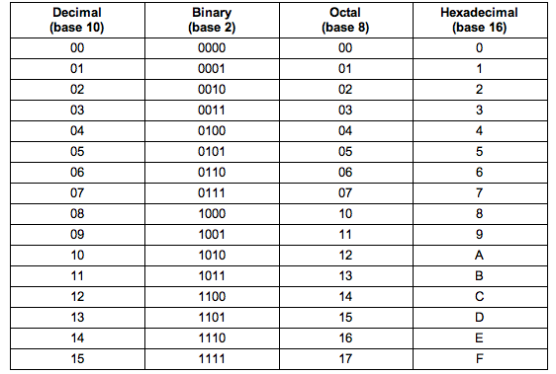
Different Radix / base conversion into Decimal
Numbers with Different Base
Table:

Slide 21
Different Radix / base conversion into Decimal
Base 5 System
An example of a base‐5 number is
(4021.2)₅ = 4 * 5³ + 0 * 5² + 2 * 5¹ + 1 * 5⁰ + 2 * 5⁻¹ = (511.4)₁₀
= 4 x 125 +0x25+2x5+1x1+0.4
= 500+0+10+1+.4=511.4
The coefficient values for base 5 can be only 0, 1, 2, 3, and 4
Base‐8 System
The octal number system is a base‐8 system that has eight digits: 0, 1, 2, 3, 4, 5, 6, 7.
(127.4)₈ = 1 * 8² + 2 * 8¹ + 7 * 8⁰ + 4 * 8⁻¹ = (87.5)₁₀
_{= 64+16+7+0.5 =} _{87.5}

Slide 22
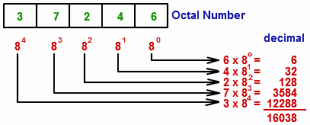
Different Radix / base conversion into Decimal
Base 5 System
An example of a base‐5 number is
(4021.2)₅ = 4 * 5³ + 0 * 5² + 2 * 5¹ + 1 * 5⁰ + 2 * 5⁻¹ = (511.4)₁₀
= 4 x 125 +0x25+2x5+1x1+0.4
= 500+0+10+1+.4=511.4
The coefficient values for base 5 can be only 0, 1, 2, 3, and 4
Base‐8 System
The octal number system is a base‐8 system that has eight digits: 0, 1, 2, 3, 4, 5, 6, 7.
(127.4)₈ = 1 * 8² + 2 * 8¹ + 7 * 8⁰ + 4 * 8⁻¹ = (87.5)₁₀
_{= 64+16+7+0.5 =} _{87.5}

Slide 23
Octal System
Computer scientists are often looking for shortcuts to do things
One of the ways in which we can represent binary numbers is to use their octal equivalents instead
This is especially helpful when we have to do fairly complicated tasks using numbers
The octal numbering system includes eight base digits (0-7)

Slide 24
Transform (44978)₁₀ to Octal
Division | Quotient | Remainder | Binary
44978 / 8 | 5622 | 2 | 2
5622 / 8 | 702 | 6 | 62
702/8 | 87 | 6 | 662
87/8 | 10 | 7 | 7662
10/8 | 1 | 2 | 27662
1/8 | 0 | 1 | 127662
.

Slide 25
EXAMPLE 1.2
Convert decimal 153 to octal. The required base r is 8.
First, 153 is divided by 8 to give an integer quotient of 19 and a remainder of 1.
Then 19 is divided by 8 to give an integer quotient of 2 and a remainder of 3.
Finally, 2 is divided by 8 to give a quotient of 0 and a remainder of 2. 153 19 1 2 3 0 2 = (231)8

Slide 26
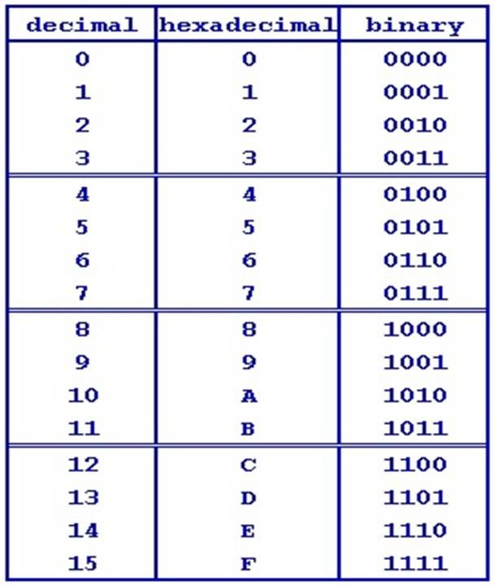
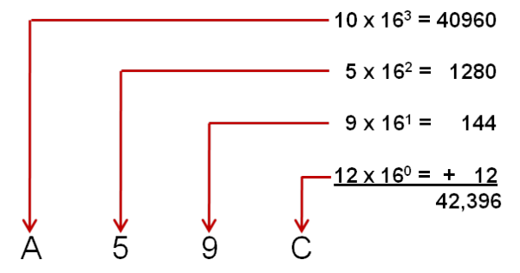
Different Radix / base conversion into Decimal
hexadecimal (base‐16) number system
The letters A, B, C, D, E, and F are used for the digits
10, 11,12, 13, 14, and 15, respectively.
Example A59C = 42396

Slide 27
hexadecimal (base‐16) number system
An example of a hexadecimal number conversion into decimal
(B65F)₁₆ = 11 * 16³ + 6 * 16² + 5 * 16¹ + 15 * 16⁰ = (46,687)₁₀
Therefore, the conversion
from binary to decimal can be obtained by adding only the numbers with powers of two corresponding to the bits that are equal to 1.
For example,
(110101)₂ = 32 + 16 + 4 + 1 = (53)₁₀

Slide 28
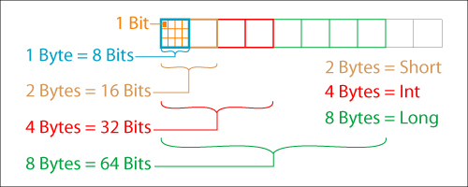
Bytes in Computer System
In computer work, 2¹⁰ is referred to as K (kilo), 2²⁰ as M (mega), 2³⁰ as G (giga), and 2⁴⁰ as T (tera).
Thus, 4K = 2¹² = 4,096 and 16M = 2²⁴ = 16,777,216
Computer capacity is usually given in bytes.
A byte is equal to eight bits and can accommodate (i.e., represent the code of) one keyboard character.
1 Byte = 8 bits
A computer hard disk with
four gigabytes of storage has a capacity of 4G = 232 bytes (approximately 4 billion bytes)

Slide 29
O C TA L & D H E X A D E C I M A L N U M B E R S
Binary to Octal & Hexadecimal Conversion
the conversion from and to binary, octal, and hexadecimal plays an important role in digital computers, because shorter patterns of hex characters are easier to recognize than long patterns of 1’s and 0’s.
Since 2³ = 8 and 2⁴ = 16, each octal digit corresponds to three binary digits and each hexadecimal digit corresponds to four binary digits.
The conversion from binary to octal is easily accomplished by partitioning the binary number into groups of three digits each, starting from the binary point and proceeding to the left and to the right.
(10 110 001 101 011 . 111 100 000 110)2 = (26153.7406)8 2 6 1 5 3 7 4 0 6

Slide 30
Table of 2
Bit Line Number | Powers of 2 Exponent | Binary Bit Weight in Decimal | Highest Number Count (Memory Address)
 |  |  | Decimal | Hexadecimal | Binary
1 | 2⁰ | 1 | 1 | 0001 | 0000 0001
2 | 2¹ | 2 | 3 | 0003 | 0000 0011
3 | 2² | 4 | 7 | 0007 | 0000 0111
4 | 2³ | 8 | 15 | 000F | 0000 1111
5 | 2⁴ | 16 | 31 | 001F | 0001 1111
6 | 2⁵ | 32 | 63 | 003F | 0011 1111
6 | 2⁵ | 32 | 63 | 003F | 0011 1111
7 | 2⁶ | 64 | 127 | 007F | 0111 1111
8 | 2⁷ | 128 | 255 | 00FF | 1111 1111
9 | 2⁸ | 256 | 511 | 0000 01FF | 0001 1111 1111
10 | 2⁹ | 512 | 1,023 | 0000 03FF | 0011 1111 1111
11 | 2¹⁰ | 1,024 | 2,047 | 0000 07FF | 0111 1111 1111
12 | 2¹¹ | 2,048 | 4,095 | 0000 0FFF | 1111 1111 1111

Slide 31
Binary to Octal & Hexadecimal Conversion
Binary to Hexadecimal conversion
Conversion from binary to hexadecimal is similar, except that the binary number is divided into groups of four digits:
(10 1100 0110 1011 . 1111 0010)2 = (2C6B.F2)₁₆
2 C 6 B F 2

Slide 32
Octal & Hexadecimal to Binary Conversion
Conversion from octal or hexadecimal to binary is done by reversing the preceding procedure.
Each octal digit is converted to its three‐digit binary equivalent.
Similarly, each hexadecimal digit is converted to its four‐digit binary equivalent. :

Slide 33
Binary to hexadecimal
Conversion from binary to hexadecimal is similar, except that the binary number is divided into groups of four digits
: (10 1100 0110 1011 . 1111 0010)2 = (2C6B.F2)₁₆ 2 C 6 B F 2
From Octal & Hexadecimal to Binary
(673.124)₈ = (110 111 011 . 001 010 100)₂ 6 7 3 1 2 4
and
(306.D)₁₆ = (0011 0000 0110 . 1101)₂ 3 0 6 D

Slide 34
Assignment
What is the exact number of bytes in a system that contains (a) 32K bytes, (b) 64M bytes, and (c) 6.4G bytes?
Convert the following numbers with the indicated bases to decimal:
(a) (4310)₅ (b) (198)₁₂ (c) (435)₈
3. Determine the base of the numbers in each case for the following operations to be correct:
(a) 14/2 = 5 (b) 54/4 = 13 (c) 24 + 17 = 40.
4. The solutions to the quadratic equation x2 - 11x + 22 = 0 are x = 3 and x = 6. What is the base of the numbers?
5. Convert the hexadecimal number 64CD to binary, and then convert it from binary to octal.
6. Convert the decimal number 431 to binary in two ways: (a) convert directly to binary; (b) convert first to hexadecimal and then from hexadecimal to binary. Which method is faster?
7. Convert the following binary numbers to hexadecimal and to decimal: (a) 1.10010, (b) 110.010. Explain why the decimal answer in (b) is 4 times that in (a)

Slide 35
Information searching tools
(IEEE Xplore, Science Direct, Google, Google Scholar, Scopus, ACM Digital Library)
Avoiding Plagiarism,
Copyright,
What is plagiarism?
Definition – ”Plagiarism is passing off someone else’s work, whether intentionally or unintentionally, as your own for your own benefit”
(Carroll, 2002, p. 9).

Slide 36
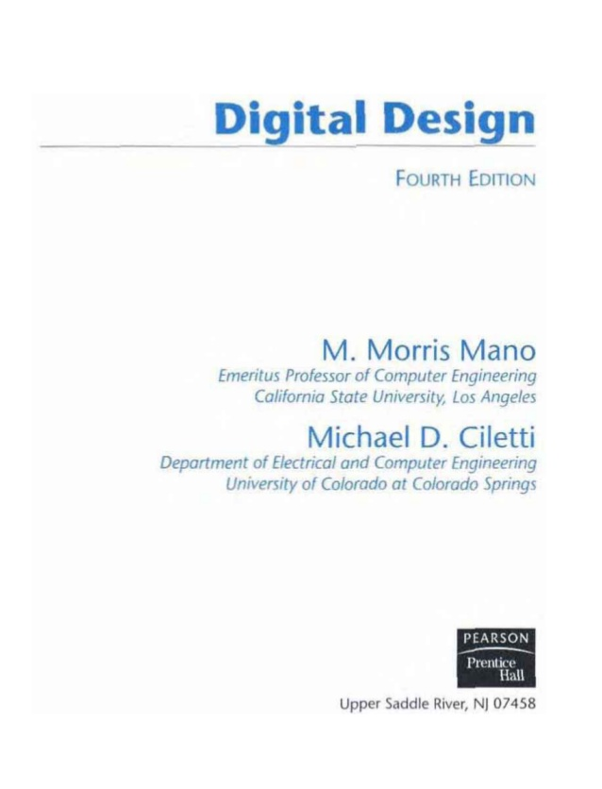
References

Slide 37
THANK YOU!
QUESTIONS

