Slide 1
What is JAD
20
Recommended For
Pharmacy Student!
Part
Pharm-D (Doctor of Pharmacy),
DPT (Doctor of Physiotherapy) &
Pharmacy Technician.
Muhammad Munim Akhtar

Slide 2
Welcome to
Computer & its Application in Pharmacy with Munim Akhtar
Free online quality educational tutorials about Computer in Pharmacy

Slide 4
JAD
Joint Application Development

Slide 5
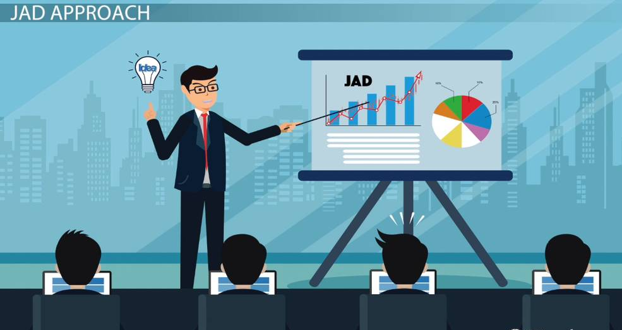
Origins
JAD was developed by Chuck Morris and Tony Crawford in 1970
Crawford led several workshops to prove the concept.
JAD became widely accepted in many companies.
Definition:
by Crawford An Interactive systems design concept involving discussion groups in a workshop.

Slide 6
Joint Application Development
JAD is a methodology that involves the client or end user in the design, through a succession of collaborative workshops called JAD sessions. Or
Joint Application Development is a process that accelerates the design of IT solutions.
JAD uses customer involvement in groups to accurately represent the user's view, need and to jointly develop a solution.

Slide 7
What is Joint Application Development?
It brings together
business people (end users) &
IT Professionals (Information Technology) in a highly focused workshop.
It also improves the quality of the final product by focusing on the key issues.
Reducing the probability of errors that are expensive to correct later on.

Slide 8
What is Joint Application Development…
JAD Participants get together in a room to discuss the problem/project.
Everyone hears what the rest of the group has to say.
JAD can eliminate many of the problems with traditional meetings.
All of these groups work together on a project as equal partners.
JAD Purpose:
to define the project,
design a solution &
monitor the project until it reaches completion.

Slide 9
JAD Participants
JAD participants typically include:
Project sponsor
Project leader
Facilitator
End users
Developers
Observers
Subject matter experts

Slide 10
All participants come together in a joint forum.
Project Sponsor
Observers
Facilitator
Project Lead
Scribe
Subject Matter Experts
Developers
End User

Slide 11
1- Executive
The executive is the person from the customer's organization who has the ultimate authority to make decisions about the project.
The executive has the following responsibilities:
Accept ultimate authority and responsibility .
Resolve business policy conflicts.
Set the vision for the project.
Communicate customer support and cooperation.
Ensure the project team has access to and commitment from the right business user experts.

Slide 12
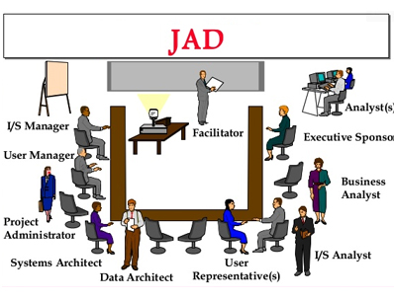
2- Facilitator
The success or failure of the JAD process is closely tied
to how the facilitator handles the session.
Must be highly trained.
Have an excellent working knowledge with different techniques
Must be able to communicate effectively with the different personality.

Slide 13
3- User
Users have the following responsibilities in the JAD process
Provide business expertise.
Serve as the main focus of JAD
Represent the strategic, tactical(Calculated), or operational direction of the business.
Represent all major user groups affected by the project.

Slide 14
4- IT representatives
IT representatives have the following responsibilities:
Help customer ideas into models of business requirements.
Represent job functions such as
data administration, business analysis, programming, prototyping to operations management.
Ensure all technological constraints are represented.
Develop an understanding of user business goals.

Slide 15
5- Observer
An observer has the following responsibilities in the JAD process:
Watch and listen.
Learn about user needs and workshop decisions.
Interact with the participants and facilitator only during breaks or before and after sessions.

Slide 16
Many Tools used to Automate JAD
Various software tools used to assist JAD sessions e.g. interactive development tool etc.
Word processors are used to record the core sessions.
The Internet created many opportunities for group work.
Virtual communication, It is now possible to include participants from many remote locations or anywhere in the world.

Slide 17
JAD Life Cycle
Planning/ Define objective (To complete the Planning stag)
Preparation (To complete the Preparation stage)
Design Sessions (To complete the Design Session component of JAD)
Finalization (To complete the Finalization component)

Slide 18
Planning/Definition
In Planning stage, perform the following tasks:
·Designate the executive sponsor.
·Establish the need for the system.
·Select team members for the definition component.
·Define the scope of the session.
·What are the expected benefits?
·What opportunities does it address?
·What problems would it resolve?
·What are the risks?
·How does it fit in with the strategic direction of the organization?

Slide 19
Preparation
To complete the Preparation stage, you must perform the following tasks:
Schedule design sessions.
Conduct orientation and training for design session participants.
Prepare the materials, room, and software aids.
Customize the design session agenda.

Slide 20
Design Sessions
To complete the Design Session component of JAD, you
must perform the following tasks:
Review the project scope, objectives, and definition document.
Identify data, process, and system requirements.
Identify system interfaces.
Develop a prototype.
Document decisions, issues, assumptions, and definitions of terms.
Assign someone to resolve all issues.

Slide 21
Finalization
To complete the Finalization component, you must perform the following tasks:
Complete the design documents.
Sign off on the design documents.
Make a presentation to the executive sponsor.
Demonstrate the prototype.
Obtain the executive sponsor's approval to proceed.
Evaluate the JAD process.

Slide 22
Benefits
JAD achieves these benefits because of the following
factors:
The decision makers are present.
The facilitator keeps the group focused on the goals.
Different views are handled immediately.
Most errors are caught in the Analysis and Design stages.
The system design reflects the user's desires.
Issues are resolved quickly.

Slide 23
Advantages
This technique allows for the simultaneous gathering and consolidating of large amounts of information.
Produces relatively large amounts of high-quality information in a short period of time.
Issues are resolved immediately with the aid of the facilitator.
This technique provides a forum to explore multiple points of view regarding a topic.

Slide 24
Disadvantages
Requires significant planning and scheduling effort.
Requires significant stakeholder commitment of time and effort.
Requires trained and experienced personnel for facilitation and recording.

Slide 25
Today quote:
“An investment in knowledge pays the best interest. “
- Benjamin Franklin

Slide 26
?

