Slide 1
Soil Mechanics
(BS-GEOLOGY)
UOS
SAEED HASSAN

Slide 2
Permeability of Soil
Soils are permeable due to the existence of interconnected voids through which water can flow from points of high energy to points of low energy. The study of the flow of water through permeable soil media is important in soil mechanics.
It is necessary for estimating the quantity of underground seepage under various hydraulic conditions, for investigating problems involving the pumping of water for underground construction, and for making stability analyses of earth dams and earth-retaining structures that are subject to seepage forces.

Slide 3
Definition
• The property of soils that allows water to pass through them at some rate.
• This property is a product of the granular nature of the soil, although it can be affected by other factors (such as water bonding in clays)
• Different soils have different perm abilities, understanding of which is critical to the use of the soil as a foundation or structural element

Slide 4
Soil and rock are porous materials
• Fluid flow takes place through interconnected void spaces between particles and not through the particles themselves
• No soil or rock material is strictly “impermeable”

Slide 5
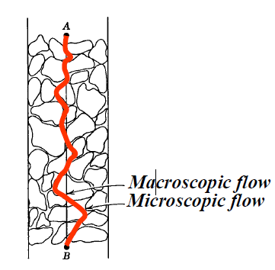

Slide 6
The study of flow of water through porous media is necessary for-
¨ Estimation Seepage Loss
¨ Estimation Pore Water Pressures
¨ Evaluation Quicksand Conditions
¨ Dewatering System Design
¨ Drainage System Design

Slide 7
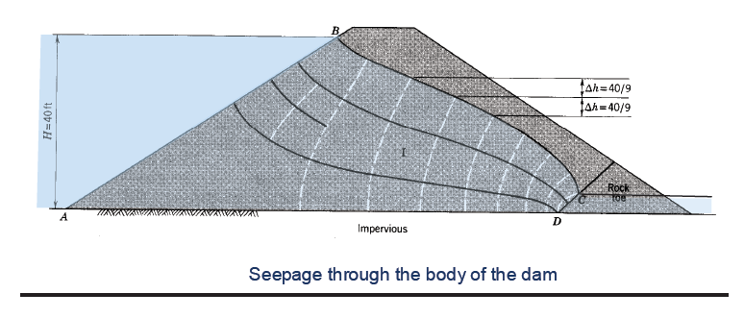

Slide 8
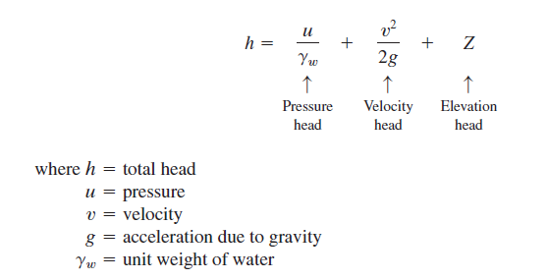
From fluid mechanics, we know that, according to Bernoulli’s equation, the total head at a point in water under motion can be given by the sum of the pressure, velocity, and heads, or

Slide 9
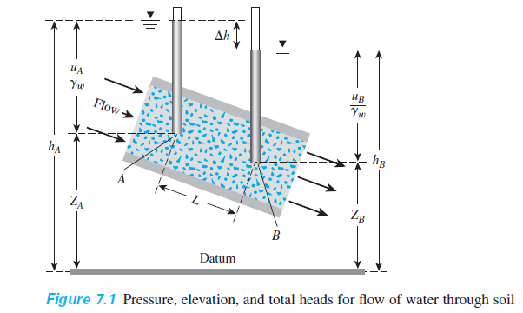

Slide 10
If Bernoulli’s equation is applied to the flow of water through a porous soil medium, the term containing the velocity head can be neglected because the seepage velocity is small, and the total head at any point can be adequately represented by

Slide 11
Figure 7.1 shows the relationship among pressure, elevation, and total heads for the flow of water through soil. Open standpipes called piezometers are installed at points A and B. The levels to which water rises in the piezometer tubes situated at points A and B are known as the piezometric levels of points A and B, respectively. The pressure head at a point is the height of the vertical column of water in the piezometer installed at that point. The loss of head between two points, A and B, can be given by

Slide 13
In most soils, the flow of water through the void spaces can be considered laminar and thus

Slide 14
Darcy’s Law
In 1856, Darcy published a simple equation for the discharge velocity of water through saturated soils, which may be expressed as

Slide 15
Hydraulic Conductivity or Coefficient of permeability (k)
It is defined as the rate of flow per unit area of soil under unit hydraulic gradient, it has the dimensions of velocity (L/T) such (cm/sec or ft/sec).
It depends on several factors as follows:
1. Shape and size of the soil particles.
2. Distribution of soil particles and pore spaces.
3. Void ratio. Permeability increases with increase of void ratio.
4. Degree of saturation. Permeability increases with increase of degree of saturation.
5. Composition of soil particles.
6. Soil structure

Slide 16
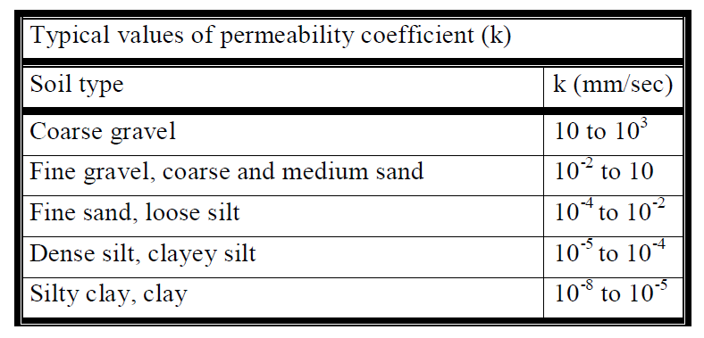
The coefficient of permeability of soils is generally expressed at a temperature of 20 ºC. At any other temperature T, the coefficient of permeability can be obtained from eq as:

Slide 17
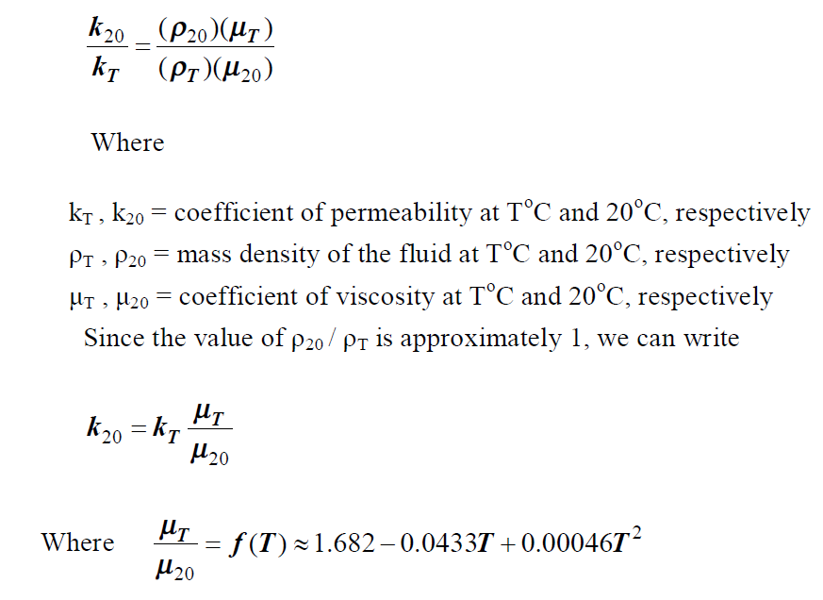

Slide 18
Laboratory methods
The two most common laboratory methods for determining the permeability coefficient of soils are the following:
1. Constant – head test.
2. Falling – head test.

Slide 19
Constant Head Test
Direct measure of permeability using Darcy's Law
Suitable for cohesionless soils with permeabilities
> 10 x10⁻⁴ cm/sec
The simplest of all methods for determining the coefficient of permeability
This test is performed by measuring the quantity of water, Q, flowing through the soil specimen, the length of the soil specimen, L, the head of water, h, and the elapsed time, t. The head of water is kept constant throughout the test.

Slide 20
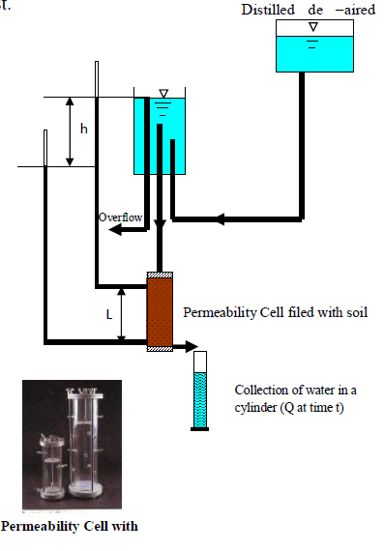

Slide 21
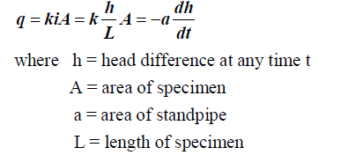
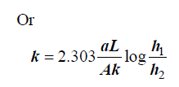
Falling – head test
Indirect measurement of permeability using time of flow
Suitable for cohesive soils with permeabilities < 10 x 10⁻⁴ cm/sec
The rate of flow through the soil is

Slide 22
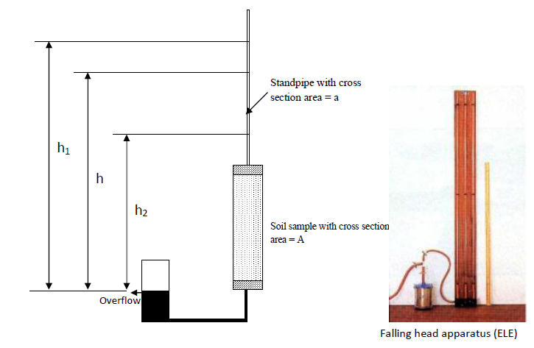

Slide 23
SEEPAGE
In the preceding sections of this chapter, we considered some simple cases for which direct application of Darcy’s law was required to calculate the flow of water through soil. In many instances, the flow of water through soil is not in one direction only, and it is not uniform over the entire area perpendicular to the flow. In such cases, the groundwater flow is generally calculated by the use of graphs referred to as flow nets. The concept of the flow net is based on Laplace’s equation of continuity, which governs the steady flow condition for a given point in the soil mass.

Slide 30
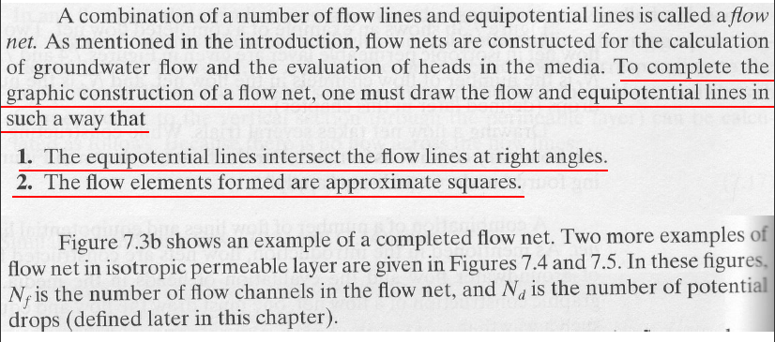

Slide 31
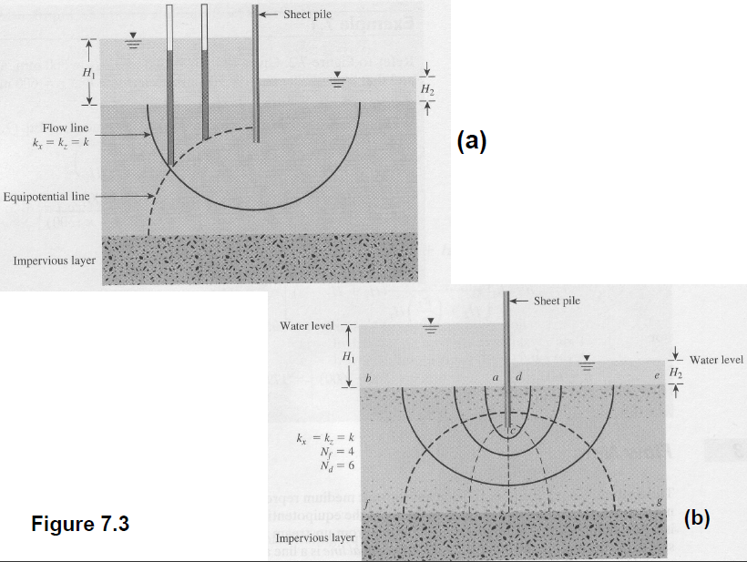

Slide 32
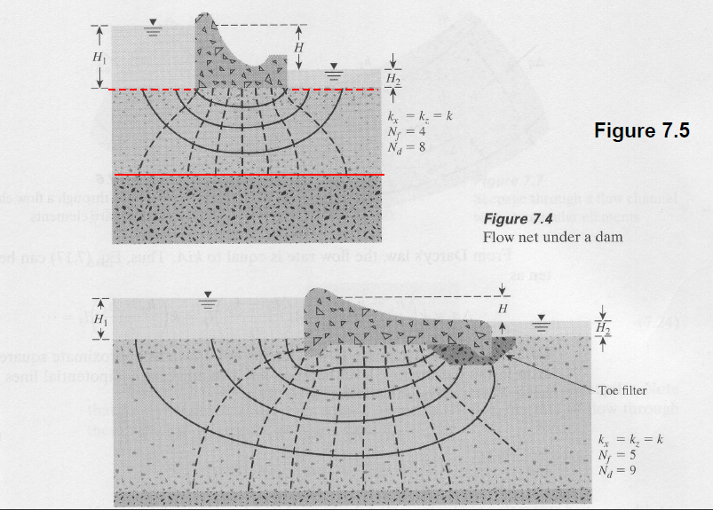

Slide 34
