Slide 1
Introduction To Demography ^{BS Sociology} Semester: 5th ^{Lecture No. 14} ^{Instructor: Mumtaz Hussain} University of Sargodha Sb Campus ^{Bhakkar}

Slide 2
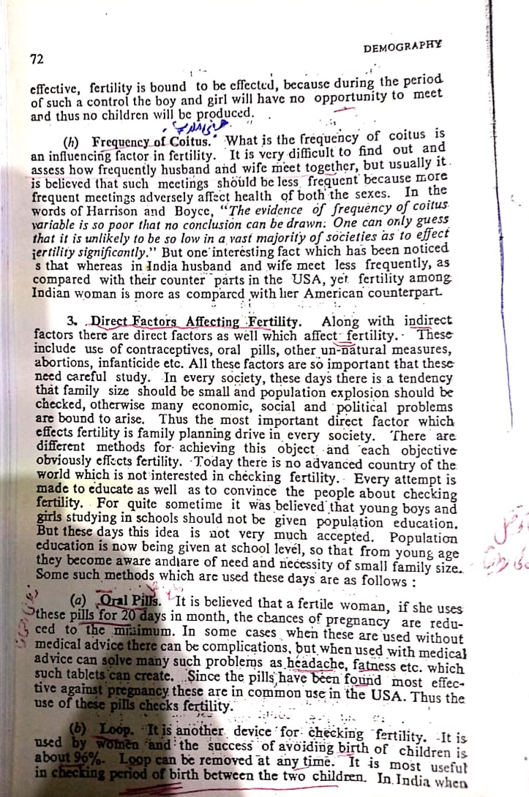

Slide 3
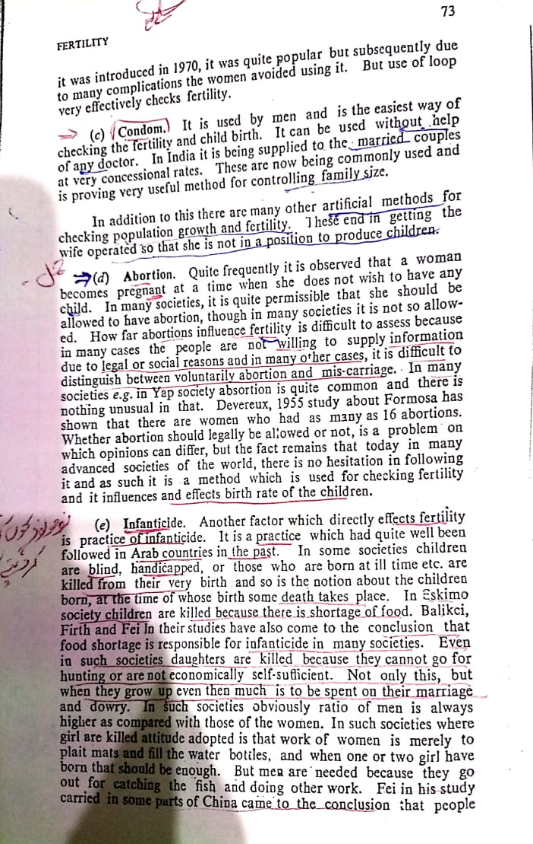
.

Slide 7
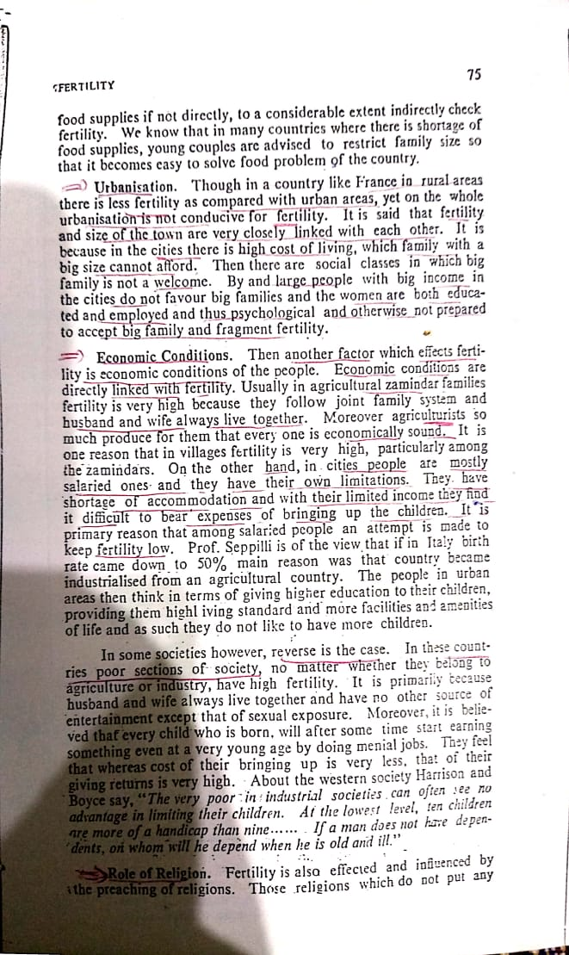

Slide 14
Thank You

