Slide 1
Insect Nervous system
Dr. M. Asam Riaz
Assistant Professor
Department of Entomology, University of Sargodha, Sargodha, Pakistan
Asam.riaz@uos.edu.pk

Slide 2
Nervous system
Conducting system ensure
Rapid functioning
Co-ordination of effectors
Modify the response of effector according to the input of peripheral sense organs

Slide 3
Basic element in NS are nerve cells
Length 1mm to 1m
Diameter 45 to 50 microns
Nerve impulse move along axons
Ganglia
The aggregated bodies of nerve cells are called ganglia

Slide 4
Nerve cell
Neuron
Cell body known as soma or perikaryon
nucleus
Contains mitochondria, Golgi complexes and rough endoplasmic reticulum.
all organelles and proteins manufactured in the soma.
long cytoplasmic projections known as Axons
Dendrites on the end of neuron
Golgi complexes and rough endoplasmic reticulum absent from the dendrites and axon.
No protein synthesis occurs in these parts

Slide 5
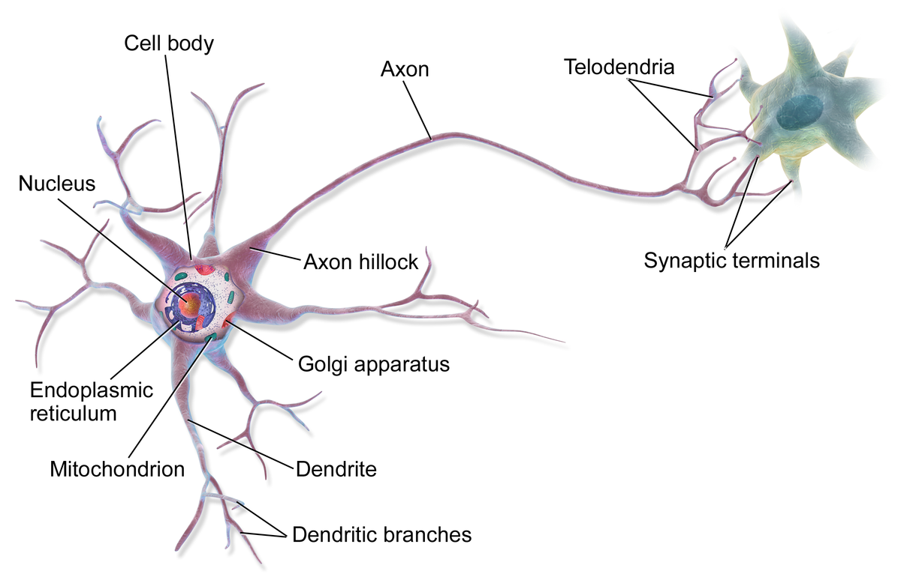
Nerve cell

Slide 6
Synapses: points at which neurons receive information from, or convey it to, other cells
Synaptic cleft: gap between neurons (20-25nm)
synaptic vesicles, contains neurotransmitter, 50–80 nm in diameter
Galial cells: cover the neurons

Slide 7
Transaction of ganglion

Slide 8
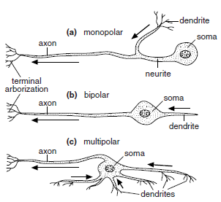
Types of neurons
Types of Neurons
axon
unipolar
bipolar
multipolar

Slide 9
Types of neurons
Unipolar
single axonal projection from cell body
Nearly all insect central nervous system neurons are monopolar,
Bipolar
Two axonal projection from cell body
usually unbranched,
distal dendrite receiving stimuli from the environment and
a proximal axon extending to the central ganglia (Fig. b).
e.g., The peripheral sense cells,
Multipolar
More than two axonal projections
occur in the ganglia of the nervous system (Fig. c)

Slide 10
Type of neurons based on functioning
Sensory/afferent neurons
Conduct message from sense organ to central nervous system
Motor/efferent neurons
Conduct message from the CNS to organs (effectors)
Interneurons
Neurons between sensory and motor neurons

Slide 11
NS divided into 3 divisions
CNS (consists of brain, suboesophageal ganglion, ventral nerve cord)
Peripheral NS: nerves that connect CNS with sense receptors (sense organ)
Visceral NS: consists of nerve and ganglia that connect CNS with viscera such as gut, heart, reproductive organ

Slide 12
Brain
Brain is divided into three parts
Protocerebrum
Bilobed
Optic lobe on lateral side
Provide nerves to compound eyes and ocelli
Deutocerebrum
Fused ganglia of antennae
Provide nerves to antennae
Tritocerebrum
Form by ganglia and fibres
Link brain and suboesophageal ganglion

Slide 13
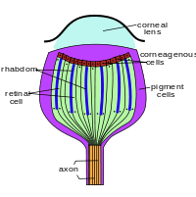

Slide 14
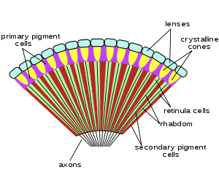

Slide 15
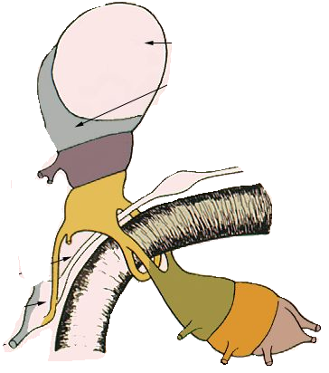
Insect Brain
protocerebrum
hypocerebral ganglion
deutocerebrum
tritocerebrum
recurrent nerve
frontal ganglion
subesophageal ganglion

Slide 16
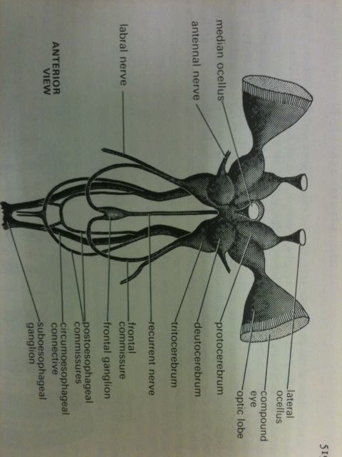
Brain

Slide 17
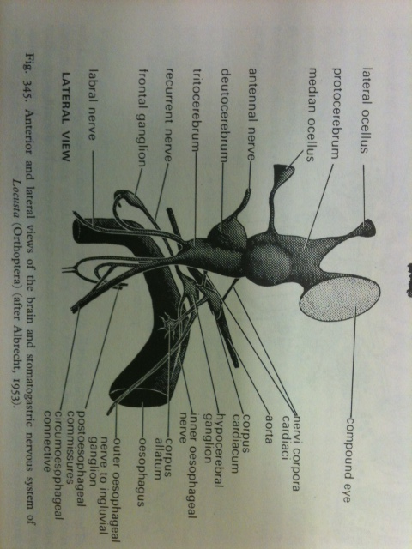

Slide 18
Suboesophageal ganglion:
Fusion of ganglia of the mandibular, maxillary and labial segments
Ventral nerve cord
Lies on floor of thorax and abdomen
In Dictyopterus, 3 thoracic and 8 abdominal ganglions
In Musca, all thoracic and abdominal are fused

Slide 19
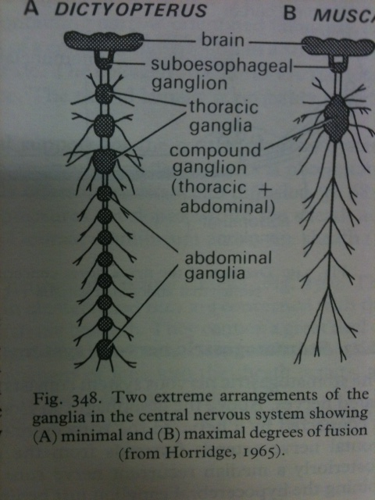
Nervous system
Notes:
3. Insect Nervous System
4. Axon Membrane Potential
5. Synapse Structure and Function

Slide 20
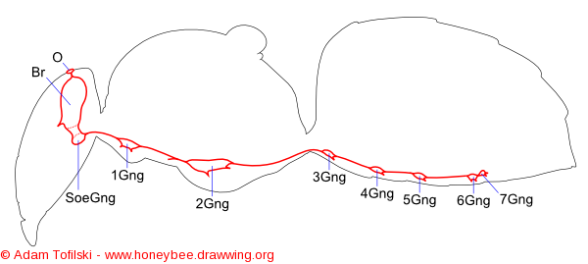
Honey bee
References
Michener C.D. (1974) The social behavior of the bees: a comparative study. Harvard Univ. Press., Cambridge, Mass.

Slide 21
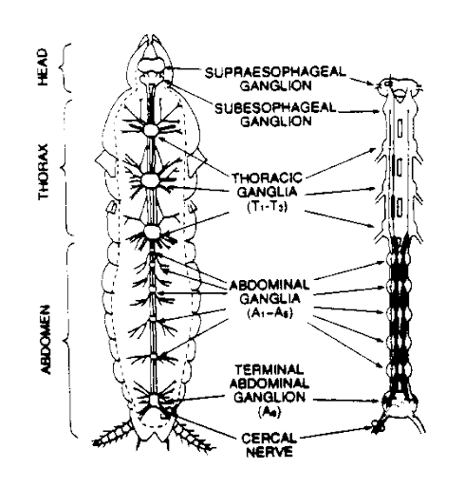
Cockroach

Slide 23
Transmission of nerve impulse

Slide 25
Transmission of nerve impulse
Resting potential
Inside negative charge
Na⁺ pumped out
K⁺ inward movement
negatively charged protein and nucleic acid molecules also inhabit the cell; therefore, the inside is negative as compared to the outside.

Slide 26
Action potential
Permeability of axon membrane changes
Na ions comes in (produce +ve charge inside)
K ions goes
Duration of action potential is 1-2 milliseconds
Adjacent area of axon are negatively charged so that a current flow in a local circuit away from the point of depolarisation

Slide 27
Repolarization: Potassium ions move outside, and sodium ions stay inside the membrane.
After the inside of the cell becomes flooded with Na+, the gated ion channels on the inside of the membrane open to allow the K+ to move to the outside of the membrane.
With K+ moving to the outside, the membrane's repolarization restores electrical balance, although it's opposite of the initial polarized membrane that had Na+ on the outside and K+ on the inside. Just after the K+ gates open, the Na+ gates close; otherwise, the membrane couldn't repolarize.

Slide 28
Refractory period puts everything back to normal: Potassium returns inside, sodium returns outside.
The refractory period is when the Na+ and K+ are returned to their original sides: Na+ on the outside and K+ on the inside.
While the neuron is busy returning everything to normal, it doesn't respond to any incoming stimuli. It's kind of like letting your answering machine pick up the phone call that makes your phone ring just as you walk in the door with your hands full.
After the Na+/K+ pumps return the ions to their rightful side of the neuron's cell membrane, the neuron is back to its normal polarized state and stays in the resting potential until another impulse comes along.

Slide 29
Hyperpolarization: More potassium ions are on the outside than there are sodium ions on the inside.
When the K+ gates finally close, the neuron has slightly more K+ on the outside than it has Na+ on the inside.
This causes the membrane potential to drop slightly lower than the resting potential, and the membrane is said to be hyperpolarized because it has a greater potential. (Because the membrane's potential is lower, it has more room to "grow.").
This period doesn't last long, though (well, none of these steps take long!). After the impulse has traveled through the neuron, the action potential is over, and the cell membrane returns to normal (that is, the resting potential).

Slide 30
if cell membranes allow ions to cross, how does the Na+ stay outside and the K+ stay inside?
The answer is that the Na+ and K+ move back and forth across the membrane.
There are Na+/K+ pumps on the membrane that pump the Na+ back outside and the K+ back inside. The charge of an ion inhibits membrane permeability (that is, makes it difficult for other things to cross the membrane).
Three Na ions comes in and two K comes in and one ATP is consumed

Slide 31
Sodium channel
It is classified as
Voltage-gated sodium channel also called "VGSCs”, it is sensitive to voltage.
(ligand-gated sodium channels) a binding of a substance (a ligand) to the channel

Slide 32
Structure of channel
Sodium channels consist of a large α subunit that associates with other proteins, such as β subunits. An α subunit forms the core of the channel and is functional on its own.
When the α subunit protein is expressed by a cell, it is able to form channels that conduct Na+ in a voltage-gated way, even if β subunits or other known modulating proteins are not expressed.
The α-subunit has four repeat domains, labeled I through IV,
each domain contains six membrane-spanning segments, labeled S1 through S6.
The highly conserved S4 segment acts as the channel's voltage sensor.
The voltage sensitivity of this channel is due to positive amino acids located at every fourth position.
When stimulated by a change in transmembrane voltage, this segment moves toward the extracellular side of the cell membrane, allowing the channel to become permeable to ions.
The ions are conducted through a pore, which can be broken into two regions.
The more external portion of the pore is formed by the "P-loops" (the region between S5 and S6) of the four domains. This region is the most narrow part of the pore and is responsible for its ion selectivity.
The inner portion (i.e., more cytoplasmic) of the pore is formed by the combined S5 and S6 segments of the four domains.
The region linking domains III and IV is also important for channel function. This region plugs the channel after prolonged activation, inactivating it.
Notes:
Spanning= duration, space

Slide 33
voltage-sensitive sodium channel α-subunit. G – glycosylation, P – phosphorylation, S – ion selectivity, I – inactivation. Positive (+) charges in S4 are important for transmembrane voltage sensing
Yu FH, Catterall WA (2003). "Overview of the voltage-gated sodium channel family". Genome Biol 4 (3): 207. doi:10.1186/gb-2003-4-3-207. PMC 153452. PMID 12620097

Slide 34
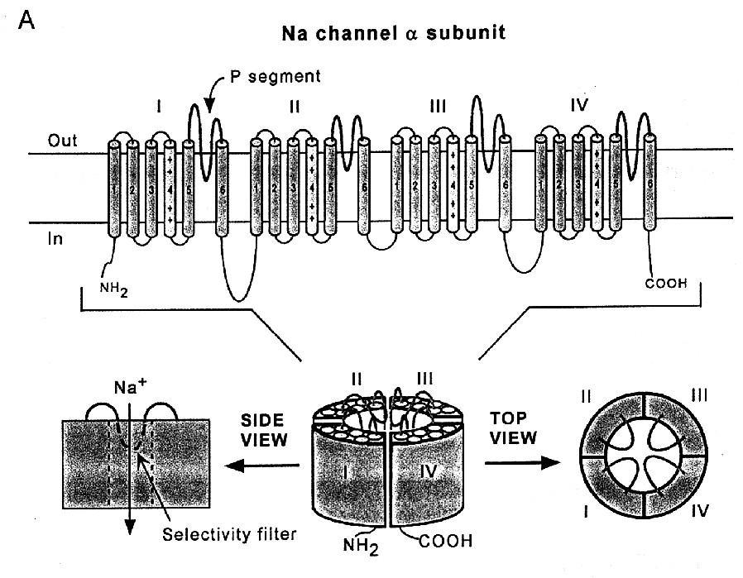

Slide 35
Neurotransmitter
Amino acids:
Glutamate
Aspartate
D-serine
Gamma aminobutyric acid (GABA)
Glycine

Slide 36
2-Monoamines
Dopamines
Norepinephrine
Epinephrine
Histamine
Serotonin (5-HT)

Slide 37
3-Others
Acetylcholine
Adenine
Nitric oxide (NO)
H₂S
CO₂
Zn

Slide 39
