Slide 1
Foundations Of Education Topic: Aims of Education
BY: Shamsa Mubeen

Slide 3
Individual Aim of Edu: 1:Its means to develop the individuality of the learner according to learner’s aptitude and interest. 2: its encourage the notion that individual is forefront of Educational Process. 3: Foster the Growth of individuality of learner 4: to understand the psyche of individual
individuality
Individual is forefront of Educational process
Foster the free Growth of individual
Understanding the needs and interest of Individual

Slide 4
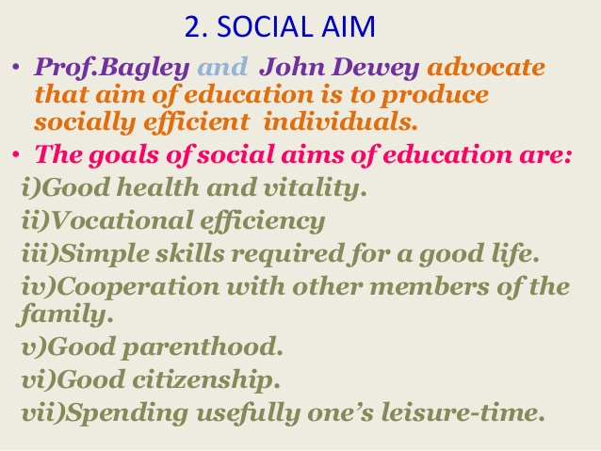

Slide 5
Spiritual aims of education refer to those aims through which national ideology and values are injected in the character of the present and future generation. These aims are given priority in a system of education. These aims serve as a foundation of a system of education. They are directly concerned with the life ideology of a nation.

Slide 6
The term vocational education is general and includes every form of education that aims to the acquirement of qualifications related to a certain profession, art or employment or that provides the necessary training and the appropriate skills as well as technical knowledge, so that students are ale to exercise their Skills.

Slide 8
1: Preservation of Culture 2: promotion of culture heritage 3:Culture change 4:transmission of culture 5: Revival of culture

Slide 9
Moral Aim of Education: 1: Purification of soul 2: Character building 3: moral training 4:Healthy moral Environment

Slide 10
Intellectual aim- it is essential for acquiring knowledge, thinking, reasoning, judgment and generalization. Education provides enough opportunities to develop the innate intellectual capacity of the student development of intelligence through education will enable the child to lead an independent life with confidence.

