Slide 1
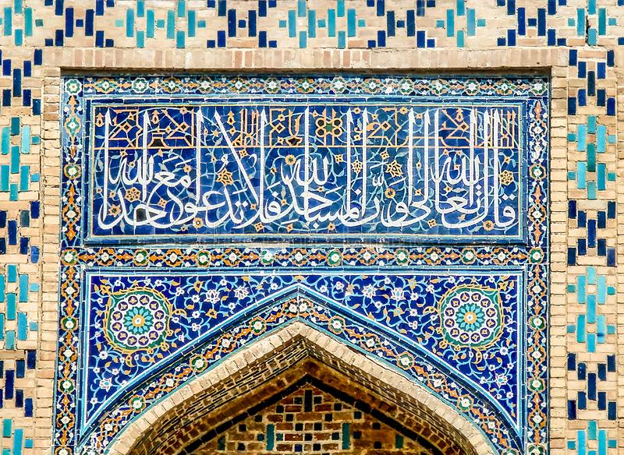
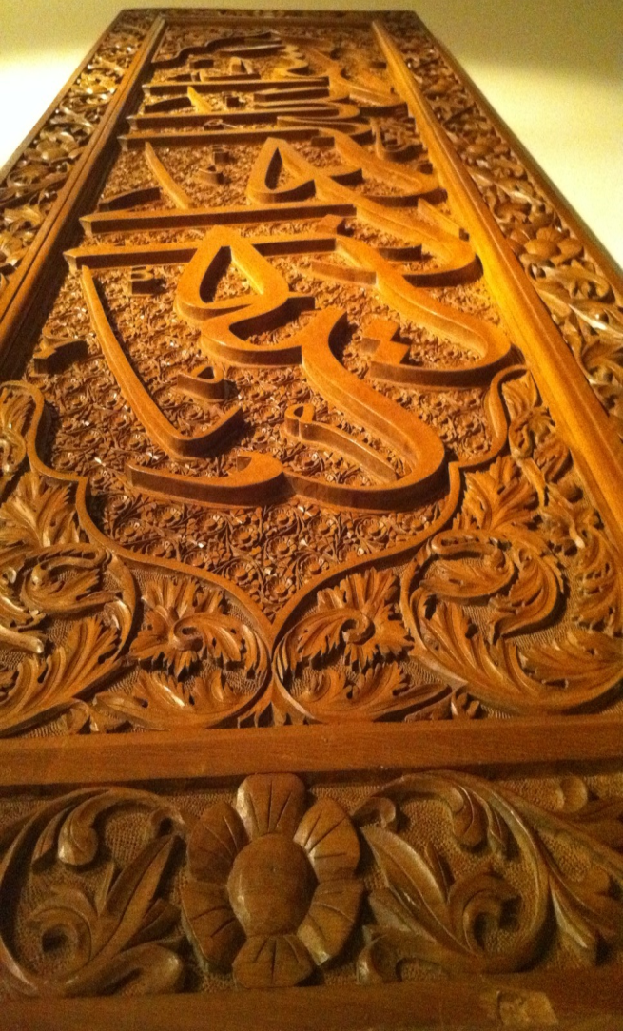
Calligraphy & Diversity of Materials
Glass
Mosaics
Wood

Slide 2
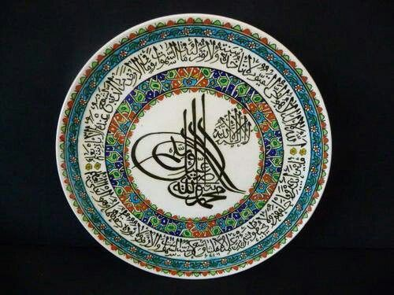
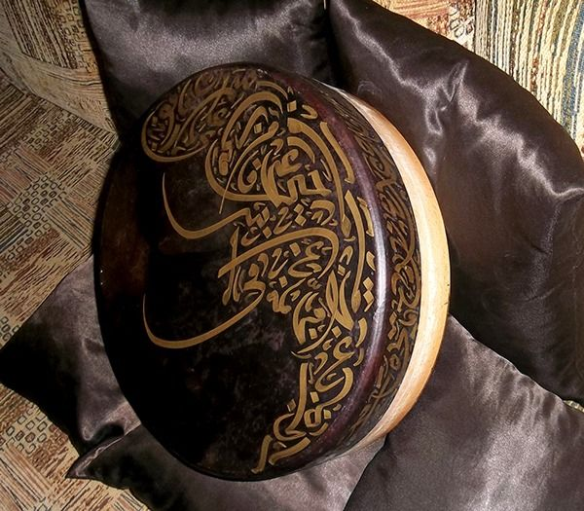
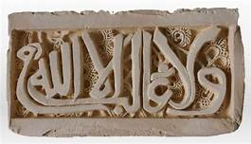
Ceramic
Leather
Plaster

Slide 3
Contemporary Development
For over a century, there has been no major
development in Arabic Calligraphy, except:
• Development of new type styles – for printing
• The use of Digital Media
• Incorporating Calligraphy in Fine Arts

Slide 5
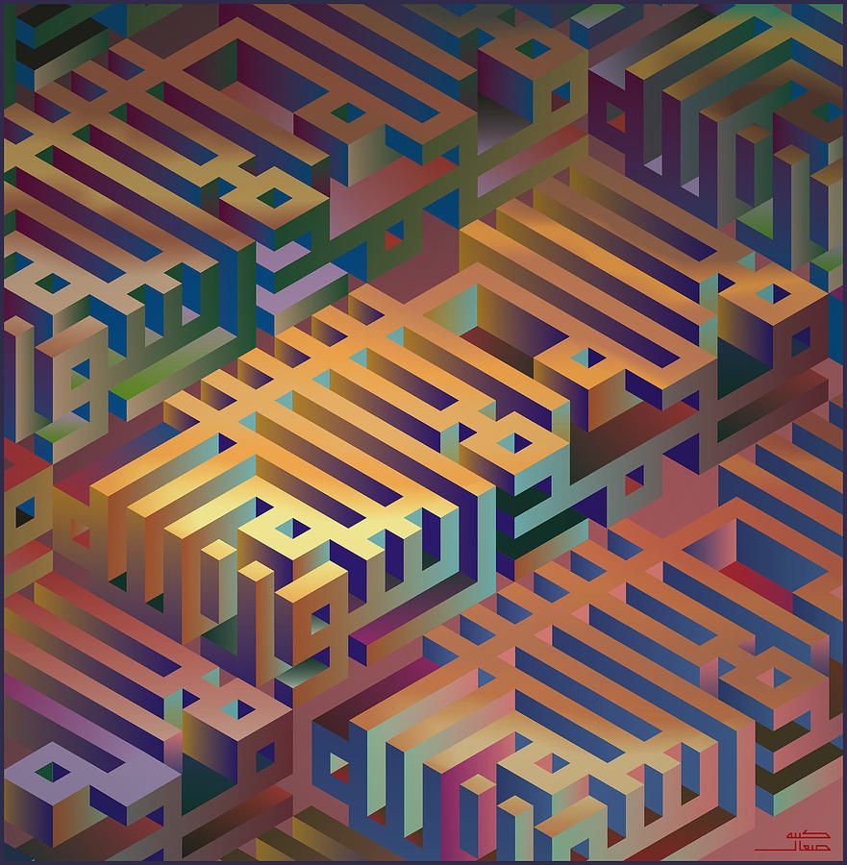
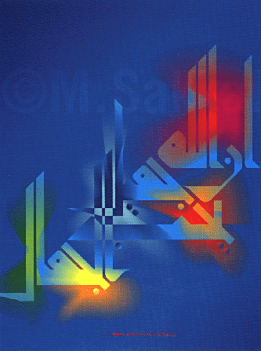
Calligraphy and Fine Art
Steps and Shadows by Mamoun Sakkal
God is Beautiful and Loves Beauty
by Mamoun Sakkal Steps

Slide 6
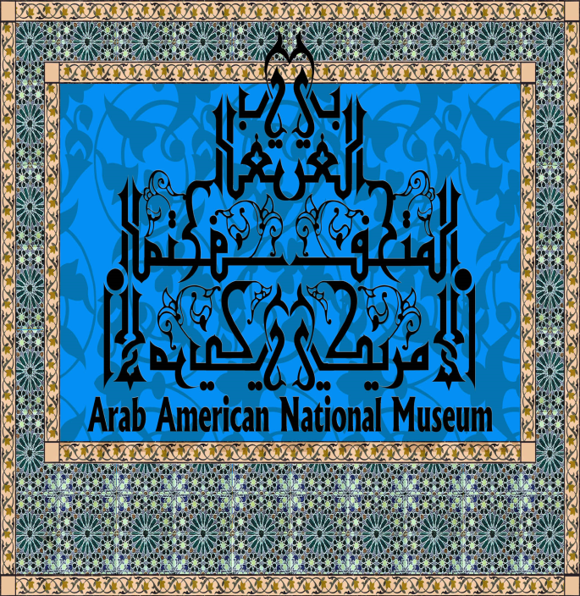
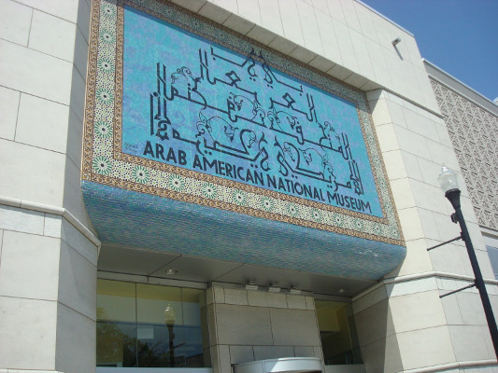
Arab American National Museum- Front Entrance, 25’x16’ – Mosaics
Dearborn, Michigan, May 2005. Implemented by Mosaics House- Morocco

Slide 7
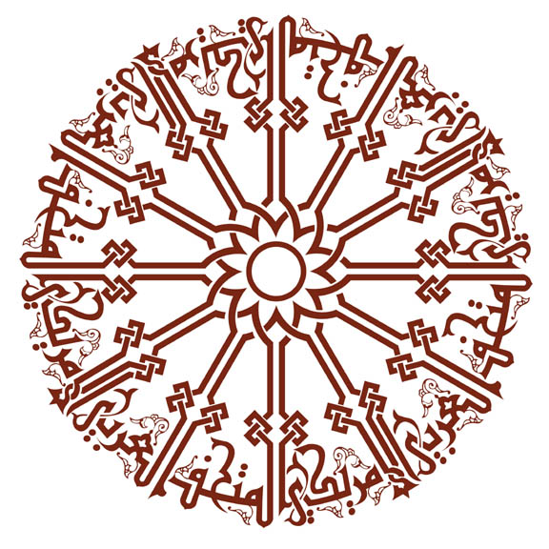
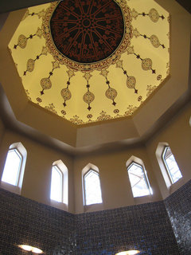
Arab American National Museum Calligraphy of the Dome, 30’ Diameter- Acrylic Dearborn, Michigan. May 2005.

Slide 8
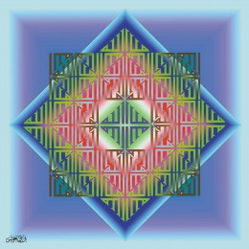
Calligraphy and Fine Art
Fayeq Oweis, 2001. Allah “series”

Slide 9
Internet resources:
Islamic Art & Architecture Organization www.islamicart.com
Los Angeles County Museum
www.lacma.org
Mamoun Sakkal Design
www.sakkal.com
Fayeq Oweis
www.oweis.com

