Slide 1
Layering

Slide 2
The development of roots on a stem while the stem is still attached to the parent plant is called layering
A layer is the rooted stem which is latter detach from the parent plant.

Slide 3
Some plants propagate naturally by layering
but sometimes plant propagators assist the process.
Layering is enhanced by wounding the stem where the roots are to form.
The rooting medium should always provide aeration and a constant supply of moisture.

Slide 4
Types of layering

Slide 5
1. Simple layering
by bending a low growing, flexible stem to the ground.
wounding the lower side of the bent branch
Cover part of it with soil, leaving the remaining 6 to 12 inches above the soil

Slide 6
Simple layering can be done in early spring using a dormant branch
in late summer using a mature branch.

Slide 7
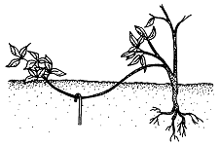

Slide 8
2. Tip layering

Slide 9
Tip layering
quite similar to simple layering
Dig a hole 3 to 4 inches deep
Insert the tip of a current season’s shoot and cover it with soil

Slide 10
The tip grows downward first, then bends sharply and grows upward
Roots form at the bend.
The re-curved tip becomes a new plant

Slide 11
3. Compound layering

Slide 12
3. Compound layering (serpentine layering)
similar to simple layering, but several layers can result from a single stem.
Bend the stem to the rooting medium as for simple layering, but alternately cover and expose sections of the stem

Slide 13
Each section should have at least one bud exposed and one bud covered with soil.
Wound the lower side of each stem section to be covered

Slide 14
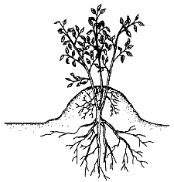
4. Mound (stool) layering

Slide 15
useful with heavy-stemmed, closely branched shrubs and rootstocks of tree fruits
Cut the plant back to 1 inch above the soil surface in the dormant season
Dormant buds will produce new shoots in the spring. Mound soil over the new shoots as they grow

Slide 16
Roots will develop at the bases of the young shoots.
Remove the layers in the dormant season.
Mound layering works well on apple rootstocks, quince,

Slide 17
5. Air layering

Slide 18
Air layering (ghooti or marcottage)
used to propagate large, overgrown house plants such as rubber plant, croton
For optimum rooting,
make air layers in the spring…. on shoots produced during the previous season
in mid to late summer …..on shoots from the current season’s growth.

Slide 19
Choose an area just below a node and remove leaves and twigs on the stem 3 to 4 inches above and below this point
Surround the wound with moist, sphagnum moss that has been soaked in water and squeezed to remove excess moisture
Wrap the moss with plastic

