Slide 1
The Underpainting Technique Part 2
By Awais Naqvi

Slide 2
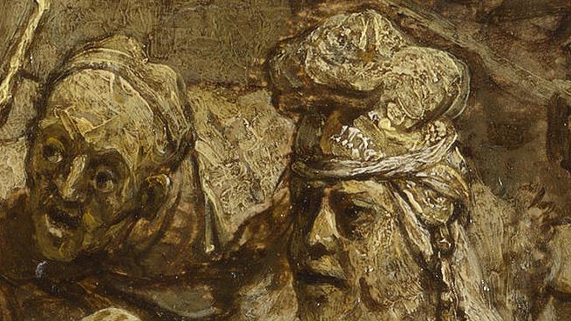
Colours
Underpaintings are most often executed using browns, such as umbers and siennas (known as Imprimatura), or black-and-white (known as Grisaille).

Slide 3
Tonal Rendering
The underpainting is a fairly complete tonal rendering of the final painting. This allows you to concentrate entirely on the tonal relationships of your composition, without having to worry about colour. It can be overwhelming trying to figure out both the tonal and colour relationships in a painting at the same time.

Slide 4
Grisaille
Some very famous artists have painted using a process called grisaille
Grisaille painting (it's pronounced 'griz-EYE') is done when an artist uses a limited palette related to one color like gray to create a painting's first layer, called the underpainting.
Grisaille results in a detailed image that looks like a carefully rendered marble statue lacking any color. In fact, grisaille is a French word meaning 'gray.'

Slide 5
French word
In fact, grisaille is a French word meaning 'gray.‘
During the fifteenth and sixteenth centuries in Northern Europe, artists often used the grisaille method.

Slide 6
First Color
the first layer of color. In this indirect approach to oil painting, each layer of color is applied gradually. The layers become more and more transparent as they are applied.

Slide 7
Second Colors
After the first layer of color has dried, I then move on to second color in which the colors on the figure get more specific, and we bring the figure to an overall finish.

Slide 8
Final Touches
the last part of the oil painting.
the final glazes and highlights, and bring the background to a finish.

Slide 10
The End

