Slide 1
Microscopy

Slide 2
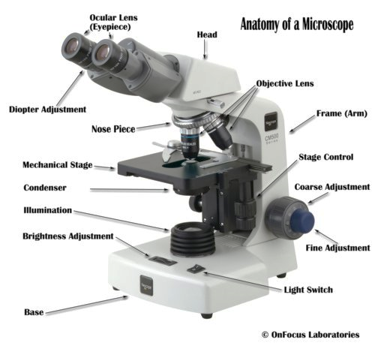
MICROSCOPE
An optical instrument that uses a lens or a combination of lenses to produce highly magnified images of small specimens or objects especially when they are too small to be seen by the naked (unaided) eye

Slide 3
TYPES OF MICRSOCPE
Light Microscope
The Bright-Field Microscope
The Dark-Field Microscope
Phase-Contrast Microscope
Differential Interference Contrast Microscope
Polarized light microscope
Fluorescence Microscope
Metallurgical Microscope
Electron Microscopes
Spin-polarized low-energy electron microscope (SPLEEM)
Reflection electron microscope(REM)
Transmission Electron Microscope(TEM)
Scanning Electron Microscope(SEM)
Latest Techniques in Microscopy
Confocal Microscopy
Confocal laser scanning microscopy (CLSM or LSCM)
Scanning Probe Microscopy
Atomic force microscopy (AFM) or scanning force microscopy (SFM)
Handheld Digital Microscopes

Slide 4
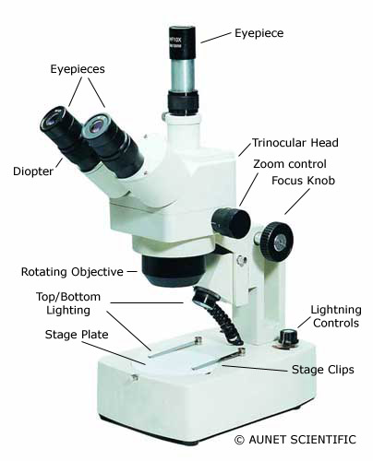
LIGHT MICROSCOPES
Compound (high power microscopes),
Stereo or dissecting (low power microscopes).

Slide 5
BRIGHT FIELD MICROSCOPY
Simplest of all the optical microscopy illumination techniques
Illuminated from below and observed from above

Slide 6
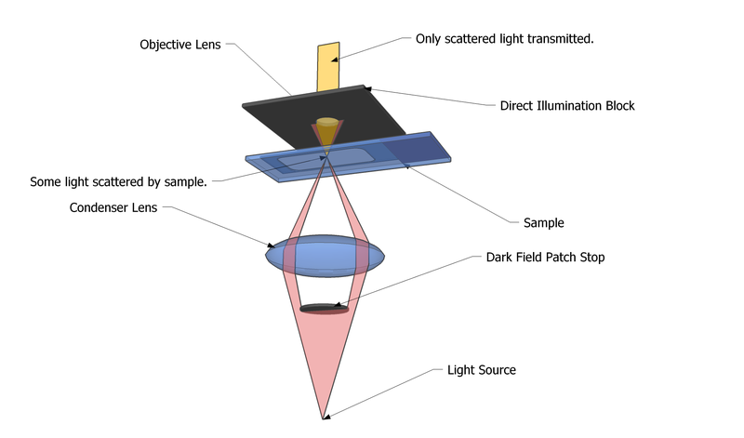
DARK FIELD MICROSCOPY
Live and unstained biological samples

Slide 7
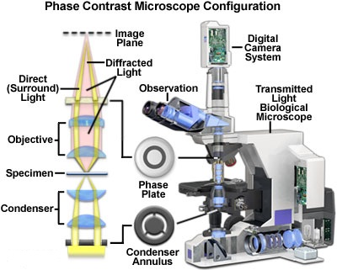
PHASE CONTRAST
Differences in the phase of light transmitted or reflected by a specimen to form distinct, contrasting images of different parts of the specimen

Slide 8
POLARIZING MICROSCOPY

Slide 9
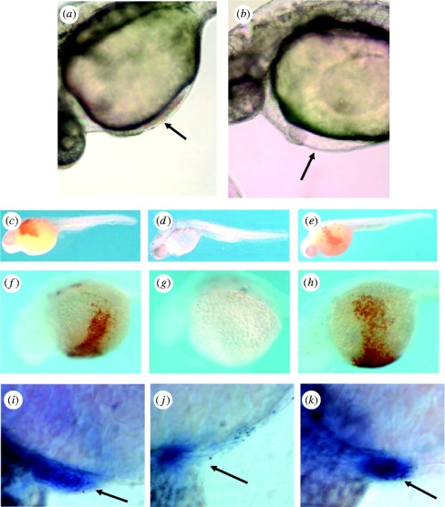
DIFFERENTIAL INTERFERENCE CONTRAST MICROSCOPY
Nomarski Interference Contrast (NIC) or Nomarski microscopy, is an optical microscopy illumination technique used to enhance the contrast in unstained, transparent samples

Slide 10
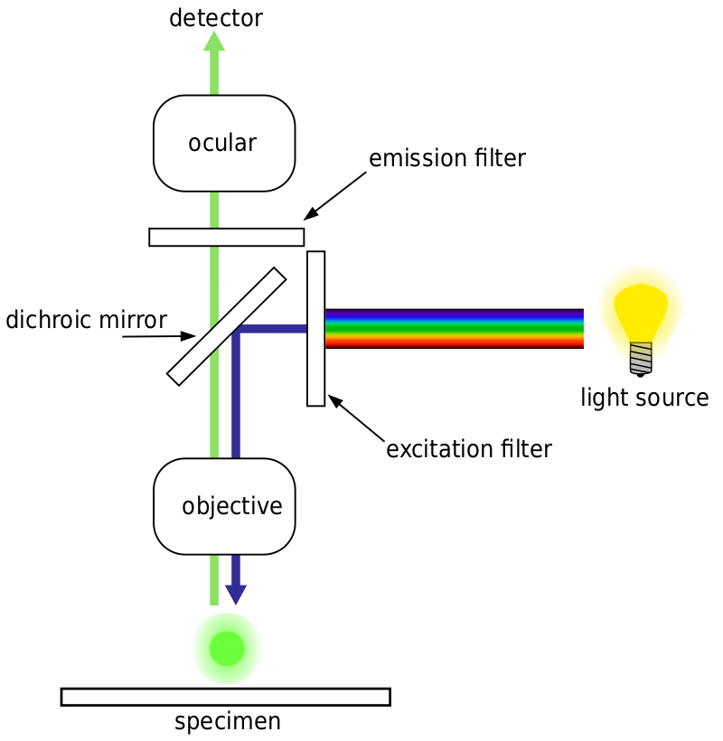
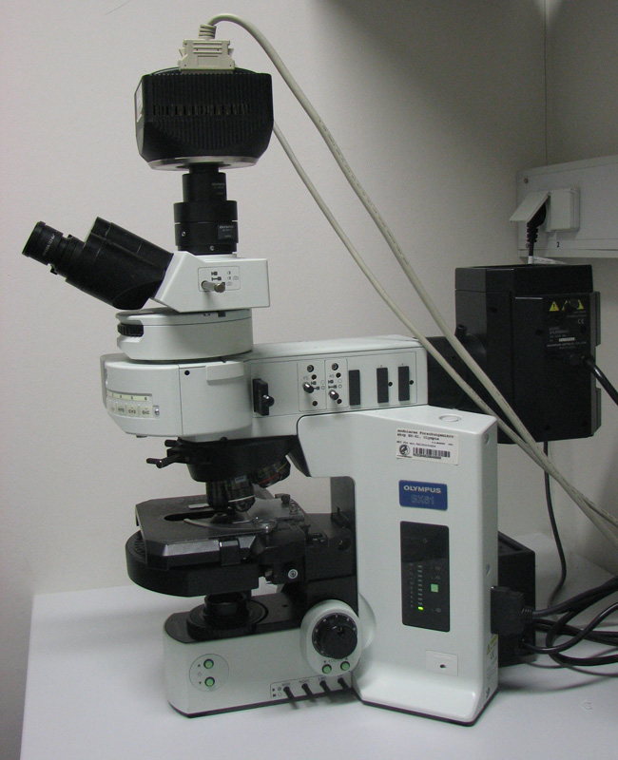
FLUORESCENCE MICROSCOPE

Slide 11
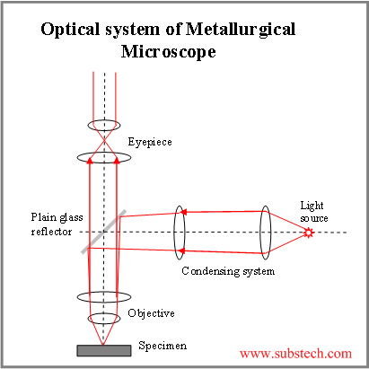
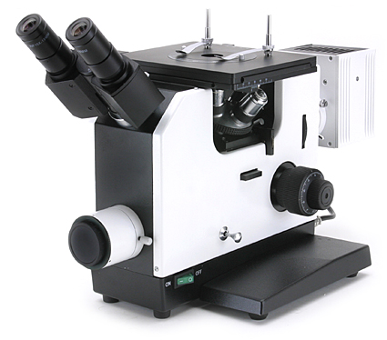
METALLURGICAL
Identification, inspection, and analysis of different metals and alloys

Slide 12
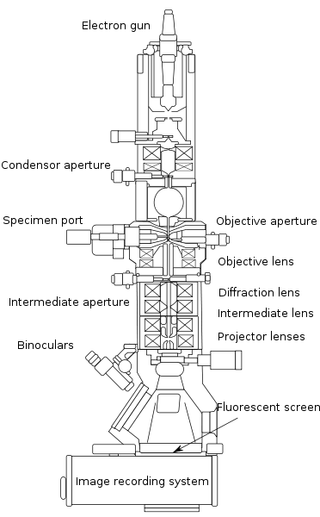
ELECTRON MICROSCOPE
Transmission electron microscopy (TEM)
First TEM was built by Max Knoll and Ernst Ruska in 1931

Slide 13
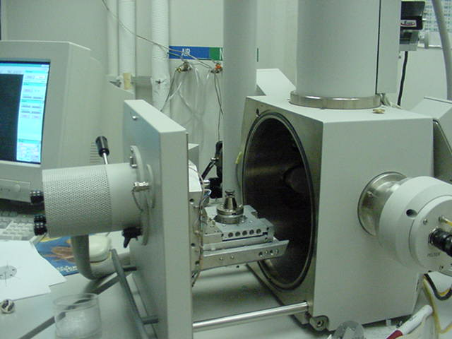
SCANNING ELECTRON MICROSCOPE (SEM)

Slide 14
REFLECTION ELECTRON MICROSCOPE
In the reflection electron microscope (REM) as in the TEM, an electron beam is incident on a surface but instead of using the transmission (TEM) or secondary electrons (SEM), the reflected beam of elastically scattered electrons is detected. This technique is typically coupled with reflection high energy electron diffraction (RHEED) and reflection high-energy loss spectroscopy (RHELS). Another variation is spin-polarized low-energy electron microscopy (SPLEEM), which is used for looking at the microstructure of magnetic domains

Slide 15
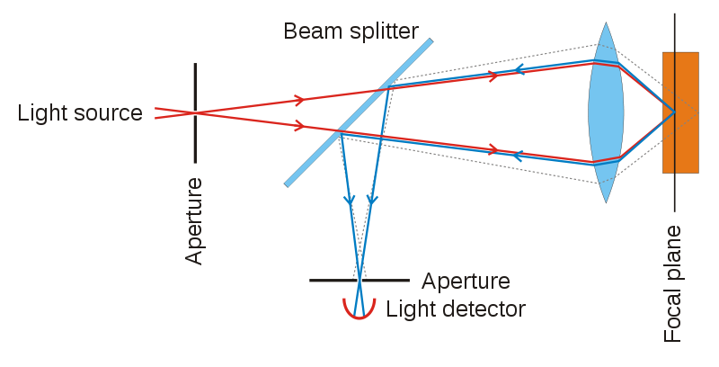
CONFOCAL MICROSCOPY
Increase optical resolution and contrast of a micrograph by using point illumination
Applications are in life sciences, semiconductor inspection and materials science
3D structures

Slide 16
CONFOCAL LASER SCANNING MICROSCOPY
Obtaining high-resolution optical images with depth selectivity

Slide 17
SCANNING PROBE MICROSCOPY
Forms images of surfaces using a physical probe that scans the specimen

Slide 18
ATOMIC FORCE MICROSCOPY
Also called scanning force microscopy (SFM) is a very high-resolution type of scanning probe microscopy

Slide 19
Handheld Digital Microscope

