Slide 1
CONGENITAL HEART DISEASES
DR ALLAH NAWAZ
MBBS(K.E),FCPS(PAK)
Consultant general & laparoscopic surgeon
Assistant Professor surgery
TSU DHQ Hospital (UOS)

Slide 16
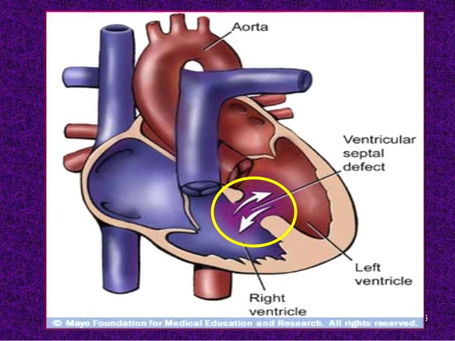

Slide 30
